Slide 1
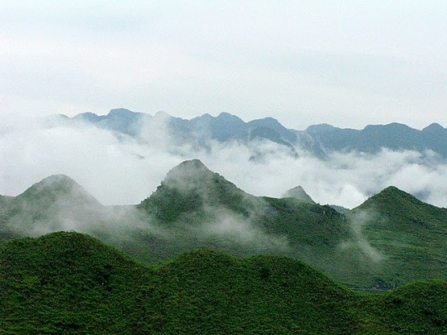
Survey Results and Introduction to Group-Work

Slide 2
Civil Society
The Survey
UN Agency
Government
Ranking risk, from none (0) to extreme (5)
42 respondents from 66 requests

Slide 3
Trends
Civil Society rated corruption risks on average 0.66 points higher than government (UN intermediate)
But some exceptions:
Collusion to favour certain types of activities: difference = 1.1
Bribery to falsify claimed emission reductions from areas: difference = 0.25

Slide 4
The “Biggies”!
Top 5 overall:
Fraud related to the distribution of benefits
Undue influence to ignore breaches of REDD+ regulations
Creation of fraudulent licenses, land titles or C rights
Collusion to favour certain types of activities
Corruption resulting in weak REDD+
safeguards

Slide 5
The “Biggies”!
 | Government | UN | Civil Society
Fraud related to the distribution of benefits | 1 | 10 | 4
Undue influence to ignore breaches of REDD+ regulations | 2 | 2 | 5
Creation of fraudulent licenses, land titles or C rights | 3 | 7 | 1
Collusion to favour certain types of activities | 6 | 3 | 2
Corruption resulting in weak REDD+ safeguards | 4 | 8 | 3
Bribery to register C rights over particular parcels of land | 5 | 1 | 9
Undue influence to exclude or include areas | 8 | 4 | 10

Slide 6
Country Results
No two countries had the exact same ranking of the top 4 risks
No clear trends among sub-regional neighbours (e.g., Pacific, or S. Asia)

Slide 7
Country Trends
No country ranked “The laundering of money and other assets through the purchase and sale of carbon rights” in the top 4
Six countries ranked “Undue influence and bribery to ignore routine breaches of REDD+ regulations” in the top 4
Five countries ranked “Fraud related to the distribution of benefits from REDD+ revenues” in the top 4

Slide 8
Group Discussions
We have grouped countries according to:
Similarity in “risk profiles”
Geography
Equality in numbers!

Slide 9
Group Discussions
Group 1:
Cambodia, Myanmar, Viet Nam
Group 2:
Bangladesh, Nepal, Sri Lanka
Group 3:
Mongolia, Papua New Guinea, Solomon Islands
Group 4:
Indonesia, Philippines

Slide 10
Mandate of Groups
PLEASE
Do NOT debate risk rankings!!!
Do …
Discuss the elements of a work programme to reduce the risk of the three types of corruption assigned to your group in terms of …
Actions; scheduling and responsibilities

Slide 11
Corruption Risk by Groups
Group 1:
Undue influence and bribery to ignore breaches of REDD+ regulations
Bribery of public officials to register fraudulent carbon rights over particular parcels of land
Corruption that results in weak REDD+ safeguards
Group 2:
Fraud related to the distribution of benefits from REDD+ revenues
Powerful elites exert link carbon rights to State ownership of forests – thus excluding customary tenure
Undue influence and bribery to ignore breaches of
REDD+ regulations

Slide 12
Corruption Risk by Groups
Group 3:
Artificially inflating the baseline in order to increase the emissions reductions
Undue influence and bribery to ignore breaches of REDD+ regulations
Fraud related to the distribution of benefits from REDD+ revenues
Group 4:
Fraud related to the distribution of benefits from REDD+ revenues
Undue influence and bribery to create fraudulent licenses, land titles or carbon rights
Undue influence to link carbon rights to State ownership
of forests – thus excluding customary tenure

Slide 13
Bribery of public officials to register fraudulent carbon rights over particular parcels of land
Corruption that results in weak REDD+ safeguards
Powerful elites exert link carbon rights to State ownership of forests – thus excluding customary tenure
Artificially inflating the baseline in order to increase the emissions reductions
Undue influence and bribery to ignore breaches of REDD+ regulations
Fraud related to the distribution of benefits from REDD+ revenues
Undue influence and bribery to create fraudulent licenses, land titles or carbon rights
Undue influence to link carbon rights to State ownership of forests – thus excluding customary tenure

Slide 14
Group 1
Group Reports
Corruption risk | Baseline (Actions already taken) | Actions | Actors

Slide 15
Group 1
Group Reports
Corruption risk | Baseline (Actions already taken) | Actions | Actors

Slide 16
Group 1
Group Reports
Corruption risk | Baseline (Actions already taken) | Actions | Actors

