Slide 1
Overview of the international climate policy & finance framework and the building of the REDD+ mechanism
Josep A. Garí
Africa Advisor, UN-REDD Programme
UNDP - Environment & Energy Unit
United Nations Office at Nairobi, Kenya.
E-mail: josep.gari@undp.org
Africa workshop on strengthening
transparency and accountability in REDD+
Lusaka, ZAMBIA | 24-26 March 2012

Slide 2
Framework agreement
No targets
No mechanisms
?
targets (Annex I)
3 mechanisms (CDM et al.)
2005-2012 (extended ?)
targets (Annex I + others) ?
Kyoto mechanisms ? Others ?
climate finance (GCF)

Slide 3
Climate change causes and REDD+

Slide 4
REDD+
Reducing Emissions from Deforestation and Forest Degradation
The " + " includes conservation of forests, Sustainable Forest Management, and the enhancement of Ccrbon stocks
an international environmental finance mechanism of national-level scope
under discussion (UNFCCC negotiations), but formally retained
to compensate countries for demonstrated efforts in reducing deforestation & forest degradation in their territories (i.e. environmental performance)
due attention to social & environmental safeguards required (i.e. governance performance)

Slide 5
The REDD concept
REDD+: forest conservation, enhancement of carbon stocks and SFM
REDD
credits
REDD Fund and/or
Carbon markets
Forests (Carbon)
Time

Slide 6
Phases of REDD+
REDD+ Strategy
[ Low-emissions &
climate-resilient development ]
--- PHASE 1 ---
REDD+ Readiness
--- PHASE 2 ---
Implementation of REDD+ Strategy
(policy reforms/measures & investments)
--- PHASE 3 ---
Performance-based credits
Notes:
6

Slide 7
Components of REDD+ Readiness
Coordination, stakeholder engagement, participation
Coordination &
stakeholder engagement
Training, knowledge management, consensus-building
Analysis + consultation + experiments
Drivers of deforestation
REDD+ Strategy
Transformative vision
Cost estimates and options
Reference emission levels
MRV
REDD+ institutional framework
Safeguards, FPIC
Multiple benefits
Payment distribution system
Nat’l REDD+ finance mechanism

Slide 8
International finance architecture for REDD+
REDD+ readiness (phase 1):
UN-REDD (FAO, UNDP, UNEP)
FCPF (World Bank)
and the REDD+ Partnership
Options for phase 2 (investments & reforms):
Bilateral support
Fast-start finance, Green Climate Fund
Investment programmes: FIP, World Bank, CBFF, etc.
New international fiscality: e.g. Carbon tax for air travel, levy on international financial transactions
Philanthropic finance
Credits (phase 3) (future):
FCPF (World Bank) – Carbon Fund
International fund (possible)
Market systems for REDD+ credits (e.g. cap-and-trade schemes)

Slide 9
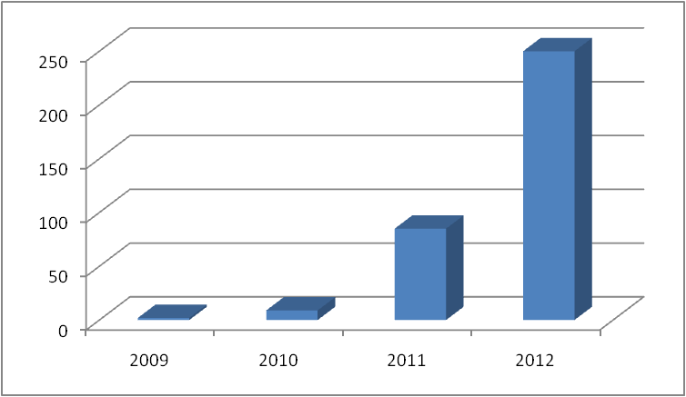
The scaling up of REDD+ finance:
the case of the DRC (in US$ millions)
Intended, up to US$ 500 millions

Slide 10
REDD+ and climate finance
Fast-start climate finance (Copenhagen climate agreements, 2009): US$ 30 billion, “new and additional”, for mitigation & adaptation in developing countries, 2010-2012.
Climate finance targets (Copenhagen and Cancun climate agreements): US$ 100 billion by year for climate affairs and for transforming economies and societies, by 2020.
Green Climate Fund: major vehicle for climate finance, endorsed by UNFCCC negotiations, under final design
Climate finance available for:
Transformational policies and strategies, “readiness” (phase 1)
Investments and reforms (phase 2)
Performance payments (phase 3)

Slide 11
Some requirements and challenges of climate finance
transformational plans (low-emission & climate-resilient strategies; green development; green economies)
impact of investments and actions – transformative impact
performance-based approach
democratic governance, social & environmental safeguards
corruption risks, need of transparency & accountability measures
equity, participation
implementation bottlenecks
country access versus mediation by international agencies
Global financial crisis, climate finance versus ODA

