Slide 1
REDD+ AND FOREST GOVERNANCE PGA Kick off workshop
Hà Nội, 6 tháng 3 năm 2012
Phạm Minh Thoa
Tổng cục Lâm nghiệp - Bộ Nông nghiệp và PTNT

Slide 2
Main parts
WHAT IS REDD+?
II. THE ROLE OF FOREST GOVERNANCE FOR REDD+
NECESSARY ACTIVITIES OF FOREST GOVERNANCE FOR REDD+
RECOMMENDATIONS

Slide 3
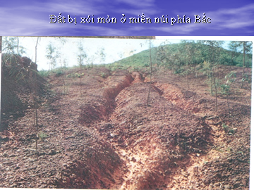
Part I: WHAT IS REDD+?
COP16/UNFCCC, REDD+ includes 5 following activities:
Reducing emissions from deforestation
Reducing emissions from forest degradation
Conservation
Sustainable management of forest resources
Enhance carbon stocks
REDD+ has a broad meaning that need an integrated management approach with new requirements.

Slide 4
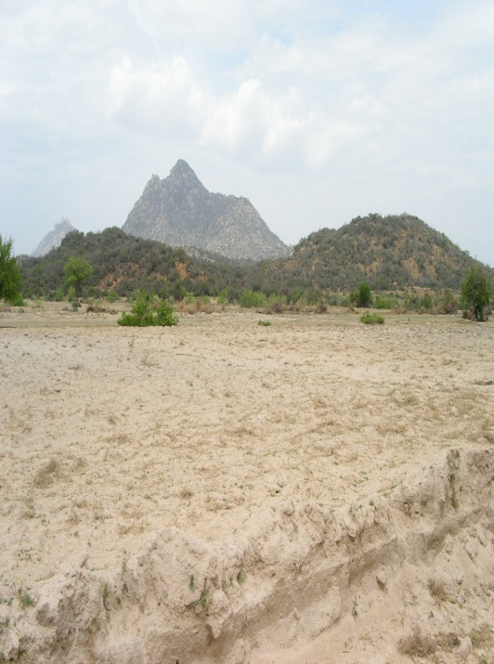
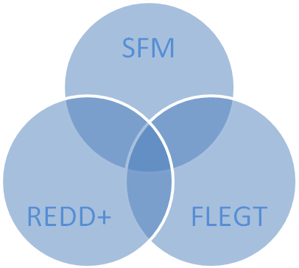
Part II: THE ROLE OF FOREST GOVERNANCE FOR REDD+
FOREST
GOVERNANCE
QUẢN TRỊ RỪNG
Reduce the risks of forest land use change, enhance sustainable management of forest land through long term and sustainable planning with closed link with land allocation, address co-benefit relationship
Reduce illegal logging through enhancing forest law enforcement, including FLEGT
Reduce forest degradation, contribute to conservation and carbon enhancement through applying environmental friendly technical measures such as RIL, SFM/FSC, reduce the risk of forest fire and diseases, re-habitation and development of forest resources
Provide positive impact on livelihood and living conditions of forest dependant people through applying multi-benefit approach

Slide 5
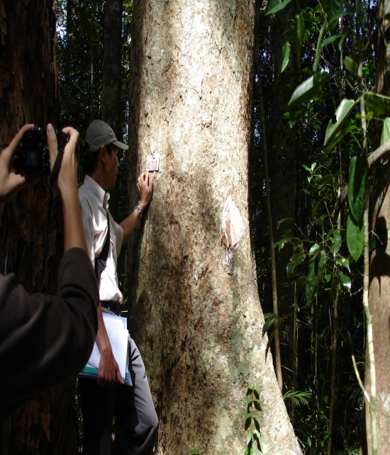
Part III: NECESSARY ACTIVITIES OF FOREST GOVERNANCE FOR REDD+
Monitoring, evaluation and forecast
Enhance capacity on monitoring, evaluation and forecast
Develop and agree on the definition of forest and forest classification system
Control the forest resources change
Conduct the biomass and carbon stocks inventory
Analyse, evaluate, forecast the impact and find out, apply mitigation and adaptation measures
Set up MRV system

Slide 6
Part III: NECESSARY ACTIVITIES OF FOREST GOVERNANCE FOR REDD+ (cont’)
Monitoring, evaluation and forecast (2)
PGA for REDD+
National stakeholders define the need of information, data for REDD+
PGA provides training for government officials for data collection
Data analysis, evaluation
PGA provides training for CSOs and local communities how to act upon data provided
PGA supports to set up national information system to ensure the safeguards as mentioned in Cancun Decision
PGA need to focus on provincial level where REDD+ activities are or will be implemented , including pilot provinces under UN-REDD Phase 2

Slide 7
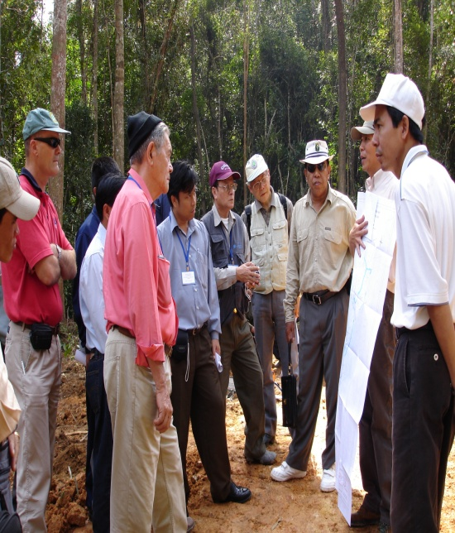
Part III: NECESSARY ACTIVITIES OF FOREST GOVERNANCE FOR REDD+ (cont’)
2. Land use planning and allocation
Ensure sustainable forest land area : on maps and on the ground
Promote the process of land allocation in paper and on the ground , ensure clear land use rights, long term forest protection contract

Slide 8
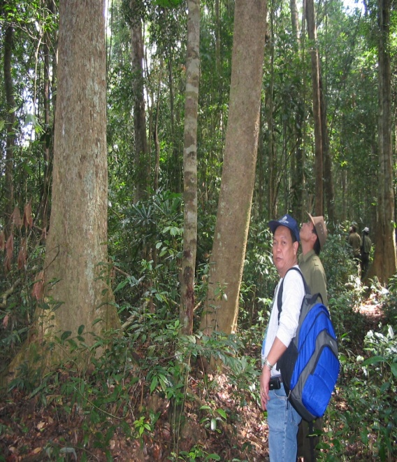
Part III: NECESSARY ACTIVITIES OF FOREST GOVERNANCE FOR REDD+ (cont’)
3. Reform institutional policy
Continue decentralization for locality, forest owners
Continue develop mechanisms to attract the active participation of all stakeholders – such as setting up public-private partnership, multilateral cooperation
Link forest management with livelihoods protection
Raise awareness, knowledge and management capacity building for authorities and local communities

Slide 9
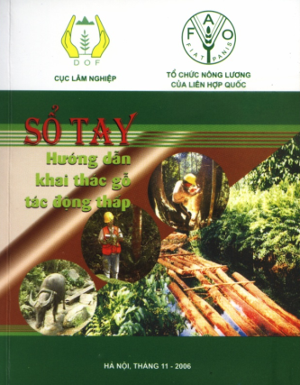
Part III: NECESSARY ACTIVITIES OF FOREST GOVERNANCE FOR REDD+ (cont’)
4. Promote technical measures
Continue to apply a participatory approach
Promote RIL and SFM, FSC measures
Using high resolution satellite imaging combine with field survey in forest status change and carbon stocks monitoring
Apply silviculture measures in forests rehabilitation and improvement

Slide 10
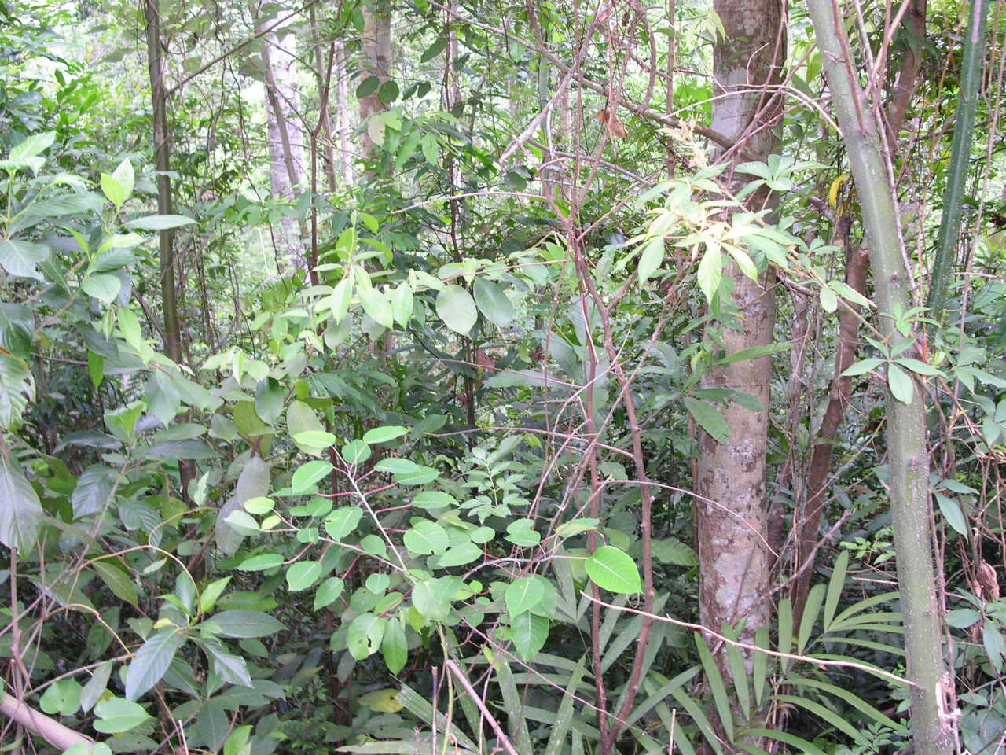
Part IV: RECOMMENDATIONS
Forest governance focus more on enhancing the quality of decision making process than simple institutional arrangement, in which the most important issue is to promote decentralization, limitation of corruption risks, illegal forest logging
REDD+ requires a new forest governance level, ensure transparency, accountability, equity and participation of all relevant stakeholders
Forest governance for REDD+ requires a specific roadmap with clear and appropriate priorities in specific context
Forest governance and REDD+ have mutual impact.

Slide 11
Thank you for your attention!

