Slide 1
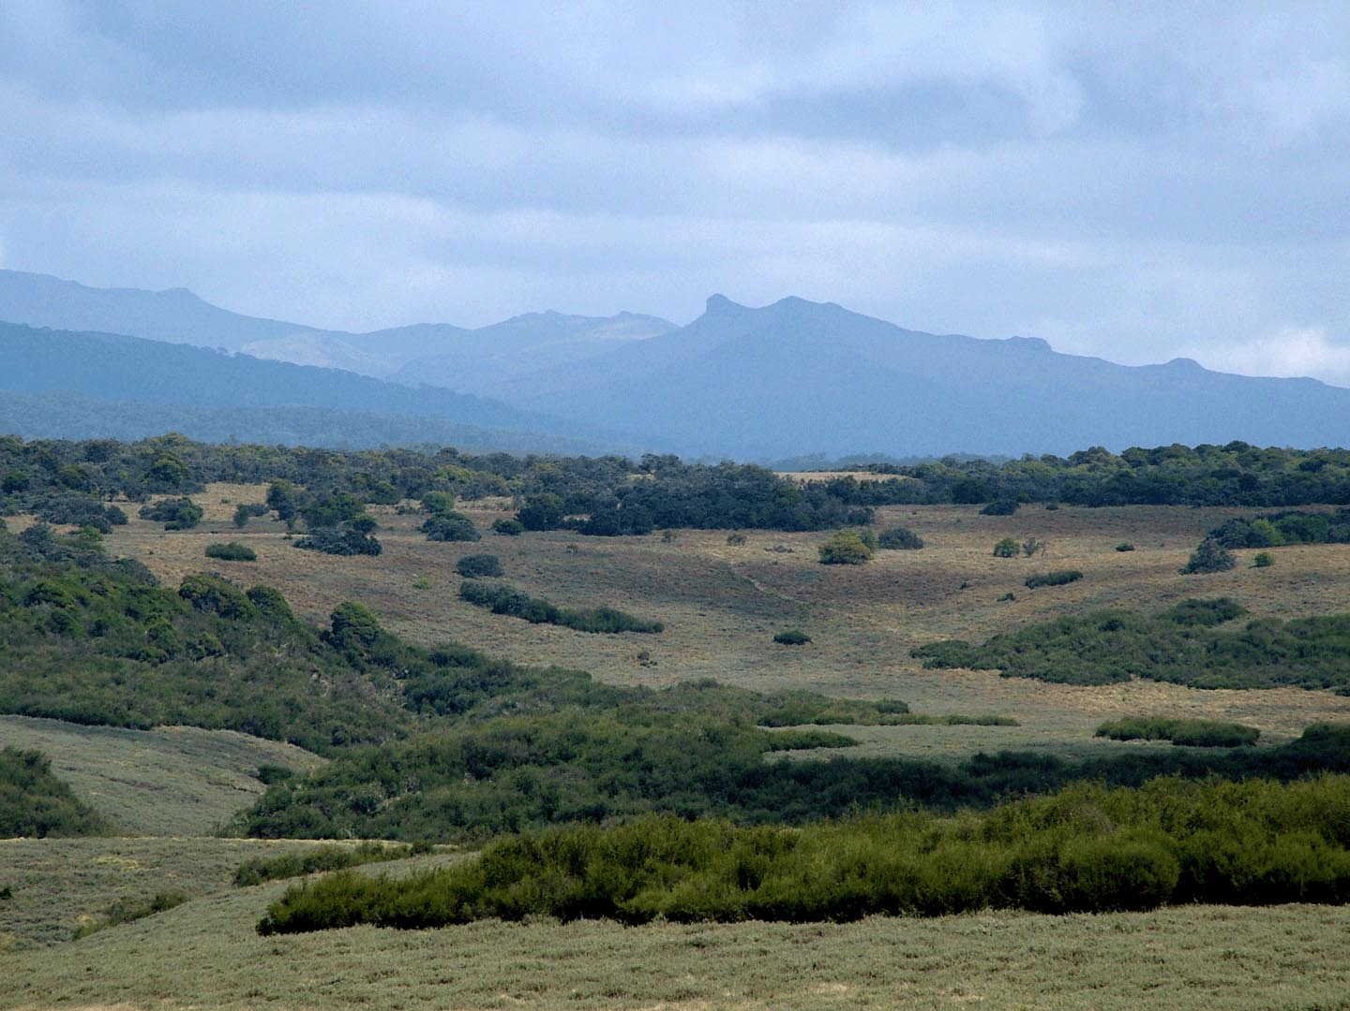
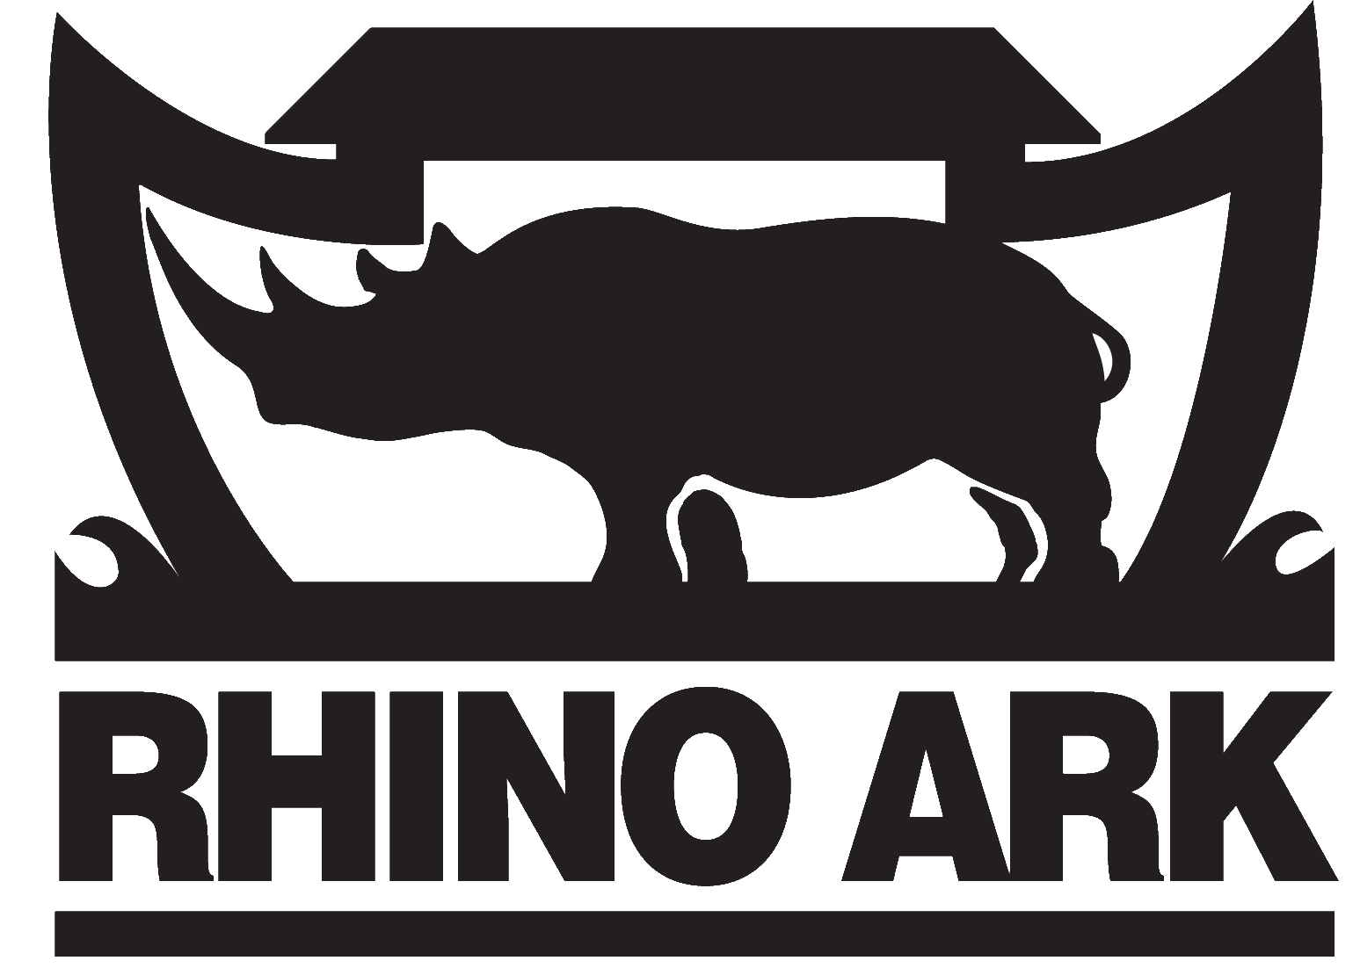
PUBLIC-PRIVATE PARTNERSHIP
AN EFFECTIVE MECHANISM TO CONSERVE
T H E W A T E R T O W E R S
A presentation by the RHINO ARK CHARITABLE TRUST
November 2012

Slide 2
PUBLIC-PRIVATE PARTNERSHIP
AN EFFECTIVE MECHANISM TO CONSERVE
T H E W A T E R T O W E R S
A presentation by the RHINO ARK CHARITABLE TRUST
November 2012

Slide 3
Rhino Ark: An introduction
Rhino Ark is a charitable trust established in 1989
Objectives
The main objective is to develop sustainable solutions to the challenges facing mountain forest ecosystems and threatened biodiversity areas, through public-private partnerships.
The specific objectives are:
Mitigate human-wildlife conflicts;
Reduce illegal exploitation of forest resources through controlled access to forests.
Focus
Originally: Aberdare National Park
Currently: Water Towers, starting with Aberdare Range, Mt. Kenya and Mau Mt. Eburu

Slide 4
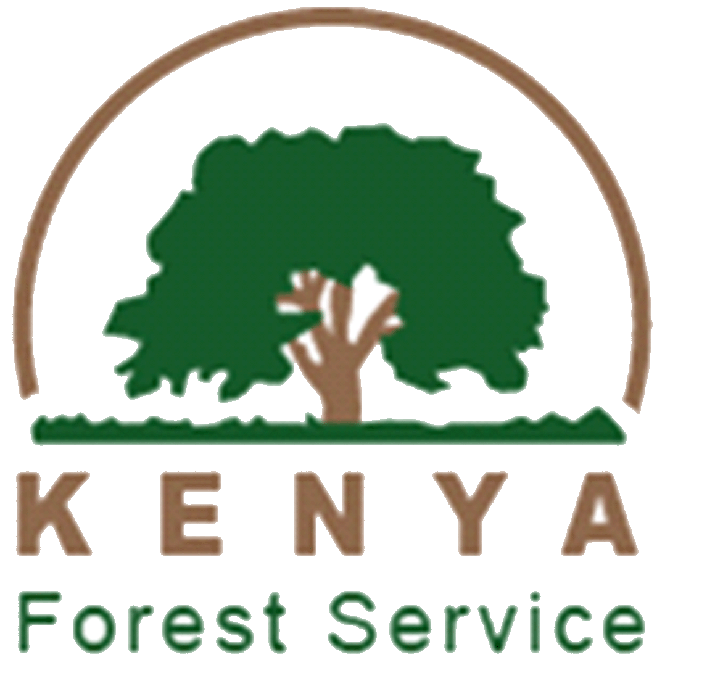
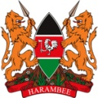
Rhino Ark: Public-Private Partnerships
Rhino Ark is based on public-private partnerships
Public-private partnerships are at the centre in all key areas:
Financing;
Governance;
Implementation;
Monitoring / Auditing.

Slide 5
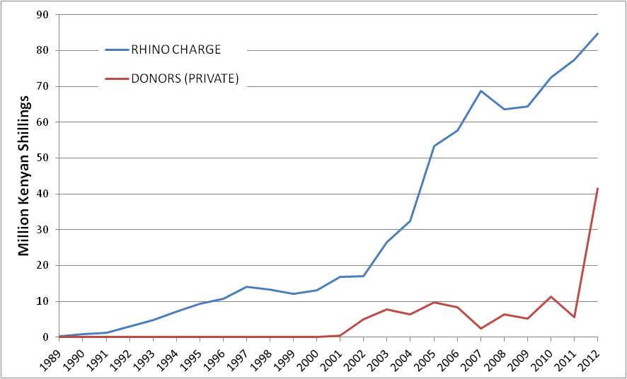
Public-Private Partnership: Financing conservation work
Since 1989, thousands Kenyans and hundreds companies and other private entities have supported Rhino Ark’s conservation work.

Slide 6
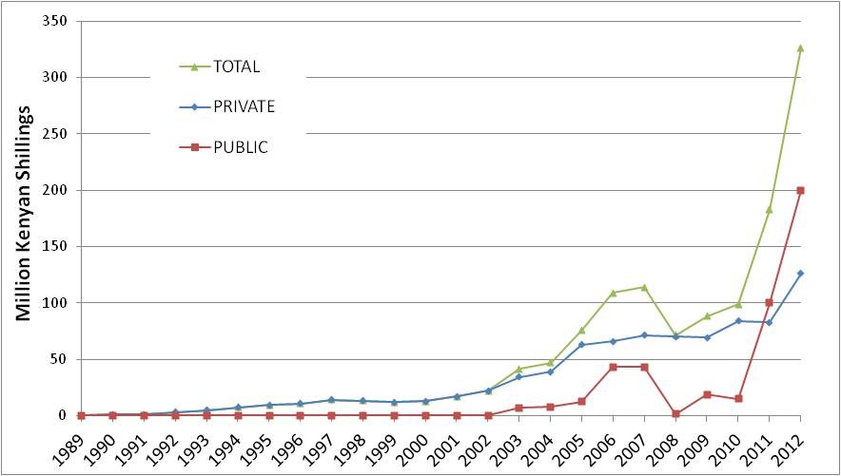
Public-Private Partnership: Financing conservation work
Over the years, contributions from the public sector have increased, although more erratically. Since 2011, they outstrip private contributions.

Slide 7
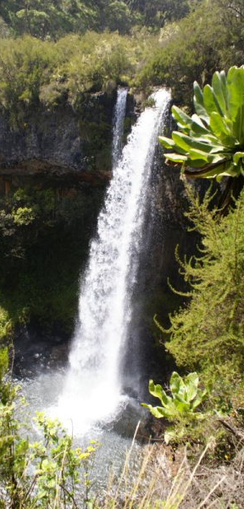
Public-Private Partnership: Governance structure
Internal and external governance structures are based on PPP
Internal – Rhino Ark’s Board of Trustees
The Board includes:
CEO of a Bank
CEO of a group of companies
High Court Judge
Manager in a private conservancy
Former Director of WCMD (KWS)
External – Joint Management Committees
Projects in each ecosystem are guided by a
Joint Management Committee:
KWS
KFS
Rhino Ark

Slide 8
Public-Private Partnership: Governance structure
Innovative governance structures based on PPP
On 11 May 2012, the Aberdare Trust
was launched by the Prime Minister.
This is a body based on PPP with
wider community participation to:
Maintain and manage the fence;
Ensure that the fence objectives are met.
Management Trust
Government KWS/ KFS
Rhino Ark
Community

Slide 9
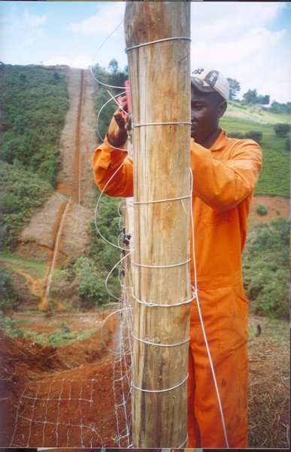
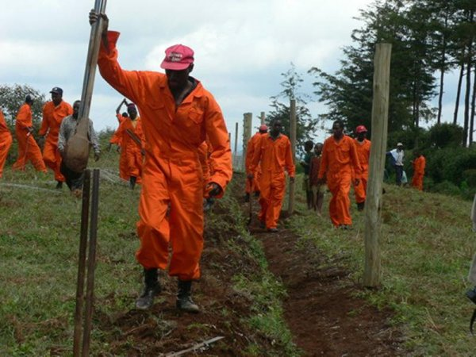
Public-Private Partnership: Implementation
COMMUNITIES
Labour for fence building / maintenance
Reforestation
Ecosystem surveillance (AJSU)
Wildlife monitoring / education (BSP)
GOVERNMENT AGENCIES
Technical expertise / training
Supervision / management
Law enforcement
RHINO ARK
Fund raising
Supervision / management
Technical expertise

Slide 10
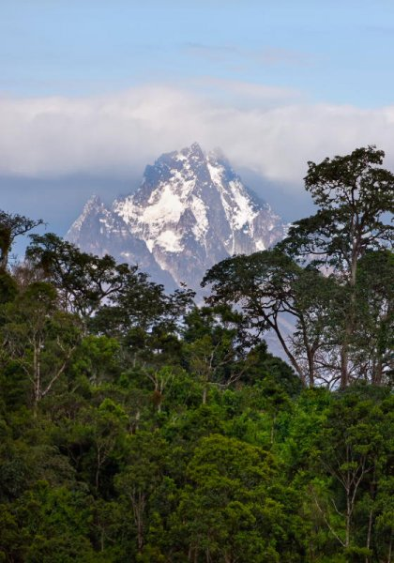
Public-Private Partnership: Benefits
FINANCING
Shared responsibility
Broader engagement of the public
Sustainability
GOVERNANCE
Increased legitimacy
Transparency and accountability
IMPLEMENTATION
Direct community participation
Increased acceptability
Increased flexibility
Reduced duplication

Slide 11
Public-Private Partnership: Challenges
Public sector:
Perception that the resources they manage belong to them
Lack of understanding of the benefits of PPP
Lack of appropriate mechanisms to engage the private sector
Private sector:
Lack of understanding on the dependency of their respective economic sector on the natural capital
Lack of understanding that investing in the natural capital helps reduce business risks
Perception that caring for the environment is a mere CSR activity
Notes:
Art. 61 (1) All land in Kenya belongs to the people of Kenya collectively as a nation, as communities and as individuals
Art. 62 (3) Public land classified under clause (1) (f) to (m) shall vest
in and be held by the national government in trust for the people of
Kenya and shall be administered on their behalf by the National Land
Commission.

