Slide 1
Session 5 – SNA Update on Country Needs Assessment
14th Policy Board meeting Washington, D.C. United States
21-22 May 2015

Slide 2
CFP 4/2014: Assessments of needs for support at National and Regional levels
Objective | Identify country needs and opportunities to support REDD+ readiness with a view to capture the different circumstances in a rapidly evolving REDD+ landscape Assist countries to scope needed support from the UN-REDD Programme and other sources Provide a planning tool to countries for enhanced coordination of domestic funding and international support.
Expected results | Enhanced leadership by countries through improved understanding of national and/or regional REDD+ capacities and needs. More efficient REDD+ implementation with better sequencing and scoping of activities to be undertaken, Improved effectiveness.

Slide 3
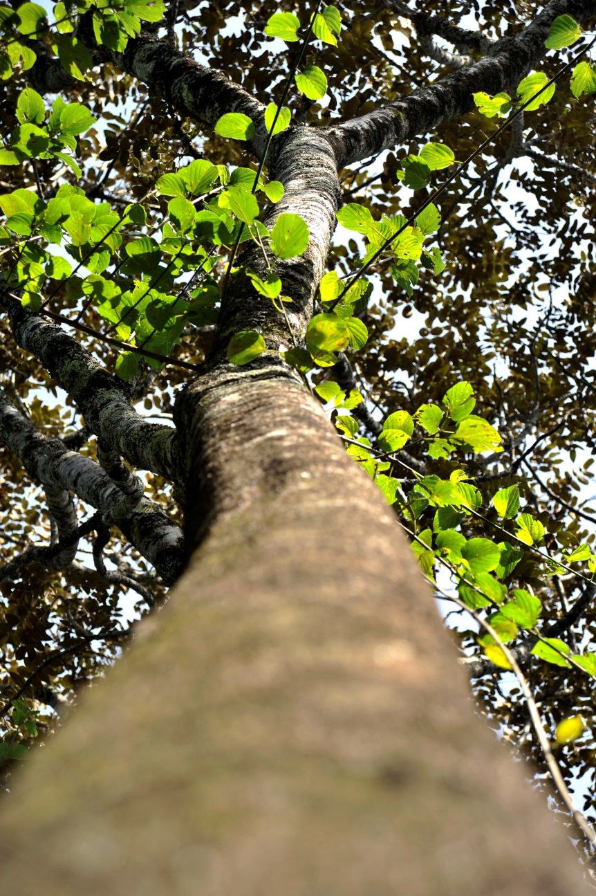
CNA Approach
Methodology defined at country level – no predetermined methodology
Objective & scoping defined at country/regional level
Focus on countries without National Programmes
Open to regional assessments with a view to strengthen cooperation and sustainability of REDD+ interventions.

Slide 4
Countries & Regions undertaking CNAs
Tunisia
Guatemala
South
Sudan
II
I
Peru
Malawi
Zimbabwe
Madagascar
Regions
I West Africa - Benin, Côte d’Ivoire, Ghana, Guinea, Guinea Bissau, Liberia, Nigeria, Sierra Leone, Togo
II. Mesoamerica - Colombia, Honduras, Mexico (El Salvador, Republica Dominicana)
Regions
1 Benin, Burkina Faso, Togo
2. Mesoamerica - Colombia, Honduras, Mexico (El Salvador, Republica Dominicana)
3. West Africa - Benin, Côte d’Ivoire, Ghana, Guinea, Guinea Bissau, Liberia, Nigeria, Sierra Leone, Togo

Slide 5
Focus areas chosen by countries
 | Madagascar | Malawi | South Sudan | Tunisia | Zimbabwe | Guatemala | Peru |  | WEST AFRICA | MESOAMERICA
National REDD + Strategies
National forest monitoring systems
Forest RELs & RLs
Safeguards and Safeguards information systems
Forest governance
Land tenure
Gender
Drivers of deforestation and forest degradation
Institutional and fiduciary arrangements
Effective participation of relevant stakeholders
Cross-sectoral and multi-stakeholder coordination
Information sharing & knowledge management
Financial gaps
Regions
1 Benin, Burkina Faso, Togo
2. Mesoamerica - Colombia, Honduras, Mexico (El Salvador, Republica Dominicana)
3. West Africa - Benin, Côte d’Ivoire, Ghana, Guinea, Guinea Bissau, Liberia, Nigeria, Sierra Leone, Togo

Slide 6
Allocated budgets
Country/Region | Budget (USD)
Madagascar | 122,000
Malawi | 64,675
South Sudan | 80,000 *
Tunisia | 88,000
Zimbabwe | 80,000
Guatemala | 40,000
Peru | 55,000 *
Mesoamérica | 385,000
West Africa | 264,366
Total | 1,179,041 *
*/ Figures are preliminar. Workplan and budget are still being finalized.

Slide 7
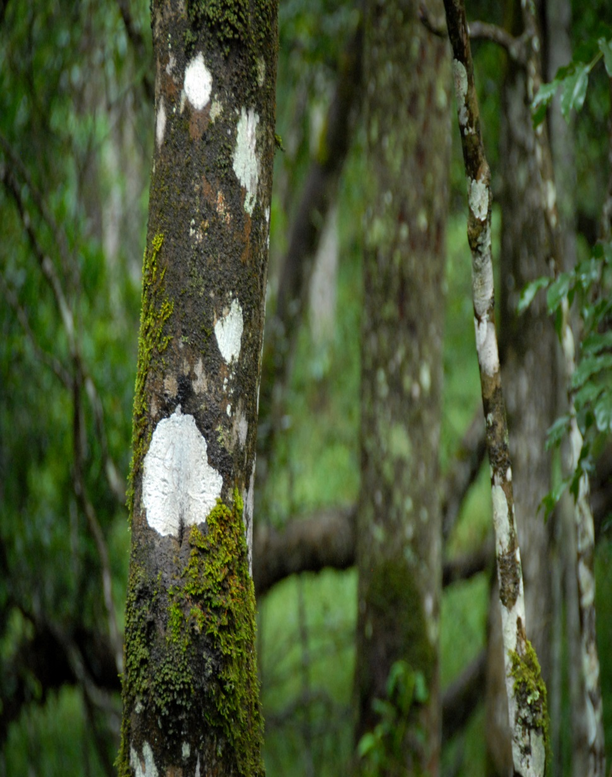
Initial analysis of the CNAs
Four countries made an option to undertake broad needs assessments (South Sudan, Zimbabwe, Guatemala and Peru) while three chose specific areas (Tunisia, Madagascar, Malawi).
Forest monitoring/Reference levels/MRV was the most prevalent theme (incl. in regional assessments)
There is a wide variation in levels of REDD+ activity across countries and regions in CNA.

Slide 8
CNAs & the broader REDD+ support
UN-REDD (TS- targeted support) | Madagascar | Malawi | South Sudan | Tunisia | Zimbabwe | Guatemala | Peru |  | West Africa 9 | Mesoamerica 10
FCPF | ‘15 |  |  |  |  | ‘14 | ‘14 |  | 5 | 10
FIP |  |  |  |  |  |  | ‘16 |  | 1 | 1
National REDD + Strategies
National forest monitoring systems |  | TS |  |  |  |  | TS |  | TS
Forest RELs & RLs
Safeguards and Safeguards information systems |  |  |  |  |  |  | TS |  |  | 2
Forest governance | TS |  |  | TS |  | TS | TS |  | 3 | 3
Land tenure |  | TS |  | TS
Gender
Drivers of deforestation and forest degradation
Institutional and fiduciary arrangements | TS | TS |  | TS |  |  | TS
Effective participation of relevant stakeholders | TS |  |  |  |  |  | TS |  | 1 | 3
Cross-sectoral and multi-stakeholder coordination
Information sharing & knowledge management |  | TS
Financial gaps
Regions
1 Benin, Burkina Faso, Togo
2. Mesoamerica - Colombia, Honduras, Mexico (El Salvador, Republica Dominicana)
3. West Africa - Benin, Côte d’Ivoire, Ghana, Guinea, Guinea Bissau, Liberia, Nigeria, Sierra Leone, Togo

Slide 9
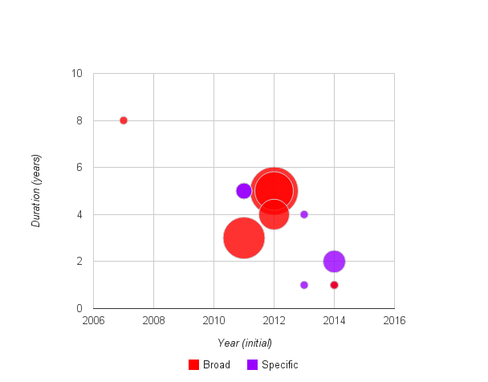
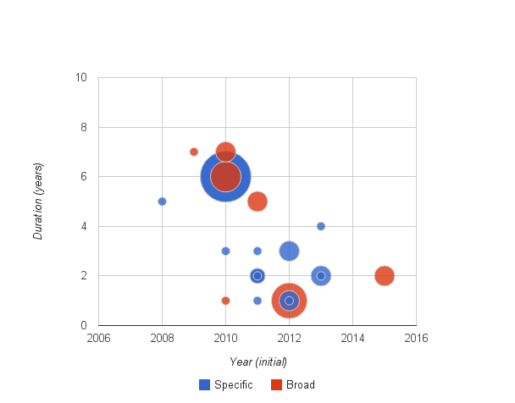
Indicative level of regional activity in NFMS & RL/RELs as reflected in VRD
West Africa
NFMS & RL/RELs work linked to other initiatives
Many upcoming
Mesoamerica
More and more specific NFMS & RL/RELs support
Many concluded or concluding
In progress
In progress
Concluded
Concluded
Source: Own analysis using the Voluntary REDD+ Database, consulted in April 2015. http://www.fao.org/forestry/vrd/

Slide 10
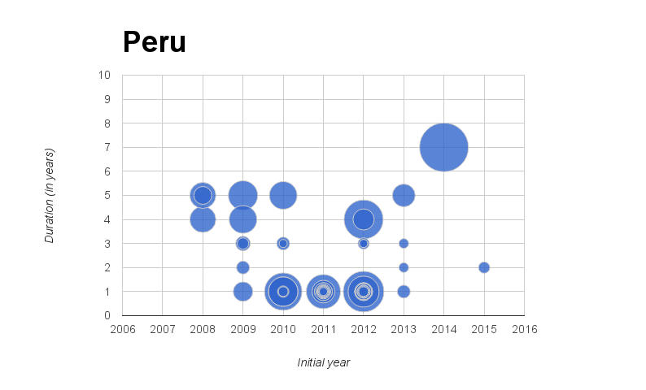
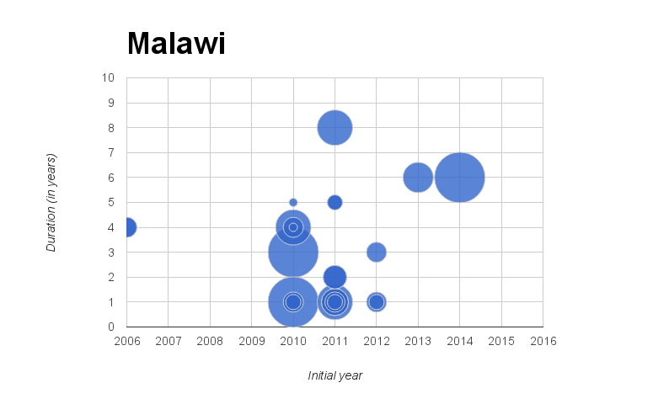
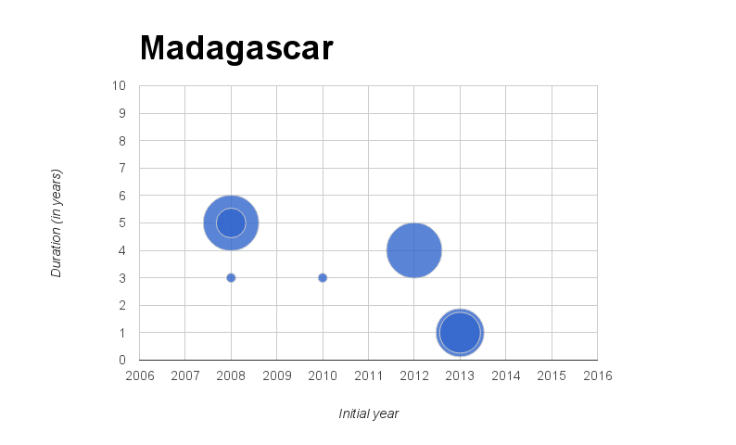
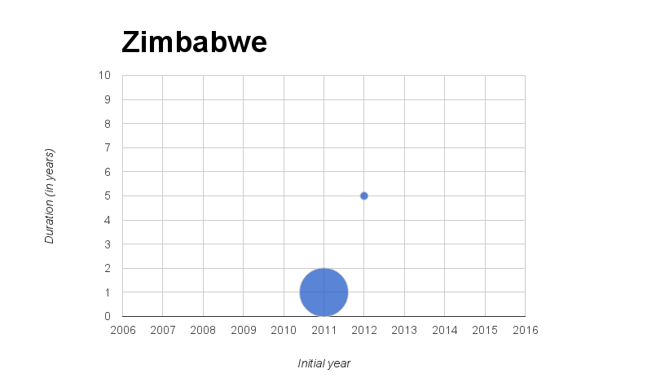
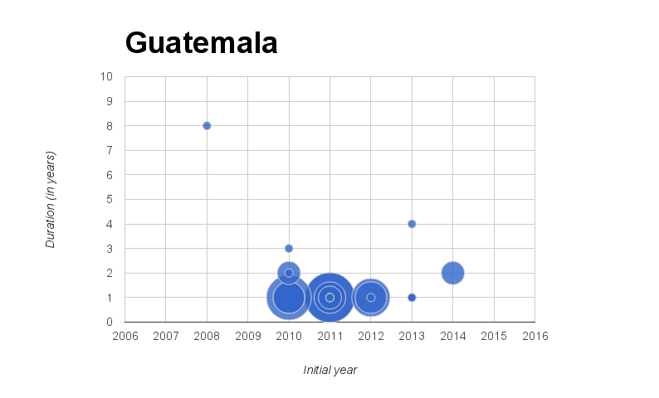
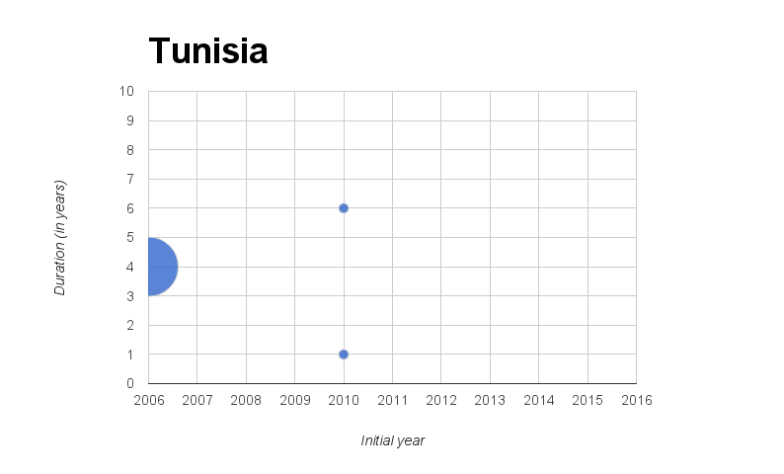
VRD is indicative of varying levels of REDD+ in most CNA countries
Source: Own analysis using the Voluntary REDD+ Database, consulted in April 2015. http://www.fao.org/forestry/vrd/

Slide 11
CNA Process overview
Approval of CNA proposal
Preparation of ToR
Hiring of consultat(s)
Methodology development
Undertaking CNA
Consolidation and analysis
Country reports
Presentation at PB15 of results/ country sharing experiences / lessons learned and way forward

Slide 12
Progress to-date
 | Madagascar | Malawi | South Sudan | Tunisia | Zimbabwe | Guatemala | Peru |  | WEST AFRICA | MESOAMERICA
Approval
Terms of reference
Hiring consultant
Methodology development
Undertaking CNA
Country reports
Consolidation and global analysis
Regions
1 Benin, Burkina Faso, Togo
2. Mesoamerica - Colombia, Honduras, Mexico (El Salvador, Republica Dominicana)
3. West Africa - Benin, Côte d’Ivoire, Ghana, Guinea, Guinea Bissau, Liberia, Nigeria, Sierra Leone, Togo

Slide 13
Insights so far
Some proposals (workplan and budget) were formulated at the same time of targeted support request –This required clarity in scope, complementarity and sequencing of the needed targeted support and the intended needs assessments.
Notably, 2014 saw countries connected geographically enhancing information exchange and initiating joint targeted support. The regional CNAs follow the same trend, fostering opportunities for South-south exchange.
Common themes being addressed in CNAs across countries open opportunities to promote useful exchanges.
Populated REDD+ space will demand significant stakeholder engagement by the consultants throughout the development of the CNA to capture needs being addressed and revise identified needs.

Slide 14
Way forward
Finalization of contractual arrangements for all regions
Promote relevant cross-country/region exchange (e.g. NFMS) through, inter alia, the collaborative platform
Support CNA process, if requested, on methodology and information.

Slide 15
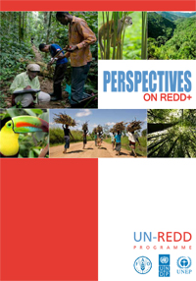
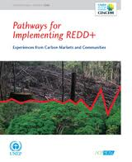
Country/Regional updates
Presentation by Madagascar, Malawi and a representative country in the Mesoamerican CNA

Slide 16
José Carlos Fernández
carlos.fernandez@un-redd.org
Thank You
Website: http://www.un-redd.org

