Slide 1
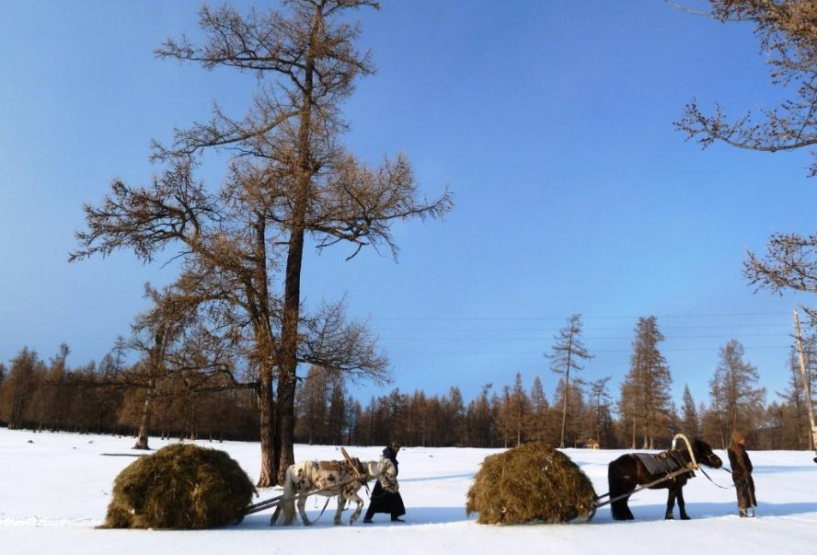
Mongolia REDD+ Readiness Roadmap 2014 - 2017
Jamsran Batbold, State Secretary
Ministry of Environment and Green Development (MEGD)
UN-REDD Policy Board Meeting in Lima, Peru (7-9 July 2014)

Slide 2
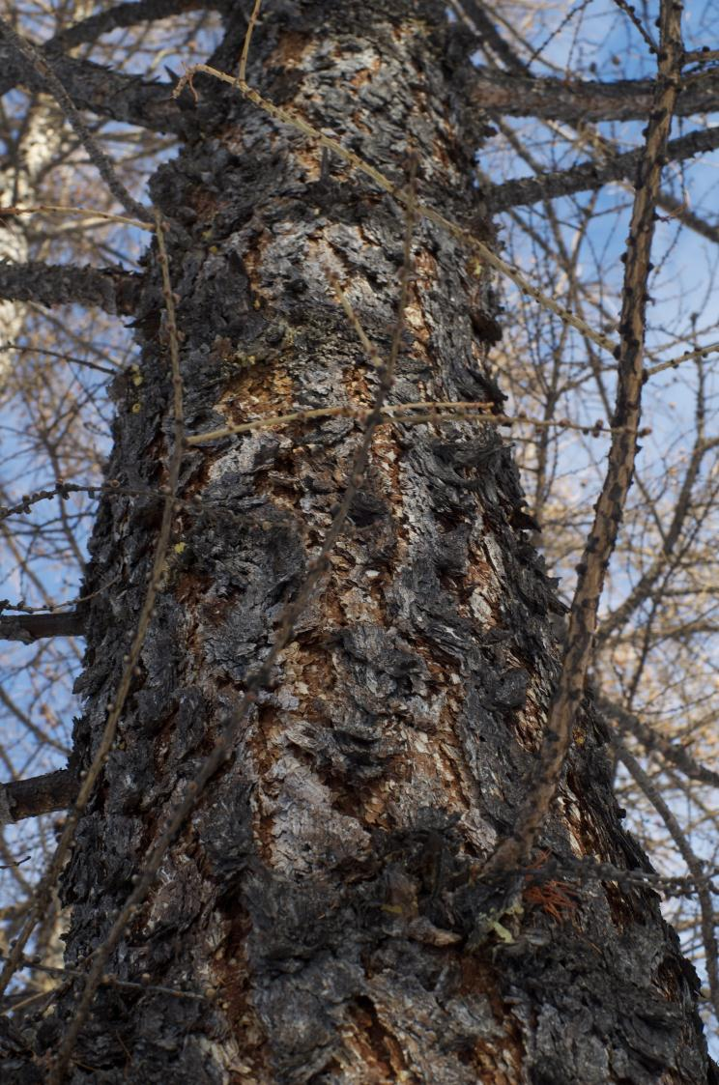
Outline of Presentation
Introduction and Basic Facts
REDD+ Readiness Process in Mongolia
Stakeholder Consultations
Overall Objective of Roadmap/R-PP
R-PP Results Framework
Proposed Management Arrangements
R-PP Budget /UN-REDD Support Requested
General Responses to Independent Review Comments
Concluding Remarks

Slide 3
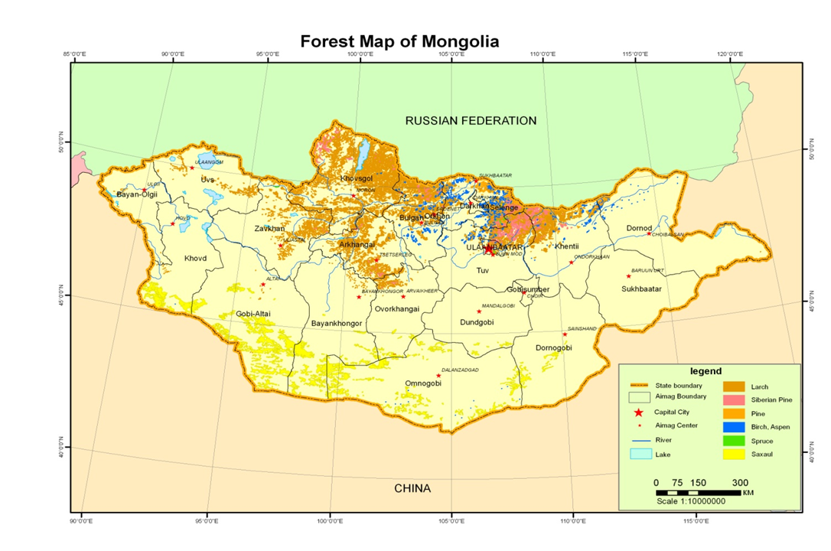
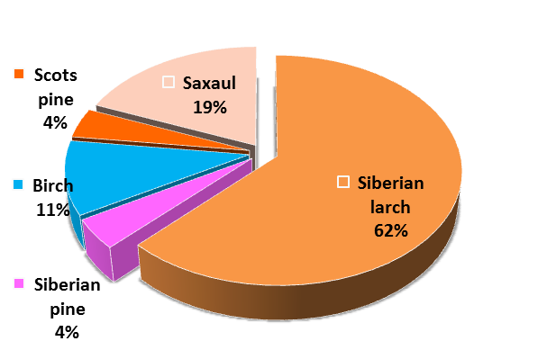
Introduction and Basic Facts
Population: ~2.9 million
Population Density: 1.84 people per km²
GDP Growth Rate: 12% (2013)
Per capita GDP: US $3,160 (2012)
Area: 1.56 million km²
Forest Area: 18.2 million ha. (12% of land area)
Annual Rate of Forest Loss: 0.74% (FAO)
Emission from LULUCF: 16.1 million tCO₂e

Slide 4
REDD+ Readiness Process in Mongolia
2011
Became Partner Country of UN-REDD in June
Decree established National REDD+ Roadmap Taskforce
2012
Draft REDD+ Roadmap prepared
First National REDD+ Workshop held to validate proposed Roadmap activities
Forest Agency presented Country Progress at PB in Paraguay
Engagement with new Government focal points initiated (elections resulted in change of Government)
2013
Forest sector valuation and MRV action plan finalized through Targeted Support
REDD+ Roadmap aligned with green development strategies and new institutional arrangements
Institutional context analysis for mainstreaming financing for sustainable forest management into sectoral budgets was conducted
2014
Capacity development plan for mainstreaming financing for sustainable forest management prepared
Assessment on Land Use, Land Use Change and Forest conducted
Invitation to submit Mongolia’s REDD+ Readiness Roadmap to the UN-REDD Programme Policy Board received
2nd National Validation of the National REDD+ Roadmap for Mongolia (5th June) held
Notes:
This slide is optional. But, if presented, should not get caught up in the details and rather go over it very briefly.

Slide 5
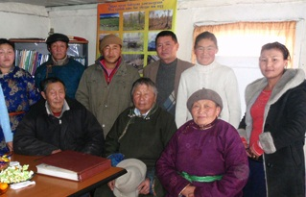
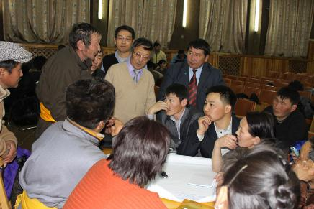
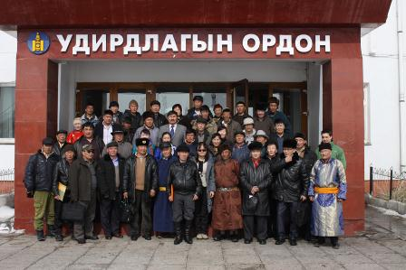
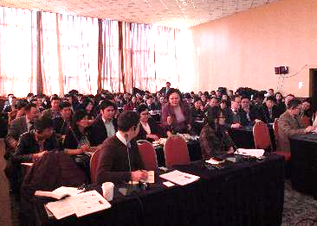
Stakeholder Consultations
Consultations with forest user groups
Four regional multi-stakeholder workshops
Several national multi-stakeholder workshops
National parliamentarians were consulted and expressed their support
Two National Roadmap validation meetings
Over 600 individuals, mainly FUGs, directly involved in consultations

Slide 6
Overall Objective of Roadmap/R-PP
By the end of this Work Programme, Mongolia will have established its REDD+ management processes, completed its National REDD+ Strategy, and developed the capacities required to begin implementation of REDD+ (Phase 2).
This work be linked to the delivery of Mongolia’s Nationally Appropriate Mitigation Actions (NAMAs) in order to facilitate coordination and reporting through the UNFCCC framework.
This objective will be achieved through the delivery of the following four outcomes and outputs.

Slide 7
Roadmap/R-PP Results Framework (1)
OUTCOME 1a: | NATIONAL REDD+ MANAGEMENT ARRANGEMENTS ESTABLISHED
Output 1a.1: | Establish a broad-based, multi-stakeholder National REDD+ Taskforce
Output 1a.2 : | Establish National REDD+ Programme Unit
Output 1a.3: | Establish CSO/LC Forum
OUTCOME 1c: | IMPROVED STAKEHOLDER AWARENESS AND EFFECTIVE STAKEHOLDER ENGAGEMENT
Output 1c.1: | Public Awareness Raised
Output 1c.2: | Consultation and Participation Plan
Output 1c.3: | National FPIC Guidelines
Output 1c.4: | REDD+ Grievance Mechanism
Notes:
The presenter should just go over the outputs and remind the audience that outputs and activities will be discussed during the breakout sessions. If all of the activities will be presented, again the presentation will be too long.

Slide 8
Roadmap/R-PP Results Framework (2)
OUTCOME 2: | NATIONAL REDD+ STRATEGY PREPARED
Output 2a: | Drivers of deforesting and forest degradation identified Legal and policy alignment needs identified
Output 2b: | Identification of strategies to reduce D&D Undertake demonstration activities to test identified drivers and strategies
Output 2c: | Implementation framework developed for REDD+
Output 2c.1 | National Fund Management and Mechanism for Distribution of Positive Incentives
Output 2c.2 | Capacity-Building Action Plan
Output 2c.3 | Gender analysis
Output 2c.4 | REDD+ Social and Environmental Safeguard Policy Framework
Output 2d | National REDD+ Strategy (Components 1 and 2 combined)
Notes:
The presenter should just go over the outputs and remind the audience that outputs and activities will be discussed during the breakout sessions. If all of the activities will be presented, again the presentation will be too long.

Slide 9
Roadmap/R-PP Results Framework (3)
OUTCOME 3: | FOREST REFERENCE EMISSIONS LEVELS AND FOREST REFERENCE LEVELS DEVELOPED
Output 3.1: | Capacity-building and activity planning
Output 3.2: | Historical data assessed
Output 3.3: | Assessment of national circumstances completed
Output 3.4: | Testing of different FRELs/FRLs methodologies completed
Notes:
The presenter should just go over the outputs and remind the audience that outputs and activities will be discussed during the breakout sessions. If all of the activities will be presented, again the presentation will be too long.

Slide 10
Roadmap/R-PP Results Framework (4)
OUTCOME 4: | NATIONAL FOREST MONITORING SYSTEM AND SAFEGUARDS INFORMATION SYSTEM DEVELOPED
Output 4a.1: | Capacity Building and National forest monitoring system Action Plan Development
Output 4a.2: | Satellite land monitoring system established
Output 4a.3: | Multi-purpose national forest carbon inventory (NFI) designed and implemented
Output 4a.4: | Capacity built for producing accurate and transparent GHG inventories for the LULUCF sector
Output 4a.5: | NFMS-related research supported
Output 4b: | Information systems for measuring multiple-benefits, other impacts, governance and safeguards established
Notes:
The presenter should just go over the outputs and remind the audience that outputs and activities will be discussed during the breakout sessions. If all of the activities will be presented, again the presentation will be too long.

Slide 11
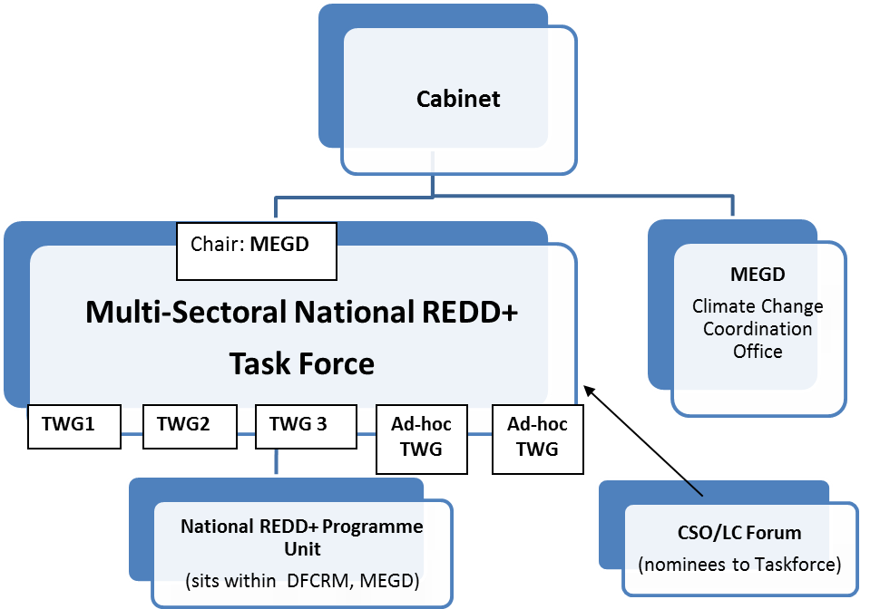
Proposed Management Arrangements
UN-REDD PMU
Notes:
The presenter should just go over the outputs and remind the audience that outputs and activities will be discussed during the breakout sessions. If all of the activities will be presented, again the presentation will be too long.

Slide 12
R-PP Budget/UN-REDD Support Requested
Budget (USD)
Outcome | Total cost | Internally Secured Funding | External Funding |  |  | Funding Gap
 |  |  | UN-REDD (excl. indirect support cost) | GIZ | UN-REDD TS & GEF
1. National REDD+ management arrangements established; improved stakeholder consultation and engagement | 1,790,000 | 400,000 | 1,160,000 | 5,500 | 100,000 | 124,500
2. National REDD+ Strategy prepared, with implementation framework and demonstration activities | 2,800,000 | 330,000 | 1,100,000 | 20,650 | 900,000 | 449,350
3. Reference emission levels and reference levels developed | 1,100,000 | 200,000 | 600,000 | 0 | 20,000 | 300,000
4. National forest monitoring system and safeguards information system developed | 4,050,000 | 1,070,000 | 875,000 | 1018800 | 80,000 | 986,200
TOTALS | 9,740,000 | 2,000,000 | (3,735,000) 3,996,450 | 1,044,950 | 1,100,000 | 1,860,050
Notes:
The presenter should just go over the outputs and remind the audience that outputs and activities will be discussed during the breakout sessions. If all of the activities will be presented, again the presentation will be too long.

Slide 13
General Responses to Independent Review Comments
Conservation as part of REDD+ agenda
Benefits of ecosystem services well recognized and no intention to “relax protected area provisions” or to “open up the fragile forests”.
Roadmap acknowledges that the policy of reducing wood consumption in utilization zones by restricting supply has led to an increase in illegal logging.
Roadmap also recognizes large potential for enhancing carbon stocks.
Safeguards referred to in appendix I to decision 1/CP.16 (the Cancun Agreements) will be addressed within the Roadmap and subsequent REDD+ Strategy, including the conservation of natural forests and biological diversity.
Inclusive consultation processes
Roadmap incorporates inputs from various stakeholders, particularly Forest User Groups (FUGs) in three provinces/aimags with the largest forest reserves.
Roadmap recognizes the importance of fully accounting for the decentralized decision-making process and role of FUGs.
Notes:
The presenter should just go over the outputs and remind the audience that outputs and activities will be discussed during the breakout sessions. If all of the activities will be presented, again the presentation will be too long.

Slide 14
General Responses to Independent Review Comments 2
Composition of the Task Force
Roadmap recognizes the need for a review of the existing Taskforce membership, and a new and broader-based National REDD+ Taskforce that will report to a Cabinet.
Capacity building beyond the central level
Roadmap acknowledges the critical role of decentralized natural resource management.
Roadmap will apply a learning-by-doing and consultation-based approach to developing appropriate coordination mechanisms and implementation arrangements between the national and sub-national governments and capacity development activities.
Roadmap also acknowledges the risk of raising high expectation at sub-national levels, hence initially limits its focus on strategic engagement and capacity development of relevant soum and aimag leaders.
More intensive efforts will follow in Phase 2 of REDD+.
Notes:
The presenter should just go over the outputs and remind the audience that outputs and activities will be discussed during the breakout sessions. If all of the activities will be presented, again the presentation will be too long.

Slide 15
General Responses to Independent Review Comments 3
Financing the implementation of the Roadmap
GoM commits $2 million in co-financing, with a small part being in-kind.
Funding gap of US$1.8 million remains, and the Roadmap will be used as a strategic programming tool for mobilizing additional funds.
Budget revisions will be considered during the inception phase to account for any new baseline activities.
Institutional architecture of REDD+ in Mongolia
Specific institutional arrangements for REDD+ implementation will be identified and established during the readiness process.
Process will note the need for MRV to be consistent with the MRV of NAMAs (UNFCCC Decision 14/CP.19).
REDD+ is one of the vehicles to deliver the Green Development Goals hence most logical for MEDG lead and coordinate.
Notes:
The presenter should just go over the outputs and remind the audience that outputs and activities will be discussed during the breakout sessions. If all of the activities will be presented, again the presentation will be too long.

Slide 16
Concluding Remarks
Mongolia sees REDD+ as part of the country’s green development agenda
Financing and other REDD+ supports and associated sustainable forest management activities cannot be limited to the forest sector in its traditional production-oriented sense.
A number of sectors dependent on forest goods and services and benefit from SFM.
Ensuring a higher prioritisation of REDD+ and sustainable forest management goals into the principles which guide the allocation of budgets and the use of policy incentives within the national level planning.
Assisting with current efforts in shifting from “brown” to “green” development by investing in natural capital with a focus on forests (ecosystem services), as well as human capital (jobs, income, equity, etc.).
Supporting the realization of a balanced economy, without putting a strong emphasis on GDP growth to ensure long-term sustainability of the economy.
Notes:
The presenter should just go over the outputs and remind the audience that outputs and activities will be discussed during the breakout sessions. If all of the activities will be presented, again the presentation will be too long.

Slide 17
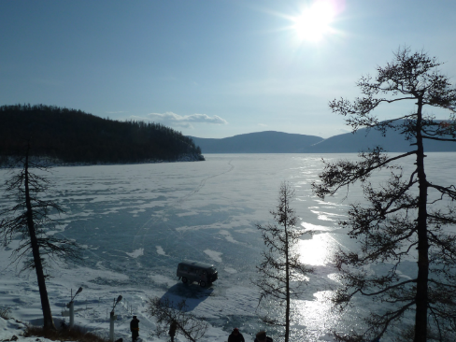
Bayarlalaa!
Ministry of Environment and Green Development (MEGD)
15160 Government Building 2., United Nations Street 5/2, Ulaanbaatar, Mongolia
www.mne.gov.mn
The Government of Japan, UNDP Country Office in Mongolia and the UN-REDD Programme provided financial support for the development of this Roadmap

