Slide 1
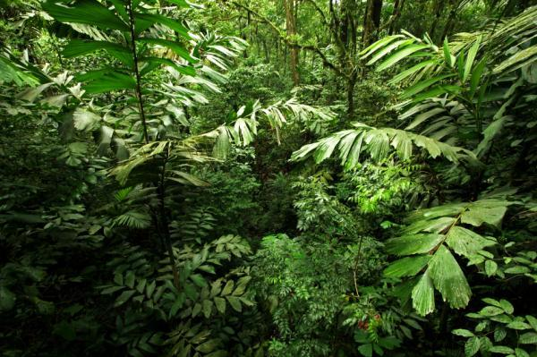
FREDDI Project Portfolio: A Work in Progress
Agus P. Sari | REDD+ Special Team |President's Delivery Unit for Development Monitoring and Oversight (UKP4)
South-South Knowledge Exchange on National REDD+ Fund Architectures| Second Workshop: Aligning Disbursements with Strategic Objectves and Modes of Delivery | Oslo, October 28, 2013

Slide 2
FREDDI: Design and Establishment Process as Funding Instrument for REDD+ in Indonesia
Proposed Design, Structure, Modality & Guiding Principles
Multi Stakeholder Consultation Process (Workshop, FGD dan
Bilateral Consultation)
Finalization the
design of FREDDI
Final Design & Establishment of
FREDDI by
REDD+ Agency
Direction & Mandate based on Presidential Regulation 62/2013
Consultation and Testing Process on FREDDI’s Elements at Sub –National Level
FREDDI or Fund for REDD+ Indonesia is designed as a funding instrument of REDD+ Agency that is responsible for managing, channeling and mobilizing REDD+ funds in a transparent, effective, efficient, fair and accountable in support to achieving the REDD+ National Strategy.
Presidential Regulation 62/2013 regarding REDD+ Agency issued in August 2013 defines Funding Instrument as:
“funding management instrument that is established by the Head of the REDD+ Agency to guarantee a transparent management of fund that is transparent, accountable, effective in accordance with the guidelines and REDD+ funding safeguards pursuant to the prevailing laws and regulations”
Notes:
----- Meeting Notes (8/19/13 15:30) -----
Add slides on buy-in examples - 4 pilot projects, DKN, CSOs (through FIP);

Slide 3
Structure of FREDDI
National MRV Agency
Safeguards Unit
REDD+ Agency
Emission Reduction Verification
MRV Unit of REDD+ Agency
Safeguards Committee
Report on Verified Emission Reduction
Disbursement and Investment Committee
Board of Trustee FREDDI
FREDDI
Trustee
Report on Emission Reduction Measurement
Sub-National MRV Unit
REDD+
Support Facility
FREDDI
Secretariat
Partner Agencies
Executing Agencies
Grant for Programs, Projects and Activities

Slide 4
FREDDI:
Overall Objectives
Support the emissions reduction efforts from deforestation and forest degradation in Indonesia;
Support the implementation of the REDD+ National Strategy
Support the institutional strengthening and further work of the REDD+ Agency through Funding Window 1;
Promote payment for performance approach;
Provide funding that is complimentary to existing sources including national budget, regional budget and other donors
Ensure that REDD+ funding is sustainably and effectively managed, disbursed and mobilized further.

Slide 5
FREDDI: Guiding Principles
Effectiveness, Efficiency, Fairness,
Transparency and Accountability;
Government of Indonesia leadership
in design, management and governance
of FREDDI;
Ensuring that PRISAI as safeguards are
part of FREDDI operation and
REDD+ Projects;
Flexibility to finance national
initiatives, provincial priorities,
demand-driven proposals,
and small grants.

Slide 6
Addressing Key Challenges : The five pillars of the National REDD+ Strategy
Legal review, reform, and enforcement.
Institutional setting and strengthening.
Awareness raising and paradigm shifting.
Stakeholder engagement.
Strategic programs through Sustainable landscape management; Sustainable natural resources management and Conservation & rehabilitation.

Slide 7
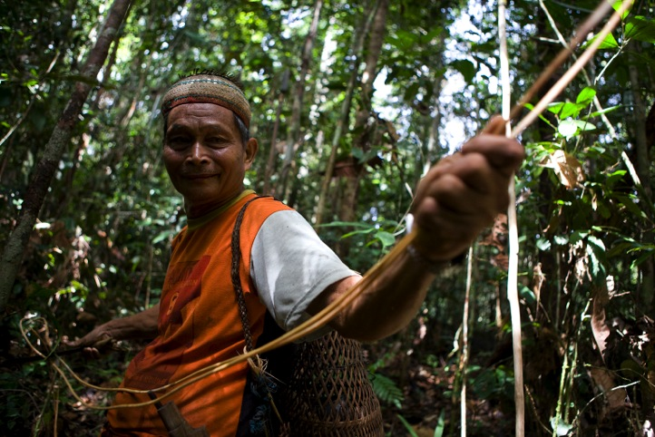
Modality 1.A: Pure Grant Final Stage of Design
Consist of small scale, medium and large grant.
Grant is channeled with the priority on readiness activities, infrastructure development and capacity building.
Modality 1.B: Performance-based Grant
Final Stage of Design
Consist of small scale, medium and large grant.
Grant is channeled based on an agreed upon verified performance covering emission reduction activities and the activities that support emission reduction target.
Modality 2: Performance Aggregator
Ongoing design process.
Applied once the MRV system is ready. Returns are expected in terms of performance units.
Sequential Modality
Modality 3: Investment
Ongoing design process.
Returns are expected in terms of monetary and performance units. Applied once the readiness, MRV mechanism and the capacity are in place and ready.
Notes:
Input-based :
Hibah murni dengan penyaluran dana sebagian atau seluruhnya dilakukan di depan. Fokus terhadap no-regret activities / enabling conditions (e.g capacity building, pembangunan sistem dan/atau infrastruktur REDD+);
Result Based :
Pembayaran dilakukan berdasarkan kinerja yang telah diverifikasi baik dalam bentuk penurunan emisi (karbon) maupun manfaat non-karbon lainnya. (e.g ; insentif untuk kebijakan yang diterbitkan, hasil legal review, pembelian VER/CER dari Demonstration Activities).
Agregasi Kinerja ->
Investasi ->

Slide 8
Pipeline Portfolio Development
RAN – GRK
RAN-REDD
Provincial Strategy and Action Plan (SRAP)
Ongoing Initiatives (Ministry/Agency and ex REDD+ Task Force
Ongoing Initiatives (DAs)
Pipeline of Initiatives
Notes:
----- Meeting Notes (8/19/13 15:30) -----
Add slides on Pipeline progress -> information on current priorities;

Slide 9
FREDDI : Funding Windows
As support mechanisms of FREDDI in order to achieve its main objective by taking into account the pipeline development portfolio and the board array of stakeholders, scale, target and the duration of project.
Strategic Window: Readiness, National Priority and Emergency Intervention
Sub-National Initiatives
Competitively-Selected Initiatives
Small-Grants

Slide 10
Funding Windows : Mechanism

Slide 11
Funding Windows : Operational Timeline

Slide 12
Generic Criteria for Small Scale
Quick :
Location of project, track-record of implementing entity, stakeholders engagement on the ground, size project, capacity & management resources of implementing entity.
Impactful :
Ability to achieve measurable emission reduction or to be transitioned into emission reduction future activities, Compatibility with jurisdictional and nested approach (can be replicated), Compatibility with STRADA – SRAP, STRANAS and Funding Windows of FREDDI, Exposure to other REDD+ Taskforce elements (MRV, Legal, etc.)
Sustainable :
Equipped with elements to ensure sustainable implementation of projects for long period of time (e.g. intensive capacity building & transfer of knowledge for implementing entities for project implementation, including management, monitoring & evaluation and reporting).
Notes:
Stakeholders engagement (FPIC), size project (amount), kapasitas management (Reporting, M&E) – leadership, internal structure, field capacity – STRADA, MRV, Legal Workshop
Assessment Panel :
-
-

Slide 13
Generic Criteria for Large Scale
Based on SRAP Readiness Criteria, generic criteria are :
Location of projects/program (jurisdictional & nested approach);
Compatibility with REDD+ National Strategy n pillars;
Support & capacity of sub-national government (provincial/district) from management, regulatory & budget perspective (including SRAP completion);
Reference Emission Level (REL);
Existing projects/activities on the ground.

Slide 14
Funding Windows : Simulation for Pilot
NATIONAL PRIORITY | SUBNATIONAL PRIORITY | COMPETITIVE CYCLE | SMALL GRANTS
Indigenous Community Forest Management | Jurisdictional Approach in existing potential projects (e.g Berau and West Kutai District) | Support to SRAP based on thematic under STRANAS pillars | Programmatic Community Based Land Rehabilitation (Green Village)
Performance Aggregation on performing Demonstration Activities | Jurisdictional Approach in Peat-land area (e.g Kapuas in Central Kalimantan) |  | Programmatic Community Based Alternative Livelihoods
Ongoing Initiatives under REDD+ Taskforce & REDD+ Special Team | Jurisdictional Approach in area with pristine forest area (e.g Murung Raya in Central Kalimantan) |  | Programmatic Community Based Forest Fire Management
 | Further developing KPH model, focusing on existing area |  | Programmatic Green School Curriculum Project
Notes:
Forest fire management -> prevention
Koordinasi stakeholders
REDD+ PNPM (Community Based Forest Fire)
Gunung Mas, Murung Raya ->
3 pilar dilaksanakan secara berkelanjutan
District Readiness Criteria & Indicators
----- Meeting Notes (10/24/13 18:16) -----
Show how can collaborate.

Slide 15
Thank You

