Slide 1
Eleventh Policy Board meeting
Information and Knowledge Sharing Session:
Stakeholder Engagement:
Approaches for Addressing Grievances related to REDD+
Geneva, Switzerland
9-10 December 2013
Notes:
This is a topic where we’ve seen increasing country demand for support … beginning with Cambodia, Honduras and Suriname … who we will hear from today.
Although this area of ‘National Grievance systems’ is embedded in the template used by countries to prepare their REDD+ strategies for the UN-REDD Programme or the FCPF (the ‘R-PP Template’) it is a relatively recent addition to the R-PP Template and so was not incorporated into some of the earlier NPs / REDD+ readiness activities.
I wanted to note that if other countries are interested in exploring this work, the SE work area has TS available to support this.
Although in the first part of our presentations, we will focus on assisting countries set up their own national grievance mechanisms, the experience with the strong complaints from IPs in Panama has pointed out the need for the UN-REDD Programme itself to be organized and prepared to have its own approach to grievances – as Mario will describe for us.

Slide 2
Session Outline
Introduction
Charles McNeill, UNDP/UN-REDD Programme
Guidance on National Grievance and Lessons Learned
Jennifer Laughlin, UNDP/UN-REDD Programme
Grievance Assessment: The Honduras Experience
Manuel Alvarado Leverón, Departamento de Cambio Climático y Bosques, Ministry of Forestry, Honduras
Preventative Measures: Selection Process for REDD+ Consultation Group Representatives in Cambodia
Chea Sam Ang, Forestry Administration, Cambodia
The UN-REDD Programme Approach to Addressing Grievances
Mario Boccucci, UN-REDD Secretariat
Thoughts from a Civil Society Perspective
Chris Meyer, Environmental Defense Fund
Comments from the Floor, Q/A
Notes:
Session Outline / Introduce the Panel:
Guidance on National Grievance and Lessons Learned
Jennifer Laughlin, UN-REDD Programme
Grievance Assessment: The Honduras Experience
Manuel Alvarado Leverón, Department of Climate Change and Forests, Honduras
Preventative Measures: Selection Process for REDD+ Consultation Group Representatives in Cambodia
Chea Sam Ang, Forestry Administration, Cambodia
Thoughts from a Civil Society Perspective
Chris Meyer, Amazon Basin Outreach Manager, Environmental Defense Fund
Comments from the Floor, Q/A

Slide 3
Session Objectives
Share information on / Receive feedback on:
UN-REDD Programme Support to Strengthen National Grievance Mechanism, with a focus on Country Experiences and Lessons Learned
Proposed UN-REDD Programme Approach to Addressing Grievances

Slide 4
What is a Grievance Mechanism?
Organizational systems and resources established by national government agencies to receive and address concerns about the impact of their policies, programs and operations on external stakeholders.
Accessible, collaborative, expeditious and effective in resolving concerns through dialogue, joint fact-finding, negotiation, and problem solving.
First line of response to stakeholder concerns that have not been prevented by proactive stakeholder engagement.
Complement, not replace, formal legal channels
Doesn’t address complaints that allege corruption, coercion, or major and systematic violations of rights and/or policies
Notes:
Grievance Mechanisms are organizational systems and resources established by national government agencies to receive and address concerns about the impact of their policies, programs and operations on external stakeholders.
They are designed to be accessible, collaborative, expeditious and effective in resolving concerns through dialogue, joint fact-finding, negotiation, and problem solving.
They are the first line of response to stakeholder concerns that have not been prevented by proactive stakeholder engagement.
They are meant to complement, not replace, formal legal channels for managing grievances (e.g. the court system, organizational audit mechanisms, etc.).
These mechanisms typically do not include grievances that allege corruption, coercion, or major and systematic violations of rights and/or policies – as these are usually referred to more formal procedures like the court systems.

Slide 5
Why is a National Grievance Mechanism Important?
Identify, anticipate and resolve implementation problems in a timely and cost-effective manner
Identify systemic issues
Improve REDD+ outcomes and lessons learned
Promote accountability in REDD+ countries
Notes:
REDD+ implementation will inevitably run up against conflicts, for examples disputes could arise on issues such as land use, land rights, encroaching, illegal logging, lack of consultation, IP rights, benefit sharing etc.
Grievance Mechanisms can be useful to help to:
Identify and resolve implementation problems in a timely and cost-effective manner: As early warning systems, well-functioning Grievance Mechanisms help identify and address potential problems before they escalate, avoiding more expensive and time consuming disputes.
Identify systemic issues: Information from Grievance Mechanism cases may highlight recurring, increasingly frequent or escalating grievances, helping to identify underlying systemic issues related to implementation capacity and processes that need to be addressed.
Improve REDD+ outcomes: Through timely resolution of issues and problems, Grievance Mechanisms can contribute to timely achievement of REDD+ objectives.
Promote accountability in REDD+ countries: Effective Grievance Mechanisms promote greater accountability to stakeholders, positively affecting both specific activities and overall REDD+ governance.

Slide 6
Key Definitions
Feedback: Opinion on the performance of a project provided to those who run it.
Grievance: Distress expressed in the form of a complaint.
Redress: To set right, remedy by removing the cause of a grievance or making up for it.
Dispute: Two or more people in a confrontation over goals they perceive to be incompatible.
Notes:
Read definitions…
Redress = recourse

Slide 7
Joint FCPF/UN-REDD Guidance Note: Establishing and Strengthening Grievance Redress Mechanisms (GRMs)
Key Topics Within the Guidance
What is a Grievance Redress Mechanism and what is its purpose?
What principles should guide the design of a GRM?
What does a GRM typically look like?
GRMs and the REDD+ Readiness Phase
How can governments and other national partners establish and strengthen GRMs in the Readiness phase?
Annex 1: GRM Evaluation Tool
Annex 2: Assessing and Strengthening National GRMs: Key Steps, Stakeholders, Questions and Information Sources
Notes:
As outlined in the Joint FCPF/UNREDD Readiness Preparation Proposal Template (R-PP), REDD+ countries are expected to establish or strengthen Grievance Redress Mechanisms (GRMs) based on an assessment of potential risks to forest-dependent communities and other stakeholders from REDD+ programs and activities.
Since the purpose is to provide an accessible, rapid, and effective recourse for these stakeholders, it is essential to design and implement the GRM in close consultation with them.
The UN-REDD Programme, together with the FCPF have developed a Joint Guidance Note on Establishing and Strengthening Grievance Redress Mechanisms.
The Guidance Note covers these key topics (same as in slide):
What is a Grievance Redress Mechanism and what is its purpose?
What principles should guide the design of a GRM?
What does a GRM typically look like?
GRMs and the REDD+ Readiness Phase
How can governments and other national partners establish and strengthen GRMs in the Readiness phase?
(Annex 1 is a tool to evaluate the proposed GRM against specific guiding principles and Annex 2 outlines the key steps, stakeholders and types of questions that a country could think about in setting up a grievance mechanism.)
Note we are using Grievance Redress Mechanism and Grievance Mechanism synonymously.

Slide 8
Focus in the Readiness Phase
Focus Efforts on:
Building capacity to address potential disputes that are likely to arise during the Implementation phase, and
Addressing complaints that relate to the policy preparation process and other Readiness activities.
To be completed before REDD+ Implementation begins:
Assessment of existing GRMs and gap analysis
Procedure for grievance redress that meets process essentials (principles and steps)
The GRM is made operational
Notes:
As you know, the Readiness phase is essentially a policy-making and planning process. In preparation for REDD+ Implementation, grievance efforts during the Readiness phase will simultaneously focus on two areas:
Building capacity to address potential disputes that are likely to arise during the Implementation phase, and
Addressing complaints that relate to the policy preparation process and other Readiness activities.
During Readiness, the REDD+ program can better anticipate the kinds of grievances that are likely to arise around how REDD+ policies, projects, and activities will be implemented on the ground (e.g. are the beneficiaries receiving what the law says and through accessible mechanisms? Are some people disputing the right to benefits in a given territory?).
Countries should use the Readiness phase to identify, assess and strengthen existing spaces for resolving these grievances.
Setting up and operating a GRM is a continuous improvement effort; while countries commit to putting in place an operational GRM by the end of the Readiness phase, it is expected that they will continue to strengthen and improve this GRM during Implementation.
Before REDD+ Implementation begins, it is expected that countries will have completed the following:
Assessment of existing GRMs (which includes the identification of areas requiring continued improvement) is completed and made public
Procedure for grievance redress that meets process essentials is made public
The GRM is made operational

Slide 9
GMs can be the first line of response to stakeholder concerns that have not been prevented by proactive stakeholder engagement or effective safeguards.
Stakeholder Engagement
Safeguards
Safeguard Information System
Governance
Anti-corruption
GMs could offer an entry point for stakeholders to provide feedback and information on how safeguards are being respected.
National
Grievance
Mechanisms
GMs can increase transparency, accountability, communication and feedback loops between governments and stakeholders.
GMs can refer relevant complaints to anti-corruption authorities and mechanisms and vice versa
Notes:
Grievance Mechanisms are very closely related to other aspects of REDD+ readiness …. Read text….
With that, I’ll pass it over to Jen to fill in the details of the Guidance Note and provide some lessons from countries that have begun to assess how they can strengthen their approaches to addressing REDD+ related grievances….

Slide 10
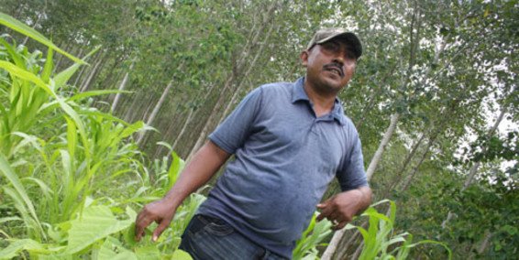
Disputes are likely to arise locally in the form of grievances – this may have impacts on how REDD+ is implemented
They are trying to take my land, my forest!
Where is the money I was promised?
Individual grievances
Absence of State Institutions
PRE-EXISTING
Deeper causes of disputes
Incompatible & incoherent policy making
Structural inequality and Limited Participation
Poor land use planning
Insecure land tenure & resource rights
Credit: Juan Dumas
Notes:
REDD+ has the potential to exacerbate deep rooted and pre-existing disputes --- See points on slide

Slide 11
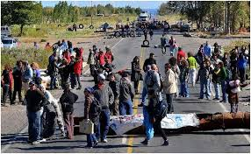
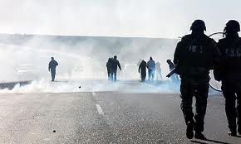
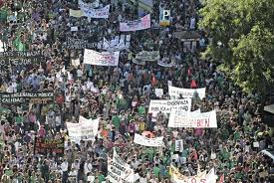
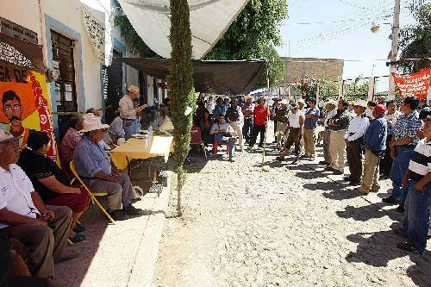
As in any dispute, grievances may escalate if not redressed early
Negotiation?
Community & allies take it to national level
Police acts
No redress
INTERNATIONAL INCIDENT
Community blocks road
Community complains formally
No redress
JUDICIAL COURTS SYSTEMS
MEDIATION
Individual grievances
GRIEVANCE REDRESS MECHANISMS
PRE-EXISTING
Deeper causes of disputes
Incompatible & incoherent policy making
Absence of State Institutions
Poor land use planning
Structural inequality and Limited Participation
Stakeholder Engagement, Safeguards PGA
Insecure land tenure & resource rights
Credit: Juan Dumas

Slide 12
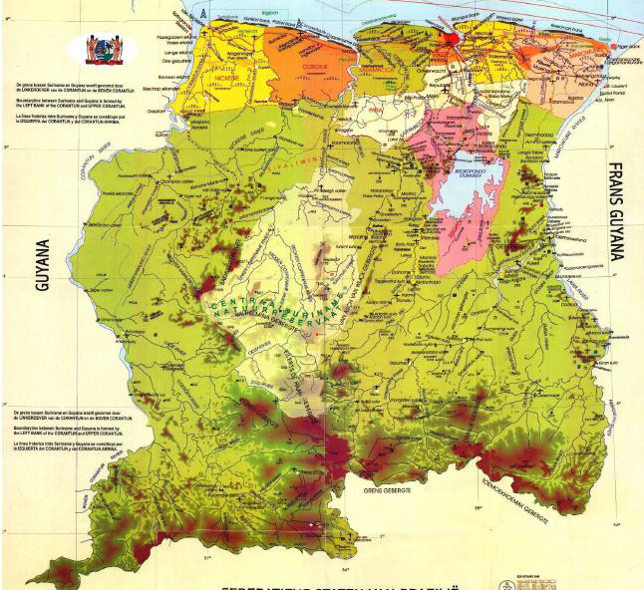
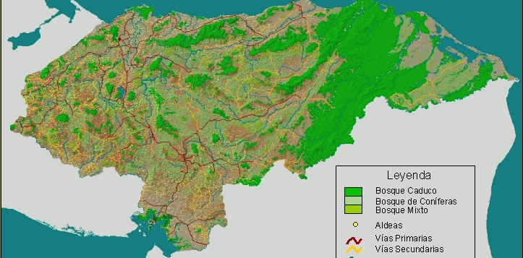
Examples
Suriname
Cambodia
Honduras

Slide 13
Following Our 3-Step Approach…
Sources of Conflicts?
Systems to Address Conflicts?
How to Strengthen these Systems?

Slide 14
Sources of Conflict: Lessons from Cambodia, Honduras and Suriname
NOTE: Sources do not derive from REDD+ but derive from (often) long-standing tensions over natural resource use. The complaints manifest through REDD+, but that is not the source.
Illegal land conversion & use, encroachment
Road and infrastructure development (sometimes linked to military personnel, border security or migratory pressure)
Multiple titles/permits for the same land
Lack of legal clarity on IP’s land rights / Unresolved land rights issues
Lack of agreed norms on consultation and consent (FPIC) / Lack of consultation
Disputes over mining & energy projects (often tied to lack of clarity on land rights and consultation)
Divisions within & between communities on land use / NRM (e.g. right to cut trees, cultivate areas or site new settlements)
REDD+ Program itself (Concerns that the program is not aligned with aspirations/visions of indigenous peoples; Concerns about fair benefit distribution)

Slide 15
Systems to Address Conflicts: Lessons from Cambodia, Honduras and Suriname
Cambodia
National level: Relevant ministries (Forestry, Land etc.)
Provincial level: Office of the Provincial Governor (supported by Commune Councils)
Local level:
Community Forest Management Committees
Community Forestry Network
Community Protected Area Committees
Supporting NGOs
Honduras
Many cases go through several government institutions
Political dialogue for large national debates (ancestral rights, norms for consultation and consent)
Conciliation Centres in some communities
If violation of law, Public Prosecutor
Commissioner for Human Rights have played a role in some disputes
Suriname
For small-scale forest/land conflicts (ad hoc):
complaints to local police; District gov’t/MP;
Appeals to Ministers and the President
National Dialogue to resolve disputes over Saramaka Judgment / land rights
Options outlined in RPP:
Major Groups Collective;
Bureau for Contact with the People;
Parliamentary Commission on Climate Change
Notes:
All three have complaints come to the major line ministries
Complaints are also common to the provincial or district government
Cambodia was striking in that there were strong structures in place to address grievances at the local level
Honduras and Suriname both had ongoing national dialogues to address large scale national debates – e.g. on land rights, consultation/consent

Slide 16
How to Strengthen These Systems? Assess with the 7 Key Principles
Is it accessible to those who face barriers (language, literacy, costs, awareness)?
Are the procedures predictable (clear time frames, scope and outcomes)?
Are the procedures widely perceived as fair (access to information and opportunities for meaningful participation in the final decision)?
Is the governance structure legitimate i.e. trusted by those who may use it?
Are the outcomes of the process consistent with applicable national and international standards (Rights compatibility)?
Are the procedures and outcomes transparent enough to meet the public interest concerns at stake?
Does the mechanism have the necessary technical, human and financial resources and capability to deal with the issues at stake?

Slide 17
Recommendations: Lessons from Cambodia, Honduras and Suriname
Beyond REDD+, recommendations aim to improve country capacity to address natural resource conflicts
Preference towards strengthening existing institutions, rather than creating new ones
Preventative measures play a significant role in reducing the risk of new conflicts and future escalation; e.g.:
Advance agreements and new norms for indigenous land rights and prior informed consent (FPIC)
Boundary demarcation and zoning for State Forests and Protected Areas
Joint, integrated local land use planning and zoning
Clearer strategy for land use decision making, consulting on and then communicating those decisions
Build dispute resolution provisions into FPIC protocols

Slide 18
Recommendations (2): Lessons from Cambodia, Honduras and Suriname
Recurring themes – there is a need for …
Clearly defined and well understood grievance procedures
More effective channels to refer disputes to higher levels
Clarified roles and responsibilities at all levels
More consistent documentation of disputes
Strengthened in-country mediation/conciliation capacity: Start with a diagnosis of current capacity and legal context, generate a list of mediators to draw from
Ensuring that District govts and police are aware of GRM and know how to access it
As a starting point, use REDD+ Steering Committee as first line for dispute prevention and resolution
Clarify representation, decision making and dispute resolution procedures in ToR
Identify appropriate institution as secretariat for intake and tracking

Slide 19
A Perspective from Suriname
…It is hoped that through inclusiveness, transparency and plenty of capacity building of both public and private entities/organizations, Suriname will be able to manage the expectations of all stakeholders during implementation of the R-PP…
…There is a widespread belief/acknowledgement that development of Suriname will not only require involvement and direction given by the public sector, but all 9 Major Groups in Suriname. Therefore, a national grievance and redress mechanism for REDD+ will be one of many other mechanisms to be used by the stakeholders to be involve during the REDD+ implementation…
Cedric Nelom
Director, National Institute for Environment & Development (NIMOS)
Suriname

Slide 20
Charles McNeill & Jennifer Laughlin
charles.mcneill@undp.org
jennifer.laughlin@undp.org
Thank You
Website: http://www.un-redd.org

Slide 21
Stakeholder Engagement Cambodia REDD+ Programme
Presented by Chea Sam Ang, PhD

Slide 22
Principles for UN-REDD/FCPF Activities
Principles (for UN-REDD/FCPF activities): Apply joint UN-REDD/FCPF Guidance on SE; key points:
Representation: CSO and IP members of PEB
Transparency & Access to Information: PEB minutes and other key documents available on REDD+ Cambodia web-site
Grievance: Initial assessment of existing grievance mechanisms and options for scaling up

Slide 23
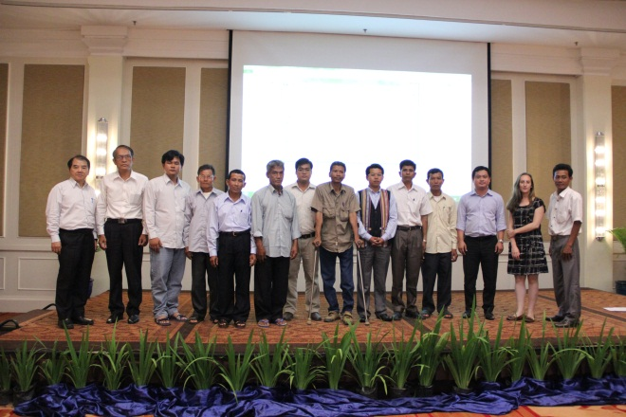
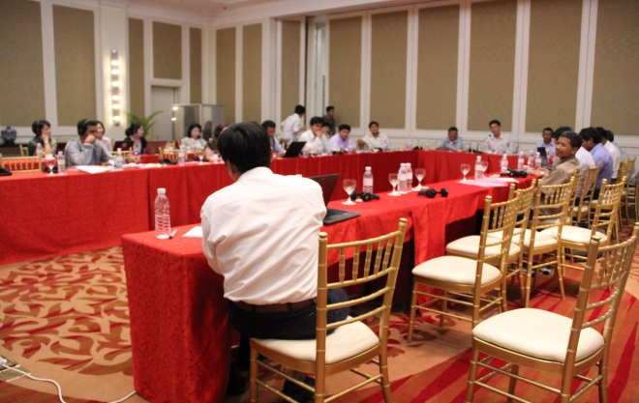
Roles & responsibilities – Consultation Group
Allows stakeholders to influence REDD+ policy and strategy development as Taskforce is government-only
18 members: 2 reps from each of 9 stakeholder groups
CG and TF activities coordinated: CG meets ahead of TF meeting and prepares brief on any or all agenda items
Two-way exchange of information between CG members and constituents: Allowing true representation – CG does not simply reflect the views of its members

Slide 24
Principals of IP selection
Participation of IP in the 15 provinces they are living
Recognition and support from provincial authority and authorized agencies
Awareness Raising on REDD+ during the process

Slide 25
IP selection process
Selection at provincial level:
Met with selected IP representatives from districts/communes, local authority and NGOs
Informed the objective of selection
Conducted awareness raising (play video clip on Introduction to REDD+ with Q & A)
Explained process and conduct election representative.
Recognition letter from provincial authority for the elected representative.

Slide 26
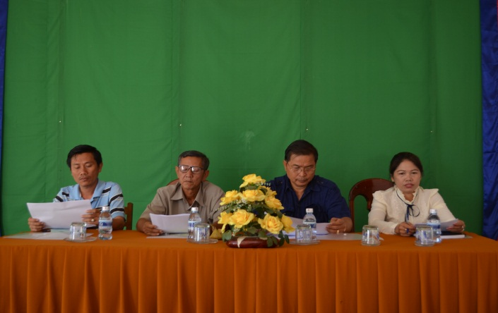
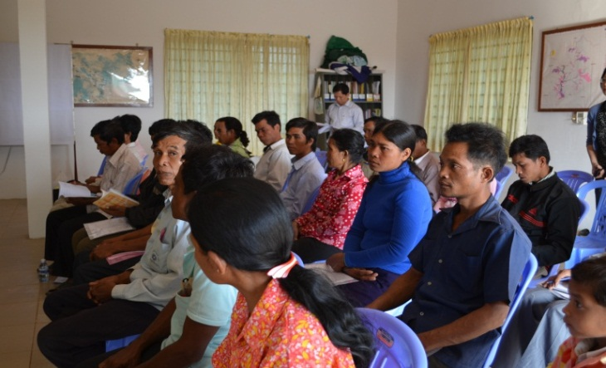
IP selection process (Continued)
Final Selection at National level:
The 15 selected IP from the 15 provinces attended CG National Workshop to elect among themselves for top 2 IP representatives and who will become IP representative in both CG and PEB.

Slide 27
Workplan / Next Steps
Once the feedback and/or flow of mechanism was finalized, all CG members will be technically and financially supported by REDD+ Taskforce Secretariat to implement accordingly.
Regular monitoring and evaluation will also applied.

Slide 28
Thank You!
Website: www.cambodia-redd.org / http://www.un-redd.org

Slide 29
Proposed UN-REDD Programme Approach to Addressing Grievances

Slide 30
Rationale
An agreed predictable process for responding to complaints from affected people can:
Clarify the process, roles and responsibilities for responding to specific complaints about Programme-supported activities;
Increase the effectiveness, efficiency and timeliness of responses and resolutions to complaints;
Ensure coordinated communication with external stakeholders and improve internal communications;
Enhance overall Programme performance and strengthen support for the Programme from multiple stakeholders.
Notes:
Summarize text from slide…
Also note that the proposed approach would complement the efforts we have just discussed to support countries to establish their own procedures for addressing complaints.
Most grievances arising from UN-REDD Programme-supported activities at the country level should be addressed by national implementing partners without direct UN-REDD Programme involvement.
In this way, the UN-REDD Programme approach to addressing complaints is intended to be a secondary recourse for stakeholders in UN-REDD Programme-supported activities.

Slide 31
Learning from Complaints Received
A complaint at the national level can have implications for the UN-REDD Programme as a whole
A shared approach to addressing complaints → more efficient and effective management of the dispute, potentially saving time and resources;
Complaints may vary significantly and require different responses so any process must be flexible
Coordination between the agencies and between different Programme levels is critical to an effective response
Notes:
The UN-REDD Programme has already begun to receive complaints.
The experience in responding to this complaint provides useful information for shaping the proposed guidelines for the UN-REDD Programme’s ability to respond to future complaints.
Perhaps most importantly, the experience highlighted the importance of anticipating future complaints and having a shared understanding of how complaints should be addressed in the future.
The experience in responding to the complaint made against the Panama NP has highlighted several general lessons relevant to the design of future responses, including among others:
A complaint at the national level can have implications for the UN-REDD Programme as a whole (including, for example, creating reputational risks and loss of trust with key stakeholders, adding demands on financial and human resources, and delaying NP activities);
Developing a shared understanding for how to respond to significant complaints would allow for more efficient and effective management of the dispute, potentially saving time and resources;
Complaints may vary significantly and require different responses so any process must be flexible

Slide 32
We are Committed to Applying the Same Guiding Principles as National Programmes…
Accessible
Predictable
Fair
Legitimate
Rights compatible
Transparent
Capability
Notes:
Is it accessible to those who face barriers (language, literacy, costs, awareness)?
Are the procedures predictable (clear time frames, scope and outcomes)?
Are the procedures widely perceived as fair (access to information and opportunities for meaningful participation in the final decision)?
Is the governance structure legitimate i.e. trusted by those who may use it?
Are the outcomes of the process consistent with applicable national and international standards (Rights compatibility)?
Are the procedures and outcomes transparent enough to meet the public interest concerns at stake?
Does the mechanism have the necessary technical, human and financial resources and capability to deal with the issues at stake?

Slide 33
A Shared Approach to Addressing Complaints
Complaint
Complaint
Complaint
Regional
National
Agency HQ
UN REDD
Centralized Hub
Complaint
One of the 3 Agencies’ Complaints Mechanism Screens and Assesses Complaint
Management Group Recommends
Lead Entity for Response
Agency Complaints Mechanism
Designated Task Force
National Coordinator
Regional
Coordinator
Notes:
Key Points:
This diagram outlines our latest thinking in terms of a design for a UN-REDD approach addressing grievances.
We would want to ensure, just as with the national grievance mechanisms, that there is one ‘home’ or centralized place for all complaints to land no matter where they come from. In our case – this would likely be the Secretariat.
The Secretariat would register and acknowledge the complaint and then send it to one of the three agencies mechanisms to recommend a response or action
The Management Group would then consider and approve this recommendation and identify the team or agency or focal point within the Programme that is best placed to carry out the recommended action. We will leave the options flexible enough to respond to different needs and to ensure the team tasked with carrying out the response has the capacity and resources to do so.
We have a draft concept note on this proposed approach that we can share with you – we welcome your feedback.
Next Steps: After further discussion within the agencies and Programme, this shared approach will be further elaborated and developed as a set of publicly available guidelines. Among the issues that will need further elaboration is the development of jointly agreed process for deploying resources, staff and external expertise in response to complaints received

