Slide 1
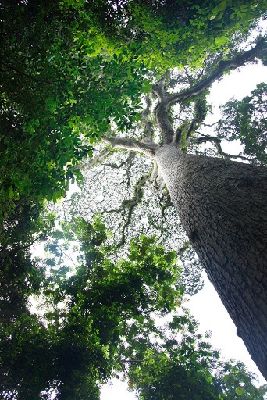
Webinar:
REDD+ and Biodiversity Conservation
Matea Osti
Programme Officer
UNEP World Conservation Monitoring Centre, on behalf of the UN-REDD Programme
23 October 2013
panda.org/forestclimate
© Alexander Belakurov/ WWF

Slide 2
WWF REDD+ Learning Session
Welcome, and thank you for joining this Learning Session:
Please:
Mute your microphone (at the right of your name) for background noise reduction.
Use and watch your chat window, this is where you can connect with the host for troubleshooting. If you are having difficulties, send a chat message to Breen Byrnes.
Leave questions for the end of the session, please put them in the appropriate section.
WWF-Forest and Climate Initiative | 2
Notes:
2

Slide 3
REDD+ and Biodiversity Conservation
Topics:
1. REDD+: An introduction
2. The multiple benefits of REDD+
3. REDD+ safeguards
4. The UN-REDD Programme
5. Spatial planning for REDD+ and multiple benefits
5. Conclusions
Facilitator: Breen Byrnes

Slide 4
1. REDD+: An introduction
Forests in developing countries cover more than 2 billion ha of the Earth’s surface
They are high in biodiversity, and provide society with important ecosystem services
In recent decades, increasing pressure on forests, mainly through activities related to land-use change, have resulted in forests becoming a major source of greenhouse gas emissions

Slide 5
REDD
+
Reducing Emissions from Deforestation and forest Degradation in developing countries
Conservation of forest carbon stocks
Sustainable management of forests
Enhancement of forest carbon stocks

Slide 6
Support for REDD+
US$ 4.5 billion
(2006-2013)
Source: Voluntary REDD+ Database (http://reddplusdatabase.org/)

Slide 7
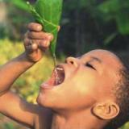
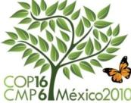
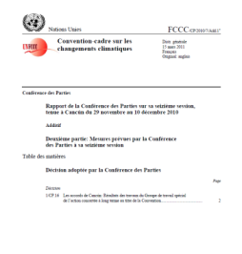
2. The multiple benefits of REDD+
When forests are retained or restored through REDD+, they deliver many benefits (“multiple benefits”) in addition to protecting or enhancing carbon stocks
The REDD+ safeguards agreed at the Cancun Climate conference emphasise the importance of conservation and enhancement of the multiple benefits of forests.
Multiple benefits include:
Biodiversity conservation
Ecosystem services
Livelihoods and social well-being

Slide 8
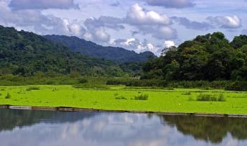
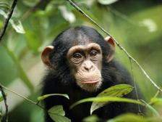
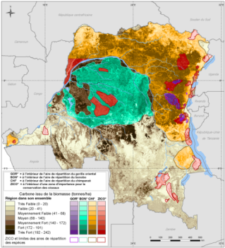
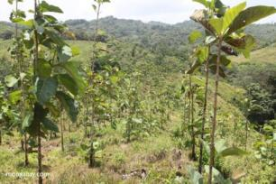
Multiple benefits are unevenly distributed in space
Different REDD+ interventions may be implemented in different regions
Forest patrolling
Ecotourism
plantation
Notes:
REDD+ is comprised of numerous interventions, all of which increase or maintain forest cover but can be quite different (see plantations vs community livelihoods from ecotourism projects that maintain forest cover – you wouldn’t do this in the same place...).
Countries have to choose where to apply each intervention – so where is the best place?

Slide 9
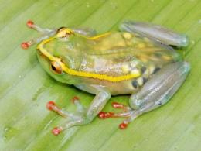
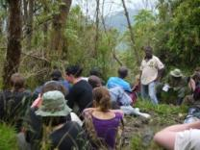
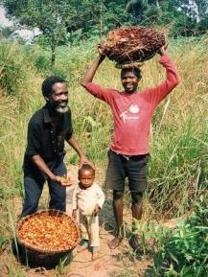
Where REDD+ actions are implemented will have variable impacts on how multiple benefits are delivered
Forest patrolling
Ecotourism
plantation
Notes:
Where you implement different interventions will yield different benefits. For example maintaining forests in one area may preserve rare and endangered species, in another area, it might contribute to watershed management, or both...
FYI – frog is Hyperolius leucotaenius found in Itombwe Highlands and northern slopes of the Kabobo Highlands, in eastern Democratic Republic of Congo
IUCN redlist endangered spp

Slide 10
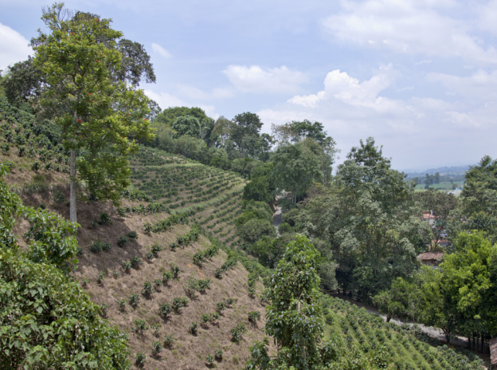
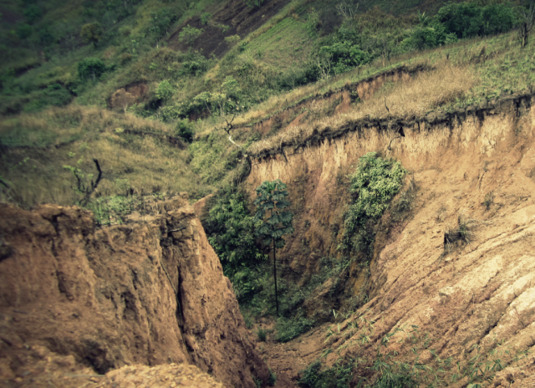
Where and how you implement different REDD+ actions will also affect the potential risks
Forest patrolling
Ecotourism
plantation

Slide 11
The benefits and risks of any REDD+ intervention will depend upon:
the type of REDD+ activity being undertaken,
the approach to its implementation
the type and condition of forests involved
Opportunities for biodiversity conservation
Risks to biodiversity
REDD+ activity
Displacement of land-use change to non-forest or
low-carbon ecosystems
Reduced deforestation
Spatial planning
for biodiversity
Slowed habitat loss and fragmentation

Slide 12
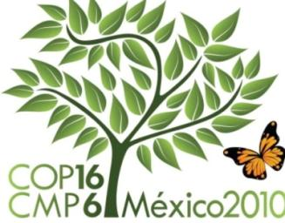
3. REDD+ safeguards
(Decision 1/CP.16):
Negotiations at the UNFCCC Climate Change Conference in Cancun in 2010 resulted in an agreement that certain safeguards for REDD+ should be promoted and supported, including:

Slide 13
That actions complement or are consistent with the objectives of national forest programmes and relevant international conventions and agreements;
(b) Transparent and effective national forest governance structures, taking into account national legislation and sovereignty;
(c) Respect for the knowledge and rights of indigenous peoples and members of local communities, by taking into account relevant international obligations, national circumstances and laws, and noting that the United Nations General Assembly has adopted the United Nations Declaration on the Rights of Indigenous Peoples;
Notes:
In 2010, Parties to the UNFCCC recognized the social and environmental benefits and risks of REDD+ in 2010, and agreed to promote and support a set of “Cancun safeguards” for REDD+.

Slide 14
(d) The full and effective participation of relevant stakeholders, in particular indigenous peoples and local communities, in the actions referred to in paragraphs 70 and 72 of this decision;
(e) That actions are consistent with the conservation of natural forests and biological diversity, ensuring that the actions referred to in paragraph 70 of this decision are not used for the conversion of natural forests, but are instead used to incentivize the protection and conservation of natural forests and their ecosystem services, and to enhance other social and environmental benefits;
(f) Actions to address the risks of reversals;
(g) Actions to reduce displacement of emissions

Slide 15
4. The UN-REDD Programme
United Nations collaborative initiative on Reducing Emissions from Deforestation and forest Degradation in developing countries
UNDP, UNEP, FAO
Supports nationally-led REDD+ processes
48 Partner countries, supported through:
Direct support to implementation of national programmes
Developing common approaches, analyses, methodologies, tools, data and best practices

Slide 16
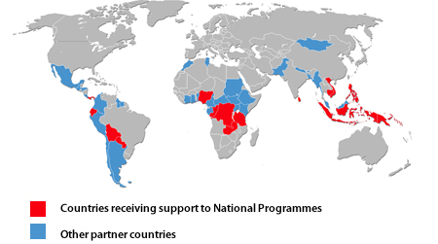

Slide 17
UN-REDD Programme Global Work Areas
Global work on common approaches, analyses, methodologies,
tools, data and best practices:
MRV and monitoring
National governance systems
Accountable management of REDD+ funding
Participatory decision making, strategy development and implementation
Safeguards and multiple benefits
Green economy and REDD+
Knowledge management

Slide 18
Objectives of UN-REDD work on safeguards
To address social and environmental issues in UN-REDD National Programmes and other UN-REDD funded activities
To support countries in developing country approaches to safeguards in line with the UNFCCC

Slide 19
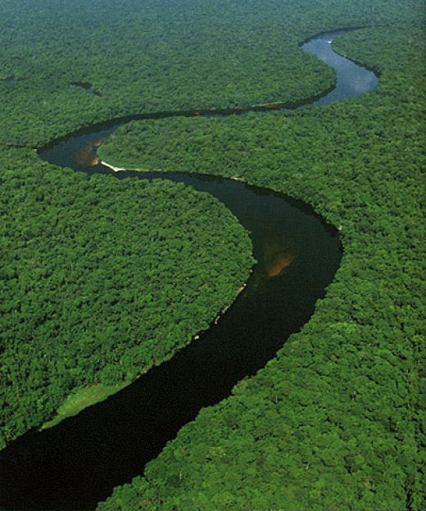
Development of a country approach to safeguards
No fixed, linear path
Steps to take will depend on:
what is in place
objectives defined by the country
Throughout the process, effective participation will be essential

Slide 20
Core elements of a country approach to safeguards
Institutions
Processes and Procedures
1.Identification/ development of relevant safeguards to be addressed and respected:
Policies, laws and regulations (PLRs), either existing or those created for REDD+
2. Safeguard Information System (SIS):
Existing or new indicators, methodologies for collecting information, and framework for provision of information

Slide 21
Core elements of a country approach to safeguards
1.Gap analysis of existing systems
2.Development of indicators
3.Data collection/ information provision approaches
Institutions
Safeguards Information System
1. Defining the goals of the safeguards approach
2. Gap analysis of existing social/ environmental PLRs and procedures
3. Creation of new PLRs and procedures (if necessary)
Policies, Laws and Regulations
Processes and procedures

Slide 22
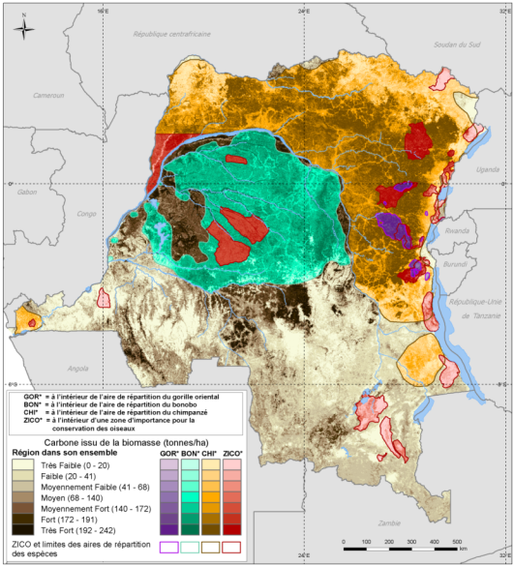
5. Spatial planning for REDD+ and multiple benefits
Why are maps useful?
Maps as tools can be:
rapid
cost-effective
easily customizable
easily communicated
Can e.g. inform REDD+ planning in participatory planning processes

Slide 23
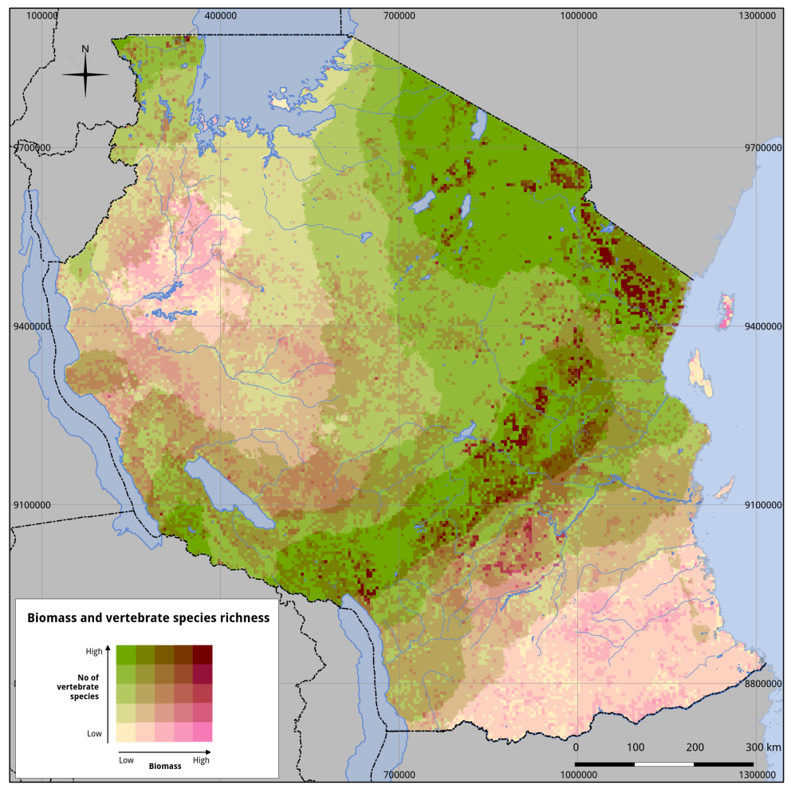
Why map multiple benefits?
Can serve the REDD+ planning process to identify areas of both:
High opportunity (e.g. where carbon and biodiversity values are both high)
High risk (e.g. low in carbon but high in biodiversity and no protection)
Map sources: Biomass: NAFORMA woody biomass only. 5km preliminary dataset base on field data only. Threatened vertebrates: IUCN 2013. The IUCN Red List of Threatened Species. Version 2012.2. <http://www.iucnredlist.org>. Downloaded March 2013. Spatial data from IUCN, 2013.

Slide 24
Examples of relevant spatially explicit questions
What areas are of importance for biodiversity, ecosystems and ecosystem services, and how do they correspond with high carbon values? Including:
What is the distribution of natural forest?
Which areas have simultaneously high species richness and high biomass?
What is the distribution of NTFP harvesting practices?
What are important pressures that these values may be vulnerable to? Where are these pressures especially high?
What forest areas are currently managed for protection versus production?

Slide 25
Country case study 1: United Republic of Tanzania

Slide 26
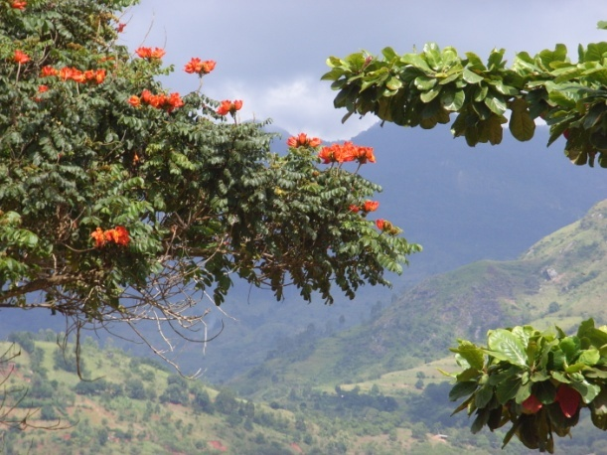
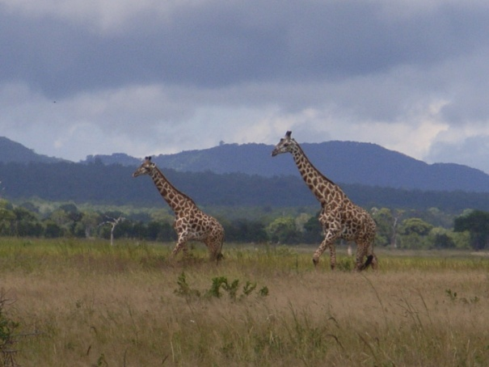
Tanzania National Programme
Linkages between the national forest inventory and the development of spatial analyses to inform REDD+ environmental safeguards and development of an Safeguard Information System (SIS)
Activities include:
Analysis of current forest inventory methodology to identify how the information collected can feed into an SIS
Analysis of existing forest inventory data to derive spatial information on the potential for environmental benefits from REDD+

Slide 27
Natural forest in REDD+ safeguards
Cancun safeguards (2010):
“[REDD+] Actions are consistent with the conservation of natural forests and biological diversity, ensuring that actions referred to in paragraph 70 of this decision are not used for the conversion of natural forests, but are instead used to incentivize the protection and conservation of natural forests and their ecosystem services, and to enhance other social and environmental benefits”
Cancun Agreement: FCCC/CP/2010/7/Add.1 Appendix I

Slide 28
Definition of natural forest
in REDD+ Strategy

Slide 29
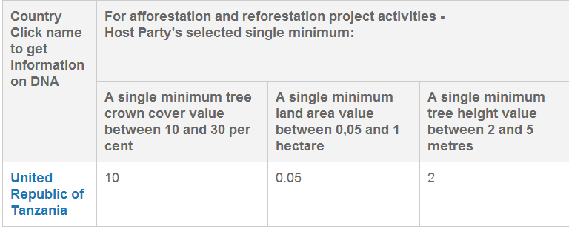
Definition of forest https://cdm.unfccc.int/DNA/bak/ARDNA.html?CID=211

Slide 30
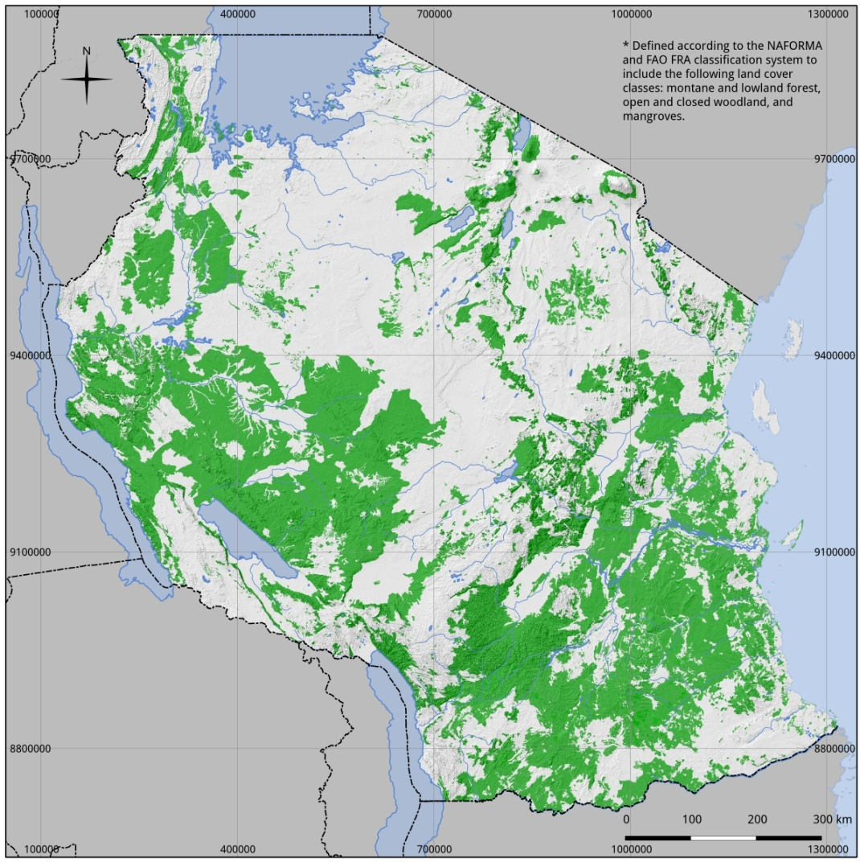
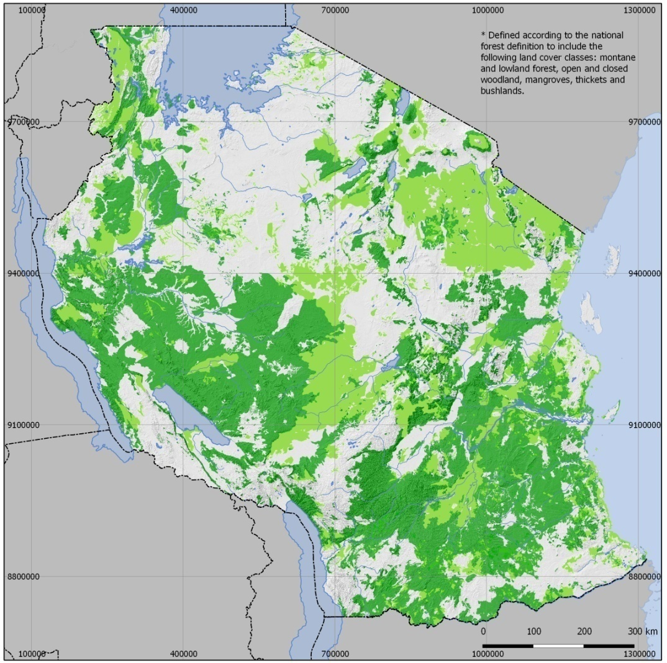
Natural forest estimation
FAO FRA
(10% canopy c + 5 m height)
Montane & lowland forest
Woodland
Mangrove
National dfn of forest-TZ
(10% canopy c + 2 m height)
Montane & lowland forest
Woodland
Mangrove
Bushland (>2m)
Thickets (>2m)
Map source: Derived form landcover classes in NAFORMA landuse landcover map 2010.

Slide 31
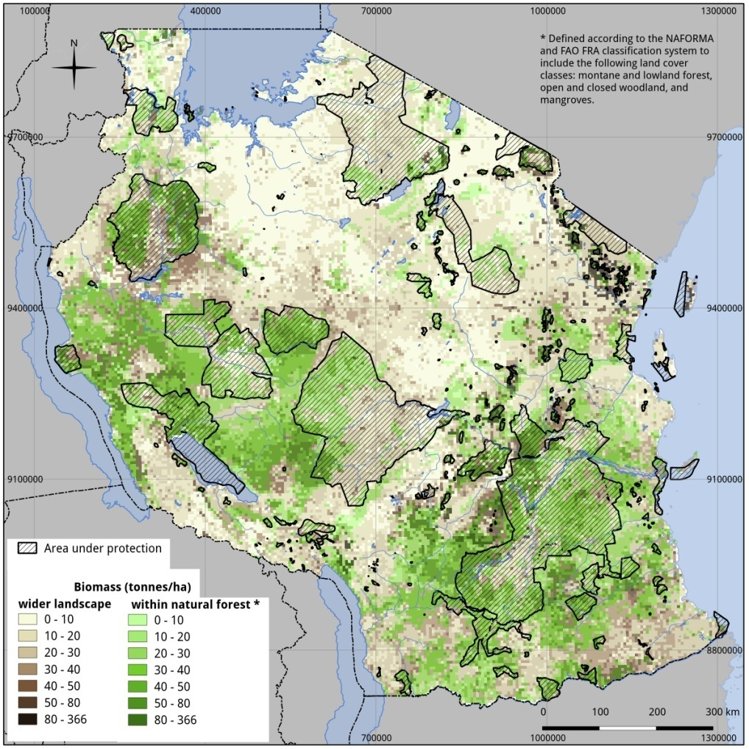
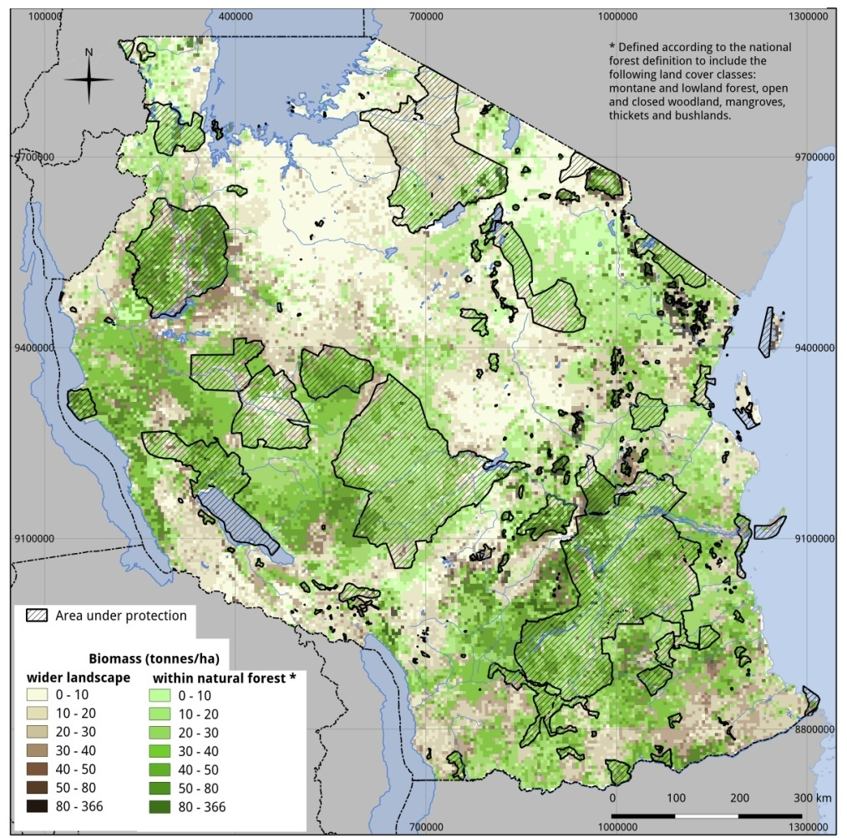
Where are high carbon values in the natural forest, and which parts are protected?
Map sources:
Natural forest: NAFORMA landuse landcover map 2010.
Biomass: NAFORMA woody biomass only. 5km preliminary dataset base on field data only.
Protected Areas and Forest Reserves: TFS and WDPA 2013.

Slide 32
Country case study 2: Democratic Republic of the Congo (DRC)

Slide 33
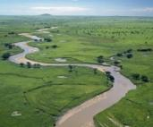
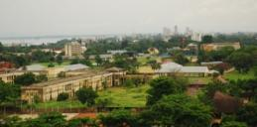
The DRC National Joint Programme
Supported by the UN-REDD Programme and the FCPF, DRC’s preparation plan for REDD+ was validated in March 2010
The DRC has committed to delivering “co-benefits” as part of this National Joint Programme, specifically through component 4(b) on multiple benefits of REDD+ and component 2(d) on social and environmental safeguards

Slide 34
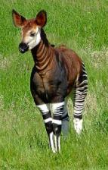
Biodiversity: legally protected species in the DRC
National context and priorities are important for identifying priority benefits that the DRC can enhance from REDD+
Legally protected species indicate conservation priorities for the DRC
UNEP-WCMC produced a map that highlights where the ranges of species overlap, and therefore where priority areas might be for REDD+ actions that conserve biodiversity.

Slide 35
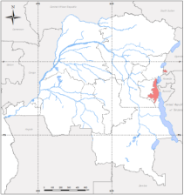
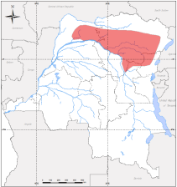
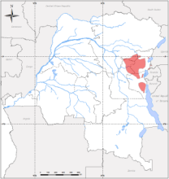
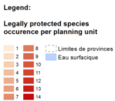
Biodiversity – Map of potential richness in fully protected species
Espece Protegee
Gorilla beringei
Espece Protegee
Okapia johnstoni
Pseudocalyptomena graueri
Espece Protegee

Slide 36
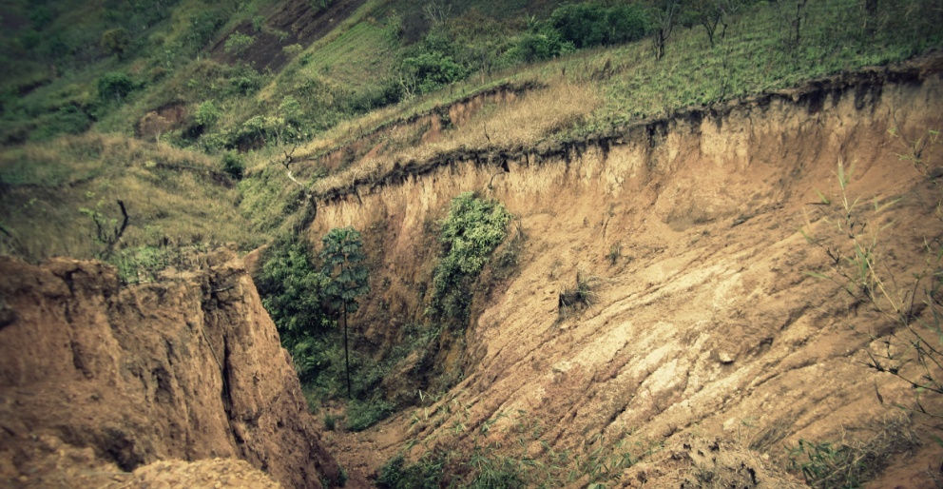
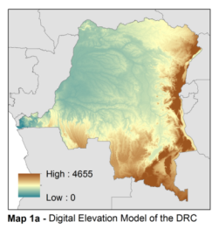
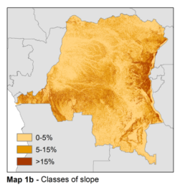
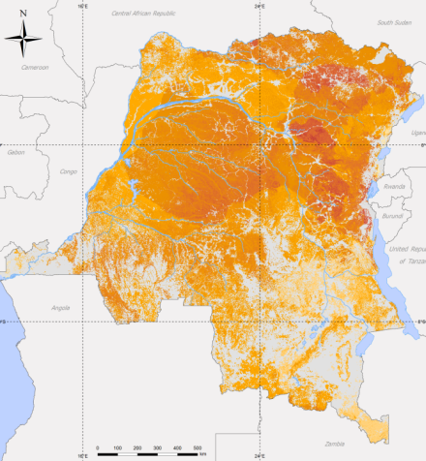
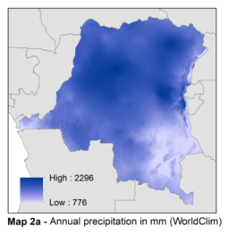
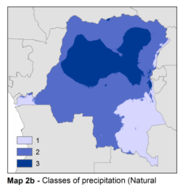
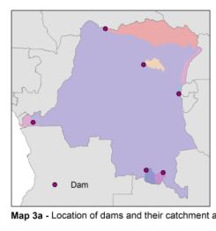
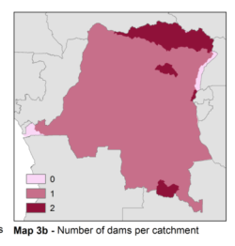
Ecosystem services: Importance of forest for reducing risk of soil erosion impacts on hydroelectric dams

Slide 37
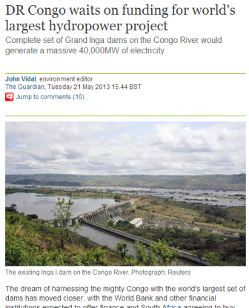
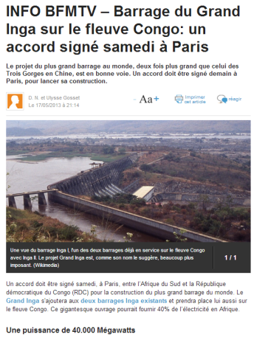
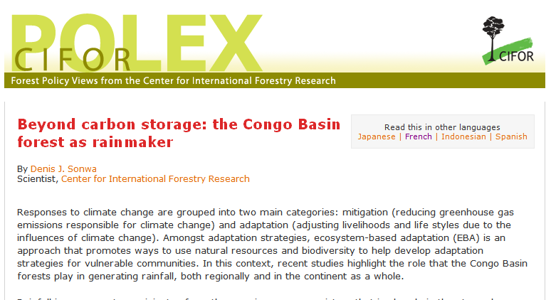
Importance of soil erosion control services for national development priorities
« le Gouvernement compte lancer des mégaprojets d’Inga III et Grand Inga ainsi que d’autres projets d’aménagement des 213 sites hydroélectriques déjà identifiés. »
Document de la Stratégie de Croissance et de Réduction de la Pauvreté

Slide 38
6. Conclusions
REDD+ has the potential to result in multiple benefits beyond carbon
Multiple benefits are not a guaranteed outcome (depends on how implemented) – there is also a risk of negative impacts
Safeguards require (or encourage) enhancing the benefits and protecting against risks associated with REDD+
Mapping can be an effective tool for countries’ REDD+ planning, and can help to identify areas of both high opportunity and high risk for biodiversity conservation and other benefits

Slide 39
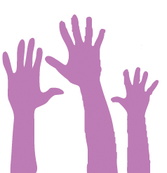
REDD+ and biodiversity
Questions?
Please submit them on the panel to the right.

Slide 40
Additional WWF REDD+ Resources
WWF REDD+ Learning Sessions – Archive of this and other sessions: bit.ly/REDDlearning
REDD+ Resource Digest – Free, weekly email round-up up international REDD+ news and information from varying sources and perspectives around the globe. Subscribe at: bit.ly/REDDinfo
CANOPY – Free, quarterly e-newsletter from WWF's global Forest and Climate Initiative, keeps you up to date on WWF REDD+ news and information. Subscribe at: bit.ly/REDDinfo
REDD+ Five Guiding Principles – Available at: bit.ly/REDDFIVE
WWF REDD+ – More info at: www.panda.org/forestclimate

Slide 41
Stay Connected…
Twitter - @WWFforestcarbon
Web - www.panda.org/forestclimate
Email contact - forestclimate@wwf.panda.org

Slide 42
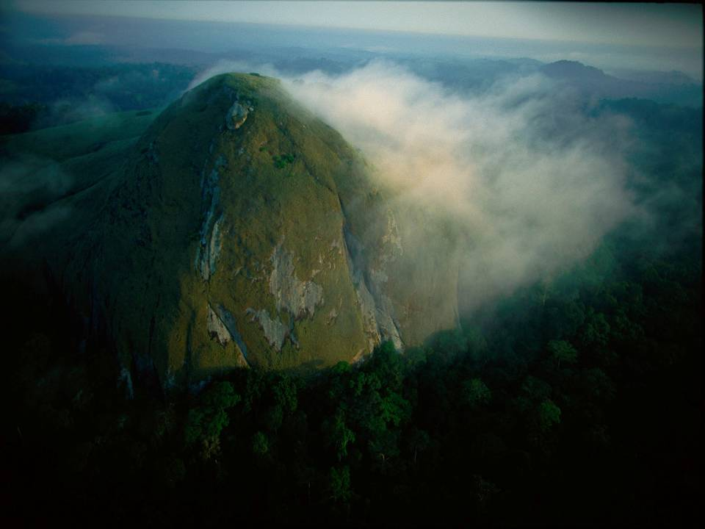
Thank you
panda.org/forestclimate

