Slide 1
Preliminary recommendations, tools and actions Combined Highlights from Kathmandu and Bangkok meetings
Estelle Fach
21 October 2011

Slide 2
Risks examined in details in the Bangkok workshop (so far)
Bribery of public officials to register fraudulent carbon rights over particular parcels of land
Corruption that results in weak REDD+ safeguards
Undue influence to link carbon rights to State ownership of forests – thus excluding customary tenure
Artificially inflating the baseline in order to increase the emissions reductions
Undue influence and bribery to create fraudulent licenses, land titles or carbon rights
Undue influence and bribery to ignore breaches of REDD+ regulations
Fraud related to the distribution of benefits from REDD+ revenues

Slide 3
Address phase 1 risks
Address phase 2 risks
Address phase 3 risks
Phase 1
Phase 2
Phase 3
Assess and prepare for phase 2 and 3 risks
Assess and prepare for phase 3 risks
Some risks are a continuum !

Slide 4
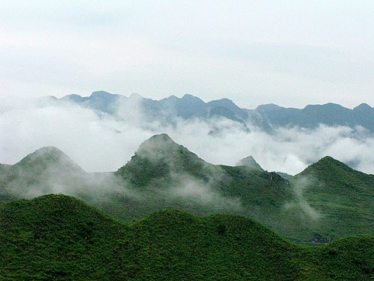
Phase 1 risks
Risks | Specific actions | Enabling framework
1. Corruption that results in weak REDD+ safeguards | Participatory and transparent agenda-setting process Documented decision- making based on publicly available data -Examine salary and enforcement incentives for local forestry officials (in preparation for phase 3) | -Develop national system of safeguards, using lessons from CCBA, voluntary carbon initiatives, UN-REDD, WB, etc – within holistic system Capacity building for local forestry officials on and local communities what the safeguards are, how to ensure they are applied Legal and policy framework and actual implementation National safeguards monitoring system

Slide 5
Risk | Specific actions | Enabling framework
2. Powerful elites exert link carbon rights to State ownership of forests – thus excluding customary tenure | Training judges/courts on land tenure, especially on REDD+ cases. FPIC policy could mitigate the collusion of interest; need to consult with customary owners on decisions regarding carbon rights lowering the risk of customary tenure being excluded Transparency on contract licensing; publish information on website/newspapers on licenses given via public bidding processes | Law should address elite capture within IP groups. Existing laws and protection of customary rights

Slide 6
Phase 2 risks
 | Specific actions | Enabling frameworks
1. Bribery of public officials to register fraudulent carbon rights over particular parcels of land | Strengthening media (including independence); Strengthen religious leaders’ roles; Process to establish bottom-up reporting and monitoring Separation of land management and land allocation functions Improved access to information (e.g. detailed registries available), including budget figures | Need national REDD+ policy (Prime Ministerial approval) Organic process to increase oversight over land Unambiguous regulatory framework National land-use planning Build local government capacity; also of local communities; | Cross-sectoral bodies at high level to improve coordination and reduce ambiguities (e.g. REDD+ Task Force in Indonesia)

Slide 7
Phase 2 risks
 | Specific actions | Enabling frameworks
2. Artificially inflating the baseline in order to increase the emissions reductions | -National Baselines to be undertaken with technical agencies but validated independently and subjected to consultations -capacity and oversight of members of parliament (implementation risk Political-disagreements between governments and other actors) | -Part of the establishment of inventory system (with support from FAO)

Slide 8
Phase 2 risks
Risk | Specific actions | Enabling frameworks
Undue influence and bribery to create fraudulent licenses, land titles or carbon rights | Capacity building for marginalised people/ victims as well as local/community officials on rights and remedies and on the use of a complaints mechanism | Clarity on definition of forests
 | Need to audit compliance on how to obtain permit according to regulations

Slide 9
Phase 3 risks
1. Fraud related to the distribution of benefits from REDD+ revenues | Specific actions | Enabling measures
Not having clear rights holders identified (phase 1) →capture | Careful development of criteria for beneficiaries Meetings with the beneficiaries to share full information on the BDS | Transparent and participatory decision-making
Corrupt processes/systems of distribution | Publish the names of the beneficiaries and what they receive (e.g., money, incentives social services) – Transparency portals in “citizen language) on projects and payments Periodic public accounting to report financial status Public expenditure tracking Community monitoring of budget/ benefit distribution | Decentralized systems Multi-stakeholder governance structure which includes councils at the regional level Community AND 3rd party monitoring of benefit distribution Capacity building of IPs and local communities Strengthened record keeping and accounts

Slide 10
Risk | Specific actions | Enabling framework
2. Undue influence and bribery to ignore breaches of REDD+ regulations | Provide legal aid Establishment/Improvements to whistle-blower protection measures (include for support actors) Knowledge of system (authorities and people); Access to system(language) Feedback / Hotline and action on complaints Support to strengthened law-enforcement and judiciary system Subsidized legal support and protection; no trust of court; Establish a centralized and accessible clearing house/database | Awareness raising / capacity development about regulations and crimes for judiciary and communities Unambiguous laws (which law to prosecute under?)

Slide 11
Transversal points
Preliminary actions
Corruption risk assessments / analysis of actors / integrity assessments
Overarching measures
Transparency/access to information through establishing information management system clear accountability mechanisms
Role of watchdogs (civil society and media) with whistleblower protection mechanism
Setting up accessible recourse/complaints mechanisms

Slide 12
Transversal themes
Many actors, many roles
Local and indigenous communities (including women)
Local governments and bureaucracy
Media *
Law enforcement (inc. transboundary)
National government
Anti-corruption commissions
Parliaments *
International NGOs
Justice sector *
Development partners
Challenges
Remoteness
Time
Capacity
Political-disagreements between governments and other actors (e.g. baseline setting)
…But
In many countries enabling or correcting laws and policies exist – need clarity, coherence and cross – sectoral application/enforcement

Slide 13
All information about this meeting (presentations, materials, outcomes) will be online on the UN-REDD Workspace at www.unredd.net under Global/Transparent, Equitable, Accountable management of REDD+ Funds
Not a member yet ? Lost your password?
Contact admin@unredd.net

