Slide 1
UN-REDD Targeted Support to Nepal
Kathmandu, Nepal
Date: 8 October 2013
Estelle Fach
Global Advisor, Governance and Accountability
UN-REDD/UNDP

Slide 2
What is the UN-REDD Programme?
Established in 2008 by the FAO, UNDP and UNEP
A response to Bali Action Plan call for REDD+ instrument in post-2012 climate change agreement
Supports development and implementation of country-led REDD+ strategies
49 partner countries across Africa, Arab, Asia-Pacific and Latin America and the Caribbean regions
16 partner countries allocated resources for National Programmes
Covers 34% of the World’s forest and 56% of the World tropical forest
US$167 million: Norway, Denmark, Spain, Japan, EU and Luxemburg
UN-REDD coordinates with FCPF (harmonized approaches) and others including REDD+ SES (safeguards)

Slide 3
How does UN-REDD support countries?
Two modalities of support by UN-REDD:
National Programmes - through which UN-REDD supports countries’ efforts to prepare and implement comprehensive national REDD+ strategies
Targeted Support (TS) - through which specific small-scale and technical support is provided on :
Measurement, reporting and verification (MRV) and monitoring
Engagement of Indigenous Peoples, civil society and other stakeholders
National REDD+ governance (participatory assessments, land tenure, anti-corruption, gender, etc)
National Fund management systems and equitable benefit sharing systems
Safeguards and Multiple benefits
Sectoral transformation
TS is demand-driven and requested by UN-REDD partner countries, and should represent additional and specific contribution to national REDD+ efforts with a view to fill gaps or to leverage other activities.

Slide 4
Support to Nepal
Discussions initiated with REDD+ Cell in March 2012
Scoping missing by UN-REDD in August 2012
- Assessment of FCPF and other partners plans and activities
- Discussions with REDD+ stakeholders relevant for the requested areas
REDD Cell and UN-REDD agreed on two focused objectives of the Targeted Support:
Increased effectiveness of the National REDD+ Strategy in addressing drivers and causes of deforestation and forest degradation; and
Increased understanding by the Government of Nepal of potential options for effective, equitable and transparent management of REDD+ finance.
Forest Action was selected through a competitive process to help deliver them
Inception workshop in March 2013

Slide 5
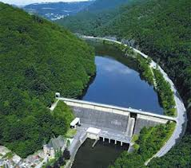
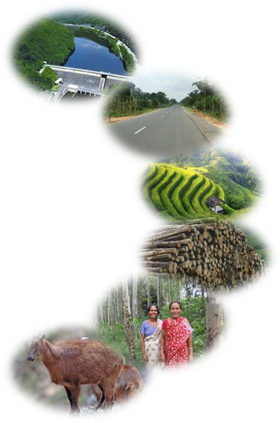
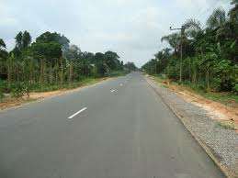
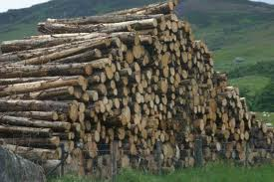
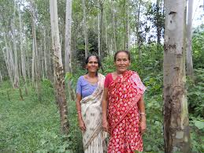
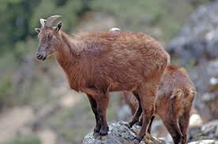
How do these studies contribute to Nepal’s REDD+ Process?
Reference Emission Level
REDD+ Activities
MRV
Positive Incentives
Social and Environmental Safeguards
Reduce Deforestation
+/-
Reduce Forest
Degradation
+/-
Policies & Measures
Results Rewarded
Nat’l
Manage REDD+ Finance
Assess past, present and future trends in forest cover and land use change
Conserve Forests
UNFCCC
Nat’l REDD+ Strategy
+/-
Sustainably Manage Forests
+/-
Enhance Forests
+
National Coordination and Institutional Arrangements (REDD Cell)
Notes:
Five activities are eligible under the REDD+ in developing countries:
Countries can focus on activity/ies most relevant to their national circumstances
National level (sub-national only as a temporary measure)

Slide 6
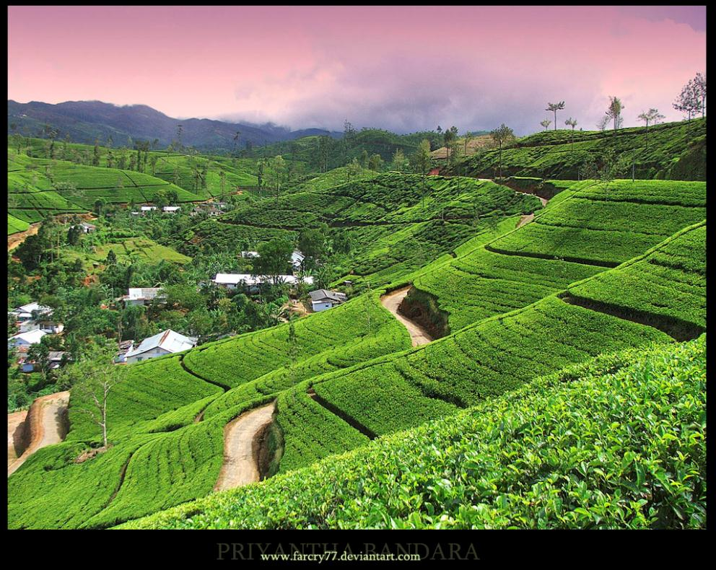
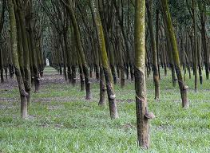
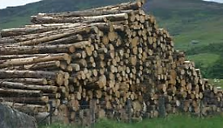
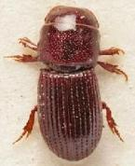
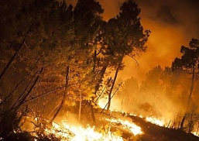
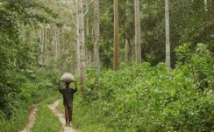
Assess drivers at policy, institutional and local levels
Understanding key drivers and underlying causes and selecting REDD+ Activities
Analyze causes/barriers
(systemic , institutional ,individual, economic and political)
Identify priority reforms and interventions
Priority F. Degradation Drivers (impact*extent)
Identify key stakeholders and assess interest and influence levels for supporting or blocking such reforms and interventions
Priority Deforestation Drivers
(impact*extent)
Identify capacity needs and develop & implement capacity development programs
Establish and implement REDD+ Polices and Measures (select REDD+ activities)
Enhance Forests
Sustainably Manage Forests
Conserve Forests
Reduce Forest
Degradation
Reduce Deforestation

Slide 7
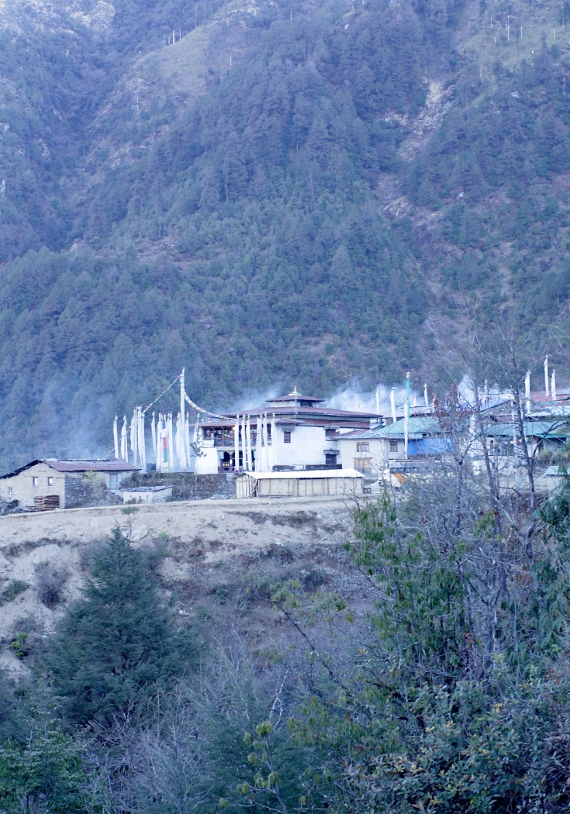
Integrity Risks and Opportunities
D&D study : Governance issues, including transparency and accountability, as facilitating or allowing certain drivers
REDD+ financing study : corruption, & mismanagement risks ; and transparency, equity and integrity opportunities used as criteria in examining different fund management options

Slide 8
Estelle Fach
Global Advisor, Governance and accountability
UN-REDD
estelle.fach@undp.org
Aki Kono
Regional Technical Advisor
UN-REDD
Akihito.kono@undp.org
Berta Pesti
Global Advisor
National Fund Management
UN-REDD
Berta.pesti@undp.org
THANK YOU
Website: http://www.un-redd.org

