Slide 1
Social Safeguards: Protecting the Rights and Interests of Indigenous Peoples and Forest-Dependent Communities in REDD+
Introductory remarks
Dr. John Parrotta
Coordinator, Task Force on Traditional Forest Knowledge, International Union of Forest Research Organizations
U.S. Forest Service ~ Washington DC (USA)
jparrotta@fs.fed.us

Slide 2
IUFRO Task Force on Traditional Forest Knowledge
Principal topics explored:
What is traditional forest-related knowledge: common features and variations across regions and cultures
Importance to culture, livelihoods, biodiversity conservation & food security
History of its interaction with external influences, including forest science and management
Threats to preservation of traditional knowledge
Opportunities for mutually beneficial interactions between TK and forest science
Relevance to current forest and related environmental policy discourses
http://www.iufro.org/science/task-forces/traditional-forest-knowledge

Slide 3
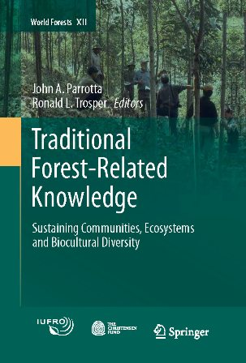
IUFRO Task Force on Traditional Forest Knowledge: 2005-2011
Regional Conferences:
Florence, Italy (June 2006)
Green Bay, Wisconsin (June 2007)
Kunming, China (December 2007)
Accra, Ghana (October 2008)
Bishkek, Kyrgyzstan (June 2009)
Seoul, Korea (IUFRO World Congress, August 2010)
Publications:
Conference proceedings and scientific journal articles
“State-of-knowledge” synthesis publication (with support from the Christensen Fund)

Slide 4
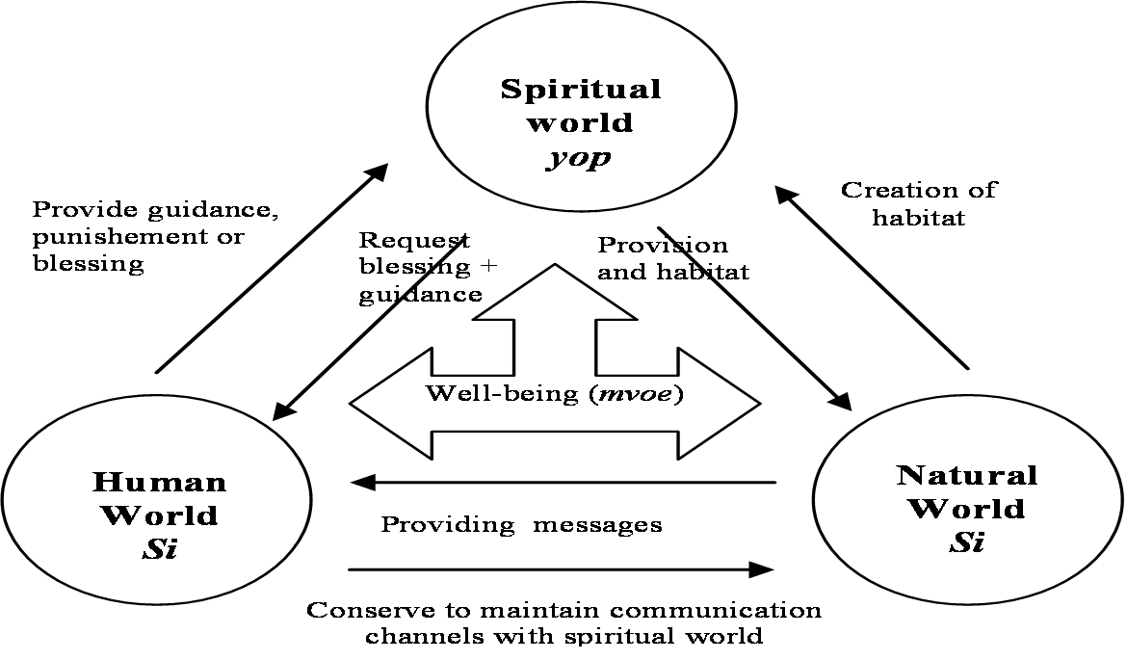
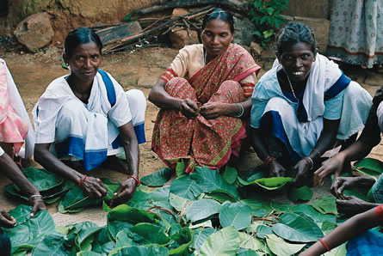
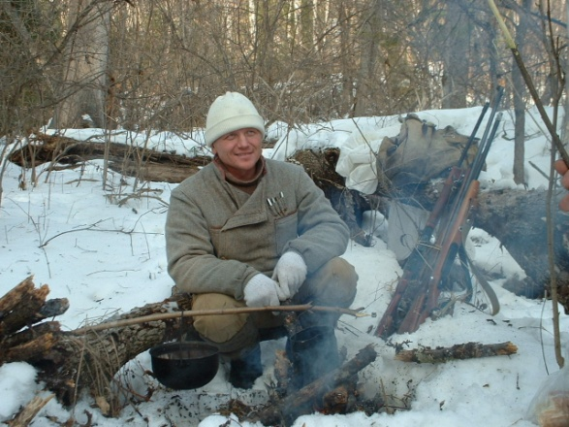
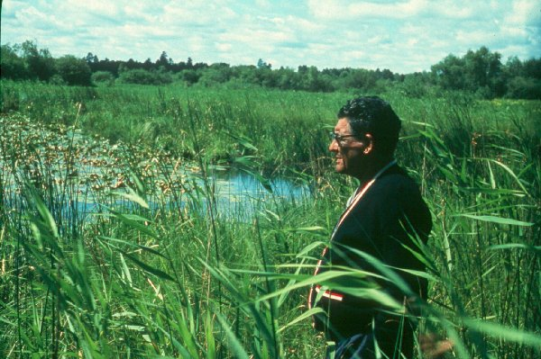
Unique features of traditional forest-related knowledge
Sustainability: the goal - maintaining the sustainability of the system.
Relationships: peoples’ connections among themselves and to their territory are not severed by the use of new knowledge, ideas or techniques.
Identity: people maintain their distinct identities.
Reciprocity: people maintain their system of benefit sharing among themselves, and
Limits on exchange: while people may engage in market exchange of products from the land, the fundamental productivity of the system itself is not viewed as capital to be exchanged.

Slide 5
Traditional forest knowledge and practices relevant to climate change adaptation and mitigation
Monitoring environmental change:
Long-term observations of climate and weather forecasting based on plant and animal species distributions, phenologies, migration patterns ….
Traditional agro-forest landscape management:
High energy-use efficiency of many traditional agro-forest management systems relative to high-input agriculture
Adaptation of traditional forest and agriculture management to low and/or uncertain rainfall regimes
Fire ecology and fire management
Universally used in traditional shifting cultivation systems worldwide
Widely used in forest and woodlands ecosystems to aid hunting, promote growth and quality of desired species, to reduce fuel loads, and increase water yield at springs

Slide 6
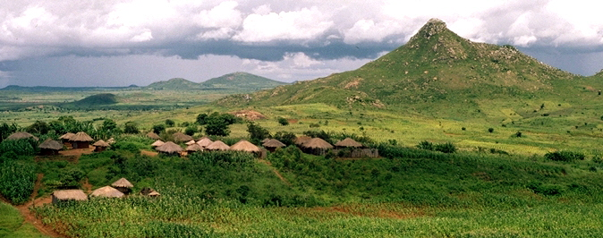
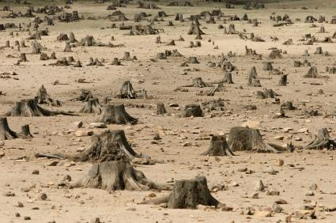
Achieving climate change mitigation and environmental/social co-benefits through REDD/REDD+ Understanding deforestation and forest degradation
Will funding promised through REDD programs help to overcome the obstacles that have severely hampered efforts to reduce forest loss and degradation over the past century? Is money the limiting factor?
Probably not. The underlying causes of deforestation in tropical and subtropical countries have political, economic, environmental and social dimensions that extend well beyond the forest sector: poverty; population growth; scarcity of land and other natural resources; human rights; governance issues; sectoral policies (finance, energy, transportation, agriculture, etc...).

Slide 7
Current REDD/REDD+ concerns of indigenous peoples and local communities are largely substantiated by a critical evaluation of past experiences
Need for clearly defined, well-established and enforced land & property rights (Q2: Forest and Land Tenure)
Recognition of, and respect for, human rights and the role of traditional forest knowledge, management systems, customary law and traditional governance institutions (Q3: Traditional forest management & use).
Concern that by putting a monetary value on forests, the spiritual, cultural, and values they hold for indigenous peoples and local communities will be neglected (Q4: Commodification of Nature).
Full and effective participation of indigenous peoples and forest-dependent communities in the design, implementation, and monitoring of REDD activities.
Accountability, particularly under conditions of poor governance, and the fair and equitable distribution of REDD benefits.

Slide 8
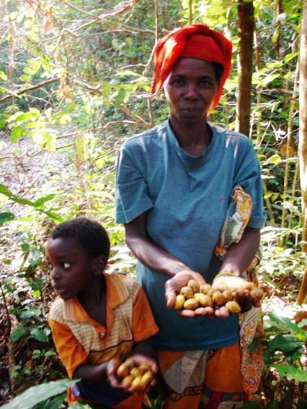
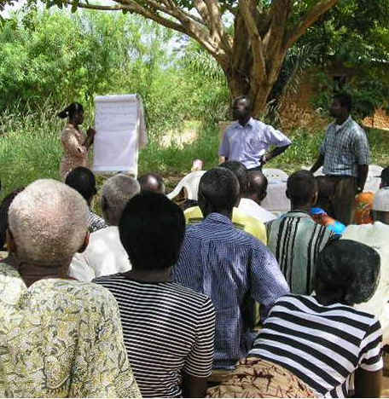
Conclusions
Traditional forest-related knowledge and practices have sustained extensive areas of forests, biodiversity, a variety of ecosystem services, and the rich cultures and livelihoods of local and indigenous communities worldwide.
Traditional knowledge and practices and associated social institutions are an important component of the social capital of traditional societies with important applications for forest biodiversity conservation, as well as climate change monitoring, mitigation and adaptation.

Slide 9
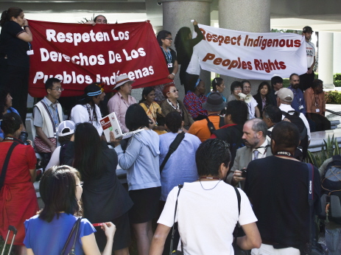
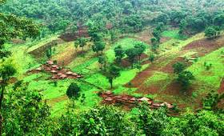
Conclusions
Persistent failure to address underlying causes of deforestation and forest degradation, and fundamental issues related to the rights and interests of local and (especially) indigenous peoples have hindered past efforts to slow deforestation and forest degradation, and to promote conservation and sustainable use of forest resources.
The sustainability of REDD/REDD+ initiatives – their capacity to deliver climate change mitigation and hoped-for co-benefits - will depend on our ability to address these issues effectively.

Slide 10
Thank you !

