Slide 1
Pilot Participatory Governance Assessment (PGA) Methodology
The Pilot PGA Team:
Dr David Oladipo (Lead Consultant)
Odigha Odigha
Prof F. Bisong
Dr Elizabeth Andrew-Essien
Dr Joy Atu
Dr Pauline Essoka
Omini Oden
Tony Atah
Richard Ingwe
Lillian Oyama
Asuquo Edet
Presented by: Sylvanus Abua

Slide 2
Team Composition
The PGA team had members from a wide range of backgrounds covering, education, development, as well the social and environmental sciences.
Team members represent key stakeholders including the Climate Change Working Group at the University of Calabar and civil society organisations (CSOs).
The team was expanded to include staff of Cross River State Forestry Commission
The team had four sub-teams, with a minimum of two members addressing each of the sub-themes.
Pairing up of team members ensured gender balance as well as interest in, and familiarity with the different subject matters.

Slide 3
Sampling Technique
Given that the PGA was designed to involve stakeholders from the three pilot communities, the study communities were preselected.
At the community level, the team engaged a wide range of stakeholders, including village authorities, resource user groups and community groups including men, women and youth.
Working with community leaders, the team encouraged interested community members to take part in the PGA exercise voluntarily

Slide 4
Data Collection Tools
Data collection was based on predesigned templates covering the following sub-topics:
  Governance risks and safeguards
  Stakeholders analysis
  Private sector-related drivers of deforestation and
  Existing communication system

Slide 5
Preparation and Planning
A series of preparatory meetings were held in Calabar at Forestry Commission Office
Prior to fieldwork, CRSFC staff conducted community sensitisation across the 3 pilot communities for REDD+.
During sensitisation, CRSFC staff provided information on purpose of the study and agreed schedule of FGD meetings with community leaders, men, women and youth.

Slide 6
Fieldwork
Data collection in the study communities spanned a total of 7 days, with intermittent schedule beginning on 20th November and ending on 30th November 2012.
In addition to the field trips, the team spent some 3 days reviewing the literature and gathering data from state-level stakeholders outside the pilot communities.
Fieldwork was carried out as scheduled below:
Study community | LGA | Fieldwork Duration
Esuk Mbah | Akpabuyo LGA | 20th to 21st November 2012
Iko Esai | Akamkpa LGA | 24th to 25th November 2012
Baunchor | Boki LGA | 28th to 30th November 2012

Slide 7
Specific Methods and Approach
Document Review
Key Stakeholder Related Documents
Newspaper
Focused Group Discussion (FGD) and In-depth Interviews
Local Stakeholders
Stakeholders’ Survey
Policy Makers at the State Level
Media Review

Slide 8
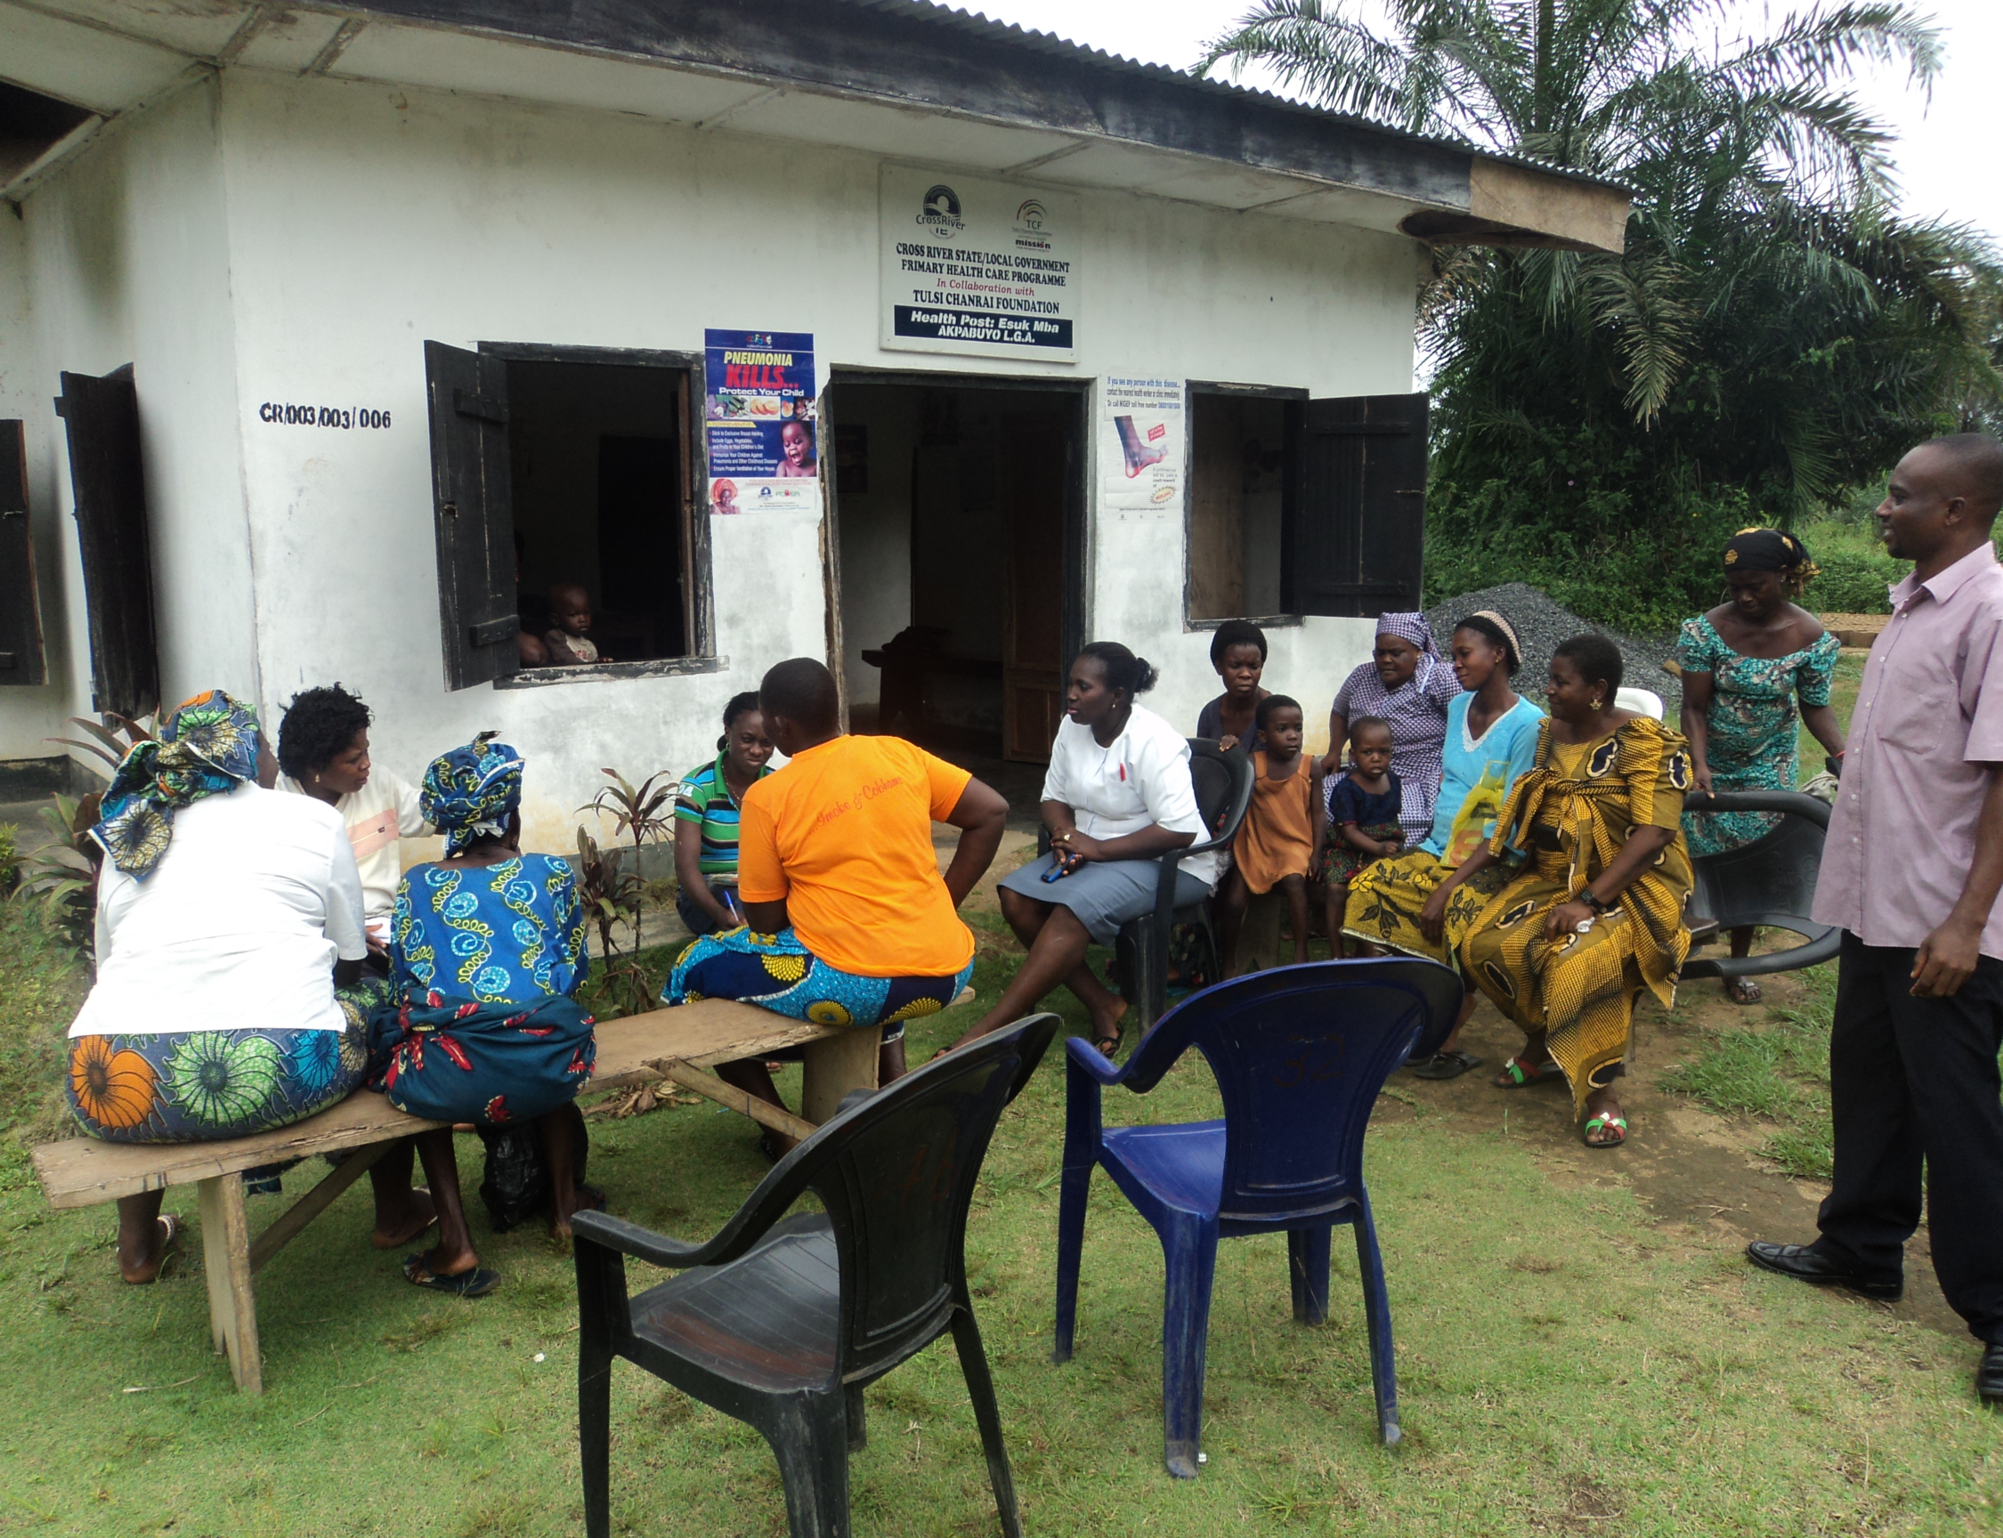

Slide 9
Stakeholder Analysis

