Slide 1
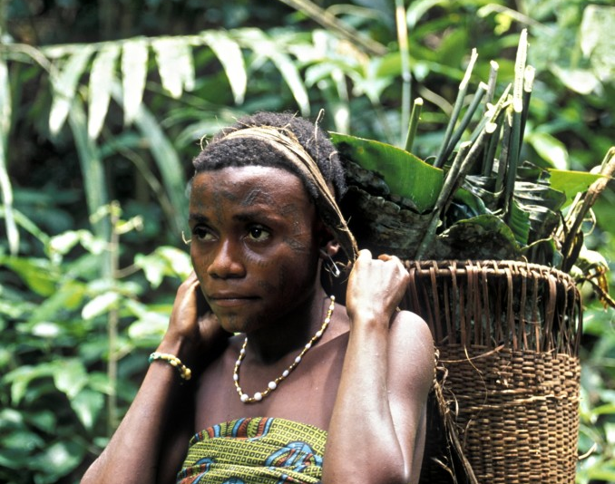
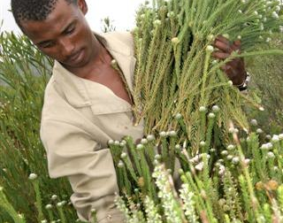
Community Engagement and Grievance Mechanisms in the Context of REDD+
Jennifer Laughlin, UNDP/UN-REDD Programme
15 May 2014

Slide 2
Outline
Framework for Community Engagement: Risks, Benefits & Cancun Safeguards
Challenges, Lessons, Key Considerations
FPIC: A Tool for Engagement
Grievance Mechanisms: Lessons and Recommendations

Slide 3
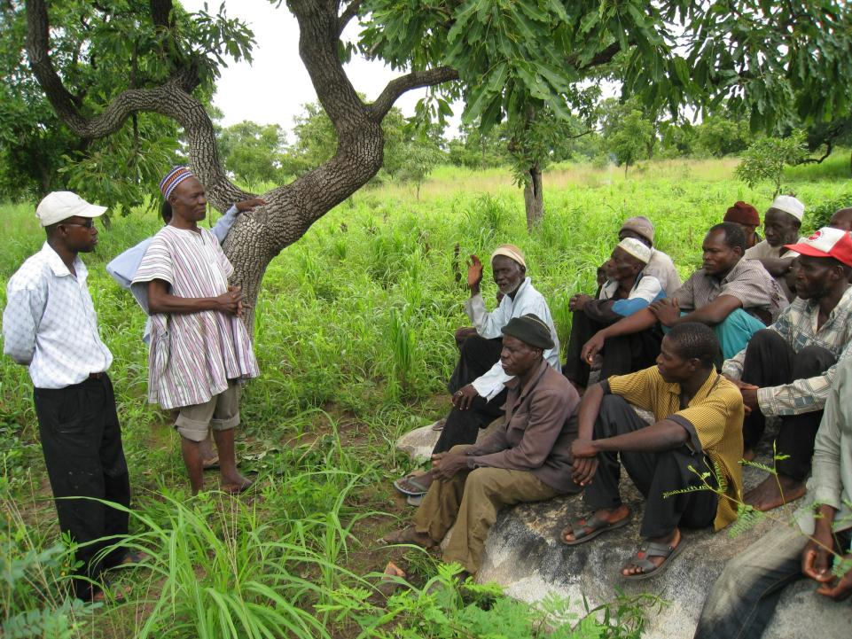
Framework for Community Engagement

Slide 4
Rationale
Rights to lands, territories, resources
(legal obligation)
Contribute to REDD+ activities
(TK, traditional practices, participatory monitoring)
Interest in maintaining the forests
(survival, livelihoods)
Interest in REDD+ incentives
(payments, rights, livelihoods, services)

Slide 5
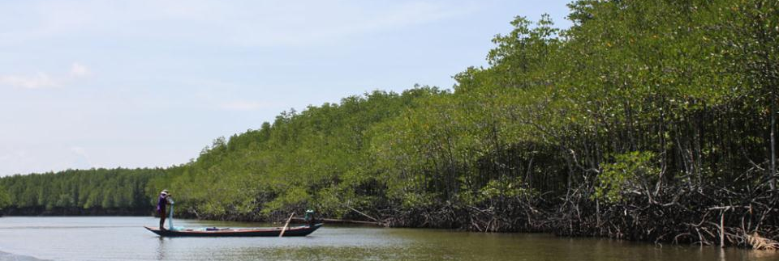
Opportunities from Authentic Engagement
Clarified resource rights
Strengthened traditional livelihoods & generation of additional resources;
Renewed push for good forest/ environmental governance & enforcement
Protection of IP/community territories and diverse forest cultures
Increased community voice, participation in decision making
More sustainable REDD+ implementation through collaborative partnerships
Notes:
REDD+ is a rare proposition in that it has the potential for gains/benefits beyond emissions reductions - for governments, communities, forests, biodiversity and other ecosystem services.
REDD+ is unique in the opportunities it could provide in the context of national governance, participation and consensus building processes.
Although REDD+ can be a divisive issue among communities, and though many communities are weary of what REDD+ may mean in their countries and how it may impact them …
We know that one of the key reasons IPs/communities are engaged in REDD+ is because they see that if done in a truly participatory manner, REDD+ has the potential to bring about gains/benefits for IPs and FDCs on a greater scale than has been possible in the recent past.
Some of the opportunities include …

Slide 6
Broader Trend
New Dynamic: Gov, IP, CSOs and others
REDD+ is Enabling Authentic Dialogue, Open Space
Notes:
On the whole, we see as that national REDD+ processes are beginning to enable authentic dialogue.
SE has begun to open and expand a safer space for dialogue and progress among governments, IP/CSOs, and others on complex issues that go beyond REDD+ (e.g. like rights, tenure)

Slide 7
Risks of Inadequate Engagement
Exclusion of indigenous peoples / FDCs from decision-making
Renewed / increased state and “expert” control over forests
Violations of land and resource rights
Inequitable community contracts / benefit-sharing
Land speculation, land grabbing and land conflicts
Elite capture of international funds
Potential conflicts among indigenous communities
Notes:
That being said, we also know that REDD+ still comes with risks. Because of what REDD+ may involve in some countries, and given past experiences related to e.g. large-scale infrastructure projects, projects related to extractive industries and other projects that have significant land-use implications, IPs and FDCs often express fears that REDD+ implementation could lead to:
Risks
Exclusion of indigenous peoples from decision-making due to highly centralized, top-down management of forests.
Renewed and even increased state and “expert” control over forests.
Violations of land and resource rights, particularly forests rights.
Unequal community contracts / benefit sharing agreements
Land speculation, land grabbing and land conflicts: competing claims on REDD compensation, contested claims over forests and between recipient and non-recipient of REDD funds.
Elite Capture of International Funds
Potential conflicts among indigenous communities

Slide 8
The Cancun Agreement (COP16, 2010) Cancun Safeguards
a. Policy alignment (nat’l & int’l)
g. Leakage
b. Forest governance (transparency & effectiveness)
Cancun Safeguards
f. Permanence
c. Knowledge and rights of indigenous peoples &local communities
e. Natural forest, biodiversity, social & environmental benefits
d. Full and effective participation of stakeholders, in particular IP & local communities
Notes:
This balance between opportunities and risks has been recognized globally and is reflected in the UNFCCC decisions outlining the 7 core safeguard considerations countries must address and respect in REDD+ implementation. Three of the safeguards – b, c and d focus on the social risks and benefits that need to considered. C and D focus on ensuring:
C. Respect for the knowledge and rights of indigenous peoples and members of local communities, by taking into account relevant international obligations, national circumstances and laws, and noting that the United Nations General Assembly has adopted the United Nations Declaration on the Rights of Indigenous Peoples;
D. The full and effective participation of relevant stakeholders, in particular indigenous peoples and local communities, in the actions referred to in paragraphs 70 and 72 of this decision;
Objectives of national forest programmes and relevant international conventions and agreements
Transparent and effective national forest governance structures
Respect for the knowledge and rights of indigenous peoples and members of local communities
Full and effective participation of relevant stakeholders
Conservation of natural forests and biological diversity
not used for conversion of natural forests
protection and conservation of natural forests and their ecosystem services,
Enhance other social and environmental benefits

Slide 9
Relevant Issues at Stake: Cancun Safeguards
b. Forest governance (transparency & effectiveness)
Transparency & access to information
Rule of law & access to justice and effective remedies
Systems for feedback, oversight and accountability
----------------------------------------------------------
Rights to land, territories and resources
Involuntary resettlement
Full and effective participation
Legitimacy/accountability of representative bodies
Free, Prior & Informed Consent (FPIC)
Traditional knowledge & cultural heritage
Grievance mechanisms
c. Knowledge and rights of indigenous peoples &local communities
d. Full and effective participation of stakeholders, in particular IP & local communities
Notes:
Issues relevant to the Cancun Safeguards: B, C and D (social focus) – as elaborated e.g. through the UN-REDD SEPC, the WB safeguards, REDD+ SES, national approaches, and various others.

Slide 10
Framework for Engagement
Entry Points
Consultation and Participation Plans (R-PP)
Representation on the REDD+ Steering Committee
Strengthening existing/traditional platforms for engagement and representation
Build capacity for self-selection processes
Set aside funds for IP/CSOs to design and manage their own activities
Strategic Environmental and Social Assessment (SESA)
Joint land use planning and territory demarcation
Tools
Stakeholder Mapping and Analysis
Guidance on SE, FPIC and Grievance Mechanisms
Safeguard approaches and Benefits and Risks Tool (BERT)

Slide 11
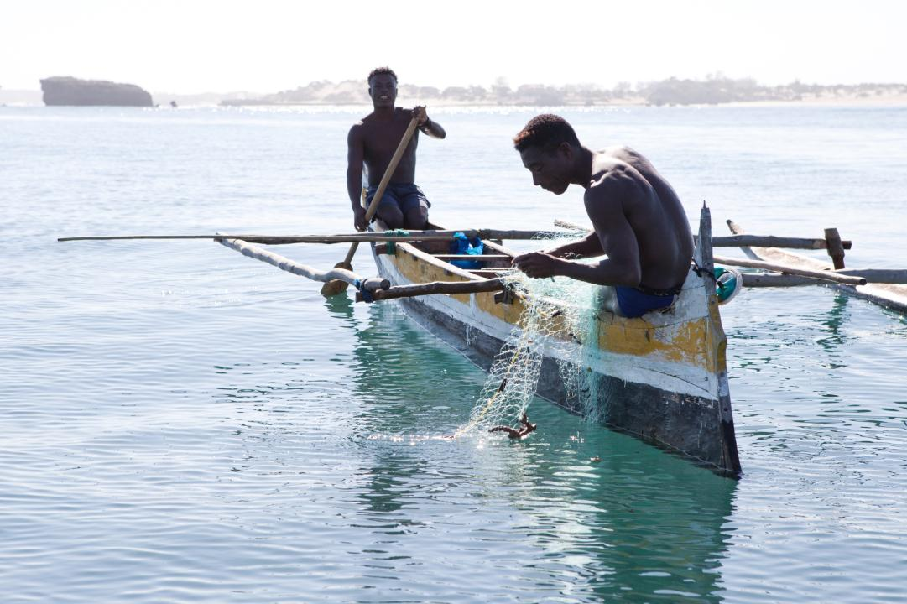
Community Engagement in REDD+
Entry Points
Participation & representation in REDD+ decision making bodies
Consultation and Engagement Plans (R-PP)
Multi-stakeholder participation platforms
Capacity building for and strengthening of existing/traditional representation structures
Strategic Environmental and Social Assessment (SESA)
Tools
Stakeholder Mapping and Analysis
Guidance on Stakeholder Engagement, FPIC and Grievance Mechanisms
Safeguard Approaches, including Benefits and Risk Tool (BERT)
Experiences and lessons of other countries
Challenges, Lessons and Key Considerations

Slide 12
Challenges
A lot has been achieved, but still a way to go…
Key Challenges
Awareness Raising and Outreach
Consultation
Representation
Notes:
A lot has been achieved, but still a way to go
Improvements in IP participation in REDD+ decision making and rights
BUT significant barriers remain which are preventing the full and effective participation of IP in the full spectrum of REDD+ decisions
Awareness Raising and Outreach
Very little awareness about REDD+ and its possible implications to indigenous peoples that hinders full and effective an engagement along with government and other REDD+ actors
Information provided are not in a language and form understood by the community and is insufficient
Consultation
There was no prior information on the consultations conducted for the IPs to be able to understand fully what the topics is all about
Decision making are being done without conducting any consultation with the communities
IPs lack sufficient capacity to engage fully and effectively in consultation
Consultations are not tailored to needs/circumstances of IPs/communities
Representation
Lack of proper structure and mechanism to ensure representation in the national and at local level
No recognition to customary institution of selecting representatives of indigenous peoples
No self-selected representation
No representation of customary rights holders

Slide 13
Paraguay’s Inclusive REDD+
Governance Arrangements
The Federation for the Self-Determination of Indigenous Peoples (FAPI) in Paraguay, an equal partner of the UN-REDD NP process from the beginning
Dedicated chapter on indigenous peoples’ participation for the NP
FAPI’s President is a member of the NP Political Committee, FAPI also participates in the NP Technical Team
FAPI helps to inform other communities about REDD+
Indigenous peoples’ contributions have led to important new developments to strengthen REDD+ in the country.
For instance, IP’s suggestion to map scared sites have been included in the country’s multiple benefits analysis, and ultimately in the REDD+ strategy.
Notes:
The Federation for the Self-Determination of Indigenous Peoples (FAPI) in Paraguay, an equal partner of the UN-REDD NP process from the beginning
Dedicated chapter on indigenous peoples’ participation for the NP
FAPI is an official signatory of the UN-REDD NP document.
FAPI’s President is a member of the NP Political Committee, FAPI also participates in the NP Technical Team
FAPI helps to inform other communities about REDD+
Indigenous peoples’ contributions have led to important new developments to strengthen REDD+ in the country.
For instance, IP’s suggestion to map scared sites will be included in the country’s multiple benefits analysis, and ultimately in the REDD+ strategy.

Slide 14
Cambodia’s IP Self-Selection Process
Self selection of representatives in 15 provinces
15 selected IPs attended Consultation Group National Workshop to elect among themselves for top 2 IP representatives, who will become the IP representatives on the Project Executive Board (equiv. to REDD+ Steering Committee)
Notes:
The selection of representatives for the Cambodia REDD+ Consultation Group is an important step in stakeholder coordination and for the development of a REDD+ Readiness process that is "inclusive and balanced, both between Government agencies and non-Government stakeholders". In order to establish the Consultation Group, the REDD+ Taskforce Secretariat began facilitating the selection process in November 2012. The process built in part upon the lessons from the experience selecting civil society and indigenous peoples’ representatives for the UN-REDD Programme Executive Board, which was initiated in May and completed in September 2012.
Selection at provincial level
Met with selected IP representatives from districts/communes, local authority and NGOs
Informed the objective of selection
Conducted awareness raising (play video clip on Introduction to REDD+ with Q & A)
Explained process and conduct election representative.
Recognition letter from provincial authority for the elected representative.
The Result:
The 15 selected IP from the 15 provinces attended CG National Workshop to elect among themselves for top 2 IP representatives and who will become IP representative in both CG and PEB.

Slide 15
Key Considerations
“Enabling conditions” for full and effective participation:
Trust and respect, and/or legal framework
National Stakeholder Mapping (= who is involved, affected, who agrees?)
Consultation guidelines, protocols (= set up rules to build trust and manage expectations)
Engage → the earlier the better
Clarification of the scope of participation
Managing expectations - what REDD+ is about / not; avoiding consultation fatigue
Decisions: WHEN to discuss WHICH questions with WHOM and WHAT kind (information sharing, consultation, participation, etc.)?
Measuring the participation in REDD+ decisions
Representation and weight in committees
Operationalization of standards and guidelines: qualitative indicators, milestones
Notes:
Still a long way to go.
Last September, more than 100 Governments, IPs, NGOs, experts and practitioners met at a workshop hosted by FCPF, UNREDD and Gov. Germany to review the status of fulfilling the requirement of full and effective participation of IPs and FDCs.
The next slides summarize some of the challenges and key considerations in SE around the world.
Lessons:
Requires significant investment of time and finances (Build trust through transparency, accountability and allocation of adequate time for dialogue and decision-making )
Engaging – the earlier, the better
Key challenge has been identifying the right stakeholders and ensuring they are representative - Self-selection is key to legitimate representation. Scoping out and strengthening existing SE platforms thru their own representative bodies is critical.
Tied to the above, more local capacity building required upfront and throughout – so stakeholders can own their participation and engagement more fully. -- While using a diversity of methods for communicating, awareness raising and outreach. We’ve received feedback that we still aren’t reaching the more remote communities – enforcing marginalization.
Also tied to the above, Stakeholder mapping/analysis should be the basis for an engagement plan – so you know up front who the rights holders are, how they will be impacted and therefore who to engage with on which activities
Conflict doesn’t mean that REDD+ is not working – it can lead to breakthroughs (We shouldn’t be afraid of conflict – it’s a way of working things out. We’re opening up spaces for dialogue so that we can get into these key issues. Conflict is often an indication that we’re hitting the key issues in the country, and that can lead to breakthrough)
Tie SE to broader multi-stakeholder processes (Tying REDD+ to larger, multi-stakeholder processes, such as national development plans, and including under-represented groups is critical to the sustainability and legitimacy of consensus and consent)

Slide 16
Key Considerations
Representation Challenges
Lack of technical and negotiation skills
Lack of legitimacy of some indigenous representatives, especially of national organizations
Need to self-organize, if they desire to participate in REDD+
Need to build local capacity
Empowerment through FPIC:
FPIC should not be reduced to the 'veto' idea - FPIC (UNDRIP) is to be seen as embedded in broad-based participation and within a system of consultation, and is intended to ensure the rights of indigenous peoples are respected
“It‘s not about the money“:
Cultural values ​​and understanding of real concerns → land rights
Conflict isn’t all bad – It can signal a breakthrough.

Slide 17
Free, Prior and Informed Consent

Slide 18
Free, Prior and Informed Consent (FPIC)
Free
Prior
Informed
Consent
From coercion, intimidation or manipulation
Before any authorization or commencement of activities, with time for consideration
All relevant information to make a decision
A collective “Yes” or “No” through a decision-making process of choice
Notes:
Quick word about FPIC – because many REDD+ countries are interested in applying it and want to learn more about it.
Vietnam, DRC, PNG and Indonesia are some of the countries that have begun developing national or subnational guidelines on FPIC.
It has been discussed a lot and misunderstood as a concept I think.
FPIC should be seen as one of the many tools out there that can help ensure full and effective engagement with IPs and other FDCs. It is part of the broader consultation and engagement cycle and cannot be separated out from it.

Slide 19
Key Components of UN-REDD FPIC Guidelines
Normative Framework
Human rights based approach
Policy Framework
Partner Country responsibilities; Who; When
Operational Framework
How – at different levels
Elaborated in the Legal Companion to the Guidelines
Notes:
The UNREDD Programme has developed guidance on the key principles, approach out operational steps associated with FPIC. It is now for governments to consult with their stakeholders to determine the details in the country context.
Normative Framework – the history and basis for FPIC in international law, which is elaborated in the Legal Companion –
Policy Framework:
What is required of Partner Countries?
When is FPIC required?
What level is FPIC applied?
Who seeks consent?
Who gives consent?
What to do with outcome of the FPIC process?

Slide 20
FPIC: Operational Framework
FPIC Scoping
(could be done thru SESA)
FPIC Proposal
FPIC Process & Independent Evaluation
Proposed activity + impacts (could be done thru SESA)
Were principles and definitions of FPIC met?
Rights holders
How to engage
Status of land, territory or resource
Capacity needs
Facilitation
Timeline
Language
Decision making process
How to address grievances
How FPIC is provided
Method of verification
Notes:
The core steps to an FPIC process are outlined here.
But it is likely that e.g. most of the work in the FPIC scoping phase will have already been undertaken thru the SESA for example.
Basically it is just a more detailed and elaborate process of ensure engagement follows all the right steps and principles to ensure a successful outcome.
As I mentioned several countries are now in the process of piloting FPIC and developing guidelines – and we have begun to learn from these experiences. I can share more details with you after but today I’m not going to focus on these lessons.
In fact, many of the challenges and lessons that are arising are very similar to the ones I’ve already outlined above related to the general SE processes.
Partner countries, in collaboration with relevant rights-holders, and taking into account the duties and obligations under international law, will undertake an FPIC Scoping Review, including the following components:
A description of the proposed policy or activity;
A description of the rights-holders, their governance structures and how they wish to be engaged, including the institutions and individuals that are empowered to represent them;
A description of the legal status of the land, territory and resources concerned, including a description of the geographical area under formal, informal and/or customary use by the rights-holders (including whether women have access to formal, informal and/or customary use of lands and resources), including maps and methodology used to establish the maps;
An assessment of the social, environmental, and cultural impacts of the proposed policy/ activity on the rights-holders, including the specific impacts that have required the partner country to seek FPIC and how these impacts will be mitigated;
An assessment of the substantive rights of the peoples concerned, as affirmed in domestic and international law, that may be affected by the proposed policy/activity; and
Resources allocated for seeking FPIC.
Once the FPIC Scoping Review has been mutually agreed upon, the partner country, in consultation with the rights-holders, should develop an FPIC Proposal that outlines the proposed process to seek FPIC, including the following components:
Capacity and information needs of the National Implementing Partner and/or rights-holders that need to be addressed before the FPIC process can take place;
A designation of whether the process will require a facilitator, and if so, who it should be;
Where and how the consultations will take place;
A timeline for the proposed consultation process to seek FPIC;
The appropriate language and media for information sharing and distribution;
How decisions will be taken by the community in accordance with their traditions and customs, and whether special measures have to be adopted to ensure the participation of women and other vulnerable groups within the community;
The geographical territory and communities that the decision will cover;
How FPIC will be given, recognized and recorded;
The role of others in the process (if any), including local government officials, UN agencies, institutions, donors, independent observers (strongly recommended) and other stakeholders;
Methods of verifying the process, including, where relevant, participatory monitoring arrangements;
Terms and frequency of review of the agreement(s) to ensure that conditions are being upheld; and,
Process for voicing complaints and seeking recourse on the FPIC process and proposed policy or activity.

Slide 21
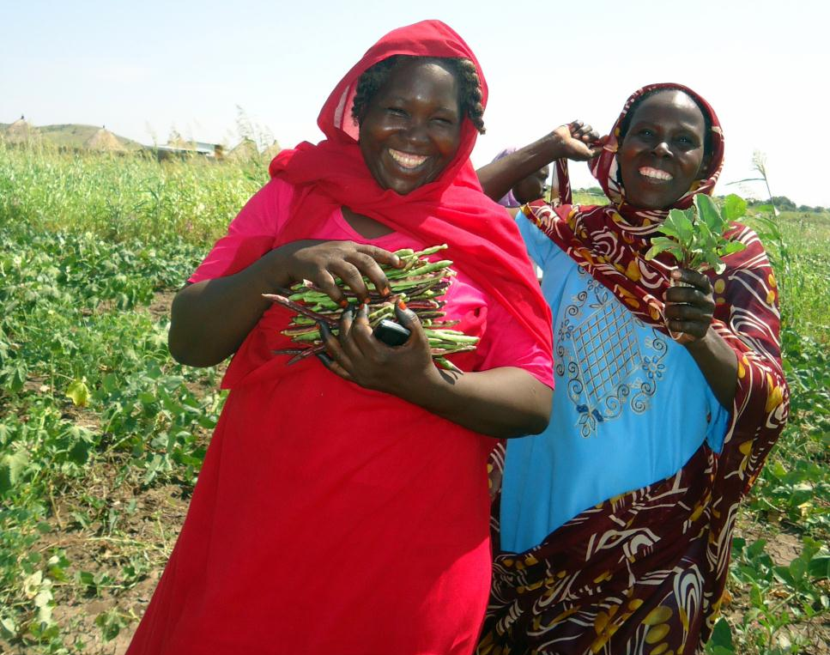
Grievance Mechanisms
Notes:
Another tool that can be used in the context of ensuring full and effective engagement is grievance mechanisms.

Slide 22
Stakeholder Engagement and Response
PROACTIVE REACTIVE
Stakeholder Engagement
Screening for Impacts
SESA
Management Plans
Grievance Mechanisms
Notes:
The application of robust social and environmental safeguards and stakeholder engagement processes should be able to mitigate most risks of complaints or conflicts related to REDD+.
The whole idea of the SESA is to apply proactive risk assessment and management plans when potential adverse impacts and tradeoffs cannot be avoided.
At the same time we recognize that even with good planning, unanticipated impacts and conflict may still arise so mechanisms need to be in place to manage and respond to grievances from affected people.

Slide 23
What is a Grievance Mechanism?
Accessible, collaborative, expeditious and effective in resolving concerns through dialogue, joint fact-finding, negotiation, and problem solving.
First line of response to stakeholder concerns that have not been prevented by proactive stakeholder engagement.
Complement, not replace, formal legal channels
Doesn’t address complaints that allege corruption, coercion, or major and systematic violations of rights and/or policies
Notes:
Grievance Mechanisms are organizational systems and resources established by national government agencies to receive and address concerns about the impact of their policies, programs and operations on external stakeholders.
They are designed to be accessible, collaborative, expeditious and effective in resolving concerns through dialogue, joint fact-finding, negotiation, and problem solving.
Organizational systems and resources established by national government agencies to receive and address concerns about the impact of their policies, programs and operations on external stakeholders.
They are the first line of response to stakeholder concerns that have not been prevented by proactive stakeholder engagement.
They are meant to complement, not replace, formal legal channels for managing grievances (e.g. the court system, organizational audit mechanisms, etc.).
These mechanisms typically do not include grievances that allege corruption, coercion, or major and systematic violations of rights and/or policies – as these are usually referred to more formal procedures like the court systems.

Slide 24
Rationale
Risk Management
Identify, anticipate, resolve issues in a timely and cost-effective manner
Identify systemic issues
Improve REDD+ outcomes and lessons learned
Promote accountability
Notes:
REDD+ implementation will inevitably run up against conflicts, for examples disputes could arise on issues such as land use, land rights, encroaching, illegal logging, lack of consultation, IP rights, benefit sharing etc.
In many countries, REDD+ processes hit up against a long history of contention and conflict in the natural resource sector, particularly surrounding issues related to tenure arrangements, governance and access over land and forestry resources.
Forest conflicts are significantly complex, and can take place at a variety of levels. REDD+ is likely to have a considerable impact on the existing roles, responsibilities and power relations among key stakeholders in the forestry sector.
Grievance Mechanisms can be useful to help to:
Identify and resolve implementation problems in a timely and cost-effective manner: As early warning systems, well-functioning Grievance Mechanisms help identify and address potential problems before they escalate, avoiding more expensive and time consuming disputes.
Identify systemic issues: Information from Grievance Mechanism cases may highlight recurring, increasingly frequent or escalating grievances, helping to identify underlying systemic issues related to implementation capacity and processes that need to be addressed.
Improve REDD+ outcomes: Through timely resolution of issues and problems, Grievance Mechanisms can contribute to timely achievement of REDD+ objectives.
Promote accountability in REDD+ countries: Effective Grievance Mechanisms promote greater accountability to stakeholders, positively affecting both specific activities and overall REDD+ governance.

Slide 25
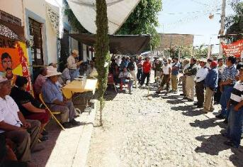
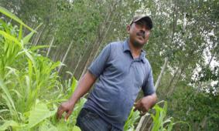
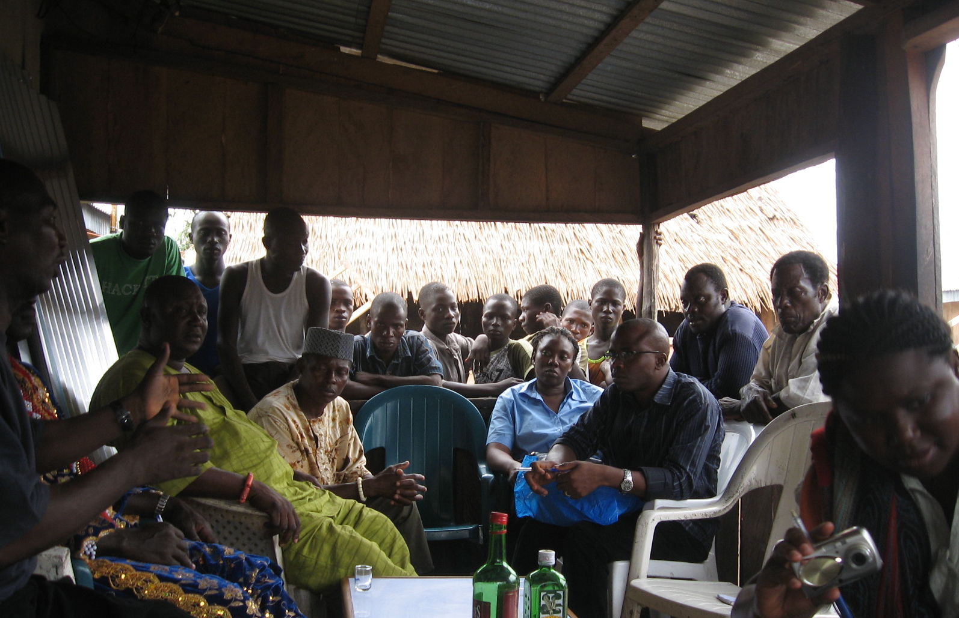
Responding to Stakeholders
They are trying to take our land, our forest!
Where is the money we were promised?
We were not consulted!
Notes:
Anticipating and already encountering 3 types of complaints: 1) Impacts on lands or livelihood (disputes over rights); 2) disputes over implementation (benefit sharing agreements); 3) engagement/consultation. In other words, claims that: this project is hurting us; we were promised something and haven’t received it; or - our voices weren’t heard.
The third type is likely the most common complaint we expect to receive which is why the upfront focus on building stakeholder engagement into the project is so important.
We’ve already begun to receive complaints along each of these lines and are beginning to understand how to address them – though of course a lot depends on the context and will have to be addressed case by case.

Slide 26
Focus in the Readiness Phase
Focus Efforts on:
Building capacity to address potential disputes that are likely to arise during the Implementation phase, and
Addressing complaints that relate to the policy preparation process and other Readiness activities.
To be completed before REDD+ Implementation:
Assessment of existing GRMs and gap analysis
Procedure for grievance redress that meets process essentials (principles and steps)
The GRM is made operational
Notes:
As you know, the Readiness phase is essentially a policy-making and planning process. In preparation for REDD+ Implementation, grievance efforts during the Readiness phase will simultaneously focus on two areas:
Building capacity to address potential disputes that are likely to arise during the Implementation phase, and
Addressing complaints that relate to the policy preparation process and other Readiness activities.
During Readiness, the REDD+ program can better anticipate the kinds of grievances that are likely to arise around how REDD+ policies, projects, and activities will be implemented on the ground (e.g. are the beneficiaries receiving what the law says and through accessible mechanisms? Are some people disputing the right to benefits in a given territory?).
Countries should use the Readiness phase to identify, assess and strengthen existing spaces for resolving these grievances.
Setting up and operating a GRM is a continuous improvement effort; while countries commit to putting in place an operational GRM by the end of the Readiness phase, it is expected that they will continue to strengthen and improve this GRM during Implementation.
Before REDD+ Implementation begins, it is expected that countries will have completed the following:
Assessment of existing GRMs (which includes the identification of areas requiring continued improvement) is completed and made public
Procedure for grievance redress that meets process essentials is made public
The GRM is made operational

Slide 27
GMs can be the first line of response to stakeholder concerns that have not been prevented by proactive stakeholder engagement or effective safeguards.
Stakeholder Engagement
Safeguards
Safeguard Information System
Governance
Anti-corruption
GMs could offer an entry point for stakeholders to provide feedback and information on how safeguards are being respected.
National
Grievance
Mechanisms
GMs can increase transparency, accountability, communication and feedback loops between governments and stakeholders.
GMs can refer relevant complaints to anti-corruption authorities and mechanisms and vice versa
Notes:
Grievance Mechanisms are very closely related to other aspects of REDD+ readiness …. Read text….

Slide 28
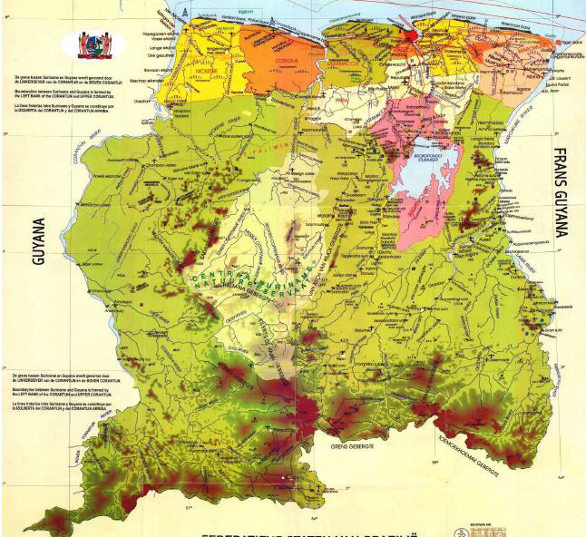
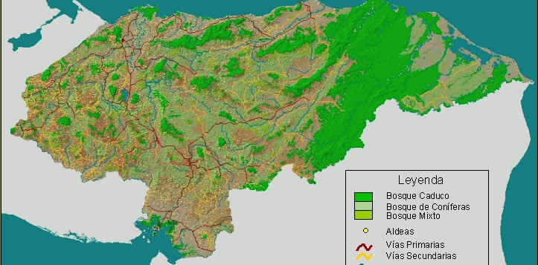
Examples
Suriname
Cambodia
Honduras

Slide 29
Following a 3-Step Approach…
Sources of Conflicts?
Systems to Address Conflicts?
How to Strengthen these Systems?

Slide 30
Sources of Conflict: Lessons from Cambodia, Honduras and Suriname
Illegal land conversion & use, encroachment
Road and infrastructure development
Multiple titles/permits for the same land
Lack of legal clarity on IP’s land rights / Unresolved land rights issues
Lack of agreed norms on consultation and consent (FPIC) / Lack of consultation
Disputes over mining & energy projects
Divisions within/between communities on land use / NRM
REDD+ Program itself
Notes:
In fact, these are similar if not the same risks we identified in the beginning of the presentation and which governments and stakeholders have already begun to identify themselves.
We are beginning to see some patterns in sources of conflict – based on assessments we undertook in 3 countries
NOTE: Sources do not derive from REDD+ but derive from (often) long-standing tensions over natural resource use. The complaints manifest through REDD+, but that is not the source.
Illegal land conversion & use, encroachment
Road and infrastructure development (sometimes linked to military personnel, border security or migratory pressure)
Multiple titles/permits for the same land
Lack of legal clarity on IP’s land rights / Unresolved land rights issues
Lack of agreed norms on consultation and consent (FPIC) / Lack of consultation
Disputes over mining & energy projects (often tied to lack of clarity on land rights and consultation)
Divisions within & between communities on land use / NRM (e.g. right to cut trees, cultivate areas or site new settlements)
REDD+ Program itself (Concerns that the program is not aligned with aspirations/visions of indigenous peoples; Concerns about fair benefit distribution)

Slide 31
Systems to Address Conflicts: Lessons from Cambodia, Honduras and Suriname
Honduras
Many cases go through several government institutions
Political dialogue for large national debates (ancestral rights, norms for consultation and consent)
Conciliation Centres in some communities
If violation of law, Public Prosecutor
Commissioner for Human Rights have played a role in some disputes
Cambodia
National level: Relevant ministries (Forestry, Land etc.)
Provincial level: Office of the Provincial Governor (supported by Commune Councils)
Local level:
Community Forest Management Committees
Community Forestry Network
Community Protected Area Committees
Supporting NGOs
Suriname
For small-scale forest/land conflicts (ad hoc):
complaints to local police; District gov’t/MP;
Appeals to Ministers and the President
National Dialogue to resolve disputes over Saramaka Judgment / land rights
Options outlined in RPP:
Major Groups Collective;
Bureau for Contact with the People;
Parliamentary Commission on Climate Change
Notes:
Examples of systems to address grievances, as identified in 3 countries
All three have complaints come to the major line ministries
Complaints are also common to the provincial or district government
Cambodia was striking in that there were strong structures in place to address grievances at the local level
Honduras and Suriname both had ongoing national dialogues to address large scale national debates – e.g. on land rights, consultation/consent

Slide 32
How to Strengthen These Systems? Assess with 7 Key Principles
Accessible?
Predictable?
Fair?
Legitimate?
Rights-compatible?
Transparent?
Sufficient Capacity?
Notes:
Once we have a baseline of existing structures/systems to address grievances related to REDD+, we need to consider how to strengthen these systems to ensure they meet 7 key principles.
We have a tool to support this type of assessment – these questions outline the key issues that need to be considered.
Is it accessible to those who face barriers (language, literacy, costs, awareness)?
Are the procedures predictable (clear time frames, scope and outcomes)?
Are the procedures widely perceived as fair (access to information and opportunities for meaningful participation in the final decision)?
Is the governance structure legitimate i.e. trusted by those who may use it?
Are the outcomes of the process consistent with applicable national and international standards (Rights compatibility)?
Are the procedures and outcomes transparent enough to meet the public interest concerns at stake?
Does the mechanism have the necessary technical, human and financial resources and capability to deal with the issues at stake?

Slide 33
Recommendations: Lessons from Cambodia, Honduras and Suriname
Beyond REDD+, recommendations aim to improve country capacity to address natural resource conflicts
Preference towards strengthening existing institutions, rather than creating new ones
Preventative measures play a significant role in reducing the risk of new conflicts and future escalation; e.g.:
FPIC
Boundary demarcation and zoning
Joint, integrated local land use planning and zoning
Clearer strategy for land use decision making, consulting on and then communicating those decisions
Notes:
Emerging lessons from the 3 assessments we undertook
Beyond REDD+, recommendations aim to improve country capacity to address natural resource conflicts
Preference towards strengthening existing institutions, rather than creating new ones
Preventative measures play a significant role in reducing the risk of new conflicts and future escalation; e.g.:
Advance agreements and new norms for indigenous land rights and prior informed consent (FPIC)
Boundary demarcation and zoning for State Forests and Protected Areas
Joint, integrated local land use planning and zoning
Clearer strategy for land use decision making, consulting on and then communicating those decisions
Build dispute resolution provisions into FPIC protocols
These are things Suriname, Honduras, Cambodia and other are including or considering including in the Readiness phase because they want to be pro-active about mitigating risks of conflict down the line.

Slide 34
Recommendations (2): Lessons from Cambodia, Honduras and Suriname
Recurring themes – there is a need for …
Clearly defined and well understood grievance procedures
More effective channels to refer disputes to higher levels
Clarified roles and responsibilities at all levels
More consistent documentation of disputes
Strengthened in-country mediation/conciliation capacity
Ensuring that District govts and police are aware of GRM
As a starting point, use REDD+ Steering Committee as first line for dispute prevention and resolution
Notes:
Finally,
Emerging lessons from the 3 assessments we undertook
Recurring themes – there is a need for …
Clearly defined and well understood grievance procedures
More effective channels to refer disputes to higher levels
Clarified roles and responsibilities at all levels
More consistent documentation of disputes
Strengthened in-country mediation/conciliation capacity: Start with a diagnosis of current capacity and legal context, generate a list of mediators to draw from
Ensuring that District govts and police are aware of GRM and know how to access it
As a starting point, use REDD+ Steering Committee as first line for dispute prevention and resolution
Clarify representation, decision making and dispute resolution procedures in ToR
Identify appropriate institution as secretariat for intake and tracking

Slide 35
Questions? Thank You!
Jennifer Laughlin, UNDP/UN-REDD Programme
Jennifer.laughlin@undp.org

