Slide 1
Benefits and Risks Tool (BeRT) Supporting countries to address and respect the Cancun safeguards

Slide 2
Benefits and Risks Tool (BeRT) Supporting countries to address and respect the Cancun safeguards
BeRT helps countries to:
Identify benefits and risks associated with REDD+ actions, in the context of the Cancun safeguards
Understand how the country’s existing policies, laws and regulations (PLRs) address those benefits and risks
Identify gaps in PLRs with respect to the Cancun safeguards
Utilize information on the risks and benefits of specific REDD+ actions to inform a decision on which actions to include in the REDD+ strategy.
Document information for use in the summary of information on how they are addressing and respecting the safeguards through existing PLRs
Notes:
The Benefits and Risks Tool (BeRT) has been developed to support the review of Policies, Laws and Regulations (PLRs) in the development of country approaches to safeguards.
Focus on PLRs - Countries wishing to plan their overall work to safeguards may find it useful to run the Country Approaches to Safeguards Tool (CAST).

Slide 3
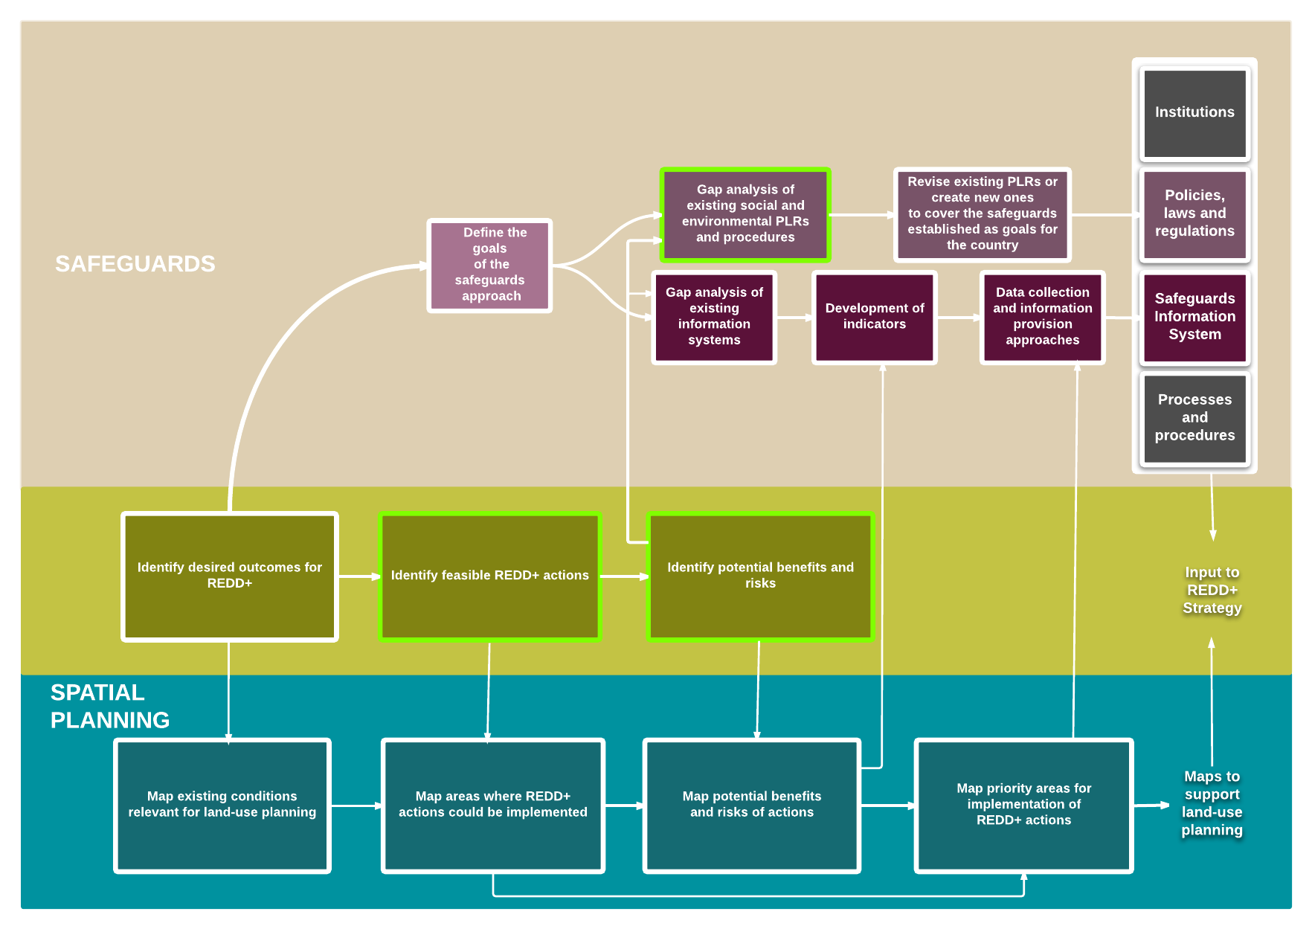
BeRT in Context

Slide 4
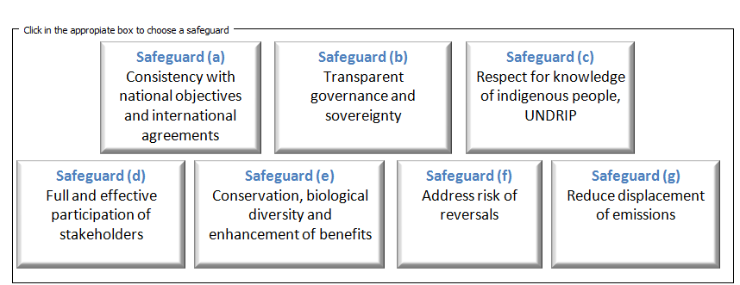
Structure of the BeRT
Module 1
Documenting REDD+ actions
Excel-based
Organised by the Cancun safeguards
Key issues and guiding questions support application
Allows for the prioritization of benefits and risks
Flexible: user can focus on given safeguards or modules
Module 2
Identifying benefits and risks
Module 3
Identifying relevant PLRs and gaps in coverage
Notes:
The spreadsheet-based tool is organised by the Cancun Safeguards and includes 3 modules.
The BeRT is intended for use at the national level, primarily in a workshop setting.

Slide 5
Module 1: Documenting likely REDD+ actions
Purpose: Documenting REDD+ actions that are anticipated in the country
Output: Table of REDD+ actions

Slide 6
Module 2: Identifying benefits and risks
Purpose: Identifying the potential risks and benefits of these REDD+ actions.
Output: Table of potential risks and benefits under each of the Cancun safeguards, with a qualitative assessment of impact and probability
Notes:
Example of safeguard (a):
Above some guiding questions for (a)
Below automated text that appears in the table to be revised and edited for the relevant country context
Module 2 allows for qualitative assessment of probability and impact (high, medium, low)

Slide 7
Module 3: Identifying relevant policies, laws and regulations
Purpose: Identifying...
existing policies, laws and regulations (PLRs) that address the benefits and risks;
gaps in coverage;
any PLRs that conflict with the safeguards.
Output: Table of existing PLRs that address the Cancun safeguards, an assessment of how well they address the benefits and risks identified and a list of gaps in PLRs
Notes:
Screenshot with example for safeguard (e)
Screenshot shows part of module 3 (further columns not visible include: conflicting PLRs & gaps identified)

Slide 8
BeRT is being finalized and trialled in-country
Launch in January 2015
To enquire about trialling the tool, email BERT@un-redd.org

Slide 9
Thank You!

