Slide 1
The Quality Assurance/
Quality Control (QA/QC) Plan
Presenter: Kimberly Todd
UNDP/UN-REDD
Prepared by: US EPA
Regional African Workshop on National Forest Monitoring Systems and Greenhouse Gas National Inventory Systems
25 – 27 February
Livingstone, Zambia

Slide 2
Purpose
What will this presentation achieve?
Describe the important aspects of a QA/QC plan, share lessons from experience, provide considerations for the review/design of a draft QA/QC plan for your inventory work
Notes:
This presentation will discuss both quality assurance and quality control. It is likely that some quality assurance and control procedures are already taking place in the preparation of your inventory. As you listen to the presentation, if any of these QA/QC checks are already a part of your inventory preparation, think of how they can be formally incorporated into your QA/QC plan. A formal, communicated plan can increase the quality of all sector estimates. The ultimate goal in our assistance with your QA/QC planning is to provide you with a set of procedures that are reasonable to implement considering resource and time availability. We’ll provide you with a template today to assist in your planning and we’ll give you guidance from our own experience with QA/QC.

Slide 3
Overview
Overview
Introduction to QA/QC
Who, What, When, Where
Lessons Learned from support to countries on GHG inventory QA/QC
Notes:
We should note that our system has evolved over time and we understand that each countries national circumstances are different.

Slide 4
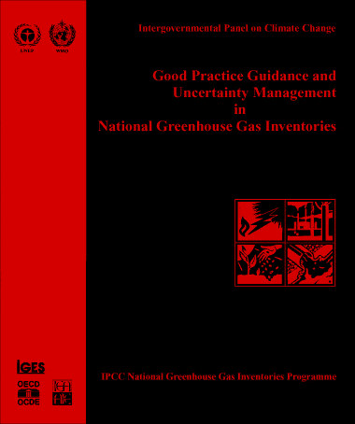
IPCC GPG 2000
Quality Assurance (QA)
What is Quality Assurance?
Planned system of review, and sometimes audit, procedures conducted by personnel not involved in the inventory development process
Reviews, preferably by independent third parties, are performed on a finalized inventory following implementation of the Quality Check (QC) procedures to:
Verify the data quality objectives defined by the inventory agency were met
Ensure that the inventory represents the best possible estimates of emissions and sinks given current scientific understanding and data availability
Support the QC program
Notes:
Quality assurance and quality control procedures are basically a system of reviews and checks that can be done to ensure an inventory is high quality.
The IPCC defines Quality Assurance as a planned system of review procedures conducted by personnel not involved in the inventory development process. --Essentially, that means peer, expert, and/or public review of the inventory.
It is especially important if possible to have the QA come from someone who is not close to the materials. It is more difficult to see the mistakes in your own work because you see it as how it should be.

Slide 5
IPCC GPG 2000
Quality Control (QC)
What is Quality Control?
System of routine, planned technical activities implemented by inventory development team to measure and control the quality of the inventory as it is being prepared, including:
Checks to ensure data integrity, correctness and completeness
Checks to identify errors and omissions
Checks on data acquisition and calculations and the use of approved standardized procedures for emissions calculations, emissions measurements, estimating uncertainties, documentation, archiving and reporting
Technical reviews of data, methods and results
Notes:
The IPCC defines quality control as a system of routine, planned technical activities implemented by the inventory development team to measure and control the quality of the inventory as it is being prepared. --A simpler way of saying that is that it’s a series of internal checks that the inventory team sets up.

Slide 6
Key Components of QA/QC
Key Components of QA/QC
Inventory agency responsible for coordinating QA/QC activities (develops QA/QC plan)
General QC procedures
Source/sink category-specific QC procedures
Coordinating QA procedures
Reporting, documentation, and archiving procedures

Slide 7
What Procedures to Apply the QA/QC
Example QC Procedures
Check that units are properly labeled | Reproduce a representative sample of emissions calculations | Check that estimates are reported for all source categories and for all years
How many of these checks can be done?
How will they be prioritized?
Notes:
Include list of QC procedures
It may seem like there are many checks, but most are simple and not too time-consuming, but still have to consider how many checks are reasonable to require. Prioritizing is important but the IPCC GL and other resources provide guidance both in terms of the types of checks and where to focus additional QC.

Slide 8
When to Apply the QA/QC
Which procedures will be conducted annually?
Consider inventory cycle?
What level of QC is needed annually?
Data updates
A sample of data and calculations from each sector should be check each year.
QC should be performed prior to expert review
How Often to Perform QC
Biannual? | Annual? | Biennial? | Triennial?
Notes:
Key questions to decide which/where/when:
How significant is this source to total inventory estimate?
What is the source’s contribution to trends in emissions over time?
Has there been a change in the data or characteristics of the source category? Technological advances? Policy changes increasing reductions?
Is it likely that the level of uncertainty has changed?
In developing a plan for QC, it is important that scheduling be included. You must determine when certain procedures will be applied. Always take into consideration the inventory cycle.
It will have to be decided which procedures and at which levels will be conducted for every inventory?
For every other inventory?
Throughout the inventory cycle?
What is important is that a sample of data and calculations from each sector should be checked in someway for each inventory and that QC should be performed prior to expert review.
It is important to understand that QA/QC should be an ongoing practice through the Collection of data and the development of estimates. It’s also important to conduct QA/QC on the draft and final report, which should be done by the inventory team as well as outside experts.
Based on comments from the QA/QC process, the inventory team should revise the draft report to address errors and comments.

Slide 9
Where to Apply the QA/QC
Some processes need more QA/QC than others
Focus On These
Key Categories | Emission and removal categories with recent data changes | Emission and removal categories with recent methodological changes
Notes:
Most likely to need attention are the Key Categories, emission and removal categories with recent data changes, and emission and removal categories with recent methodological changes.

Slide 10
What Can The Template Workbook Do For Me
The QA/QC template helps you and the inventory team:
Identify existing QA/QC procedures
Define roles responsibilities for QC and QA
Establish QC and QA procedures
Develop a schedule and customized QA/QC program to build upon
Find calculation errors
Be confident in their inventory
Enhance National Communication report by applying IPCC Good Practice
Notes:
QA/QC Summary
This template helps inventory teams to develop a QA/QC system.
It gives inventory teams a place to:
Guidance to help you develop your own customized QA/QC procedures
Identify past and current QA/QC procedures
Define roles and responsibilities, i.e., who is responsible for reviewing the estimates and documentation
Establish QC procedures. First by listing the minimal QC procedures that you will undertake (there is a sample checklist provided). Then providing recommendations for more rigorous QC or more in-depth examination of specific sources
Identify or establish external review or QA, establish process and schedule for inventory review (e.g. expert and/or public review)
Establish the overall schedule for the QC plan, which should occur throughout the inventory process.
Uncover errors in the calculation of emissions
Be confident that they have a reliable, defensible, and accurate inventory. The inventory should be available for expert and public review.
The QA/QC plan and procedures can be referenced in your National Communication or in any provincial level inventory report
The inventory coordinator in collaboration with team members/consultants can have a meeting using the template as a guide for discussing existing practices, defining roles and developing a plan.

Slide 11
U.S. Participants: Example Roles
QA/QC effort can be spread across different individuals or agencies
Agency Inventory Lead | QA/QC Coordinator | Emission and Removal Category Lead | Outside Experts | Consultants (depending on institutional arrangements)
General QA/QC | Directs overall implementation of QA/QC and maintaining plan | Implements source specific QA/QC; Responsible for taking corrective actions | QA by university experts, industry groups | Day-to-day QC and additional QA support
Notes:
The inventory agency is ultimately responsible for coordinating QA/QC activities. The agency can designate responsibilities for certain tasks to certain members of the inventory team. For example, it is important to have a QA/QC coordinator for the inventory who ensures that objectives of the QA/QC program are met.
But, everyone working on the inventory has some shared responsibility. This includes consultants, university groups…anyone working on the inventory.
And finally, external reviewers are involved in Quality Assurance.

Slide 12
QC Examples
What are some examples of Overall QC checks?
Checking that spreadsheets use consistent units
Cross-checking spreadsheet values to publication values
Performing matrix comparisons between relevant worksheets or file versions
Checking cell formulas/linking architecture to ensure consistency
Checking that in-text references have a citation in the references section
What are some examples of Sector-Specific QC checks (Energy)?
Check for fuel consumption year to year trends
Follow up with external sources when fuel consumption inputs show unusual trends
Notes:
Minimum levels of QC to be met:
Basic checks should be completed on entire inventory (Tier 1) (see Good Practice Guidance Chapter 8)
More in-depth examination of specific sources (Tier 2)
Instructions for documenting and archiving of QA/QC
Provide templates, copies of checklists, etc.

Slide 13
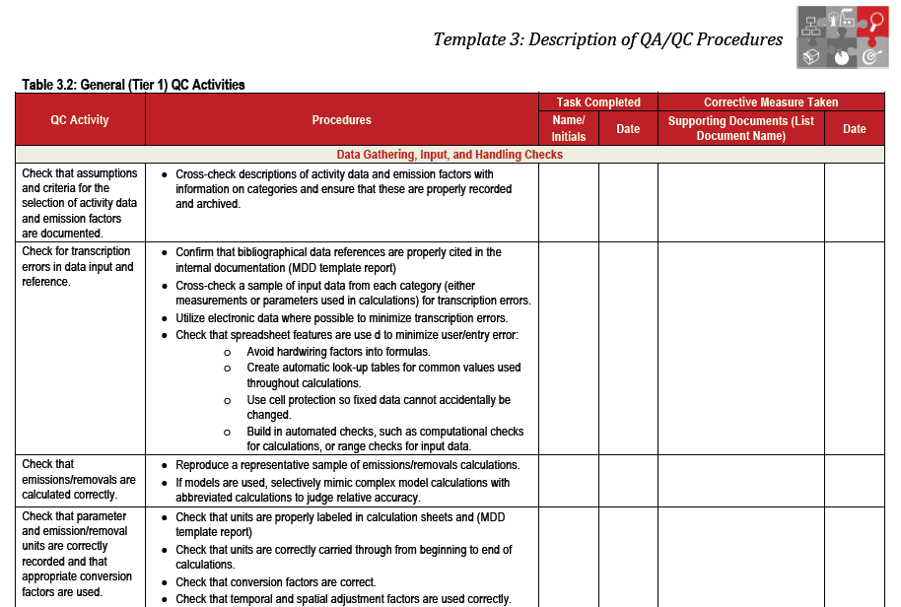
Example: Forms & Checklists for Source-specific QC
Notes:
The U.S. and other countries use a very similar checklist to the tier 1 QC checklist found in the template workbook. These forms ensure documentation of all QA/QC procedures. While these forms specifically cover Tier 1 activities, it is important to document additional QA/QC as well.
Let’s take a look at this example. Each QC activity has a number of procedures or CHECKs attached to it and you initial and date when each has been completed. While this may seem simple, it is difficult to remember each activity individually and this will give you a person to contact should you have any questions.
Checklists can include:
Tier 1: Individual Source Category Checklist
Tier 2: Source Category Checklist
A: Data Gathering and Selection
B: Secondary Data and Direct Emission Measurement
Sample Data/Reference Tracking Sheet
Contact Report
Can be used to record personal communications
Supplemental Report

Slide 14
Review Prioritizing QA/QC Procedures
Is a source/sink a key category?
Is a methodology complex or “data heavy”?
Are emission factors different from IPCC default factors or commonly used factors?
Was a category updated a long time ago?
Did the last QA/QC and verification take place a long time ago?
Did significant changes occur in how data are processed and managed?
Is there a risk of double counting or incomplete estimates?

Slide 15
Data Management tips to support application of QC procedures
Some tips to facilitate and enhance QC!
Do not hard-code equations (instead link cells)
Put commonly used factors in their own cells, and link to them (EFs, GWPs, conversion factors).
If they change, then it’s easy to implement broadly
Use conditional formatting (or “checkers”), for example
national total = Σ sectors
sector = Σ sources
Notes:
Some tips for spreadsheet QC
This is not explicitly covered in the templates, but I thought I’d mention here a few concrete tips that we’ve found really helpful for QC of spreadsheets. If you’re preparing emissions calculations, you’re probably using a spreadsheet. There are ways you can set up your spreadsheet that make it a lot easier for you to QC your work, or for a later person to come along and understand what you are doing.
First, and most important, do not hard-code equations. By that, I mean, if you’re calculating something in the spreadsheet, implement conversions and the equation using links to other cells, rather than putting a calculated number directly in the cell. That way, you can trace how the equation is put together with the underlying data and trace calculation errors more easily.
Another related tip is to put factors and constants in a separate cell, and link to the cell, rather than typing them directly jnto an equation. That way it’s a lot quicker to make changes, for example if the emission factor you’re using needs to change.
Third is, you can use the “conditional formatting” function in Excel to automatically alert you about certain conditions. For example, you can set it so that if the Inventory total doesn’t meet the sum of the individual sources, the cell will have red text, which would alert you that there is a problem.
That may all be stuff you’re familiar with already, but if not, we hope those are some helpful tips.

Slide 16
Action Plan: Apply Template!
Assign specific responsibilities for QA/QC
Define procedures
Develop a QA/QC Plan
Include budgeting!
Communicate QC plan with all working on inventory
Establish process and schedule for inventory review (expert and/or public review)
Implement QA/QC Plan
Notes:
Apply the template!

Slide 17
Audience Participation
Discussion questions:
What QA/QC procedures do you currently have in place? How was this managed under the previous inventory? When do you implement them? Do you have a point person for your QA/QC? What role do sectoral experts/compilers currently play? Do you use checklists and track each step of the QC process? Do you currently have a QC plan in place? Plan for QA? Can you think of any improvements that would be helpful?

Slide 18
Thanks For Your Attention!
U.S. EPA Inventory Preparation Tools
www.epa.gov/climatechange/EPAactivities/internationalpartnerships/capacity-building.html
Notes:
I hope you have found this helpful. That’s it! Thank you so much for you attention, and I’d be happy to answer any questions.
Thanks for your attention!

