Slide 1
2nd UN-REDD Latin-American and Caribbean Regional NFMS Workshop
“Exchange and training Workshop on satellite forest monitoring systems for REDD+”
3rd to 5th September 2014
Panama City, Panama
Notes:
Set up / copy a standard opening slides for ppts

Slide 2
Introduction to the workshop
Adam Gerrand,
FAO UN-REDD

Slide 3
Overview of NFMS regional workshop series
UN-REDD working in 51 countries, 19 Nat. Prog.
Lots of experience nationally, learning in each country
Objectives of the series of regional workshops:
Share experiences, learn from each other (south-south)
Gain efficiencies and consistency in approaches
Share what works well and learn to handle challenges
11 Latin American countries in Ecuador, April 2013
17 Asia-Pacific countries in Thailand, October 2013
21 African countries in Zambia, April 2014
All presentations on UN-REDD Workspace internet

Slide 4
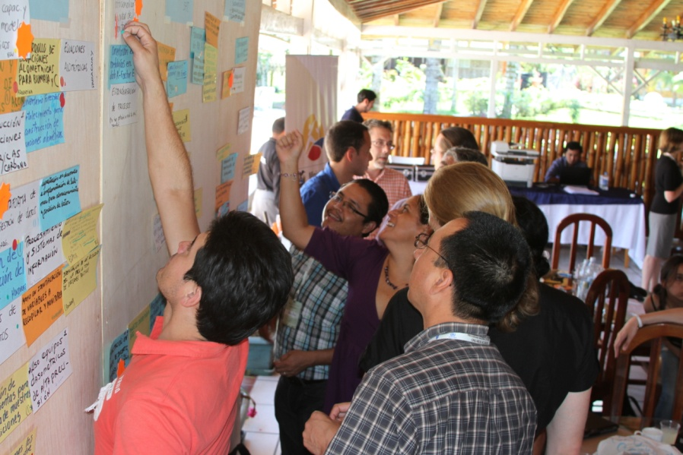
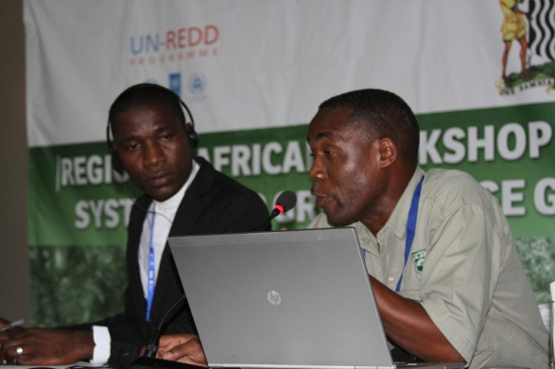
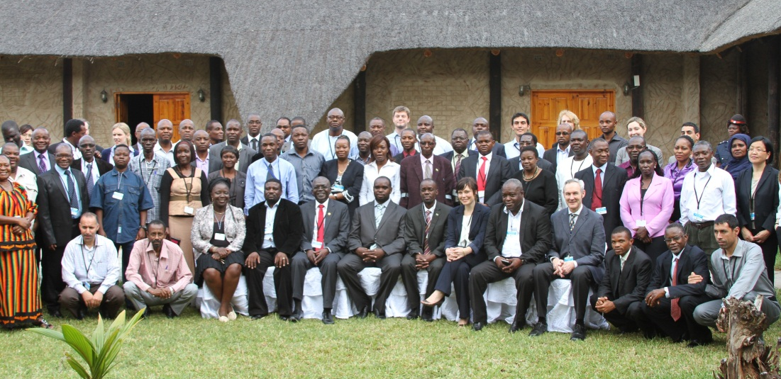
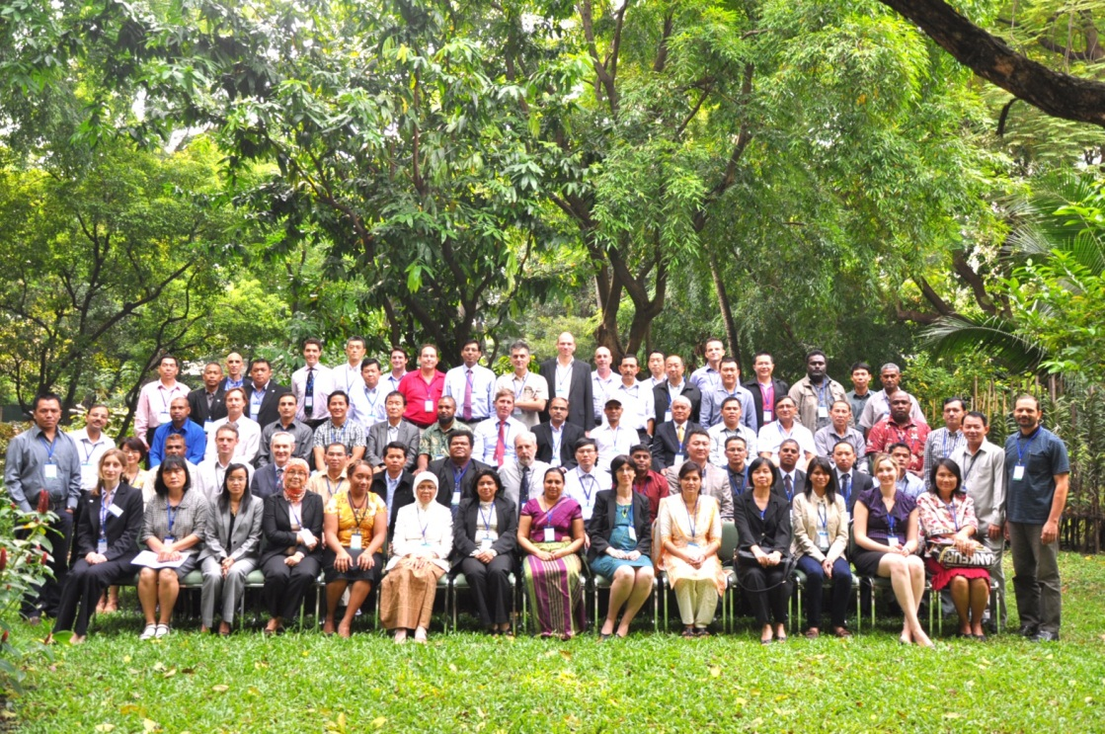
Part of a global series: 1st Latin American NFMS workshop 63 people from 11 countries, Ecuador April 2013
Some formal presentations, active discussion, working groups = sharing knowledge:
1st African NFMS LECB workshop 85 people from 20 countries, Zambia Feb 2014
Asian NFMS workshop,
Thailand, October 2013

Slide 5
Functions of the NFMS
NATIONAL FOREST MONITORING SYSTEM
MONITORING
MRV
Satellite Land Monitoring System
For monitoring and reporting on REDD+ activities
Web Interface
For assessing national area change over time (Activity Data)
National Forest Inventory
Community Monitoring
System to provide information on Safeguards
(SIS)
GHG Inventory
Other Forest-Related Monitoring Systems

Slide 6
Enfoques e instrumentos para cumplir con los Sistemas Nacionales de Monitoreo de los Bosques
El SNMB tiene dos funciones: 1) monitoreo, 2) Medición, Reporte, Verificación
SISTEMA NACIONAL DE MONITOREO DE LOS BOSQUES
(SNMB)
MONITOREO
MRV
Sistema Satelital de Monitoreo de la Tierra
Sensores Remotos
Plataforma diseminación web
Inventario Nacional Forestal
ELEMENTOS
EJEMPLOS
Monitoreo Comunitario
Inventario de GEIs
Monitoreo forestal tradicional

Slide 7
Panama Workshop objectives
Main Objectives: To share lessons learned and discuss methods to improve the generation and use of remote sensing data to generate activity data including for REDD+ and reporting to the UNFCCC.
Central themes:
Measurement of historical and current area and changes: in forests and other land uses
Mapping of land use at different resolutions and comparability
Evaluation of the accuracy of land use and / or change maps
Measuring forest degradation
Surveillance and early warning of deforestation
Measurement of carbon stock and emissions / removals from forest carbon via satellite images (data link with NFI & GHG Inventory)
Notes:
Workshop objectives: (English)

Slide 8
Outline of the workshop
Country & expert presentations and time for discussion panels
Day 1: Session 1 Introductions plus NFMS for REDD+ MRV
Maps from RS for Land Cover / Land-use for national & UNFCCC reporting
Measurement of the historical and current changes (deforestation)
Day 2: Session 2 - Measuring forest degradation
Approach estimating loss of canopy cover
Using ecosystem integrity index
Comparison between biomass maps
Session 3: Early Warning Systems
Day 3: Session 4: Integration with field data
Session 5: Evaluation of accuracy of maps of land use and change
Workshop evaluation and feedback
Notes:
Outline of the 4 days of the workshop
Read from slide

Slide 9
What is your current knowledge, what are your expectations?
Think about your expectations for workshop
Answer the questions in the initial survey
Write the 1 most important expectation for you in the box
We will come back to these at the end of the week and see how the workshop went compared to your expectations
PS All speakers please give presentations to Claudia well before your session
Notes:
Workshop objectives:
The key objectives of the meeting are to:
Build consistency in understanding of key issues relating to NFMS for REDD+, and in application of this understanding in the context of national REDD+ Readiness activities and REDD+ Strategy development;
We will be using the UN-REDD report to guide our discussions "National Forest Monitoring Systems: Monitoring and Measurement, Reporting and Verification (M & MRV) in the context of REDD + activities".
Provide an overview of the purposes, benefits, practices, and costs of monitoring forest carbon for REDD+ and for traditional national forest inventory
Provide an opportunity for information exchange and joint learning across countries in the Asia-Pacific region on NFMS for REDD+;
Identify capacity gaps in NFMS development and plan follow-up activities for support at regional and national levels.

Slide 10
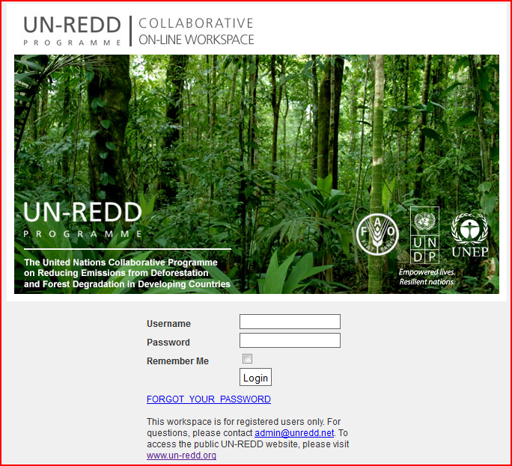
Thank you for your attention.
For more information go to our websites:
www.un-redd.org
http://www.unredd.net/
Notes:
Thank you for your attention.
For more information go to our websites listed on the slide.

