Slide 1
2nd UN-REDD Latin-American and Caribbean Regional NFMS Workshop
“Exchange and training Workshop on satellite forest monitoring systems for REDD+”
3rd to 5th September 2014
Panama City, Panama
Notes:
Set up / copy a standard opening slides for ppts

Slide 2
Overview of UN-REDD
Adam Gerrand,
FAO UN-REDD

Slide 3
Outline
What is REDD+ (plus)
Why its important, and how it can help
What UN-REDD does, and which countries
Phased / stepwise approach
Global and National Programme activities
UN-REDD Strategy 6 main Work Areas, FAO focus
Concluding comments

Slide 4
What is REDD+ (plus)?
REDD is incentive mechanism for developing countries to protect & better manage forests, reducing GHG emissions & provide climate benefits
REDD+ (REDD plus) is broader than reducing emissions from deforestation and degradation, adding:
the role of conservation [of forest carbon]
sustainable management of forests [production, livelihoods]
enhancement of forest carbon stocks in reducing emissions.

Slide 5
The UN-REDD Programme is...
The United Nations Collaborative Programme on Reducing Emissions from Deforestation and Forest Degradation (UN-REDD) in Developing Countries
Started 2008 (young, but rapid growth - country demand, donor interest)
UN-REDD aims to help countries get “ready for REDD+”
US$200m from Norway, Denmark, Spain, Japan, EU and Luxembourg pledge, budget 2014= $48m, 2015= $24m
Excellent example “working as one UN” - jointly implemented by FAO, UNDP, UNEP using all expertise

Slide 6
How REDD works to reduce GHG
Emissions
(Gt CO2)
without REDD+
Projection
Emissions
Reductions
Reference
Period
with REDD+
Actual
Emissions
Year
Green shaded area is reduced emissions from REDD+ actions

Slide 7
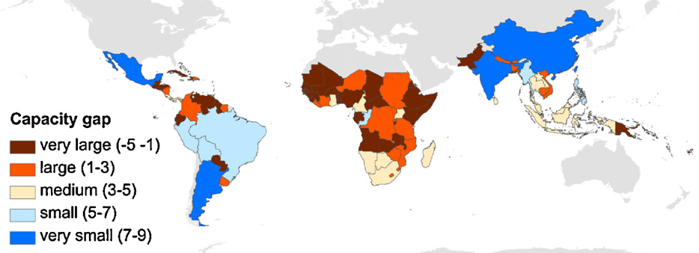
Where are the Capacity gaps for REDD?
Very large capacity gaps in forty nine countries (brown), mostly in Africa
while only four countries had very small capacity gap (blue).
Source: Romeijn et. al. 2012 Assessing capacities of non-Annex I countries for national forest monitoring in the context of REDD+ . Environmental Science and Policy 19–20 (2012) 33–48.
Notes:
Areas identified as having constraints to REDD+ (Romeijn et. al. 2012 )
dark blue is best, light blue ok, orange is poor and dark brown is worst
the study assessed the status and development of national monitoring capacities between 2005 and 2010 in tropical non-Annex I countries
Very large capacity gaps were observed in forty nine countries (brown), mostly in Africa, while only four countries had a very small capacity gap (blue).
4 countries had good results with a small capacity gap (dark blue). This means they can measure and report on their forests well for REDD.
Mexico, Argentina, India and China.
The countries with the bigggest capaity gaps were mostly in Africa, although north-eastern part of South Anmerica and Central Americ were also weak.

Slide 8
UN-REDD in 51 countries
Countries with UN-REDD National Programmes: Bolivia, Cambodia, Democratic Republic of the Congo (DRC), Ecuador, Indonesia, Nigeria, Panama, Papua New Guinea, Paraguay, the Philippines, Republic of Congo, Solomon Islands, Sri Lanka, Tanzania, Viet Nam and Zambia.
Other partner countries: Argentina, Bangladesh, Benin, Bhutan, Cameroon, Central African Republic, Chile, Colombia, Costa Rica, Ethiopia, Gabon, Ghana, Guatemala, Guyana, Honduras, Ivory Coast, Kenya, Lao PDR, Malaysia, Mexico, Mongolia, Morocco, Myanmar, Nepal, Pakistan, Peru, South Sudan, Sudan, Suriname, Tunisia and Uganda.
Notes:
The UN-REDD is working to support 48 countries and has rapidly grown from 5 years ago when it started with just 9.
I am not going to list them all but the map shows the global extent of coverage and the names are listed here for more detailed checking later or please look on the UN-REDD website.

Slide 9
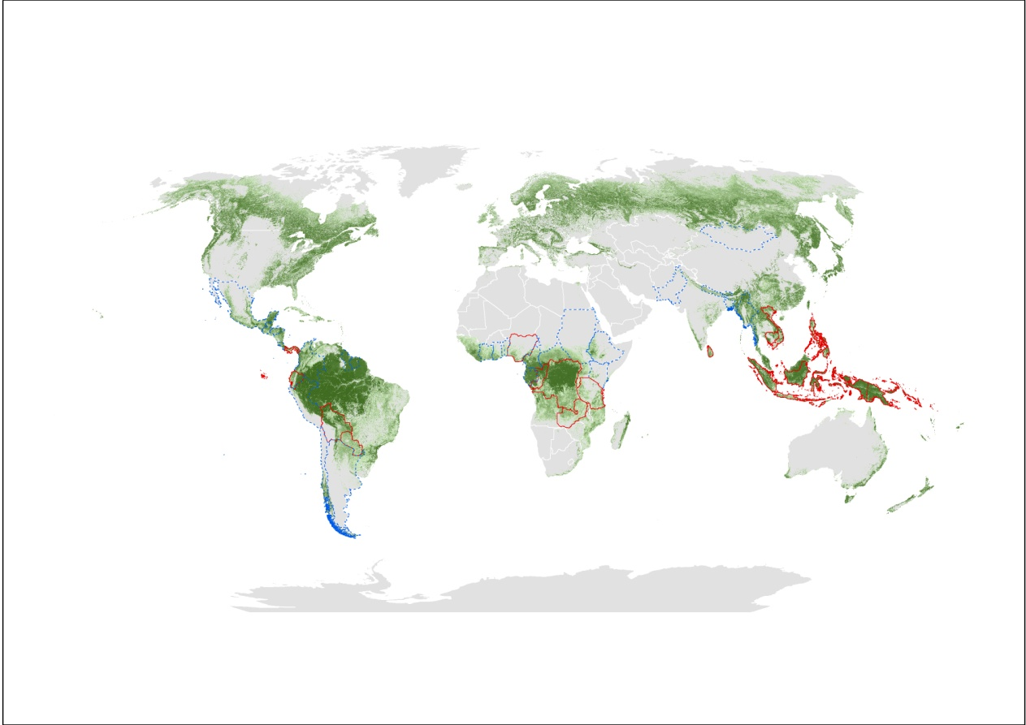
Support to 51 countries – over half the worlds tropical forest
Notes:
UN-REDD Programme (www.un-redd.org). REDD+ means reducing emission from deforestation and forest degradation. The UN-REDD Programme is one of the FAO’s flagship joint programmes. It is a joint effort among FAO, UNDP and UNEP.
It provides technical support directly to 16 countries though in-country national UN-REDD Programmes as well as additional support to about 26 other partners countries on demand.
Support to Countries The Programme currently supports 42 partner countries spanning Africa, Asia-Pacific and Latin America, of which 16 are receiving support to National Programme activities. These 16 countries are: Bolivia, Cambodia, Democratic Republic of the Congo (DRC), Ecuador, Indonesia, Nigeria, Panama, Papua New Guinea, Paraguay, the Philippines, Republic of Congo, Solomon Islands, Sri Lanka, Tanzania, Viet Nam and Zambia.
The 46 UN-REDD partner countries cover just over half of the world’s tropical forests.
The additional partner countries are: Argentina, Bangladesh, Benin, Bhutan, Cameroon, Central African Republic, Chile, Colombia, Costa Rica, Ethiopia, Gabon, Ghana, Guatemala, Guyana, Honduras, Ivory Coast, Kenya, Mexico, Mongolia, Myanmar, Nepal, Pakistan, Peru, South Sudan, Sudan and Suriname.
To-date, the UN-REDD Programme’s Policy Board has approved a total of US$59.3 million for National Programmes in these 16 partner countries. It also provides international support functions, for example operational guidelines, technical papers, and other knowledge sharing e.g. through regional and global workshops. The portfolio is $120 million since 2009, with main donors from Norway, Denmark, Japan and EC. These funds help to support the development and implementation of national REDD+ strategies.
FAO’s specific contributions are related to REDD+ monitoring including measurement, reporting and verification (MRV) as well as strengthening REDD+ governance, in addition to addressing other REDD+ safeguards as agreed in Cancun.

Slide 10
Six UN-REDD Work Areas
MRV and Monitoring
FAO lead
REDD+ Governance
Stakeholder Engagement
REDD+ Strategies
UNDP lead
Transparent Equitable Accountable Management of REDD+ Payments
Multiple Benefits of forests/REDD+
UNEP lead, FAO
REDD+ as Catalyst of Green Economy

Slide 11
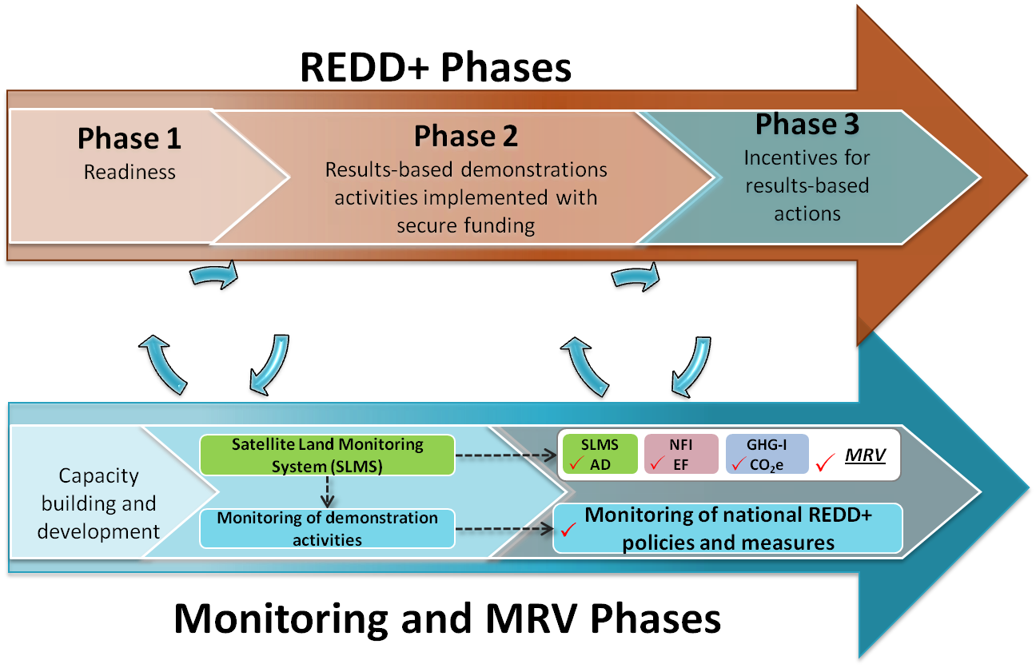
Phased implementation of the NFMS
z
Most countries are here
FAO Forestry
Notes:
Countries are implementing REDD+ in three phases over several years, in accordance with UNFCCC Decision 1/CP.16, which the NFMS will have to be developed and progressively implemented through a satellite land monitoring system and a national forest inventory.
Phased implementation of the NFMS:
1. Phase 1 is the REDD readiness phase which almost all countries are in,
2. Phase 2 involves the operationalization of monitoring for REDD+, provided by the SLMS and other relevant proxies.
3. The transition into Phase 3 is achieved by 1) monitoring REDD+ activities at the national level, and
2) operationalizing a SLMS (to produce AD),
- a National Forest Inventory (NFI) (to produce EFs) and - a GHG inventory for the LULUCF sector
enabling incentives for results-based-actions.

Slide 12
Building Capacity for National Forest Monitoring
FAO’s role in REDD+ readiness is to help countries develop, implement and operationalize their National Forest Monitoring System (NFMS and MRV)
FAO also assists countries in designing and implementing REDD+ activities and in development of policies and measures (e.g. governance, tenure)
Key principles of FAO’s support
National ownership
Alignment with the UNFCCC process
Step-wise approach that allows for improvement over time
Builds upon existing capacities, available data and systems in place
Use of open-source tools, freely available data (FAO has a lot)
Strengthening of national capacities (learning-by-doing and sharing)

Slide 13
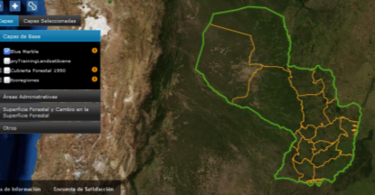
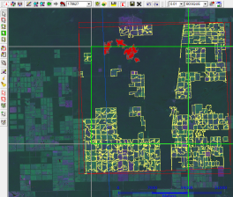
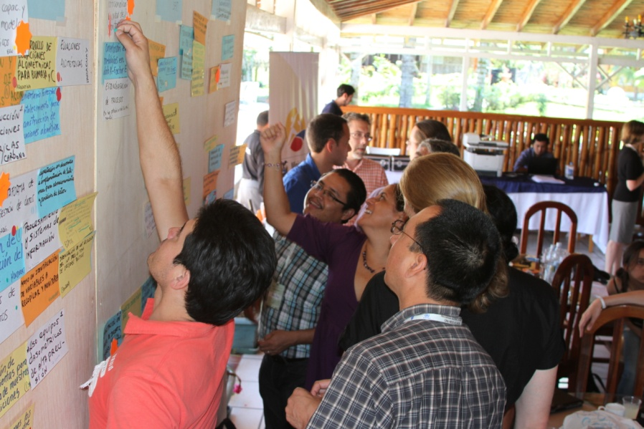
Building Capacity for National Forest Monitoring
Direct support working with countries to improve their National Forest Monitoring Systems (NFMS)
Regional workshops - share experiences:
Africa, Latin America, Asia (>60 countries, >300 people)
Aim to inform on UNFCCC requirements, build country capacity to get ready for REDD+
Global synthesis and lessons-learned workshop
Coordination with other organizations
Incl. UNDP LECB project - joint workshop!
Others: World Bank FCPF, SilvaCarbon etc,

Slide 14
Concluding comments
REDD+ is an important recent initiative allowing development opportunities plus GHG benefits
its new, multi-disciplinary (6 areas), technically complex
FAO key role support National Forest Monitoring Systems (NFMS &MRV)
REDD+ will take time for countries to learn and implement, = phased / stepwise approach
FAO UN-REDD work supports countries achieve UNFCCC
FAO, UNDP, UNEP combined strengths in UN-REDD
Principles: develop National capacities and ownership
Strong synergies and collaboration with other project work

Slide 15
Adam Gerrand
adam.gerrand@fao.org
Thank You
Website: http://www.un-redd.org

