Slide 1
Vietnam Experience
on Knowledge Management and Communications Work
Tran Minh Phuong
23 August 2016

Slide 2
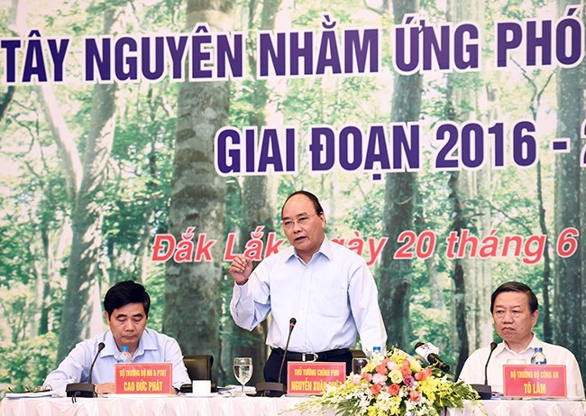
Vietnam Government declares closing of natural forests
PRIME MINISTER NGUYEN XUAN PHUC said “up to 2.25 million hectares of natural forests in the Central Highlands are not allowed to be open to commercial projects”
The conference “Seeking solutions to achieving sustainable forest recovery in the region in order to cope with climate change during 2016-2020”, 22 July 2016 at Daklak, co-organized by UN-REDD Vietnam Phase II Programme
“Even thin forests will also not be replaced by industrial tree plantations, he said, explaining that the current area of rubber, coffee and industrial trees is enough”

Slide 3
Background of the KM and Comms Strategy
01 REDD+ Communication strategy (2013-2015) with 01 action plan for PMU and 6 action plans for 6 PPMUs (pilot provinces) and they have been adjusted for the extended period 2016-2018
Communication need assessment and consultation meeting have been carried in the process of strategy establishment
The strategy covers almost relevant stakeholders: government staffs, decision makers, technical staffs, researchers, enterprises, social organizations, journalists, students, community and school teachers and pupils.
Activities: high level conference, workshop, training, meeting, education, campaign, competitions, club, event, television, radio, newspaper, panel, posters, calendar, pen, notebook, rain-coat, jacket, T-shirt, newsletter, brochure…

Slide 4
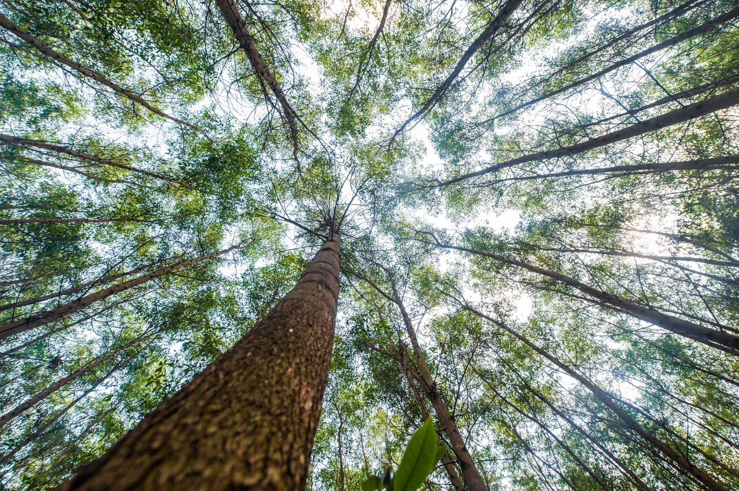
2 training on REDD+ Academy for 20 people from difference minitries
1 photo contest on Forest for People
1 writing contest on Forest for People
5 trainings for technical staffs of VNFOREST
Integrated REDD+ content in relevant subjects in the Forestry University and National Academy of Politics
Publication REDD terminology (1), UN-REDD brochure (2), poster (2 sets), newsletters (4), documentary films (2)
TOT training on REDD+ Academy for 12 people from university, VRO, FCPF, RECOFT

Slide 5
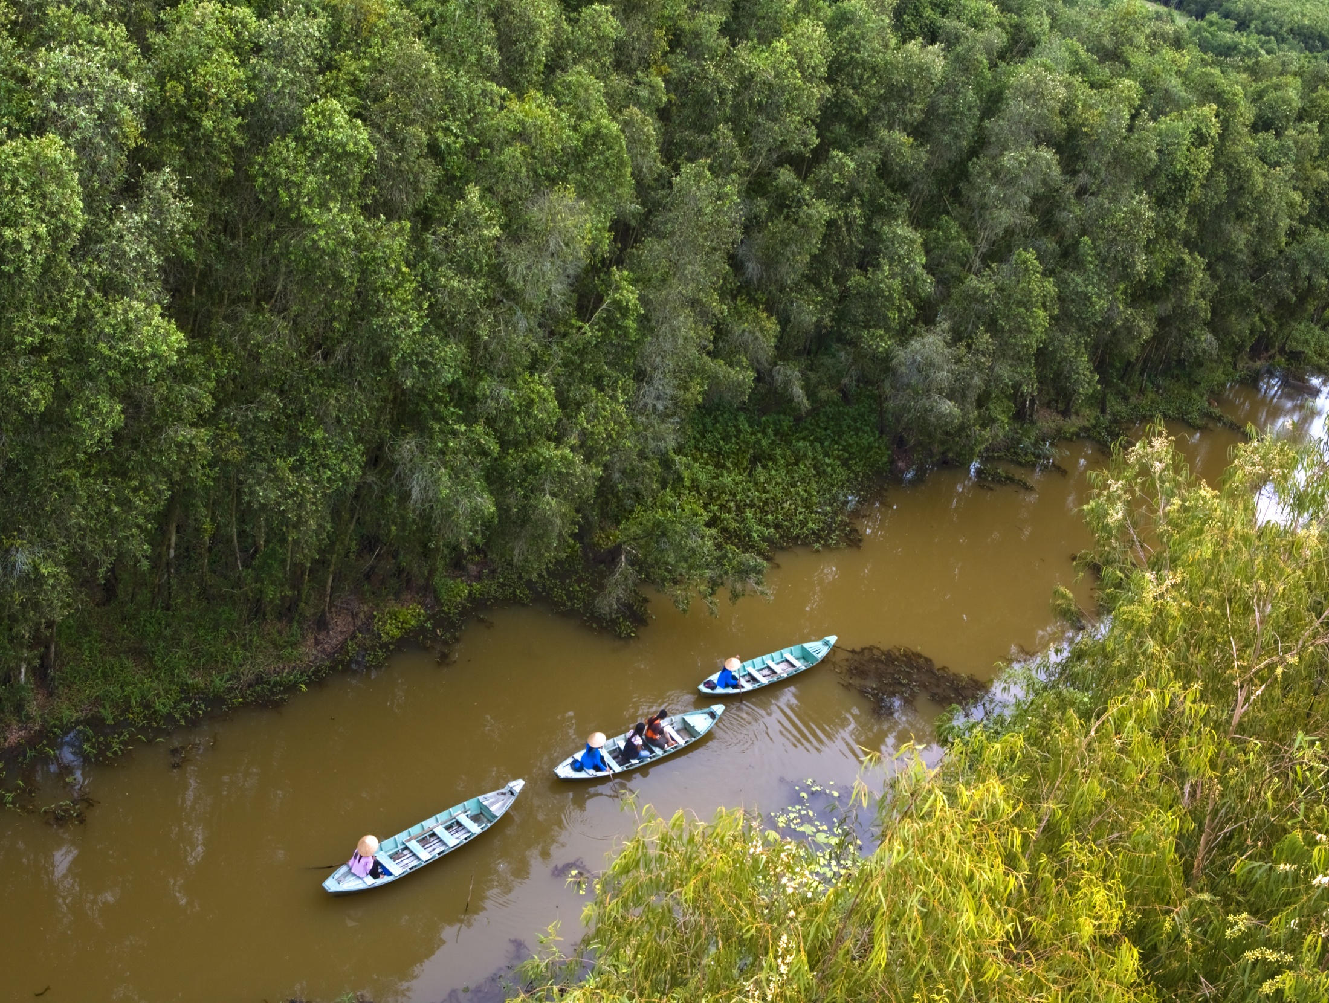
01 REDD+ communication network with 60 members from different organization from provincial to village level
18 events big provincial communication events/campaigns/competition for students, women, farmers, forest rangers
04 REDD+ Photovoice clubs in 4 secondary schools (students and teachers)
Provincial REDD+ network are being set up in 6 pilot provinces
35,000 people participate REDD+ communication activities in 6 PPMUs
14 documentary films and hundreds news on TV and newspapers
Publication REDD+ booklet, poster, newsletters, documentary film, newspaper articles, pannels
Hundreds awareness training courses to support the establishment of PRAP, SiRAP and SiRAP/BDS
150 forestry leaders of 30 other provinces are trained on REDD+, UN-REDD program

Slide 6
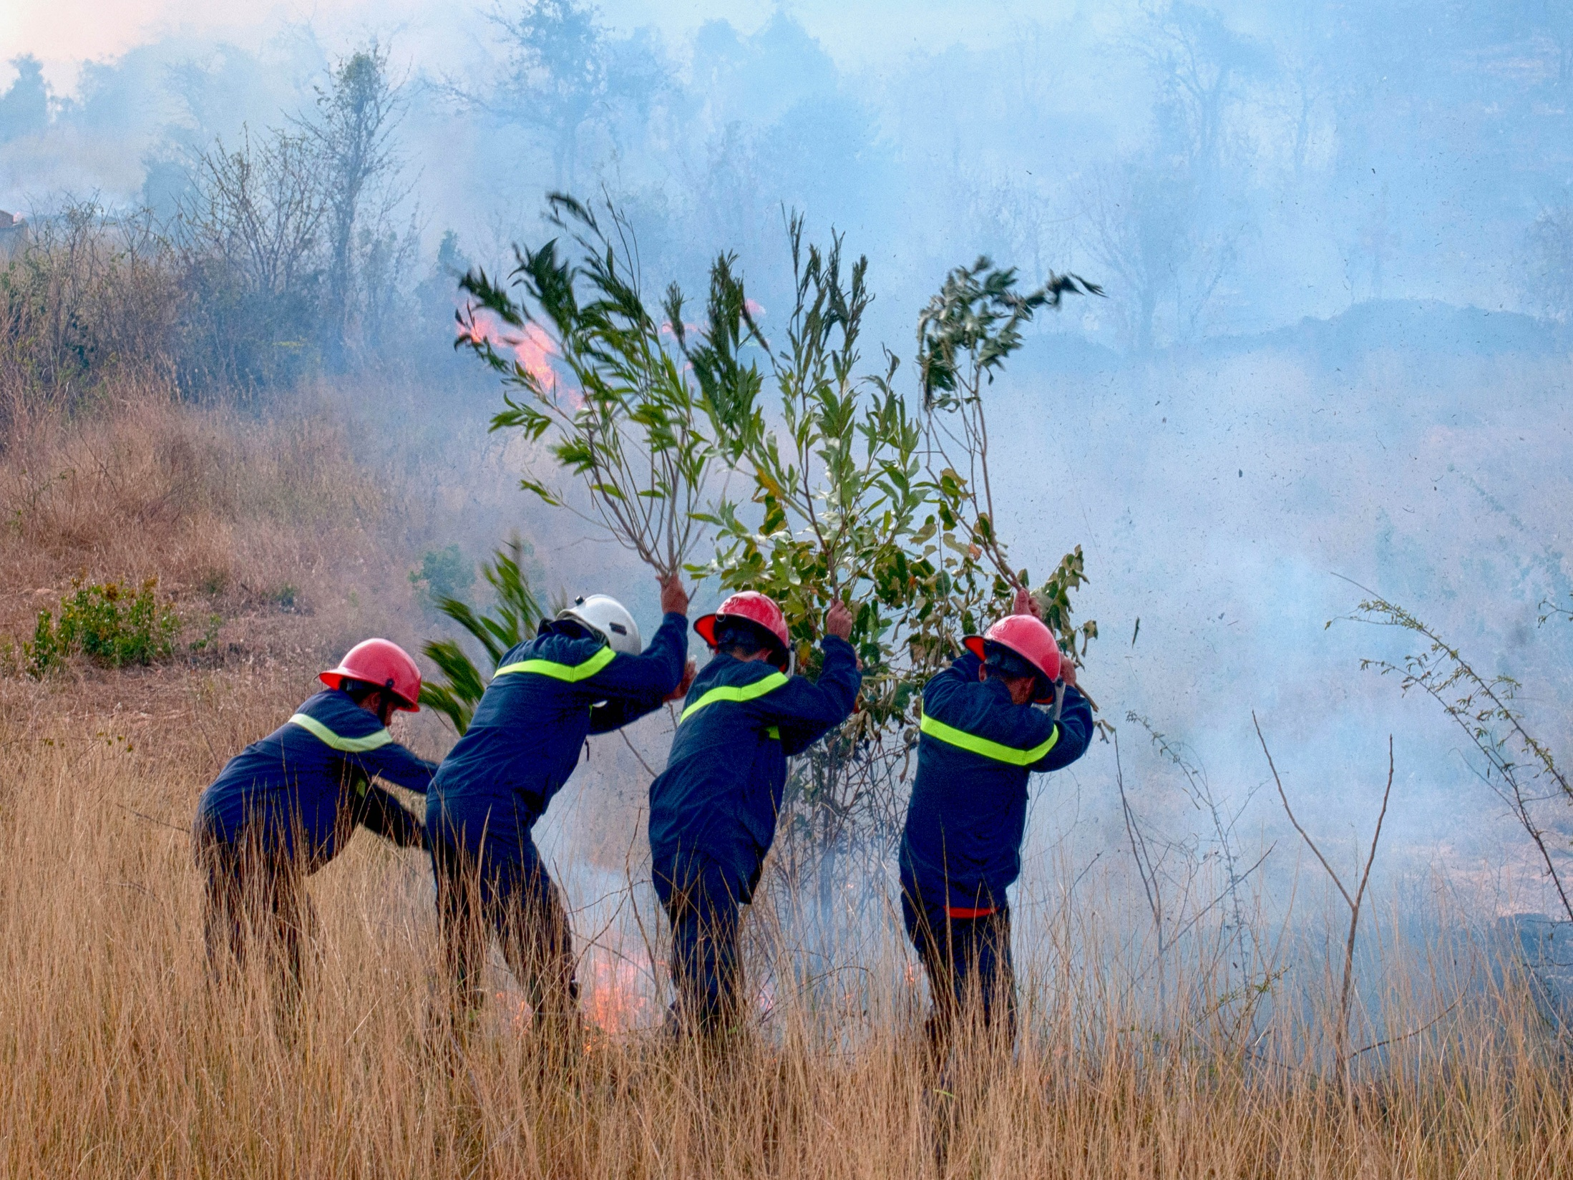
CHALLENGES ENCOUNTERED
Communication is not considered as the one of priority outcomes (under leader’s eyes)
Official REDD+ material has been available at the end of last year (REDD+ academy)
Communication officers have not been participated to TOT or trainings of REDD+ academy
Communication officers have to be in charged of many other activities (procurement, event organization…)
No more budget in the extended phase (2016-2018), less money for communication activities
Support and cooperation from other technical units is not very good

Slide 7
Support requested from regional KM/Comms Specialist
More meetings to exchange experience among REDD+ countries
TOT on REDD+ academy for communication officers
Produce REDD+ communication materials for some typical targeted groups, and REDD+ countries translate into their language
Organize yearly offline forum to share successful REDD+ stories and REDD+ heroes among REDD+ countries

Slide 8
Thank You
Tran Minh Phuong
cintapo@gmail.com
http://vietnam-redd.org/Web/Default.aspx?lang=en-US

