Slide 1
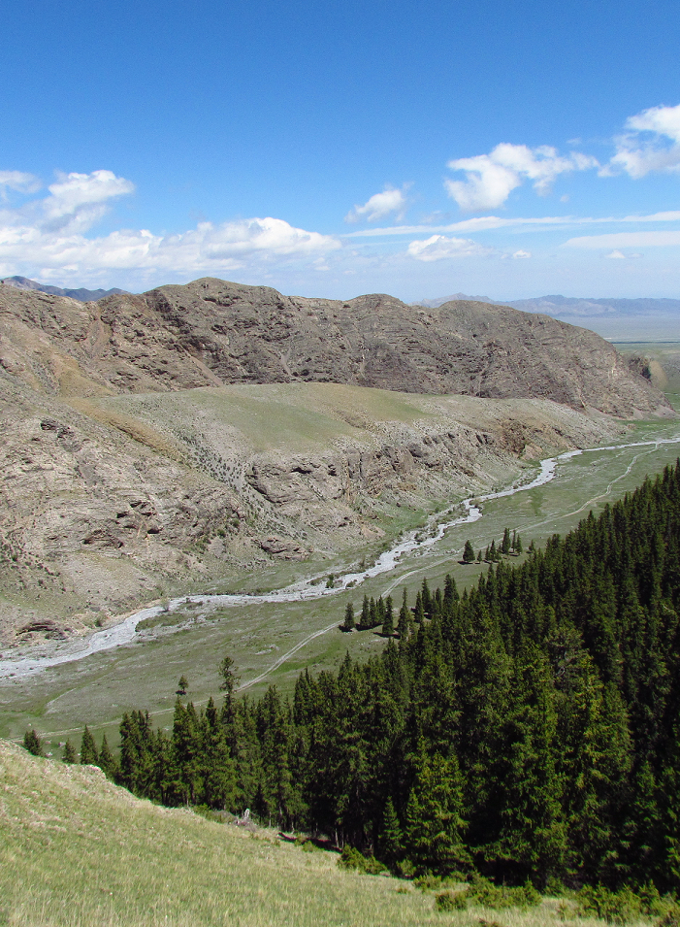
Summaries of Information
Global progress overview
Charlotte Hicks
27 October 2017 | Hanoi

Slide 2
Outline
UNFCCC requirements and guidance
Progress to date – global overview

Slide 3
UNFCCC Safeguards Requirements
2
Countries promote & support the Cancun Safeguards throughout REDD+ implementation
Safeguard information system (SIS) to provide information on how the country is addressing and respecting the Cancun safeguards
Summary of information on how the Cancun safeguards are being addressed and respected submitted before results-based payments
1
3
Notes:
These are the three key messages to remind us that there is more to UNFCCC safeguard requirements than the SIS
Requirement no. 1 – safeguards need to be operationalised throughout the implementation of REDD+ activities – is often overlooked and eclipsed by the tangible outputs of the other two key requirements: SIS and summary of information

Slide 4
UNFCCC requirements for summaries (1)
… to obtain and receive results-based payments from REDD+ …
WHAT? - Most recent summary of safeguards information submitted to UNFCCC
WHEN? - Summaries should be submitted with national communications (every four years)
- Directly to the UNFCCC REDD+ web platform on a voluntary basis (any time)
- Starting upon implementation of REDD+ actions
Notes:
9/CP.19, paragraph 11
UNFCCC Decision 12/CP.17 (Durban, 2011)
3. Agrees also that developing country Parties undertaking the activities referred to in decision 1/CP.16, paragraph 70, should provide a summary of information on how all of the safeguards referred to in decision 1/CP.16, appendix I, are being addressed and respected throughout the implementation of the activities;
4. Decides that the summary of information referred to in paragraph 3 above should be provided periodically and be included in national communications, consistent with relevant decisions of the Conference of the Parties on guidelines on national communications from Parties not included in Annex I to the Convention, or communication channels agreed by the Conference of the Parties;
UNFCCC Decision 9/CP.19 (Warsaw, 2013)
4. Agrees that developing countries seeking to obtain and receive results-based payments in accordance with decision 2/CP.17, paragraph 64, should provide the most recent summary of information on how all of the safeguards referred to in decision 1/CP.16, appendix I, paragraph 2, have been addressed and respected before they can receive results-based payments;
11. Decides that the information hub will contain, as reported through the appropriate channels under the Convention:
c) The summary of information on how all of the safeguards referred to in decision 1/CP.16, appendix I, are being addressed and respected, as referred to in decisions -/CP.199 and 12/CP.17, chapter I;
UNFCCC Decision 12/CP.19 (Warsaw, 2013)
1. Reiterates that according to decision 12/CP.17, paragraph 3, developing country Parties undertaking the activities referred to in decision 1/CP.16, paragraph 70, should provide a summary of information on how all of the safeguards referred to in decision 1/CP.16, appendix I, are being addressed and respected throughout the implementation of the activities;
2. Also reiterates that according to decision 12/CP.17, paragraph 4, the summary of information referred to in paragraph 1 above should be provided periodically and be included in national communications, or communication channels agreed by the Conference of the Parties;
3. Agrees that the summary of information referred to in paragraph 1 above could also be provided, on a voluntary basis, via the web platform on the UNFCCC website;
4. Decides that developing country Parties should start providing the summary of information referred to in paragraph 1 above in their national communication or communication channel, including via the web platform of the UNFCCC, taking into account paragraph 3 above, after the start of the implementation of activities referred to in decision 1/CP.16, paragraph 70;
5. Also decides that the frequency of subsequent presentations of the summary of information as referred to in paragraph 2 above should be consistent with the provisions for submissions of national communications from Parties not included in Annex I to the Convention and, on a voluntary basis, via the web platform on the UNFCCC website.

Slide 5
UNFCCC requirements for summaries (2)
STRUCTURE? - No UNFCCC-required structure
- Could take the form of
a narrative summary;
a summary of information by indicator;
a detailed principles, criteria and indicator framework
any combination of the above
CONTENT ? - See guidance from CoP21 (next slide…)
LINKS TO SIS? - No explicit requirement for summaries of information to be outputs of the SIS
- Many UNFCCC parties have stated that, once operational, national-level SIS should logically inform summaries of information for international audiences
Notes:
STRUCTURE – options suggested by country, donor and civil society informants during stakeholder consultations for (2015) UN-REDD SIS paper
LINKS TO SIS – as above

Slide 6
Information on national circumstances relevant to addressing and respecting the safeguards
Description of each safeguard in accordance with national circumstances
Description of existing systems and processes relevant to addressing and respecting safeguards
Information on how each of the safeguards has been addressed and respected
Any other relevant information
Information on which REDD+ activities are included in the summary of information
Improving information taking into account a stepwise approach
4.
UNFCCC Guidance on summaries
Decision
17/CP.21 (Paris)
5.a
5.b
5.c
5.d
6.
7.
Notes:
Red - Countries ‘should’’ provide this information
Orange - Countries are ‘strongly encouraged’ to provide this information
Green - Countries are ‘encouraged’’ to provide this information
Colour coding used throughout in slide titles

Slide 7
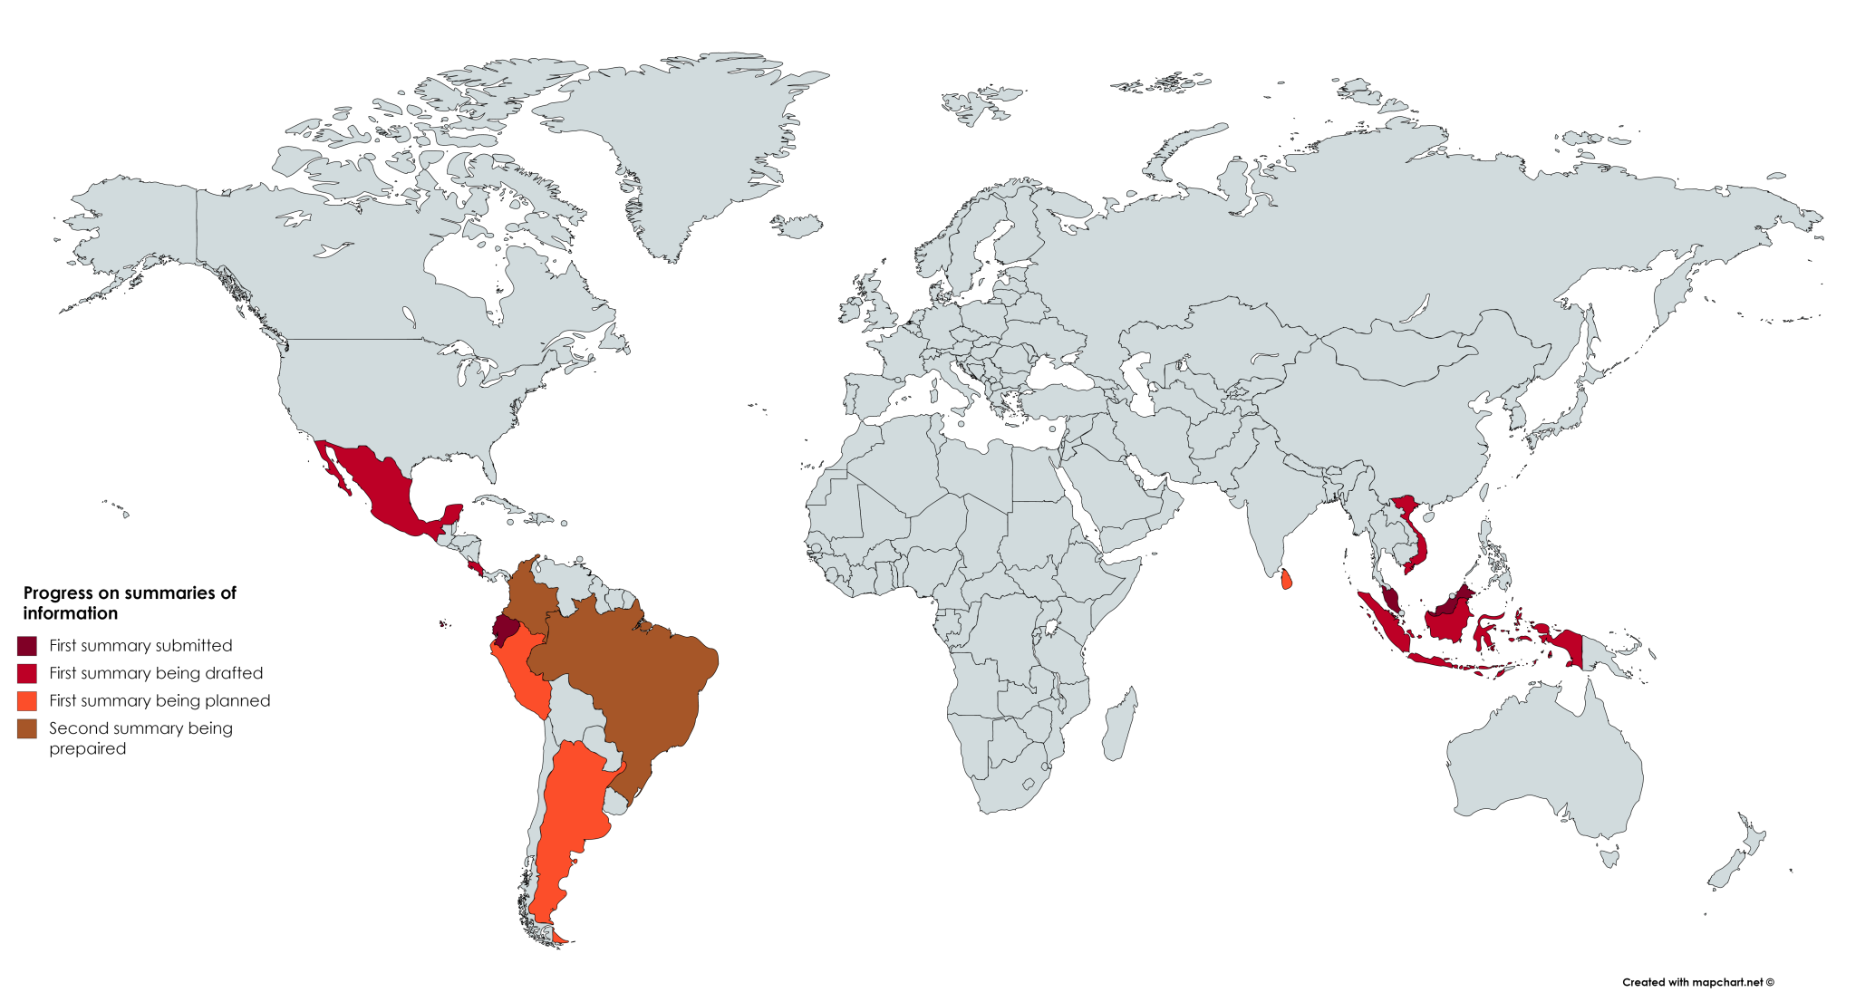
?
Progress on summaries of information
Notes:
Brown: Second summary under prep (Brazil, Colombia)
Dark red: first SOI submitted (Malaysia, Ecuador)
Red: first summary being drafted (Mexico, VN, Indonesia)
Orange: First summary being planned (SL, Argentina, Peru)

Slide 8
Some observations of ‘early’ summaries of information
Focus is on readiness phase; most countries not yet started implementing REDD+ polices and measures
Although the distinction made between addressing and respecting, limited information on respecting (especially outcomes)
Action plans of gap-filling measures, on how the safeguards will be addressed/respected, are often overlooked
SIS design descriptions weak in general, especially on links to NFMS, and how SIS will inform future summaries when it comes to implementation
No mention of GCF in any summary submitted to UNFCCC thus far; no country anticipated GCF requirements for results-based payments

Slide 9
Thank you!
Charlotte Hicks | charlotte.hicks@unep-wcmc.org
Connect with us online:
www.un-redd.org
www.unredd.net

