Slide 1
Coordination between the development processes of National REDD+ strategy and Safeguards: Experiences from Bhutan REDD+ Readiness (so far?)
Regional South-South Learning event on country approaches to REDD+ safeguards and Safeguard Information Systems
26-27 October 2017, Hanoi, Vietnam
Samten Wangchuk
Department of Forest and Park Services, Ministry of Agriculture and Forests, Royal Government of Bhutan

Slide 2
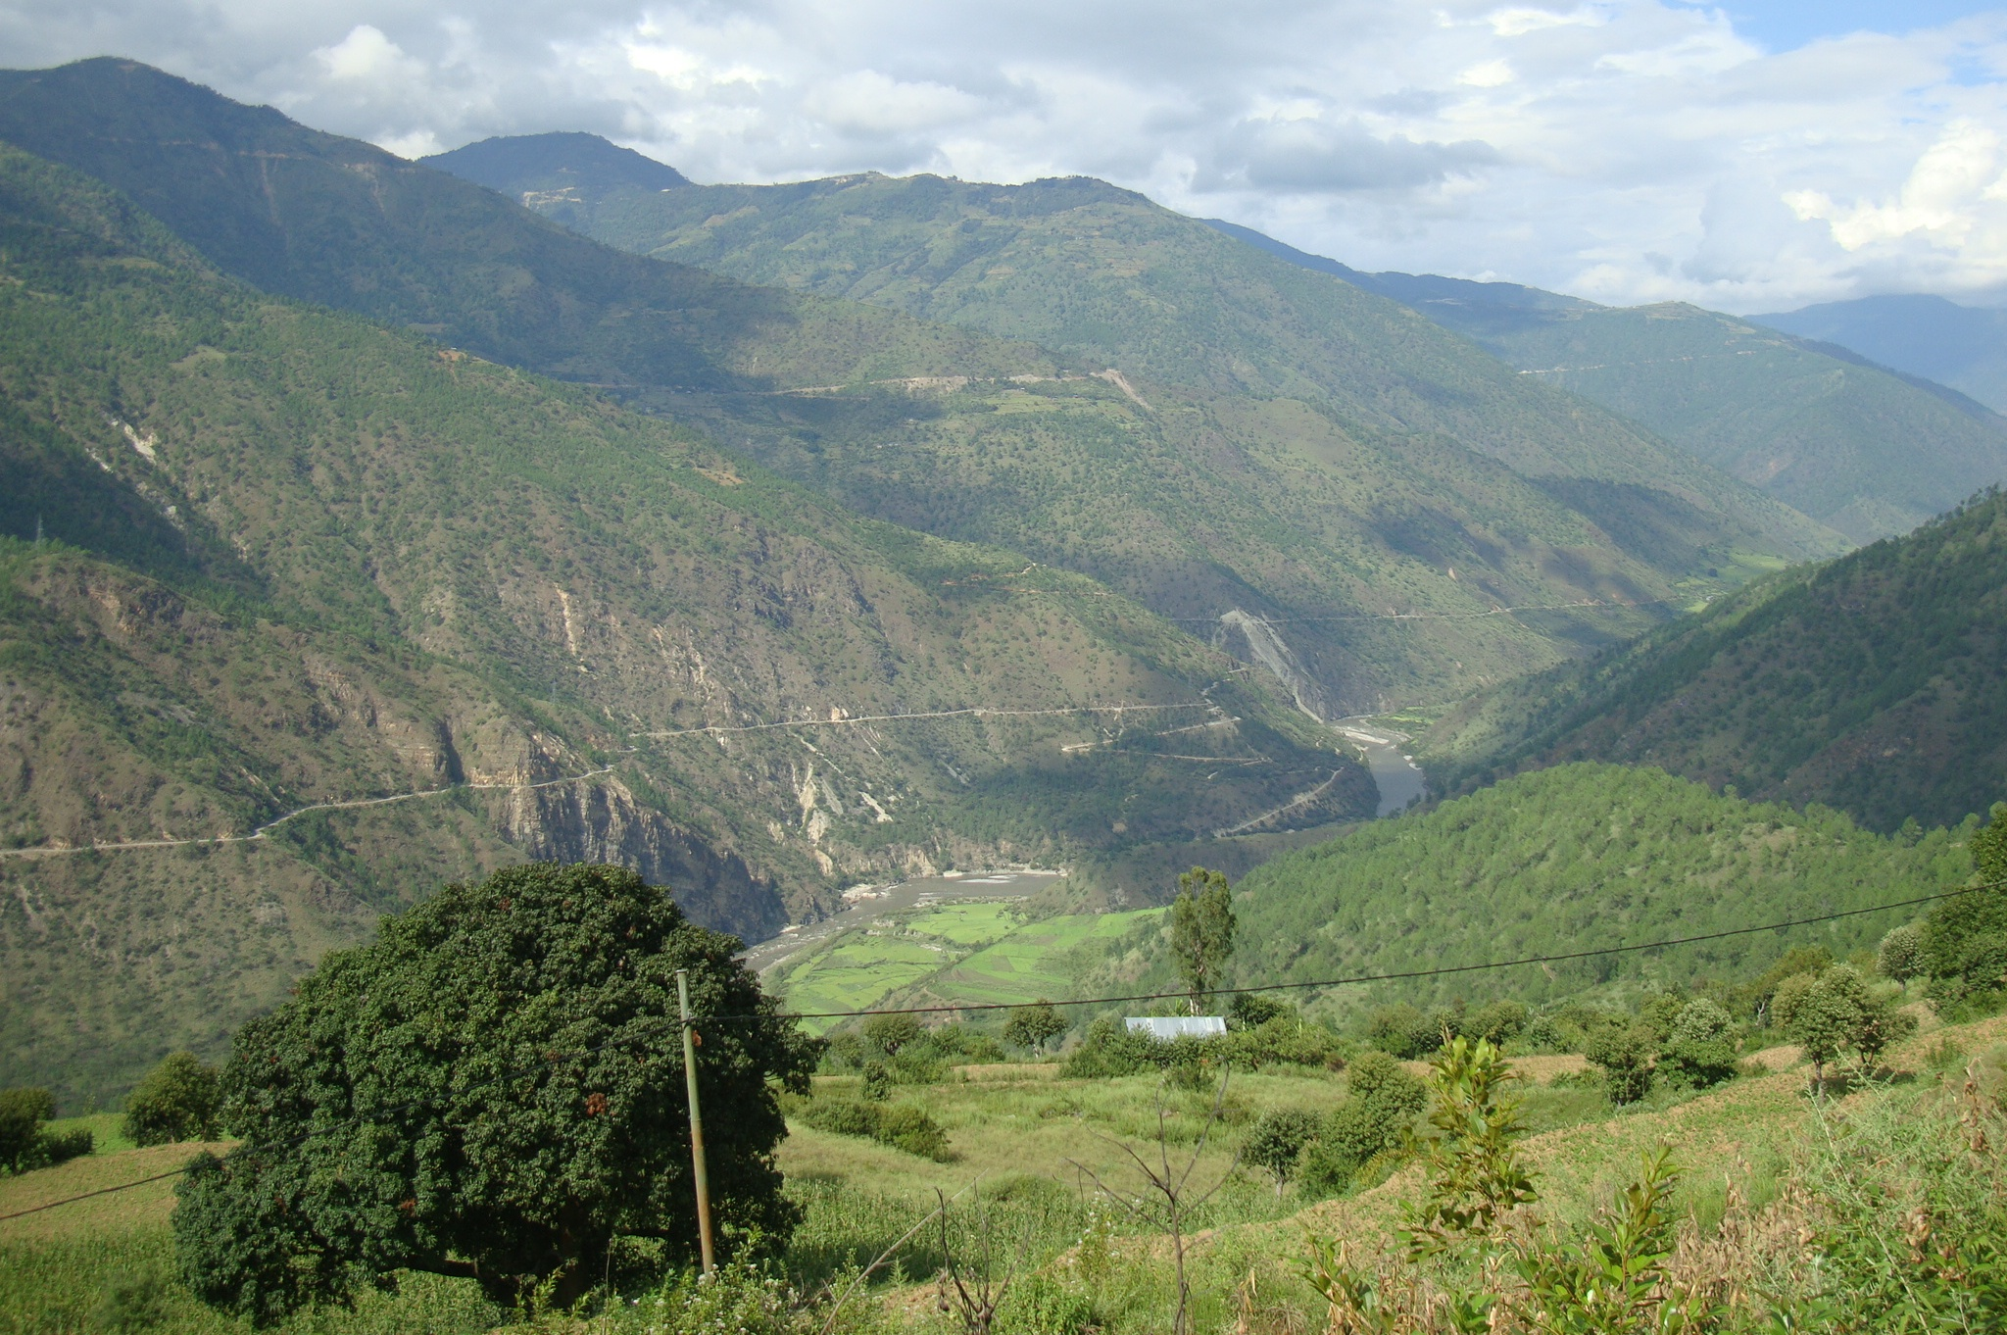
Presentation lay out
Brief updates
Processes
Challenges
Opportunities
Lessons

Slide 3
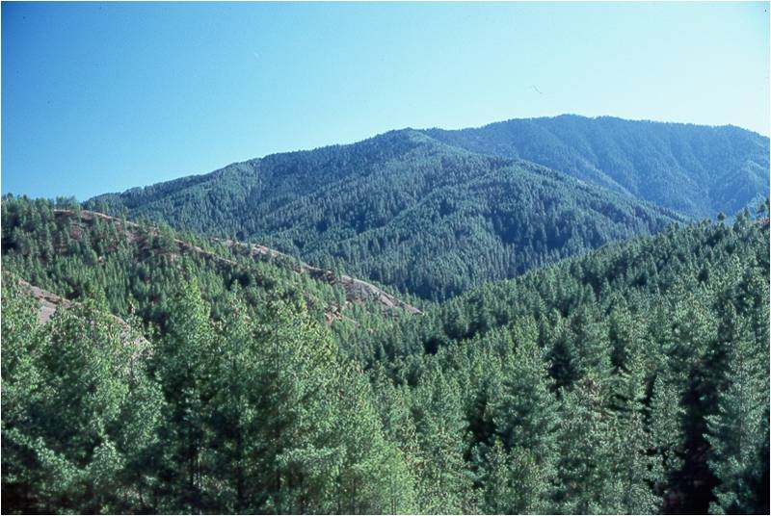
Brief updates
REDD+ Readiness phase (2014-2019)
REDD+ Strategy/Action Plan
Drivers study: preliminary strategy options identified
Intensive field consultations of the strategy options and PAMs under process
Safeguards (SESA/ESMF/SIS)
A roadmap to country approach to REDD+ Safeguards for Bhutan 2016
Corruption Risks Assessments
Stakeholder engagement guideline
Technical Working Group on REDD+ Safeguards
SESA works under process, strategy options finalization December will lead to safeguards works

Slide 4
Processes (linking processes)
Followed/following sequence in the development of National REDD+ strategy and Safeguards
Drivers of d & d study completed in 2016
REDD+ strategy works started in May 2017 (9 months) and safeguard works in June 2017 (12 months)
Draft strategy options/interventions defined by December, 2017
SESA and identification of relevant safeguards based on defined strategy options (national consultants recruited to support international)
Ensure engagement of similar stakeholders: eg: Joint workshop on REDD+ strategy and safeguards in Aug 2-4, 2017
REDD+ strategy consultations almost completed
REDD+ strategy consultation teams will carry out conduct consultations onrelevant safeguards
Possibility to link NFMS (ongoing) to SIS???
Conclusion: Proper sequencing of different REDD+ works is pivotal: Safeguards follow the REDD+ strategy options

Slide 5
Challenges
Challenges | Attempts to address
Lack of information | Rely on available data
Lack of competence (REDD+ TWGs and secretariat) | Capacity buildings of TWG members Workshops, study visits to advanced countries
Uncertainty of future REDD+ | Cautious on REDD+ awareness programs with the communities

Slide 6
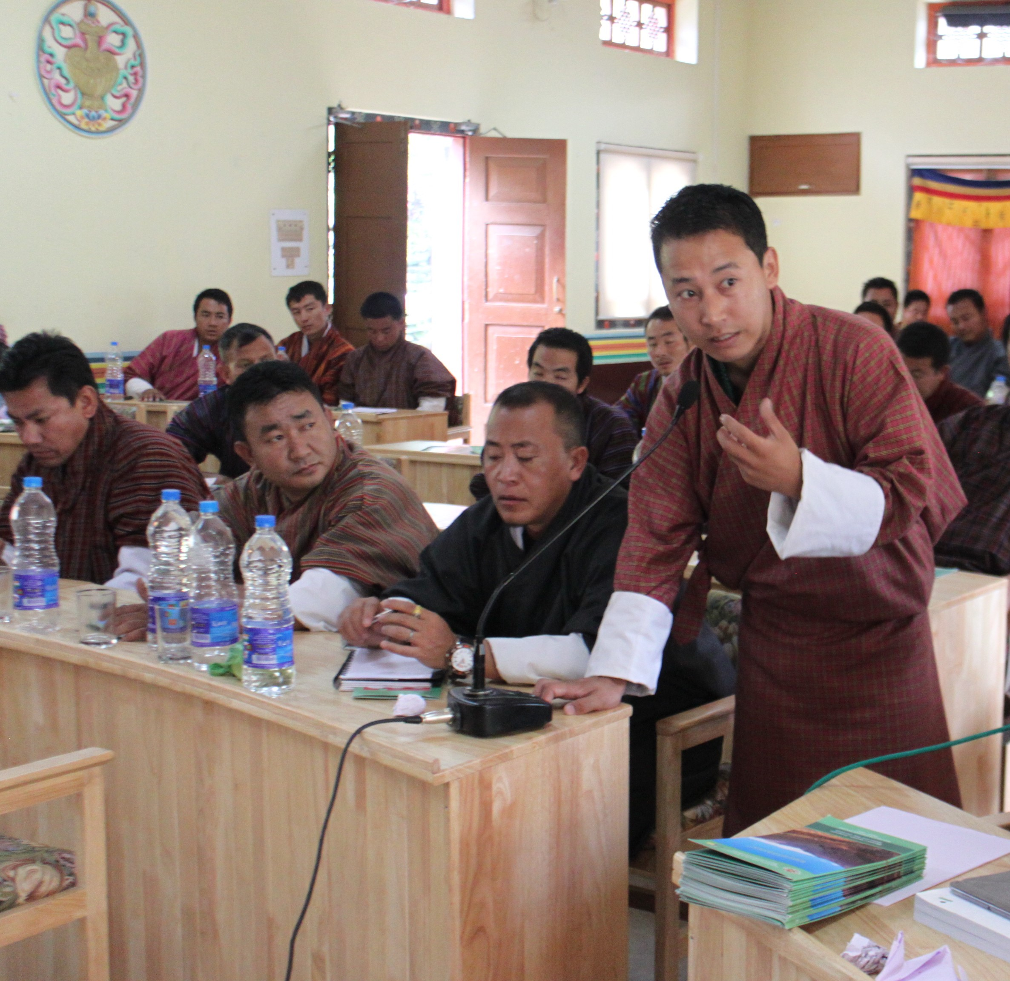
Opportunities
Comprehensive review of PLRs and linking to Cancun safeguards
Considering all safeguards as a package (SESA/ESMF and SIS):
Safeguard objectives to meet WB/FCPF and UNFCCC safeguard requirements
REDD+ secretariat is mandated to coordinate various safeguards from the outset
Engagement of all relevant stakeholders (different levels, different groups)
Learning process (exchange programs for TWG members) and learn from advanced countries

Slide 7
Lessons
REDD+ strategy options to be defined before identifying safeguards
Building on existing systems (wherever possible)
REDD+ (readiness phase) benefits nationally-no regret strategy: institutional capacity, stakeholder engagement and information generation (NFI, FIMS, NFMS)
Heritage forest (14 till now), NFI (first report on NFI published), Land use land cover mapping (LULC 2016), database on forest information management system, awaraness workshops to academic institutes, built capacity of forestry for forest management and other stakeholders

Slide 8
THANK YOU
For the opportunity to
present and learn!

