Slide 1
Cambodia Experience on
KM and Communications Work
By Tola SEM
23 August 2016

Slide 2
REDD+ Progress in Cambodia
Readiness
Implementation
Result-based Payment
NRS
NFMS
SIS
FEL
In transition
Notes:
Based on decision adopted at UNFCCC, REDD+ program in Cambodia has three phases: Readiness, Implementation and Result-based payment. Cambodia is now in a transition period from the Readiness phase to the Implementation Phase as most of the required document by the WARSAW Framework are mostly finalized.
The NRS has reached a finalized stage. The final National Consultation workshop will be organized next week.
We have produced an initial draft of NFMS and presented in UNFCCC CoP21
FRL is under developed and expected to finalize at the end of year as the National forest cover inventory is being printed.
With regard to SIS, there have been a number of consultation workshop with key stakeholder and community people to set Cambodia guideline and principle for safeguard. We have done assessment on existing policies, laws, and regulations and now we are working on environmental and social impacts assessment

Slide 3
REDD+ Information Flow
National Council for Sustainable Development
National REDD+ Taskforce
Consultation Group
REDD+ Taskforce Secretariate
Technical Team
Stakeholder
Generate
Gather
Organize
Store
Disseminate
Notes:
This is the main institutional framework of REDD+ program in Cambodia. Currently, REDD+ Taskforce secretariat act as a main body in developing and implementing REDD+ communication strategies. It generate information, store, and disseminate information from and to all key stakeholders.

Slide 4
Knowledge Management Status
Process | Mechanism | Status
Generate | Meetings Collect stories, policies decisions, technical document | No Knowledge Management Strategy. What we need: Refine information flow Have proper information clearance body Enhance the effectiveness of the system Have a good knowledge sharing platform etc Have sustainable mechnim
Gather
Organize
Store | Electronic : Website Physical: RTS Office, Forestry Administration, MoE
Disseminate | Electronic, print products, workshop, training
Notes:
The definition of Knowledge Management has not yet fully defined under Cambodia REDD+ program, but we are having an established mechanism to be further enhanced.

Slide 5
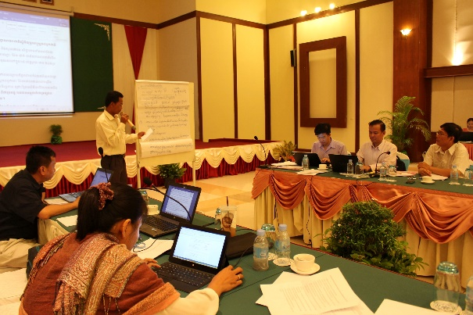
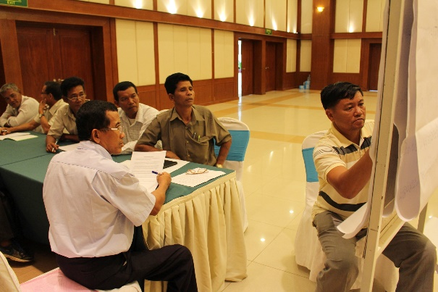
Com. Strategy
Ex. Com
NRS
Ass. Consultation
Developing a new Com. Strategy
Institutional changes
Assessing existing Com. Strategy
Assessing media products
Consultation with key stakeholders
National REDD+ Strategy (NRS)
→ expected to finalize in Nov. 2016.
New Com.
Photo by FCPF, 2016: Consultation with preventatives of local communities and Indigenous People
Notes:
The FCPF has been carrying forward most of the activities from UNREDD+ communications strategies which was produced in 2014.
Now, the new com. Strategy is under developed. Since, we have a lot of changes in intitional changes between the ministry of Environment, Ministry of Agriculture, Fishery

Slide 6
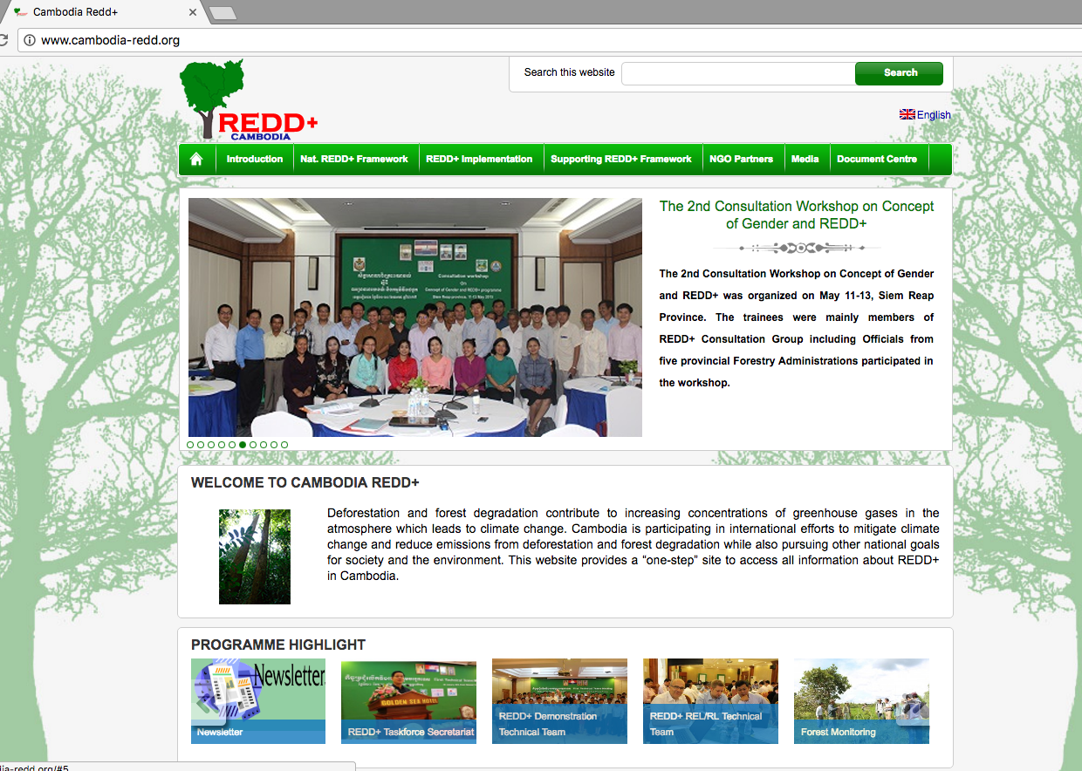
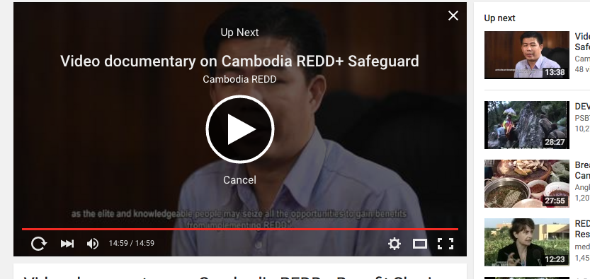
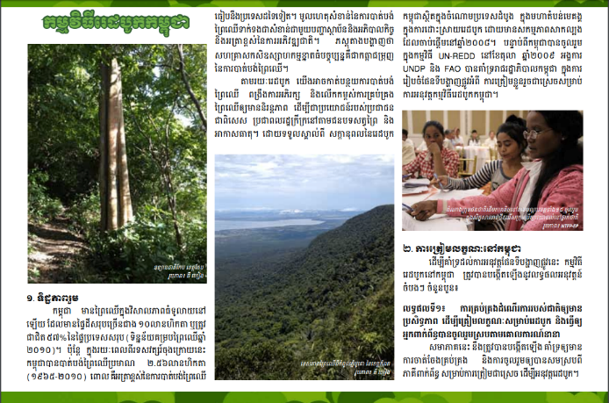
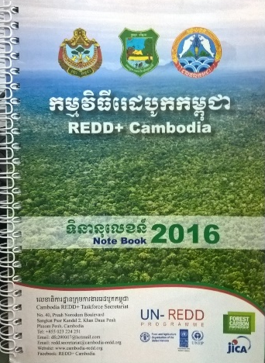
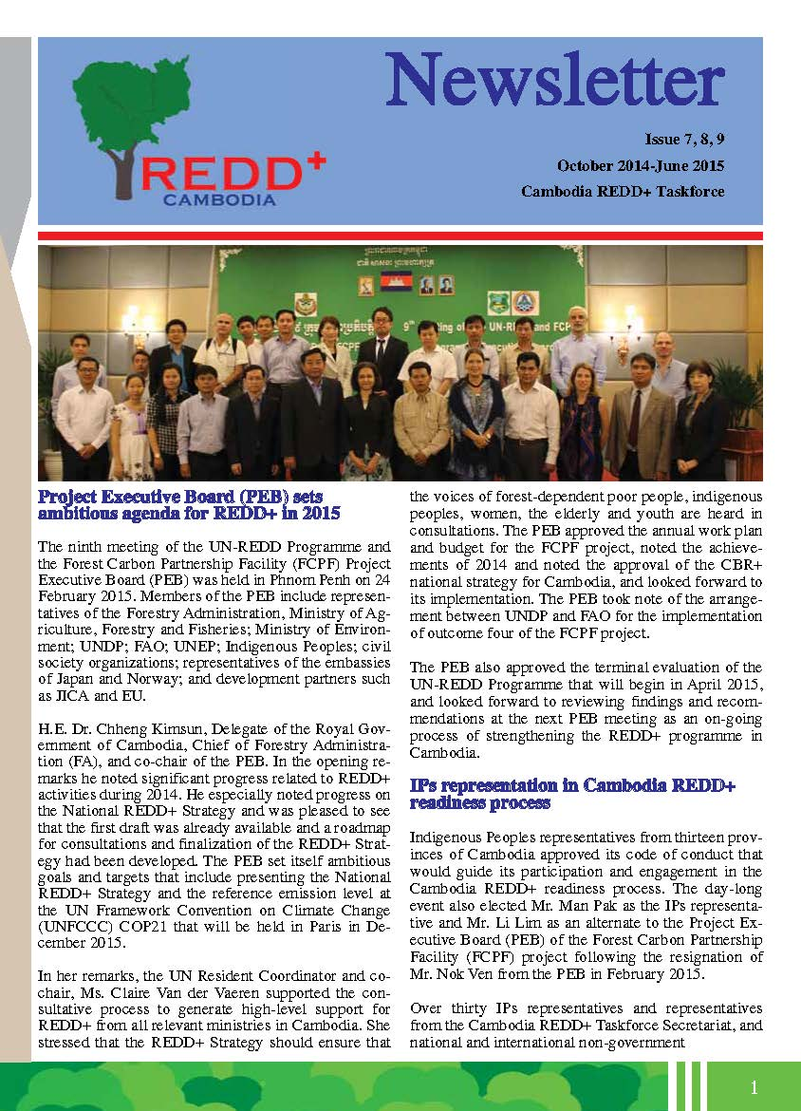
Progress
Website
Facebook
Print products
Video and Radio Talk Show
Notes:
Produced number of communications products: print products, and mass media
Roll out many awareness raising workshop from national to local level
Plan to organize Knowledge Sharing Platform
All REDD+ related projects
May participated by some REDD+ countries to share experience

Slide 7
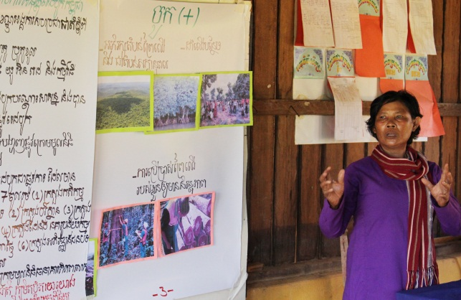
Progress
Awareness raising
Plan to organize Knowledge Sharing Platform
All REDD+ related projects
May request other countries to share experience
Notes:
Produced number of communications products: print products, and mass media
Roll out many awareness raising workshop from national to local level
Plan to organize Knowledge Sharing Platform
All REDD+ related projects
May participated by some REDD+ countries to share experience

Slide 8
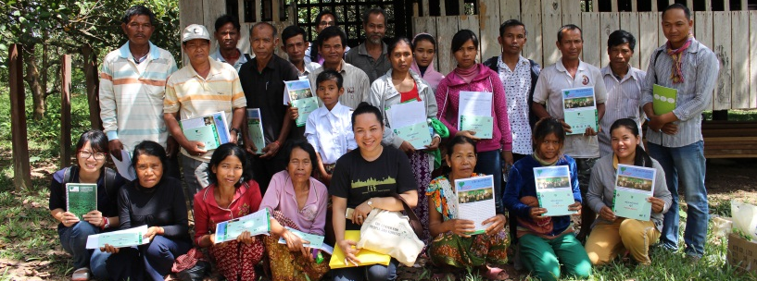
Achievement ?
Communication assessment
Not just about how they understand out REDD+, but how they respond

Slide 9
Challenges encountered
Language barrier
Misunderstanding
- Scientific information
- Too much promise
Limited access to key document
No systematic information flow
- very much adhoc
Notes:
Comprehensive directory of insititions and experts inolved in REDD+ activities,

Slide 10
Support requested from regional KM/Comms Specialist
Technical input to KM and Comm. Strategy
Share experience in KM/comms
Participate in Cambodia REDD+ Knowledge Sharing Platform

Slide 11
Thank You
Tola SEM
Tolasreypeou.sem@undp.org
www.cambodia-redd.org
Facebook: Cambodia REDD+ National Program

