Slide 1
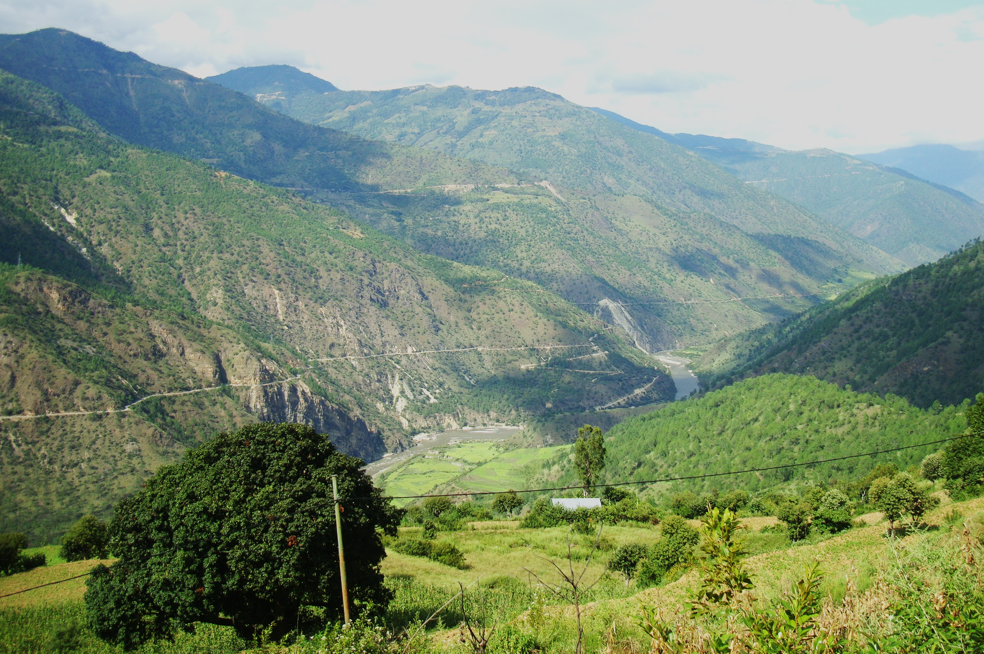
Country Experience on
KM and Communications Work in the context of REDD+ program in Bhutan
By Samten Wangchuk
23 August 2016

Slide 2
Background of the REDD+ KM and related activities
Initiated in 2010: Awareness and sensitization workshops across the country
REDD+ readiness (2014-2018)
Decisions: Stakeholder consultations, three Technical Working Groups (NFMS/FREL, Safeguards, Strategy option), MoAF and cabinet (for policy level)
REDD+ Readiness involves capacity building, awareness workshops for the field stakeholders and communities, Strategy implementation
Continued engagement with stakeholders in terms of workshops, meetings, bilateral discussions, field visits, focus group discussions for all works under REDD+ readiness

Slide 3
Awareness workshops on REDD+ ( 2010 – 2013)
Workshops | Target Audience | Date
Awareness Raising Seminar on REDD+ | National Stakeholders involved in natural resources management | Jun. 2010
National Workshop on REDD+ Strategy Development in Bhutan http://www.moaf.gov.bt/moaf/?p=7895 | Multi-sector REDD+ stakeholders | Apr. 2012
REDD+ Environmental Safeguard and Multiple Benefits workshop http://www.dofps.gov.bt/node/507 | National REDD+ stakeholders and probable implementers (District Officers) | Oct. 2012
National Forest Monitoring System Workshop | National REDD+ stakeholders, technical NFI, remote sensing/ GIS and GHG inventory staff | Dec. 2012
Awareness at district level | 11 districts (4 region) | 2013

Slide 4
Results/progress/achievements
Completed activities
Activities | Outcomes
REDD+ Academy October 2015 (UNREDD) | ToT (15), General (26)
REDD+ Safeguard workshop (Oct. 2015) | BeRT tool introduced to TWG safeguards
Initial PLR reviews completed | Majority PLRs addresses safeguards to large extent, respecting component yet to study
CRA, SE guideline, | Contribute to GRM and SIS
Country approach to Safeguard | SIS development
National Forest Inventory (field works) | 2012-2015
Capacity building on FREL and MRV | 2015

Slide 5
Ongoing and upcoming activities
Activities | Expected outcomes
Analysis of NFI data | Carbon stock
Drivers of deforestation and forest degradation and barriers to plus activities | Drivers, REDD+ strategy options, due in December 2016
SESA, ESMF, SIS and GRM, | ToRs finalized
FRL, FREL, MRV | ToRs finalized
Strategy options, Benefit sharing, fund mobilization | ToRs finalized

Slide 6
Challenges encountered
Technical Capacity: e.g. data analysis for NFI
Development of SIS: no clear guideline, or example
Lack of national capacity: most often rely on international experts

Slide 7
Support
Forum (such as this) to learn and exchange experiences from other advanced countries
Technical support as and when required

Slide 8
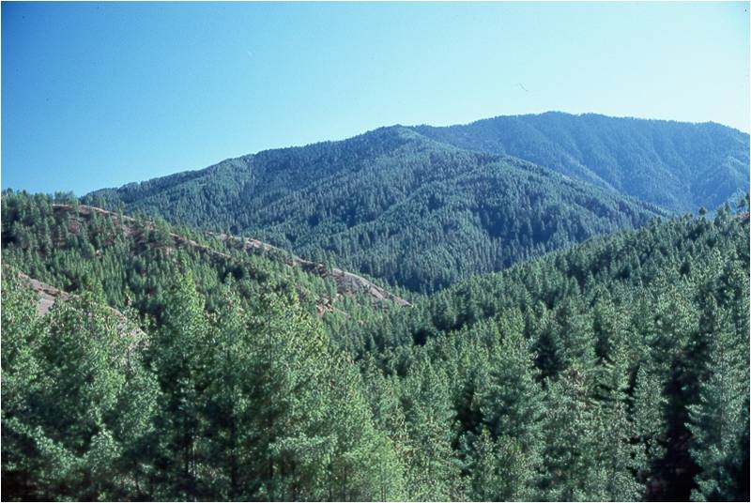
Thank You
Samten Wangchuk
Email: samtenwangchuk@moaf.gov.bt

