Slide 1
ASSESSMENT OF LAND COVER CHANGES AND ITS IMPLICATIONS ON CARBON STOCK IN OLD OYO NATIONAL PARK, NIGERIA.
by
Oluwole John PELEMO
Forestry Research Institute of Nigeria
Remote Sensing & GIS Section

Slide 2
Introduction
What is forest?
Is defined as an area of land having a minimum size of 0.5-1 hectares, tree crown cover of greater than 10-30%, and trees having the potential to reach a minimum height of 2-5 meters at maturity (FAO unpublished report of expert consultation “Kotka III”).
Tropical forests play a very significant role in mitigating global climate

Slide 3
Nigeria Forest Information and Data
Forested - 9.9% or about 9,041,000 ha, and 382,000 ha of planted forest (U.N. FAO, 2010).
Change in Forest Cover: Between 1990 and 2010, Nigeria lost an average of 409,650 ha or 2.38% per year. In total, between 1990 and 2010, Nigeria lost 47.5% of its forest cover or around 8,193,000 ha.
Nigeria's forests contain 1,085 million metric tons of carbon in living forest biomass.
the International Institute of Tropical Agriculture (IITA, 2011) observed that Nigeria has lost about 400,000 hectares of forest land to deforestation (Sanginga, 2011)

Slide 4
Figure 1: Percentage of biomass in a tree
What is Biomass?
Weight or mass of living plant tissue expressed in metric tons (t).

Slide 5
What is Carbon and Why is there interest in carbon?
C is found in the chemical compounds carbon dioxide (CO2) and methane (CH4) ghgs
burning of fossil fuels such as coal and oil.
concentration of theses gases – global warming

Slide 6
Why is there interest in forest carbon?
Process of photosynthesis
Tropical forest of America, Africa, and Asia are being cleared at a rate of nearly 8.0 million hectares per year (IPCC, 2006).
To maintain tropical forest – (IPCC, 2006)

Slide 7
Justification of the Study
Issues on;
Climate change
Land use land cover
Deforestation
Depleting carbon

Slide 8
Main Objective
Assessment of land cover changes and its implications on carbon stock in Old Oyo National Park, Nigeria with a view to conserve the park.

Slide 9
Specific Objectives
The specific objectives of this study are to;
evaluate land use land cover changes in the park between 2002 and 2015
determine carbon sequestration, stock estimation and storage capacity of trees.
determine the relationship between the carbon values derived by satellite sensor and the carbon biomass content from ground-based measurements
and to examine the correlation between calculated carbon value and estimated carbon value.

Slide 10
Methodology
Old Oyo National Park (located across northern Oyo State and southern Kwara State, Nigeria).
The Park has total land mass of 2,512km²
latitude 8º 15’ and 9º 00’N and longitude 3º 35’ and 4º 42’E.
The study site was divided into 15 plots of 30m x 30m size.

Slide 11
Figure 2: Old Oyo National Park, Nigeria

Slide 12
Software
1. ArcGIS 10.1 for GIS analysis
2. Idrisi for image processing and remote sensing application
3. Landsat images of 2002 and 2015
4. Statistical analysis
5. Microsoft excel

Slide 13
Key parameters to measure include:
1. Tree stem diameter at breast height (DBH)
2. Total height

Slide 14
Aboveground Live Dry Biomass Calculation for Trees/Plot.
AGB_{tree/plot} = (ρ*exp(-1.499+(2.148*In(D))+(0.207*In(D)²-(0.0281*In(D)³))*0.001………………..equation 2
(Chave et. al 2005)
Where ρ is the wood density (g/cm³) and D is the diameter at breast height (cm).

Slide 15
Carbon dioxide emissions calculation for an area deforested or burnt
CO₂ = AGBp* MWCO₂/MWC
Where AGBp = Aboveground Live Dry Biomass
MWCO₂ = Molecular weight of CO₂
MWC = Molecular weight of C.

Slide 16
Determine the weight of carbon in the tree
Therefore, weight of carbon = DWx0.5
where, DW = dry weight

Slide 17
Geo-spatial mapping and estimation of above ground carbon stock.
Results were displayed in form of imageries, tables and graphs
a relationship between plot level C-stock with the parameter(s) of remotely-sensed data (NDVI) representing vegetation density

Slide 18
NDVI calculation
The NDVI basically measures the slope of the line between the origin of red-NIR space and the red-NIR value of the image pixel.
NDVI = NIR-Red/NIR+Red
where NIR=value of near infra red channels;
red=value of visible-red channel
percentage with the lowest original value (-1)
presented as 0 and the highest (1) as 100.

Slide 19
SAVI calculation
SAVI = ((NIR-Red)/(NIR+Red+L)) * (1+L)
Where L is a correction factor and its value is dependent on the vegetation cover. For total vegetation cover it receives a value of zero, effectively turning SAVI into NDVI. For very low vegetation cover, it receives the value of 1.
Huete (1988) suggested that the value of 0.5 is used when vegetation cover is unknown, as 0.5 represents intermediate vegetation cover.

Slide 20
RESULTS
Old Oyo National Park, Nigeria was;
† Classified into four classes namely;
i. Savanna/Rock outcrop
ii. water body
iii. light forest
iv. dense forest,
† Results were displayed in form of imageries, tables and graphs

Slide 21
Figure 3 : Sample plots of Old Oyo National Park, Nigeria

Slide 22
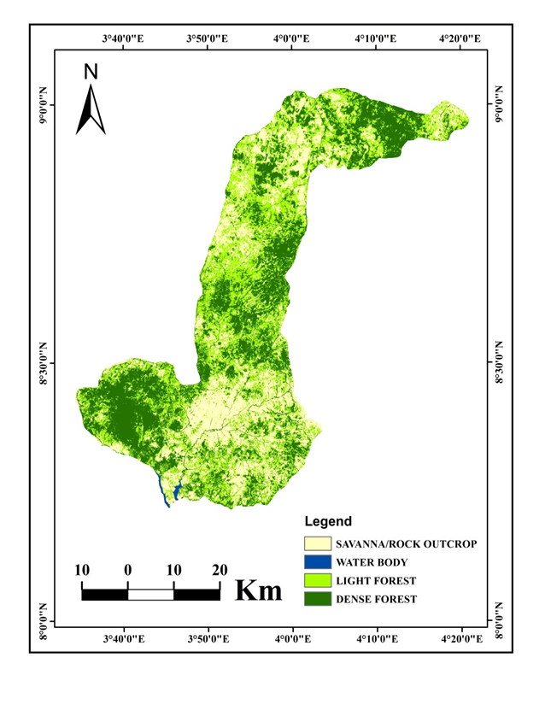
2002 2015 Figure 4: Land use land cover of Old Oyo National Park, Nigeria

Slide 23
Table 1: 2002 and 2015 Land use Land cover of Old Oyo National Park, Nigeria
 | 2002 |  | 2015 |  | 2002-2015
Category | Area (%) | Area (ha) | Area (%) | Area (ha) | Difference
Savanna/Rock_outcrop | 14.53 | 364.994 | 27.85 | 699.592 | 334.598
Water_body | 0.20 | 5.024 | 0.26 | 6.5312 | 1.5072
Light_forest | 33.67 | 845.790 | 35.39 | 888.9968 | 43.2068
Dense_forest | 51.60 | 1296.192 | 36.50 | 916.88 | -379.312
TOTAL | 100.00 | 2512 | 100.00 | 2512

Slide 24
Table 2: Probability Matrix of Old Oyo National Park, Nigeria
SNo |  | Savanna/Rock_outcrop | Water_body | Light_forest | Dense_forest | Total
1. | Savanna/Rock_outcrop | 0.4638 | 0.0004 | 0.3628 | 0.1731 | 1
2. | Water_body | 0.2198 | 0.5827 | 0.1382 | 0.0593 | 1
3. | Light_forest | 0.3350 | 0.0000 | 0.4010 | 0.2640 | 1
4. | Dense_forest | 0.1913 | 0.0000 | 0.3226 | 0.4861 | 1

Slide 25
Table 3 :Categories of Land Cover for AGB and NDVI in Old Oyo National Park, Nigeria
PLOTS | CATEGORY | NDVI | AGB
4 | Forest | 0.23 | 47.01
10 | Forest | 0.23 | 41.46
11 | Forest | 0.12 | 38.49
13 | Close_savanna | 0.18 | 37.74
15 | Forest | 0.21 | 42.97
16 | Forest | 0.20 | 39.86
17 | Close_savanna | 0.13 | 35.40
19 | Forest | 0.13 | 38.95
21 | Forest | 0.20 | 41.85
22 | Forest | 0.27 | 43.59
23 | Forest | 0.23 | 42.86
25 | Close_savanna | 0.04 | 34.77
27 | Forest | 0.21 | 41.82
29 | Forest | 0.19 | 42.49
30 | Forest | 0.27 | 45.85
31 | Forest | 0.21 | 40.57

Slide 26
Figure 5: Relationship between NDVI and aboveground carbon-stock (logarithmic scale) of selected sample plots in Old Oyo National Park, Nigeria.

Slide 27
Interpretation of regression analysis of AGB against NDVI of selected plots
R² value 0.7250 suggests that NDVI accounts for or predicts 72.5 per cent of the variation in above-ground biomass. Correlation coefficient of 0.8515 between above-ground biomass and NDVI equally suggest high correlation.
Evidence in this result showed confidence that NDVI has high correlation with above ground biomass.

Slide 28
Table 4: Categories of Land Cover for AGB and SAVI in Old Oyo National Park, Nigeria
Plots | SAVI | AGB(metric tons)_
2 | 0.12 | 25.67
4 | 0.30 | 47.01
10 | 0.31 | 41.46
13 | 0.23 | 37.74
15 | 0.28 | 42.97
16 | 0.27 | 39.86
17 | 0.17 | 35.40
21 | 0.27 | 32.75
23 | 0.31 | 43.59
25 | 0.06 | 20.47
26 | 0.21 | 34.77
28 | 0.29 | 41.82
29 | 0.25 | 39.87
30 | 0.36 | 42.49
31 | 0.27 | 45.85
32 | 0.33 | 40.57

Slide 29
Figure 6: Above-ground biomass and SAVI in Old Oyo National Park, Nigeria

Slide 30
Interpretation of regression analysis of AGB against SAVI in Old Oyo National Park, Nigeria
R² value 0.7664 suggests that SAVI accounts for or predicts 76.64 per cent of the variation in above-ground biomass. Correlation coefficient of 0.8754 between above-ground biomass and SAVI equally suggest high correlation.
Evidence in this result suggests high confidence that SAVI has some correlation with above ground biomass.

Slide 31
Figure 7: The SAVI for Old Oyo National Park, Nigeria

Slide 32
Figure 8: Regression between carbon-dioxide sequestered and emitted

Slide 33
Interpretation of regression analysis of carbon-dioxide sequestered against emitted
R² value 0.6358 suggests that CO₂ sequestered accounts for or predicts 64 per cent of the variation in above-ground biomass. Correlation coefficient of 0.7973 between CO₂ sequestered and CO₂ emitted equally suggest high correlation.
Evidence in this result suggests little or no confidence that CO₂ sequestered has some correlation relationship with CO₂ emitted.

Slide 34
Discussion
Spectral relationship between vegetation indices and sequestered carbon
The analyses conducted on the relationship between AGB and NDVI, AGB and SAVI, sequestered carbon and emitted carbon, and relationship between the two vegetation indices employed showed that the regression analysis and correlation is good and strong enough.

Slide 35
Implications of land cover changes in the Park (forest)
Tropical forests play a very significant role in mitigating global climate
Global climate change
Biodiversity loss
Not meeting with UNFCCC policy (REDD+)

Slide 36
Conclusion
The relationship between NDVI and carbon stock was distinctly curvilinear as shown in figure above.
While carbon density keeps increasing with increments of woody biomass and growth of trees, NDVI values show saturation at the values of 25 as leaf area index reach a maximum

Slide 37
Recommendations
For environmental and economic value of woody biomass, estimation is important to know forest biomass resources in the country and present these facts to international institutions or in treaties as needed.
This estimation is very important for strategic planning of the use of renewable energy sources from woody biomass.
On the other hand, estimation of the carbon content in forest woody biomass has importance in global climate mitigation policy and processes (Kyoto- and post-Kyoto period).

Slide 38
Suggestions to Sri Lanka Government
Conservation policy for natural habitats - can reduce the amount of carbon dioxide released into the atmosphere
Deforestation should be discouraged
Pubic Private Partnership in forest plantation

Slide 39
APPRECIATION
Government of Sri Lanka
Ministry of Mahaweli Development and Environment
Government of Nigeria
Federal Ministry of Environment, Nigeria
Forestry Research Institute of Nigeria
FAO Staffs
Sri Lanka UN-REDD staffs
Colleagues

Slide 40
Thanks for listening
Thanks for listening

