Slide 2
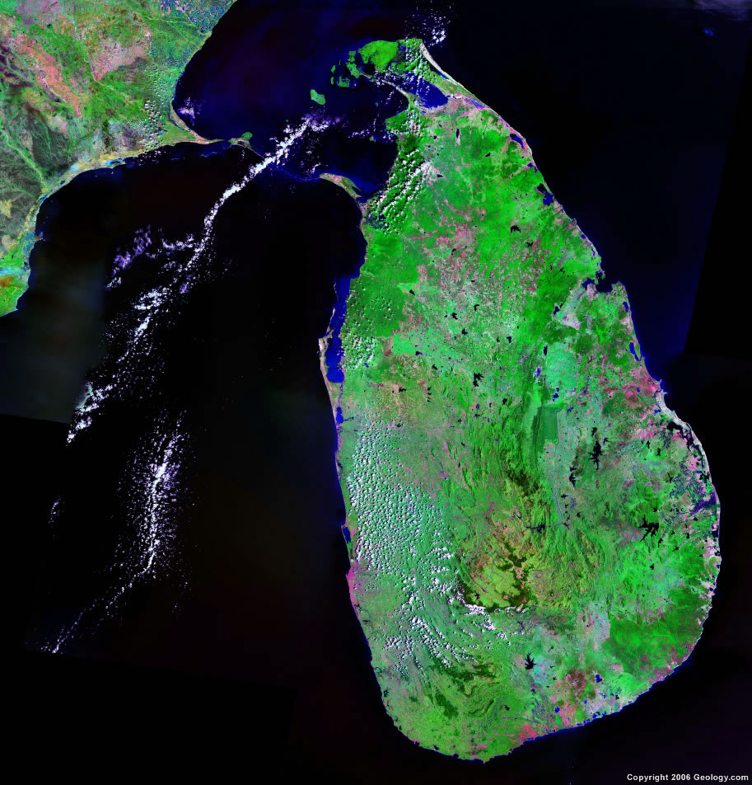
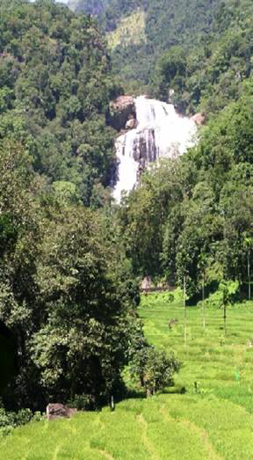
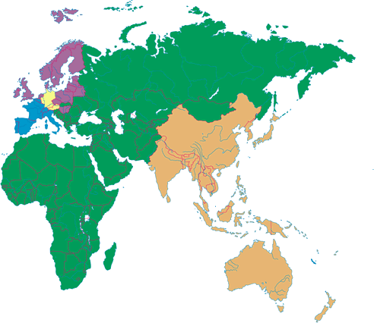

Slide 3
DEVELOPED
COUNTRIES
World Potential
SMALL HYDROPOWER POTENTIAL IN SAARC COUNTRIES
Country | Potential (MW) | Tapped (MW) | %
Bangladesh | 0.15 | 0.01 | 7
Nepal | 1430 | 70 | 5
Sri Lanka | 400 | 302 | 73.5
India | 15000 | 3198 | 21
Bhutan | 8 | 8.0 | 100
Afghanistan | 1200 | 75 | 6
Pakistan | 2265 | 281 | 12
STRINGENT REGULATIONS
PRODUCE MACHINERY
SEND CONSULTANTS
65.4 % in China

Slide 4
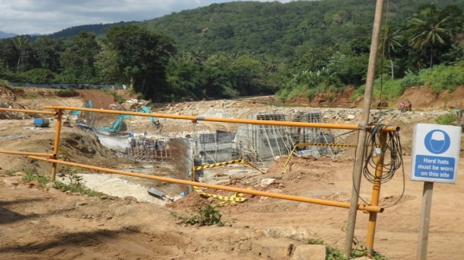
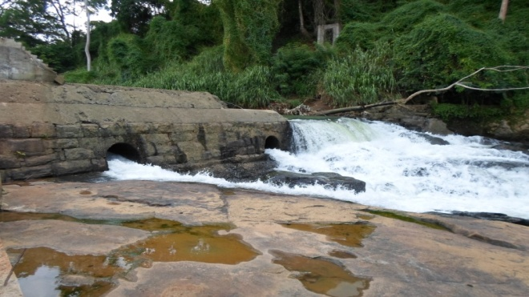
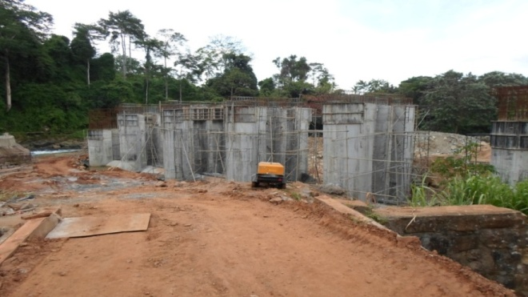
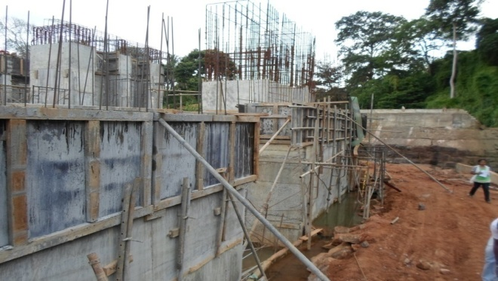
Mini-hydro: Massive Constructions

Slide 5
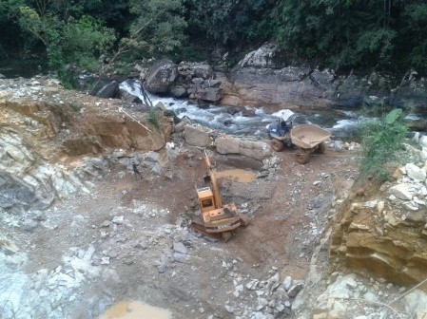
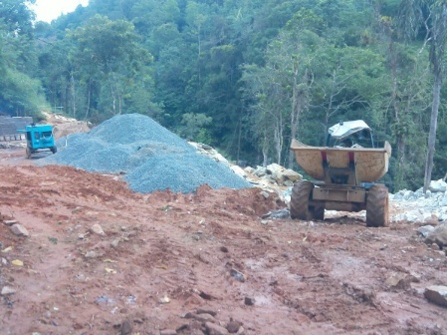
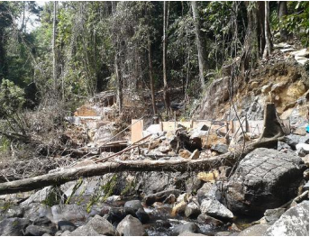
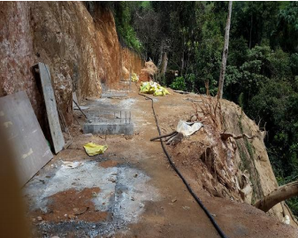
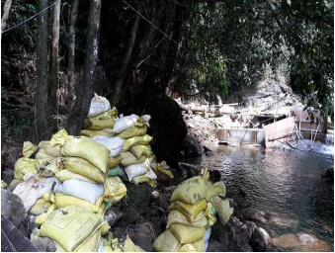
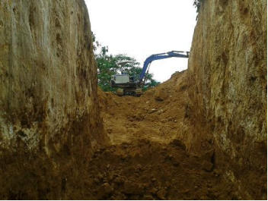
Devastating Destructions

Slide 6
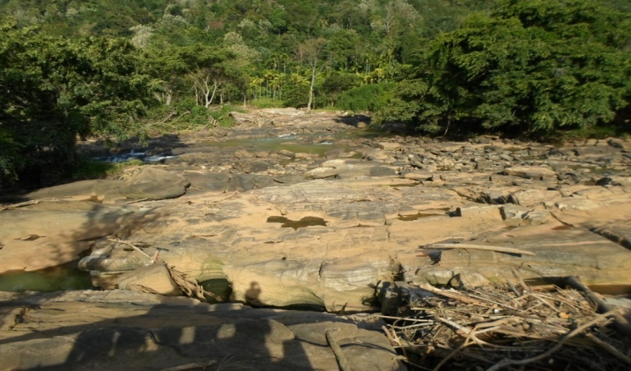
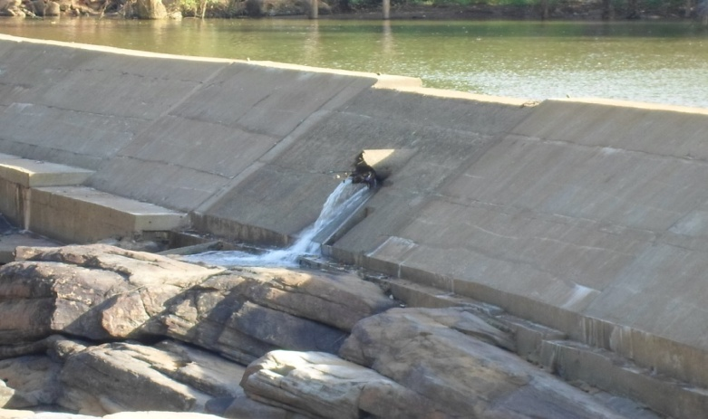
Weirs
Downstream
Downstream
Environmental Flow

Slide 7
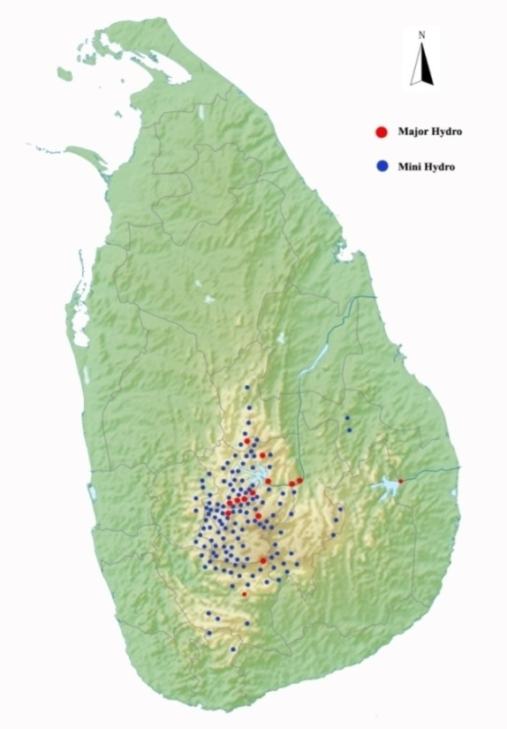
Mini Hydropower Plants in Sri Lanka Mahaweli River 59
Kelani Ganga 32
Kalu Ganga 29
Walawe River 14
Others 13
Total 147
Under construction 63

Slide 8
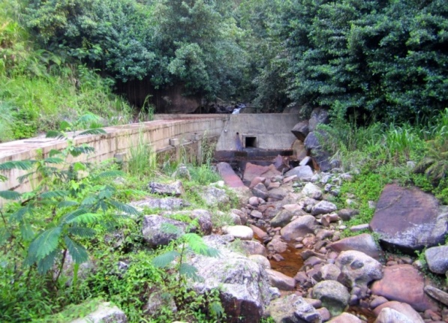
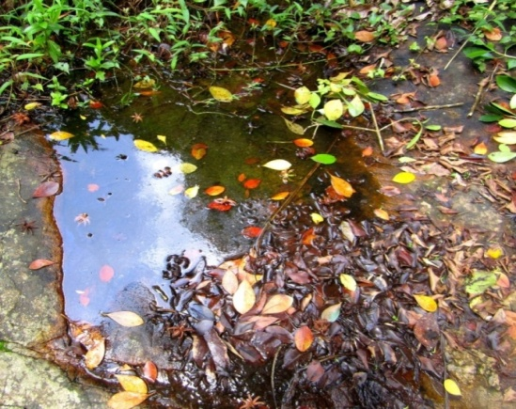
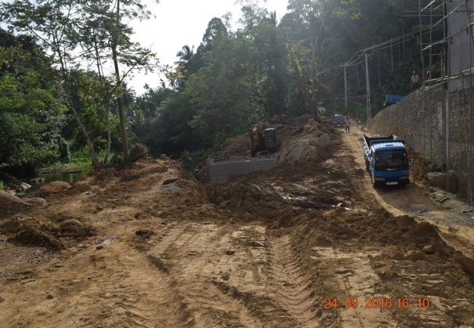
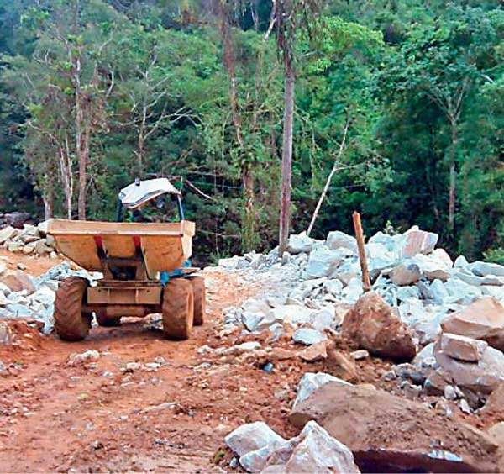
Misleading norms of small hydropower development
Run-of river system
Zero GHG emission
Minimum effects on aquatic life
No impacts on forest

Slide 9
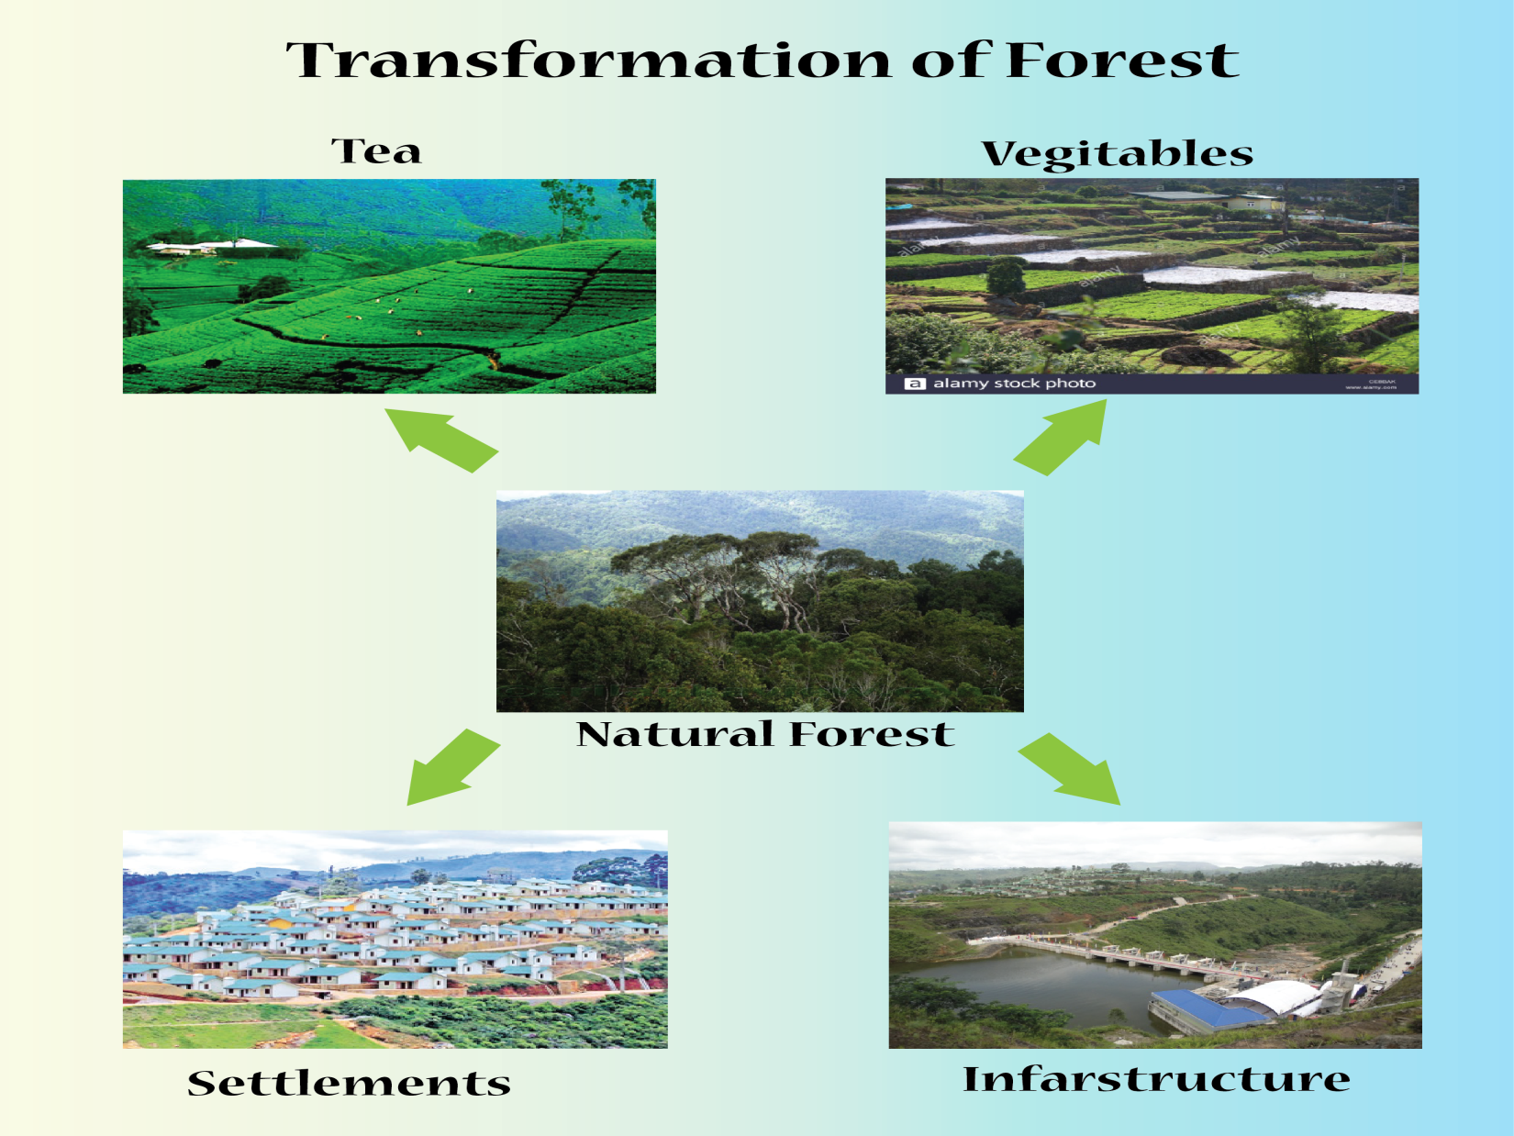

Slide 10
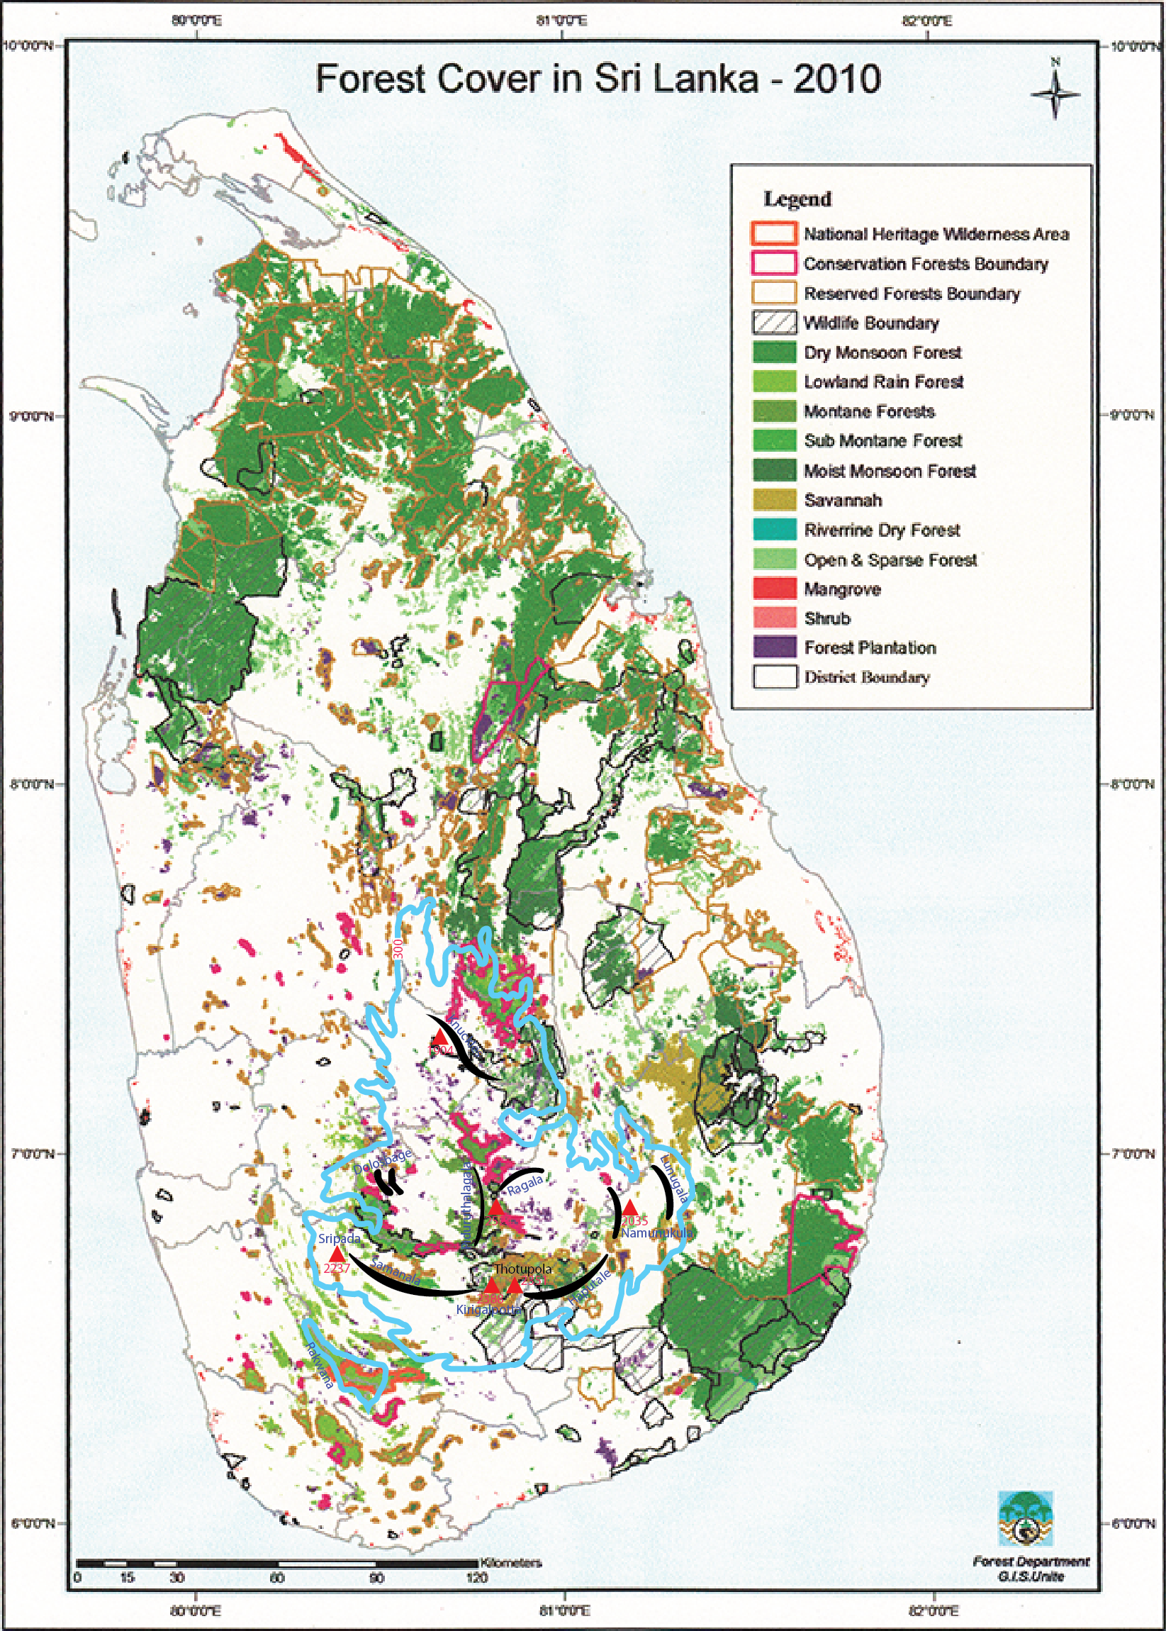
Forest Reserves
Bambarabotuwa
Dellawa (proposed)
Delwala
Gilimale-Erathna
Kalugala Aranya
Malambure
Morapitiya Runakanda
Nahitimukalana (proposed)
Rammala Kanda
Viharakele
World Heritage Sites
Sinharaja
Peak wilderness
Knuckles
Sri Pada

Slide 11
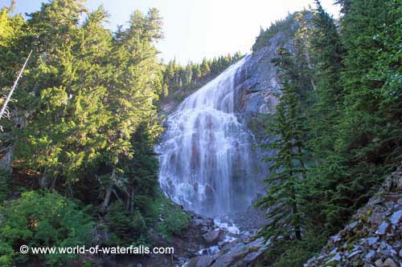
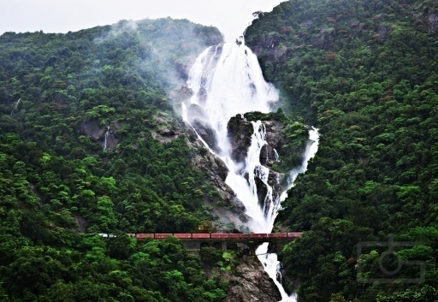
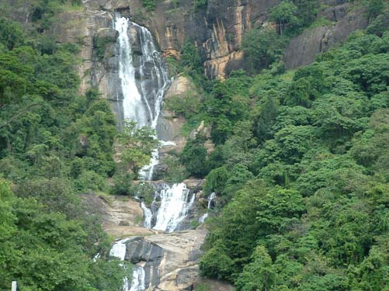
Lost Spray Zones due to Major (Red) and Minor (Blue) Hydropower Development
Mahaweli Basin | Kelani Basin | Kalu River Basin | Nilwala Basin | Walawe Basin
Aberdeen | Laxapana Fall | Alupola Fall | Ethamala Ella | Lemastota Oya
Devon Fall | Ellpita Ella | Dehan Fall |  | Fall
Pundalu Oya | Ganthuna Fall | Bambarabotwa
St. Clair Fall | Nakkawila Fall | Oya Fall
Victoria Fall | Ritigaha Oya Fall
Delta Fall | Wee Oya Fall
Glassaugh Fall
Kabaragala Fall
Manelwela Fall

Slide 12
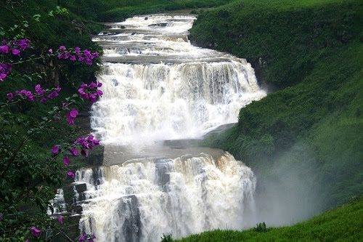
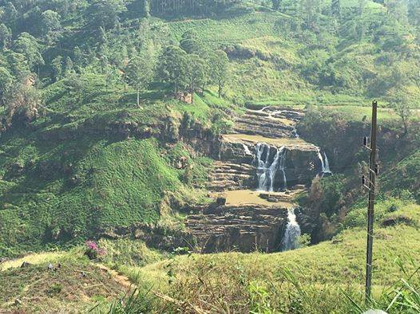
St Clair Fall – then
St Clair Fall – today

Slide 14
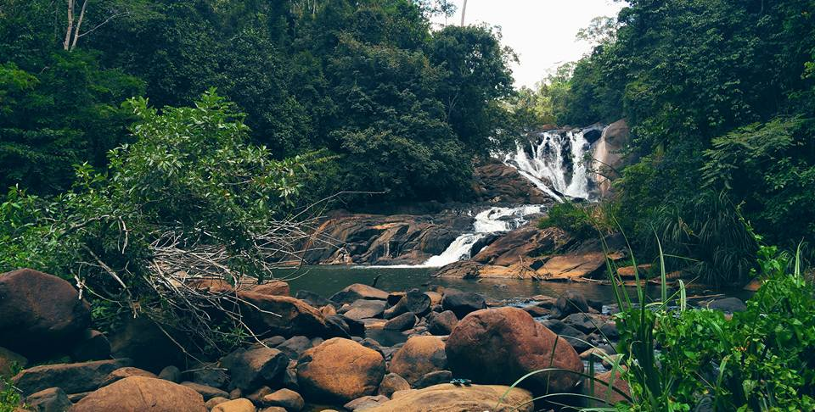

Slide 15
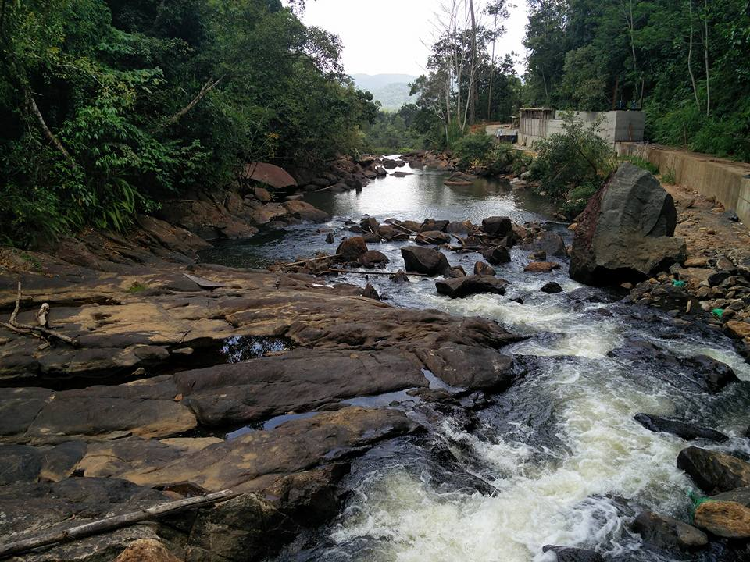

Slide 16
Tunnel and Conduit Network in the Highland (km)
 | Major hydro |  | Mini Hydro
Basin | Tunnels | Penstocks | Tunnels | Penstocks+Canals
Mahweli | 55.6 | 0.90 |  | 77
Kelani | 0.88 | 22.4 |  | 33
Kalu | 5.70 | 0.84 |  | 28
Walawe | 4.50 | 0.88 |  | 17
Others |  |  |  | 15
Total | 67 | 25 |  | 170
Penstocks and concrete canals are more injurious on forest vegetation than tunnels
Tunnels do not allow lateral transport of moisture
Both penstocks and concrete canals prevent lateral transport of moisture and root penetration of canopy trees

Slide 17
Needs of water for plant growth is
basic knowledge
No water! No plants!
But, the role of streams and rivers on forest
growth is poorly understood
Streams and rivers flow laterally providing
moisture for soils
It helps to flourish and propagate the forest

Slide 18
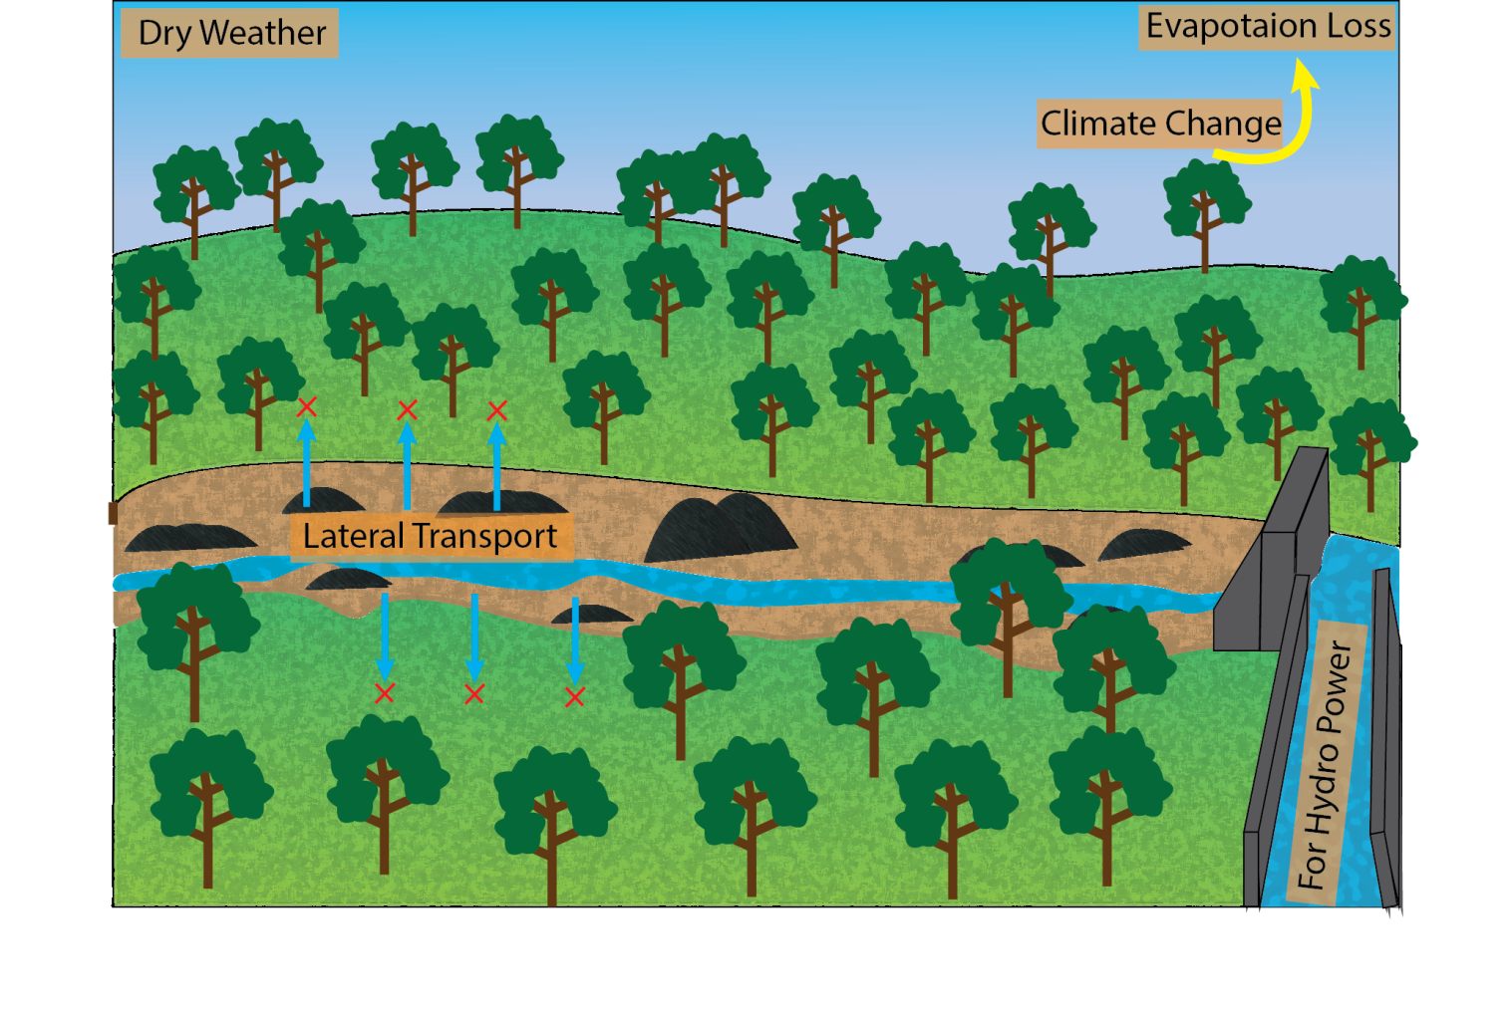

Slide 19
Small Hydropower Plants
Alter stream flow Expose stream bed Stop fish movements Affect waterfalls Change stream habitats Erode river banks Gradually eliminate forests Fade away beauty of nature
Affected Stream Stretches
Create habitats for mosquitoes Vanish bathing pools Alter water quality Emit GHGs Promote toxigenic algae Promote vector borne diseases Change groundwater balance Affect riparian community
The negative effects of small hydropower operation on forest ecosystems are obvious
Many stakeholders including ecologists are responsible for this pathetic ecological crime

Slide 20
Recommendations
Existing regulations of constructions and operation of mini hydro to be amended within a stringent legal framework to sustain forest reserves
Impacts of mini hydro development on hydrological network of mountain landscape to be analyzed in a holistic manner
Mini hydro must not establish within forest reserves
No diversions must be allowed from immediate upstream of waterfalls
Climate change induced temperature increases should be coupled with impact assessment of mini-hydro development

