Slide 1


Assessment of carbon and non-carbon benefits of natural forests and tropical homegardens for REDD-related activities in Sri Lanka
Eskil Mattsson, PhD
Madelene Ostwald, S.P Nissanka
Centre for Environment and Sustainability
University of Gothenburg/Chalmers University of Technology, Sweden
Key-note adress: International Research Symposium on Valuation of Forests Ecosystems and their Services, BMICH, Colombo, October 18, 2016

Slide 2
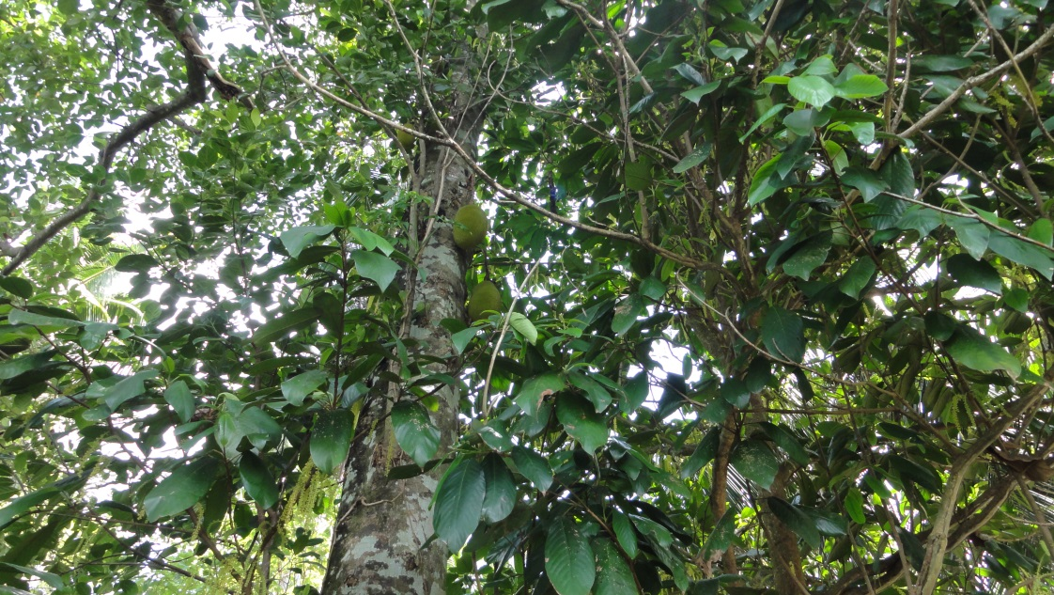
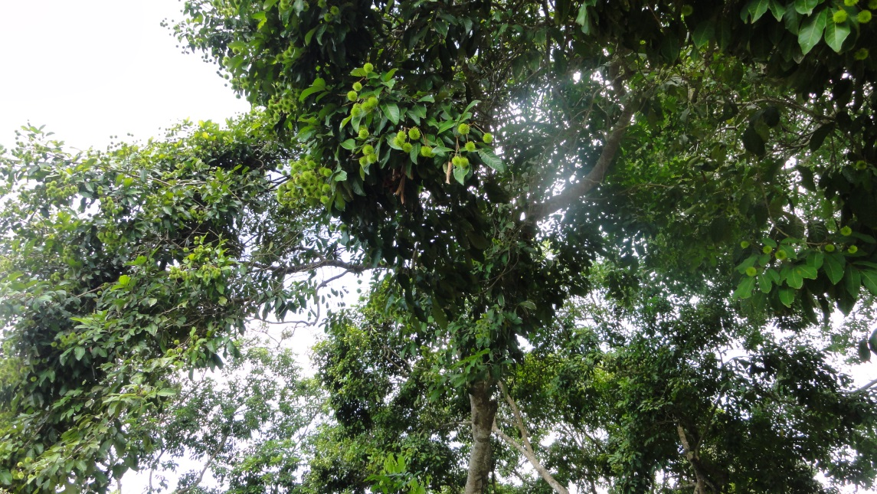
Outline
1. Recognizing the role of forests and agroforestry in relation to climate change mitigation and adaptation
  2. Forests and agroforestry in relation to global and national policy instruments
  3. Research examples
4. Opportunities, challenges and policy recommendations
Notes:
My aim with presentation is to set the scene a little bit in terms of by presenring the role of forests and agroforestry in climate chnage mitigation and adapattiion. After that I will talk brielfy about forests and agroforetsrst in alarger perspective ad link these issues to some impoprytan processes at the global and natyional level. I will then talk about some own findings from my own reserach on these aspects in Sri Lanka and from that highlight some opportunities, challneges and things to conisder in the future.

Slide 3
1. Recognizing the values: forests are key to global sustainability
Social: forests directly affect the livelihoods of 20% of the world’s population
Products and energy: provison of raw material for a broad variety of goods that are renewable and widely recycable
Biodiversity: forests are home to 80% of terrestrial biodiversity, connecting forested landscapes to intact land use mosaics
Water: forests protect watersheds, reduce erosion and control floods and droughts
Carbon capture: global forest carbon stocks: 861 billion tonnes or 27x of the worlds annual carbon emissions from fossil fuels
(FAO; IPCC AR4; Pan et al 2011)
Notes:
So this session is about reconising the values of forests. They are key to global sustainability since they provide a range of values and ES: Socialy, forest directly affect….. While AFS affect 15% We all depend on the goods and services forests generate and benefit from the educational, recreational, cultural and spiritual values forests provide.
Forests also provide raw materail and…. As well as renewable energy
Forests are also home to….. While managed forests andagrfortersty redcude pressure on natural forests protecting biodiversity further.
While AFS affect 15% And forest product industry employs 14 million people.
Forests also controls floods and droughts, reducing erosion risks and protecting watersheds that are a source for the water we drink and use.
And as forests grow they sequester carbon diozide from the atmosphere and store its carbon in their biomass. Global forest carbon stocks are
estimated to be 861 BILLION TONNES or 27x the world's annual carbon emissions from fossil fuels.

Slide 4
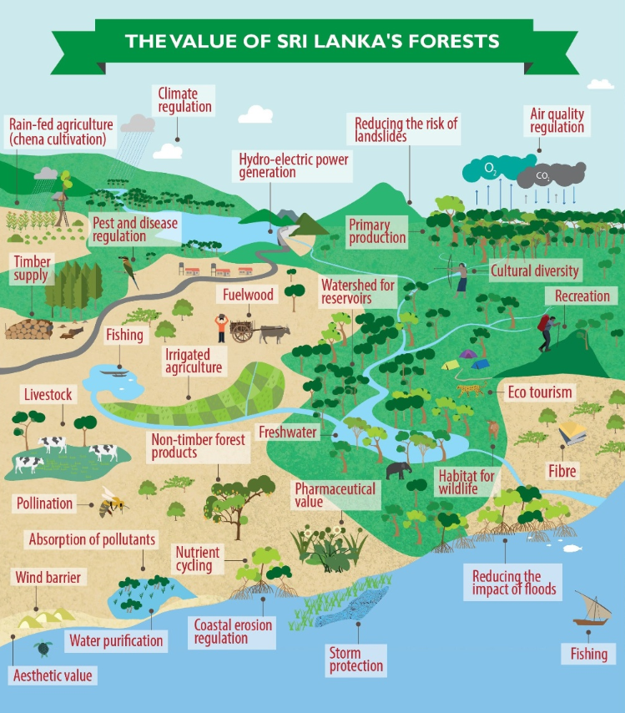
Notes:
These values are interconncted and as you can see I stole this picture from the conference webiste. And I think it is a very good and illlustrative one and I think it could be applied for most contexts areound the world. Its showing and recogbnises the diversity of values of Sri Lankan forests thorough the landscape and the interconnections between them. Even is the picture is a nice one it is complex one. Today we live more and more in a complex and connected world which also has implications for forested landscapes. It is very important to be aware of all these values and the and how they interconnect with each other and also be aware of all the different actors and stakeholders working within this landscape.

Slide 5
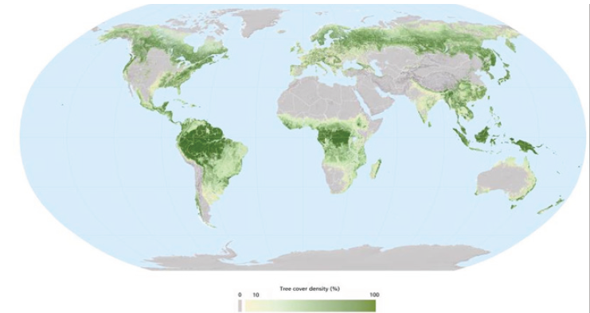
Global Forest Cover in 2010
(FAO, 2010)
Notes:
Globally, forests cover about 4 billion ha or 31% of the world’s land surface (relative to a
pre-industrial area of 5.9 billion hectares of forests). Most forests occur in the tropics, and
in large areas of the Northern hemisphere in Canada, the US, Europe, Siberia and China

Slide 6
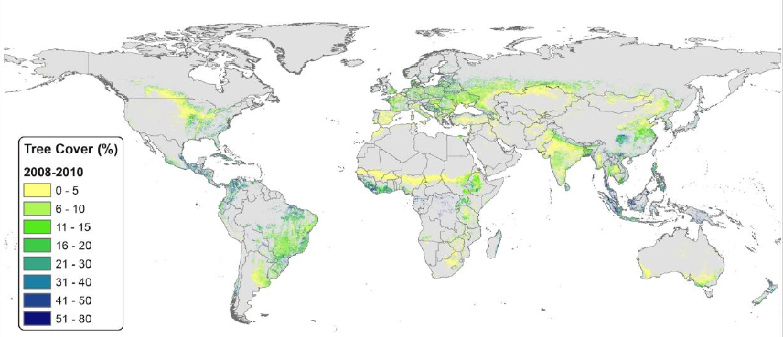
Trees on agricultural land
agroforestry is present on more than 43% of all agricultural land globally where 30% of rural populations live (>10% tree cover)
tree cover increased by 3% from 2002 until 2010 with large variations across regions
(Zomer et al. 2016)
Notes:
In terms of trees on agricultural land approximately 40% of all agricultural land in the year 2010 had at least 10% tree cover (which corresponds to the FAO definition of Forest) accounting for more than 43% of all agricultural land under some variation of agroforestry approaches.

Slide 7
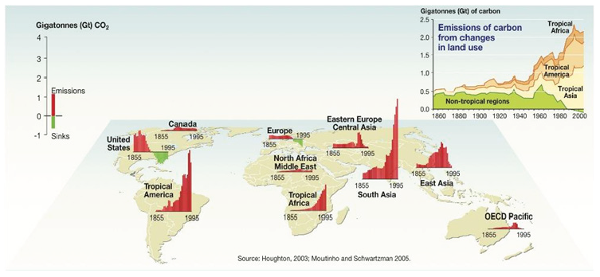
Historical forest balance
Notes:
Historically, deforestation was largely in the US, Europe and Eastern Europe, today, the
largest deforestation rates are observed in tropical rain forest regions. Figure 1.11 also
shows that boreal regions have reversed the trend and are now increasing their forest
cover. By taking into account the emissions and sinks combined, the net contribution of land use change to global emissions is about
10% (0.9 PgC/yr)

Slide 8
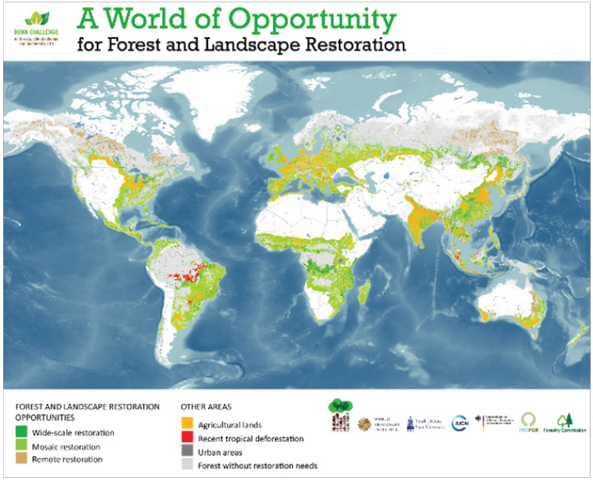
(WRI, 2015)
Notes:
More than two billion hectares worldwide may offer some form of opportunities for
restoration. In areas that were deforested but are not currently densely populated or
cultivated it may be possible to undertake some form of restoration, ranging from complete
reforestation of closed canopy cover to more mosaic restoration that includes restored
forest areas interspersed with other land uses including agroforestry, small scale agriculture
and settlements. Any restoration has to be contexst specifci taking into account the local social, economci and ecological situation. And I would like to examplify that with my own country Sweden.

Slide 9
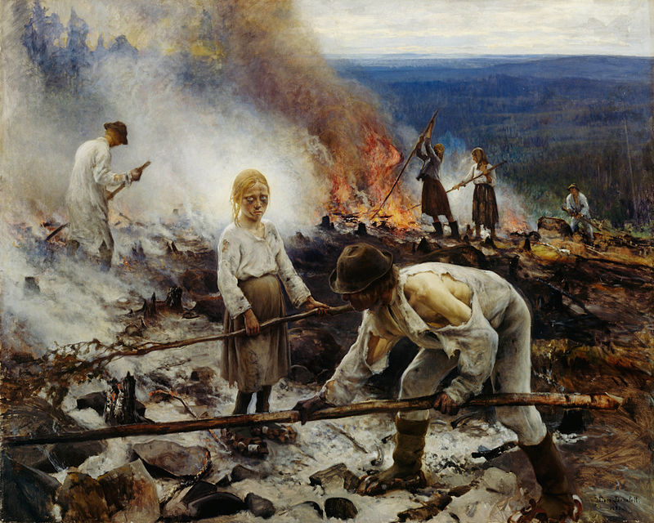
Forestry in Sweden
Sweden
Area:41 million hectares
Population:10 million
68% forest cover. Large export market (13%)
Formally protected: 5%
Trend for total standing volume since 1920
Notes:
And in Sweden a large forest cover that accoints for large share of the export market.
By the end of the 1800s and early 1900s, the forest in Sweden was largely depleted due to a combination
of industrialisation and a growing population with a need for firewood and more land for cultivation and grazing.
Before the forests got a market value, it waqs very common with slash and burn activities as illusterad by this pating here from the end of 1800s
standing volume in Swedish forests has more or less doubled during the 20th century, despite a doubling of the
Population and continuous increase in harvest levels, and increased set-aside of forest land for protection, although this number is quite low, only 5%.

Slide 10
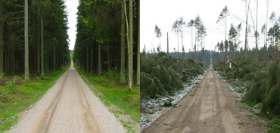
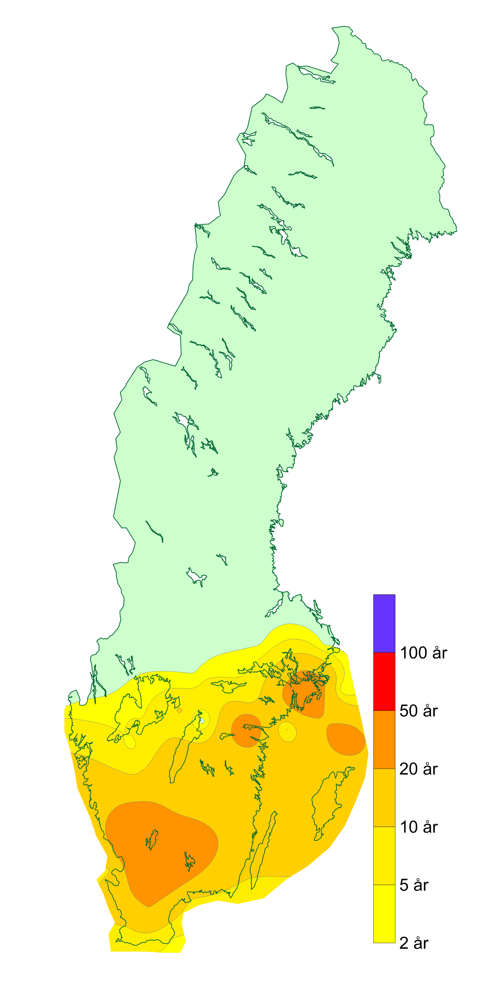
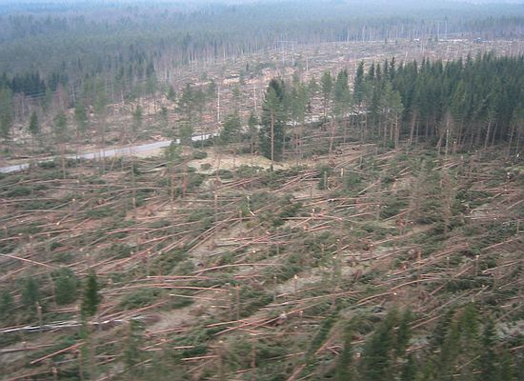
Storm ’Gudrun’ 8-9 January 2005
Importance of ”climate proof” forest management
75 000 000 m3
App. 140 000 ha
(0.5% of Swedish forest)
Before
After
Notes:
Despite the fact that we have a high forest cover with high financial and carbon values, we expericed one of the largest storms ever about 10 years ago that showed that we are very vulnerable to extreme events.
About 75 million cubic sqaure meters of wood was fellled in this storm amounting to 0.5% of the Swedish forests.
Since a majority of these forests are monoculture production forests with Scots pine and Norway spruce which are more vulnerable to these kind of events that decodiuoes forests, we had this very large devastation.
This means that in any management and restoration process you have to be aware and take into account of the threats and impacts. This situation clearly showed that we were very vulnerable despite having a quite developed forestry.

Slide 11
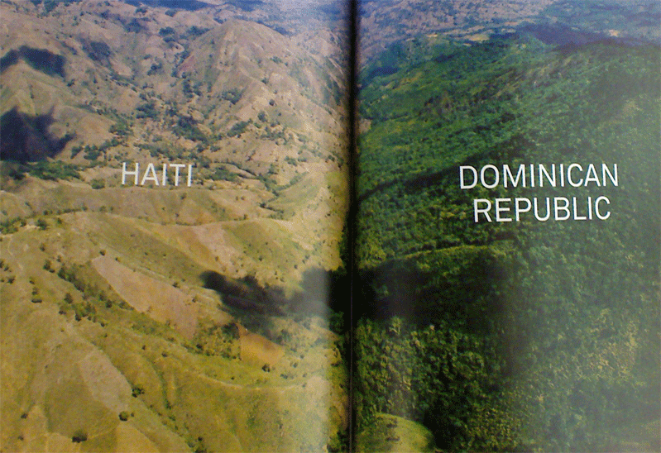
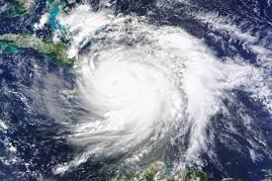
Notes:
Speaking of management, some of you have probbaly seen the sharp divide in forest cover in the border between Haiti and Domican Republic. Haiti was once lush Caribbean island nation has been virtually cut clean of its former tree cover by an impoverished people desperate for fuel while the Domican Republic has a 60% forest cover. With more healthy forests in Haiti the death toll from the hurricane Matthew two weeks ago would had most likley been lower

Slide 12

  2. Forests and agroforestry in relation to global and national policy instruments
Notes:
So what is the global response to recognise, protect and manage different aspects of forests and agrofortersty . Well there are a number of initatives at different scales, and I have not time to go through all of them, but the biggest initiave of all is the Sustainable Development Goals (SDGs) was agreed about a year ago and they are a universal call to action to end poverty, protect the planet and ensure that all people enjoy peace and prosperity.
These 17 Goals build on the successes of the Millennium Development Goals, while including new areas such as climate change, economic inequality, innovation, sustainable consumption, peace and justice, among other priorities.

Slide 13
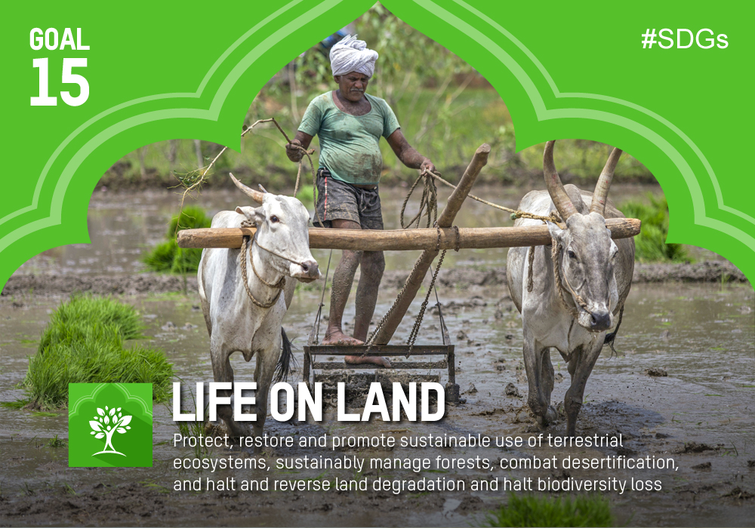
Notes:
Forests has an promintent feature in goal #15…. With different 12 targets ranging from reversing deforestaion and degradation to halt biodvievsrity loss and illegal trade.

Slide 14
Notes:
The goals are interconnected – often the key to success on one will involve tackling issues more commonly associated with another goal which means that there might be synergies and tradeoffs between these goals. The new Goals are unique in that they call for action by all countries, poor, rich and middle-income althogh governmnets governments are expected to take ownership and establish national frameworks for the achievement of the 17 Goals. Countries have the primary responsibility for follow-up and review of the progress made in implementing the Goals, this means that resrerach will have a profound role to support and provide data that is timely, accurate, accessible.

Slide 15
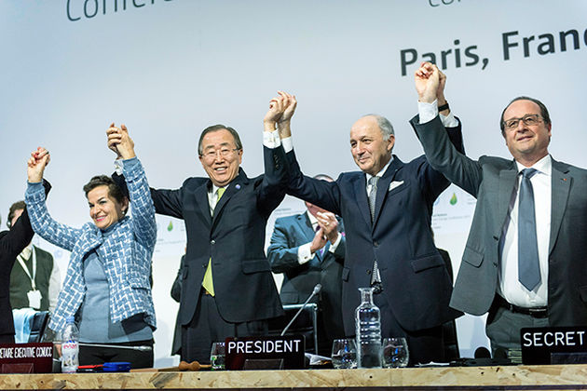
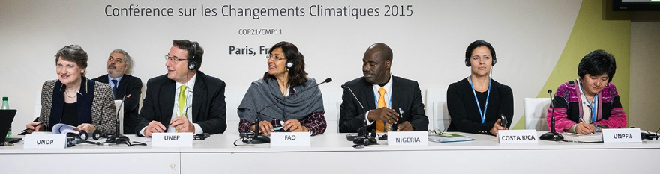
Forests and REDD+ recognized as key components of the Paris Agreement
REDD+ has evolved from one tool into a complex multifaceted framework operating across multiple governance levels
The Paris Agreement encourages country Parties to implement the UNFCCC framework for REDD+, “while reaffirming the importance of incentivizing, as appropriate, non-carbon benefits associated with such approaches” (Article 5.2).
REDD+ beyond carbon: can make REDD+ efforts more sustainable long-term, greater momentum and political will, contributing to other existing goals, reduce costs
Will require reforms beyond the forestry sector
Notes:
Another prominent mechansim and common demonator for many of you here today is reducing deforetsation and degradation (REDD) which gained prominence more than 10 years ago, and since its inception, REDD+ has evloved from euphria to reality so to speak being solely a tool for climate change mitigation based on carbon storage in the beginning into a complex multifaceted framework operating across multiple governance levels to adress other isseus as well such as NCB
The role of forests to mitigate climate change has been strongly recognized in the Paris Agreement, with a specific article devoted to REDD+, which specifically notes:…
REDD+ has a critical role to play in the economics of moving away from business-as-usual forest practices. It can help farmers and forest-dependent peoples across the tropics to adopt new practices which conserve, sustain, and/or restore forests, while also helping to implement sustainable land-use policies and ensure their enforcement.
It’s a multi stakeholder process that will take a long time in most countries since the drivers of deforestation often are located oustide the forestry sector

Slide 16
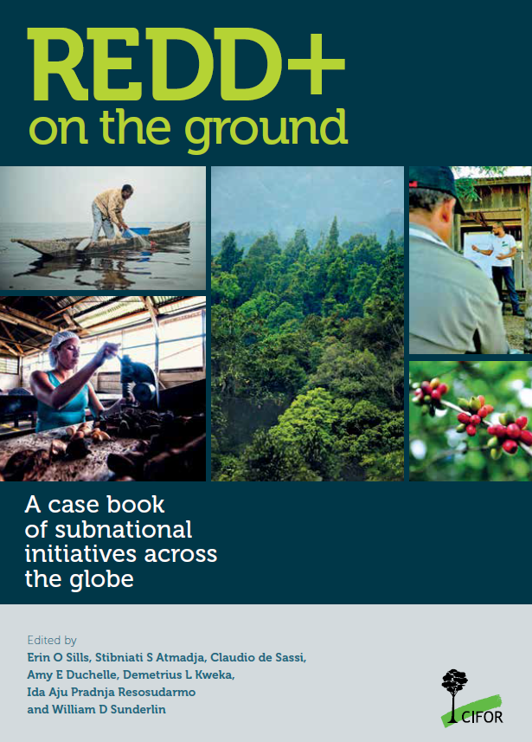
REDD+ challenges lead to opportunities (CIFOR book)
By 2009, pilot projects were being set up across the tropics. Now more than 300.
Pilot projects (23) are struggling to move from the pilot stage to actual long term implementation because of the uncertainty about funding
Subnational initiatives are leading to innovation
Regardless of the international architecture of REDD+, interventions to reduce deforestation locally, in particlular phases with different stakeholders are needed.
(Sills et al. 2014)
Notes:
A major challenge with REDD to now has been the lack of funding. As a response to that, I was co-athorting a book with CIFOR in Indonesia that evalluaed 23 different project projects around the tropics. Since the first framwork on REDD was adopted on REDD in 2009, hundeds of pilot projects were set up around the tropics with the aím to inform natiojal and sub-national governmegts of how REDD could look like in a real lif sitution whcih aspects to consider. Due to the unceratinty of funding we found that pilot projects are struggling to ….., but it doesn’t necesssarily is a bad thing because these uncertatinties lead to innovation….to perhaps bigger and betterthings such as developing long-term low carbon development strategis which wasn’t intended in the first place. This study also showed taht regardless of the international architecture, there are many ways to go about that that are very local specific dependinmg on the local economic, social and ecological context.

Slide 17
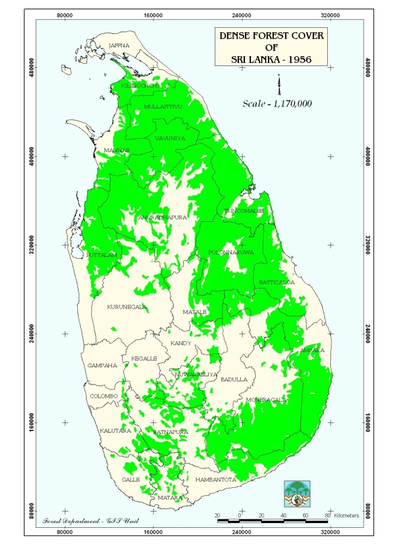
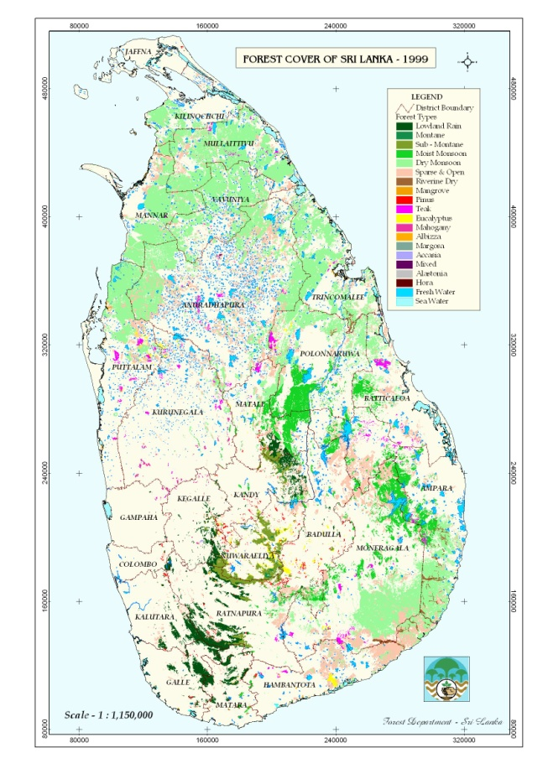
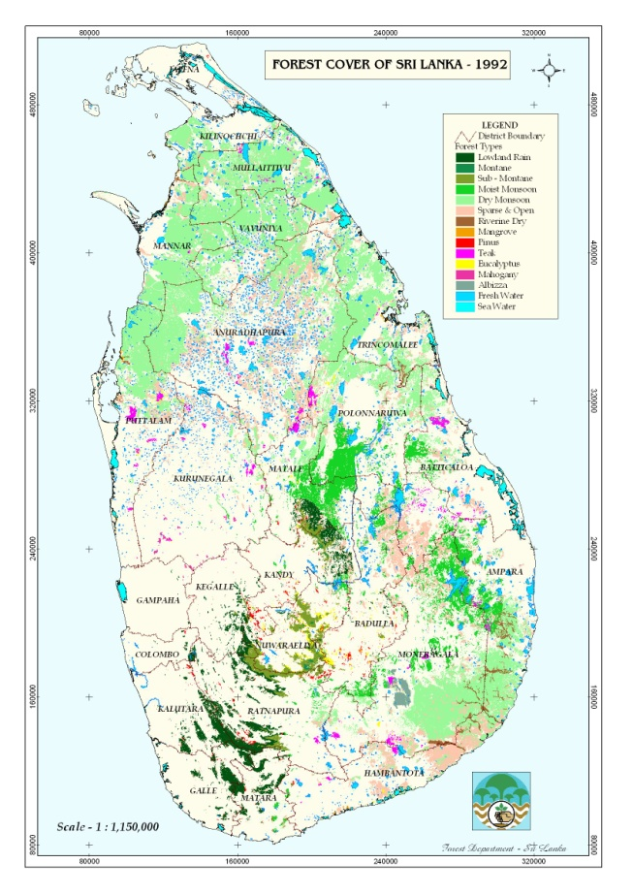
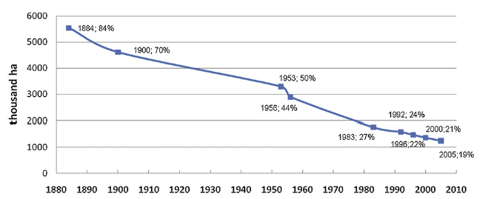
REDD+ in Sri Lanka
Low forest cover and low deforestation rates implies low potential for REDD+ result-based finance → greater values from co-benefits
REDD+ in Sri Lanka will therefore take an inclusive approach where sustainable land management and non-carbon benefits will be the primary focus.
Success on REDD+ depends on achieving transformational change
  shifts in discourses and economic incentives for the value of standing forests.
  Be aware of the broader (and other) approaches to sustainability
1956
1992
1999
Forest cover change 1880-2005
Notes:
I will not go into detail about Sri Lankas REDD strategy because many of you know much more about this than I do, but Sri Lanka now has lower which implies low potential for emission reductions and removals and therefore low prospects for securing significant REDD+ result-based finance, therefore non carbon benefits is the main focus. This is a very inspiring nut challenging task that will require a lot of commitment, collobartaiona and interest among different stakeholders, but you have come a long way already.
And success on REDD+ depends on first achieving transformational change, namely major shifts in discourses, power relations and economic incentives for the value of standing forests. Remain focus on the implementation on the components of the Paris agreement, but do so with the awareness of the broader approch to sustainability as a critical objective.

Slide 18
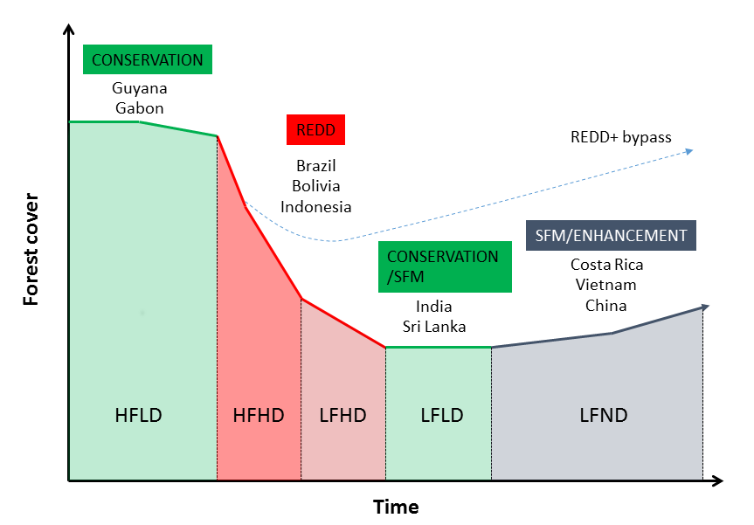
Forest transition curve – a reflection of REDD+ interests
(Angelsen et al. 2012)
Notes:
Different national circumstances can also reflected thriough the forest transition curve which means that all countries undergo a forest transition as they develop. Some developing countries (e.g. India, China, Vietnam and Costa Rica) have over the last few years undergone a forest transition; they achieved reduced deforestation and are now demonstrating a net gain in forest cover. As I mentioned, the long tradition of forest conservation in Sri Lanka together with the recent trends of declining forest loss have been reflected in the country’s increasing engagement in the international REDD+ discussions, where Sri Lanka is supporting the expanded focus of REDD+. This reflects a situation generally where the negotiation positions of the Parties within the UNFCCC reflect their respective interests as reflected in their respective positions on the forest transition curve. Countries which are not undergoing rapid deforestation and degradation have a strong incentive to argue for payments for work done to effectively manage and conserve forest stocks.

Slide 19
3. Research examples
Overall aim: Analyze the climate mitigation and adaptation potential in the land use and forestry sector at different levels in Sri Lanka
  Example of potential project for potential for forestry based CDM/PES
  Forest carbon assessments in relation to REDD+ implementation
  Role of tropical homegardens in relation to climate change mitigation and adaptation
Notes:
I will now give some exanples from the esserach on forests and homegardens that I have been carried out over the last ten years in Sri Lanka focusing on climate mitigation….. Using using a mix of quantitative and qualitative data. This research has been carried out with support from Departmnet of Crop Science at the University of Peradeniya.

Slide 20
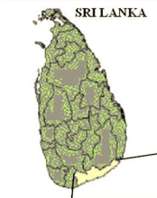
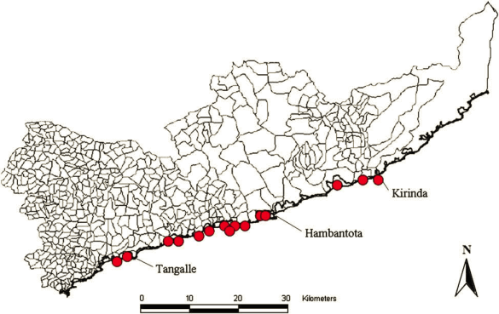
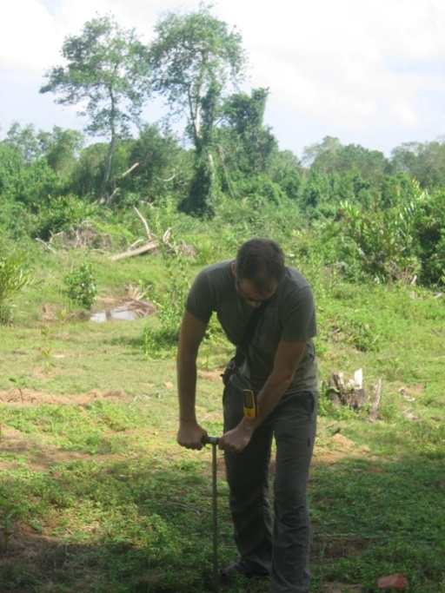
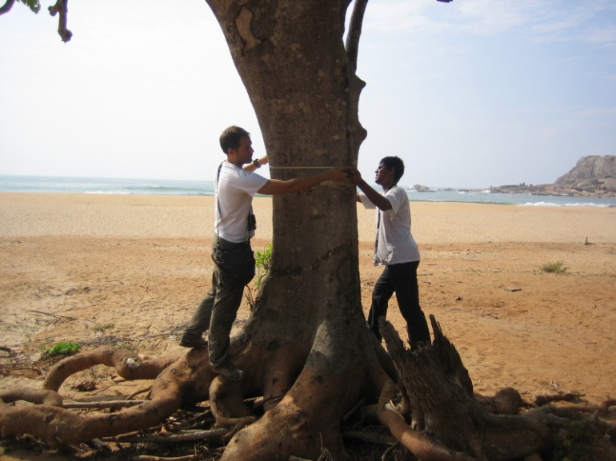
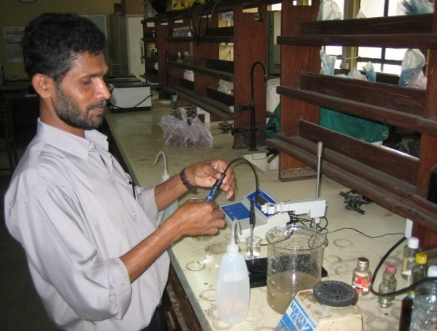
Joint mitigation and adaptation – forestry based CDM/PES for land rehabilitation?
Qualitative and quantitative approaches in Hambantota district 2006
carbon stock potential of forests and homegardens, soil and well water salinity
interviews with land users to obtain their views of future land-use and expansion
(Mattsson et al. 2009)
Notes:
One of the first studies I did in Sri Lanka was to see whether A/R CDM or PES can be a tool to rehabilitate land after extreme events, in this case the 2004 tsunami. So in order to do this, we took
soil and well water samples in different transects around Hambantota district and analyzed the salinity levels in laboratory. We also estimated the carbon stock
potential of different trees in order to see which forest types that contained most carbon. Interviews were also conducted with land users to obtain their
views of future land-use and expansion.

Slide 21
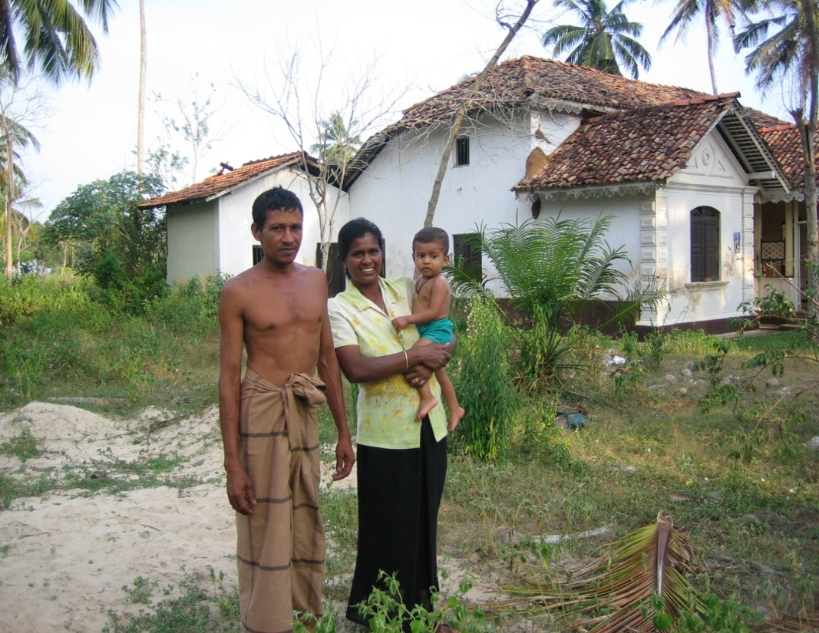
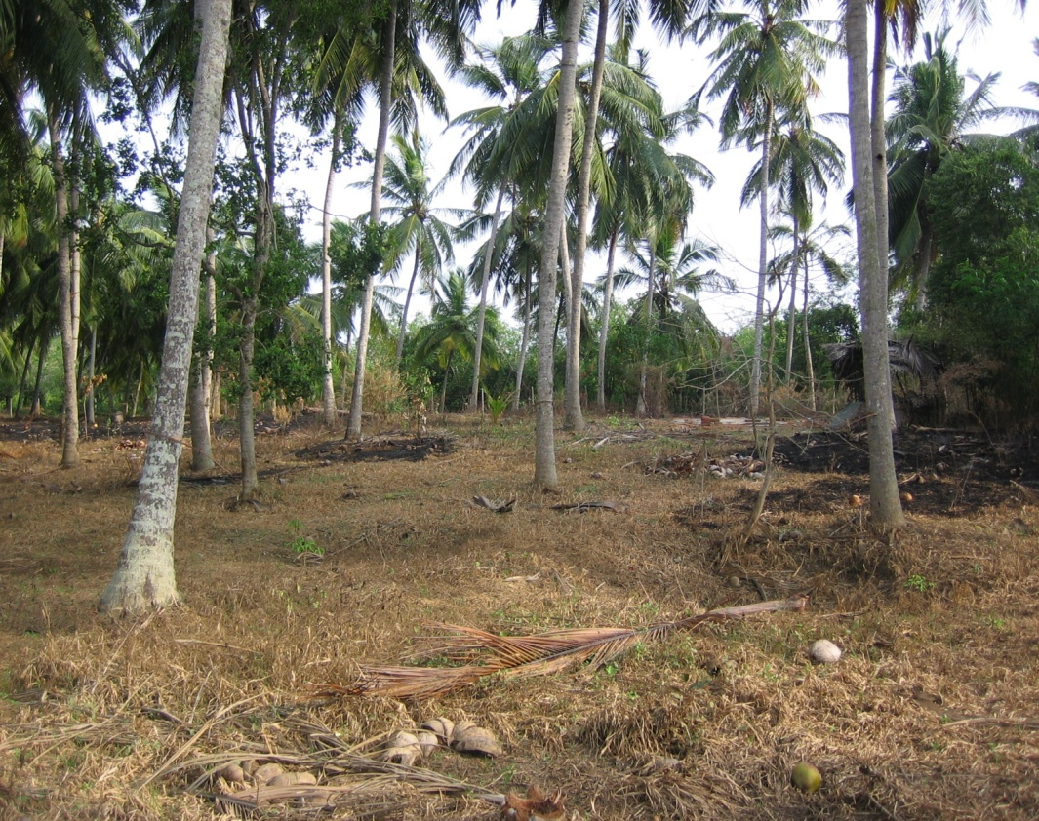
Forest based CDM/PES potential
low salinity in soils, high salinity in well water
the tsunami triggered a demand for other land use practices
coconut plantations or homegardens are suitable options for A/R CDM/PES
  trees are salt tolerant
  important for people
  high carbon stock
  environmental protection
(Mattsson et al. 2009)
Notes:
In brief, It was found that the soil salinity in the soils were low but the well water had higher levels of salinity. Land users also expressed that the tsunami triggered a demand for other land use practices. So by matching the biophysical measuerments and the interviews we found joint mitigation and adaptation benefits that … and they showed a high resilience and had tehrefore a high environmental protection.

Slide 22
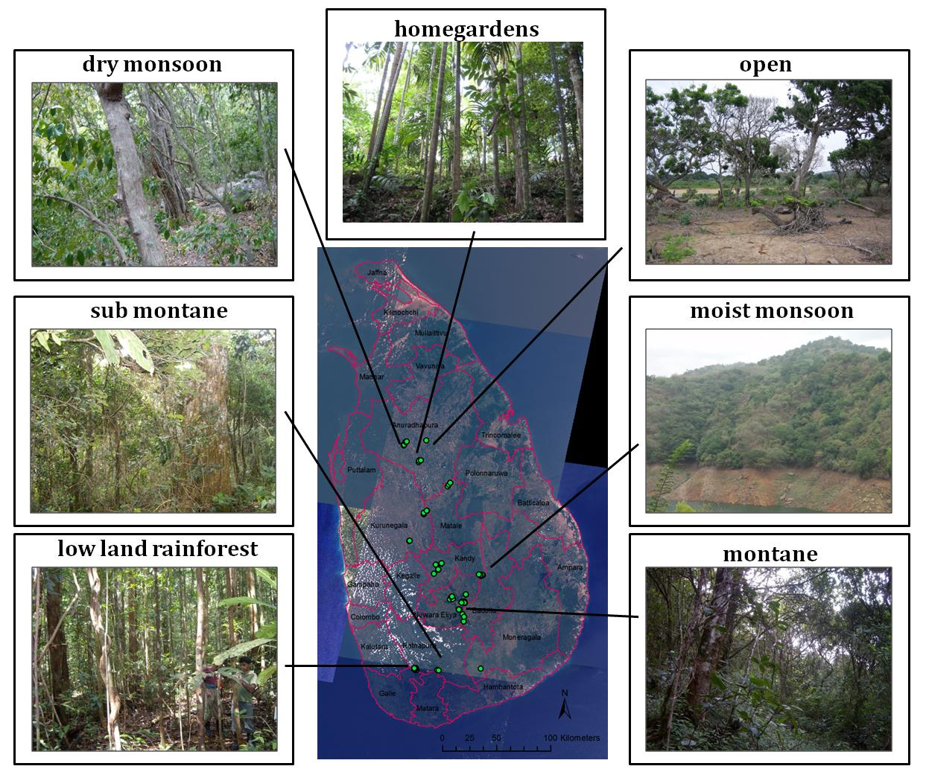
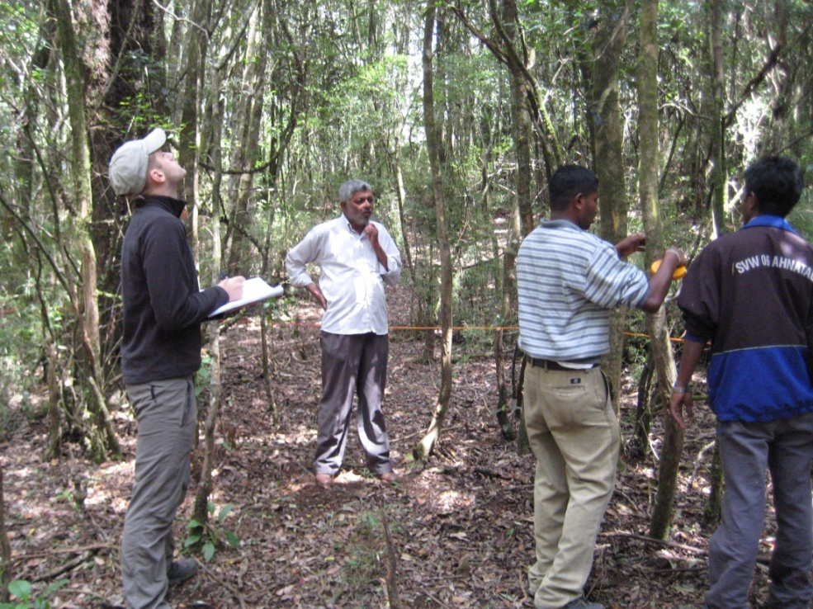
Estimating forest carbon stocks for REDD+ (2008-2009)
20 000 trees measured in 232 sample plots (30x30m)
six natural forest ecosystems and homegardens
Parameters: diameter, tree height and species
Allometic equations to estimate above ground biomass carbon stocks (Chave et al. 2005; Brown, 1989)
field data multiplied with existing forest area data to estimate total forest carbon stocks and a forest reference level
Notes:
The most comprehnsive study conducted was to estimate forest carbon stocks for various forests types to estimate the potential for REDD. This was a few years before REDD+ was launched in Sri Lanka so it was a very tiemly study.
So, we measured about 20 000 trees, distributed in 232 sample plots. over in six natural forest ecosystems, homegardens, and three plantation forests. We measured diameter of the trees, tree height and species information and we used different pan tropical allometric equations to estimate the biomass carbon stocks for each tree. These values were then upscaled to acquire the total carbon stock for each forest type.
Our field data were multiplied with existing forest area data to estimate total forest carbon stocks and a reference level.

Slide 23
Carbon stocks (above and belowground) on a national level
(Mattsson et al. 2012)
Notes:
And this work gave us Detalied figures on carbon stocks for different natural forests types that for example was higher and more detalied than earlier Tier 1 estimates for Sri Lanka from FAO data.

Slide 24
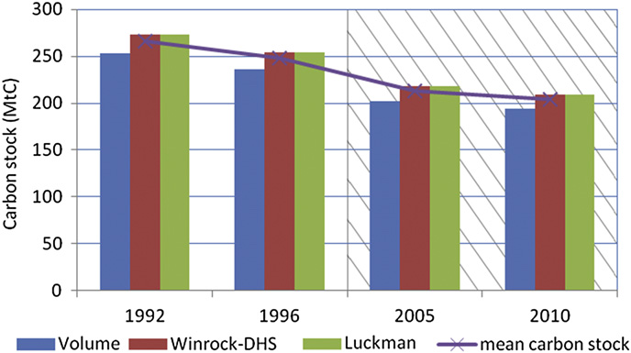
Forest reference emission level
The total carbon loss for Sri Lankan natural forests: 18 MtC between 1992 and 1996 (17 MtCO₂ yr^{–1}) and 45 MtC between 1996 and 2010 (12 MtCO₂ yr^{–1})
A fragmented forest cover and multiple sources of small-scale deforestation and degradation in Sri Lanka make MRV challenging.
Measurements of the above ground biomass carbon offer an initial practical, cost- and time-efficient method
Notes:
We also construced a histtrocal BAU baseline for different equations showing the total carbon stock loss between 1992 and 2010 assuming linear extrapolation of from 1992-1996 to 2005 and 2010 since no area information is availale for these two years. These type of data can serve as a benchmark for how much emissions that Sri Lanka has reduced. Our study also showed that a fragamneted forest cover…. And measuremnmet of the above… over past few years a lot has happend here with regard to this, but I think these points are still valid and important.

Slide 25
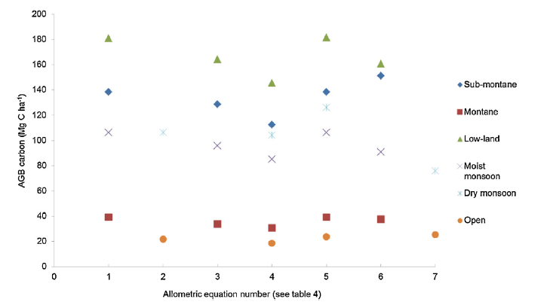
Different allometric equations give high carbon diversity
(Mattsson et al 2016)
Notes:
Also many unceratinties invloved in these types of assessments and we also showed that by using different similar alloetric equations for calculuation carbon stocks in natural forests, results could differ up to 25% for the same forest type, so robust and systematic methodlogies suited to the local context is key.

Slide 26
Blue carbon: mangrove forests (Batticaloa)
(Hedman and Jonsson, 2015)
Notes:
I also had two students who analysed carbon stocks in mangrove forests with different status in Batticaloa districts last year and found, not supringly though that the lions share of carbon is located below ground
Generally very little work has been done on assesing carbon stocks and other non carbon benefits from mangrove forests , especially in the northern parts of Sri Lanka and last year Sri Lanka became the first nation in the world to comprehensively protect all of its mangrove forests so this is very promising but monitoring environmnetal and social impacts is key so this requires more attention.

Slide 27
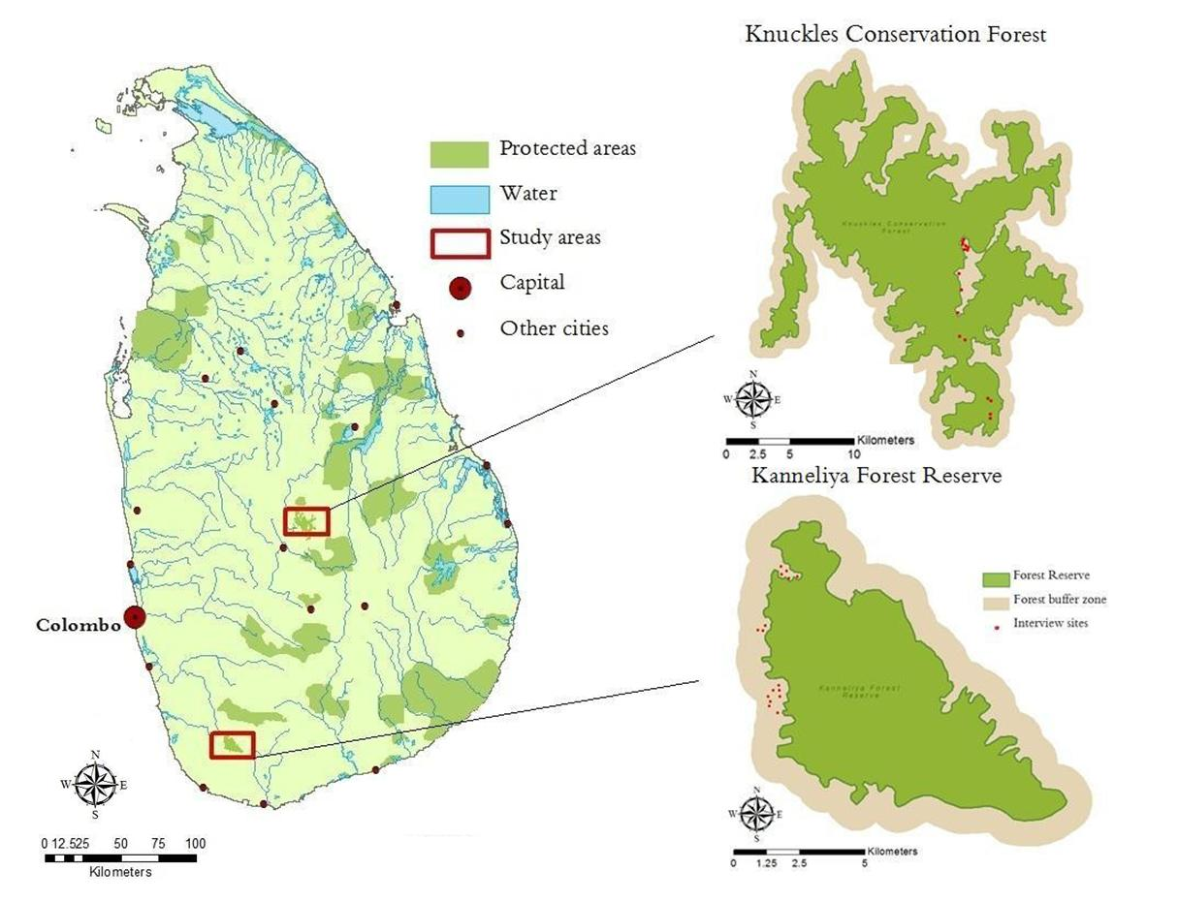
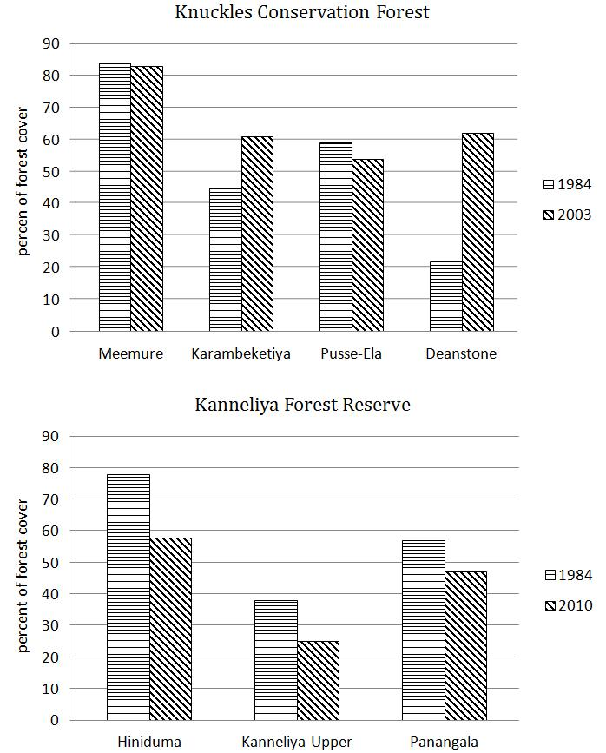
Conservation approaches in relation to livelihood impacts
land use analyses and interviews around two protected forest areas (Kanneliya and Knuckles) 1984 –2010
demarcation of forest boundaries had reduced encroachment and illegal felling of timber.
where forest protection was effective, it caused migration from forest dense areas and income reductions
Negative livelihood impacts from forest protection initiatives causes trade-offs and a need to balance development and environmental aspirations.
(Lindström et al. 2012)
Notes:
We also conducted a local case study around two protected forest areas, Kanneliya and Knuckles to see livelihood impacts from forest conservation policies between 1984 and 2010. As a complement we also interviewed small scale farmers in these areas about how they were impacted by these changes and how their livelihoods had changed. In terms of land use and forest cover changes we found that the forest cover had decreased in Kanneliya e.g. due to an increase in tea plantations whereas in Knuckles Conservation forest, forest cover had increased due to the new conservation polices. The positive outcome was that demarcation of forest boundaries had reduced encroachment and illegal felling of timber. The negative impacts included migration from forest dense areas and income reductions for local communities as a result of stricter demarcation of forest boundaries.
This study highlight the importance of a multistakeholder process in any intervention realted to land sue change to limit the trade-offs caused by development on the one hand and environemntal aspirations.

Slide 28
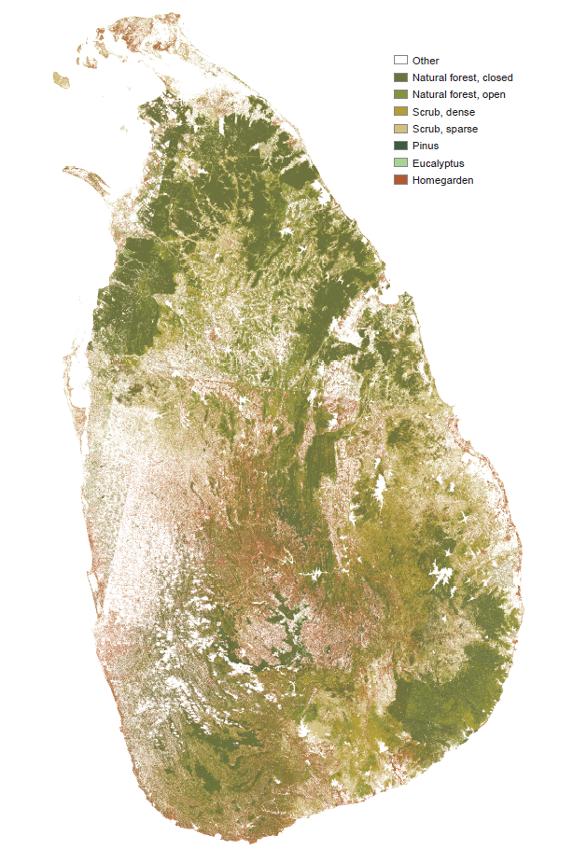
Homegardens in Sri Lanka
“agrofortestry systems where trees are managed together with crops and/or animal production in homestead settings
14 percent of total land area (Forests 25%)
Provide multiple benefits: fuelwood, timber, food and income
Can meet REDD+ goals.
Ongoing national developing programs providing free seeds, fertilizer and technical advice
Colombo
Notes:
Ok, so In the final part I will focus a little bit about tropcial homegardens. Homegardens is an agrofortersy system where trees are managed together with crops and/or animal production in homestead settings. Homegardens are very integrated land use system all obver the country covering about 14 % of the land area in this mosiac pattern as you can see in red here in this picture. They provide multiple benefits such as…. And in terms of biodiversity, more than 400 different woody species of multi uses have been found in homegardens. Over the last few years there has been a Renewed intrest in HG due to its climate mitigation and adapation potential but also due to their sustainability being self-suffucicent systems. And as a result many ongoing developmnet programs in the country are providing free seeds, fertilizer an technical advice. Sri Lanka one of few countries where homegardens are promoted through government interventions; several programs have been initiated during the last decade to promote self-suffienceny and to beat climate-linked food prices hikes

Slide 29
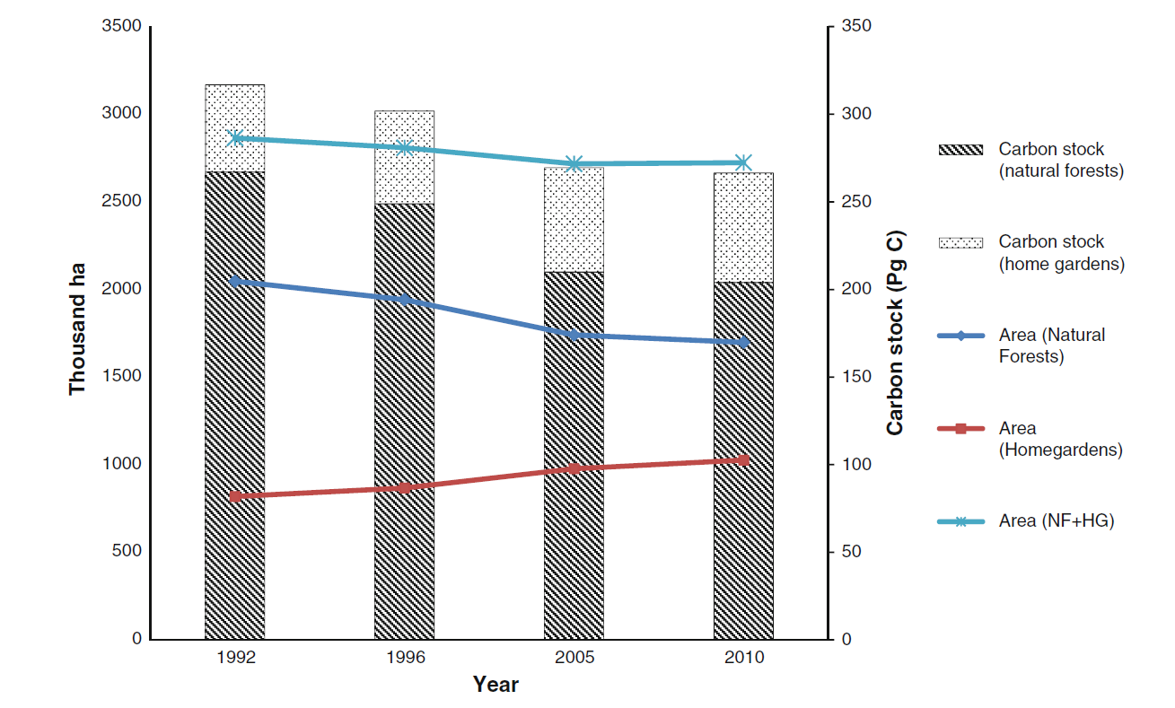
Carbon stocks in Sri Lankan homegardens
(Mattsson et al 2013)
Notes:
An important ecosystem service is climate regulation. Since homagaderns are very dense in many cases resembles a forest in structure and density, we founs in a study conduted in 2013, we found that homegardens may contain a significant fraction of the total above ground biomass carbon stock in the terrestrial system in Sri Lankan and compared to natural forests , and from our estimates its share has increased from almost one-sixth in 1992 to nearly one-fifth in 2010.

Slide 30
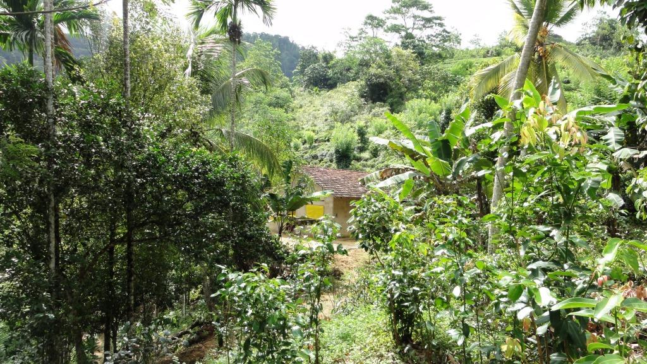
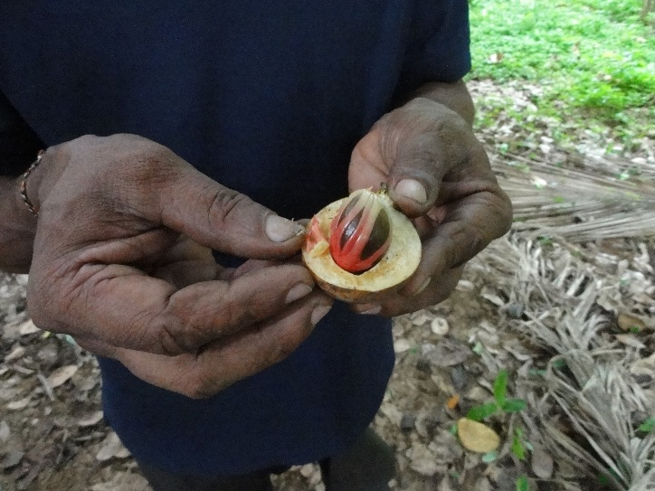
Systematic review of food secrity and nutrition aspects in Sri Lankan homegardens
Search string: Sri Lanka AND homegardens AND food security etc…
Web of Science, Scopus + backtracking and first 100 on Google Scholar => 101 abstracts selected and screened
Notes:
The most important feature of Sri Lankan homegardens is food security and food nutrition. But little work as actually been done to quantify the role of food security in homegardens. So therefore, a have recently carried out a systemaic reiew on food secrity aspects in Sri Lankan homegardens as part of a new Sida funded programme AgriFoSe, Agriculture for Food Security 2030 ‐ translating Science into policy and development.
So we developed a serach string of important key words using Web of Science, Scopus and Google Scholar and we found about 100 articles that were selcted and screened for more information.

Slide 31
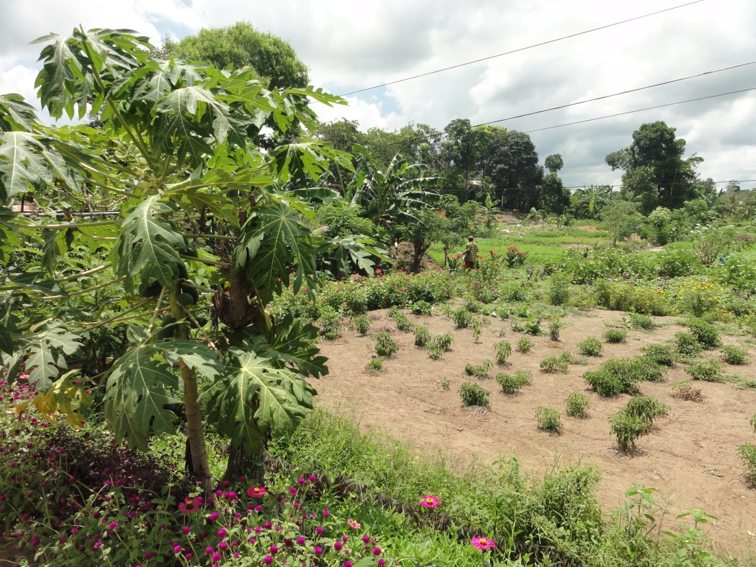
Results - food security in homegardens
28 % of articles directly quantified food security aspects, 51% indirect, 21 % were qualitative or descriptive
Most papers focus on:
1) biophysical aspects, 2) management and productivity, 3) role in climate change adaptation
Little attention paid to the role of:
economic and social sustainability attributes (women and youth, the role of value chains and markets)
many studies are very local specific with limited details on methodologies used.
comparisons with other land use systems or natural vegetation
Notes:
We found that 28% of the articles directly quantified food security aspects while about half of the papers considered food secruty indietcly while about a third of the paper discussed these issues decriptively. Most papers focsued on biophysical aspects such as structure, functions and diversity, management and productivity issues or recently also homgeradnes role to adapt to climate chnage. There was little attention paid to economic and social sustainability attributes women and youth, the role of value chains and markets. Also, many findings are very local specific with limited details on methodologies used and few studies provided a benchmark and ccompared homegardens with other land use systems or natural vegetation. Anyhow, this is still work in progress so if you have any thoughts or ideas about this I am happy to discuss this further with you.

Slide 32
4. Implications – food security in homegardens
homegardens provide food security and nutrition by providing a range of low-cost food and nutritional products throughout the year
Little empirical evidence and quantification of the food security benefits.
valuation of overall ecosystem services on homegardens in relation to other land-use systems are needed at the landscape level since the benefits of agroforestry systems are found at the individual, district, provincial, regional and the national levels
Such an approach can target synergies and trade-offs with climate and development goals while promoting community based sustainable management and conservation.
Notes:
So are the implications of these results: Well it stand clear that homegardens provide food security and nutrition by providing a range of low-cost food and nutritional products throughout the year, although there is limited empirical evidence how goofd they are.
Like I mentioned most studeis were conducted on a very local scale but more scientific studies on valuation of overall ecosystem services on homegardens in relation to other land-use systems are needed at the landscape level since the benefits of agroforestry systems are found at the individual, district, provincial, regional and the national levels. By having such an approach it will be easier to target synergies and trade-offs with climate and development goals while promoting community based sustainable management and conservation

Slide 33
4. Policy recommendations for the Government of Sri Lanka
Support and incentivize smallholders and private sector
Need for long-term multi- and transdisciplinary data-dense research programs
Apply landscape approach principles
Harmonize development programs on food secuirity with international programmes on climate mitigation and adaptation
Develop and adopt new analytical modeling tools and datasets based on traditional knowledge
Notes:
So finally we key note spekars were requested to provide some policy recommendations for the Government of Sri lanka in line with our presentation.
My first point is the need to Supporting and incentivizing smallholders and private sector. And supporting small scale farmers is important because Smallholder farmers are in charge of more than 80 percent of Sri Lanka’s total annual crop and timber production in which a large part are grown in homegardens. Supporting them will therefore be essential to future food security and this needs to be done from a farmer perspective taking into account their needs and aspirations. Interventions will be need to be different between different ecological zones beacsue of different enironmental and socail cirucumstances. Including private sector is important because they have a lot of power to influence. We are entering an era where water scarcity, deforestation, biodiversity loss will increasingly incur costs or affect revenues by companies. There are many examples from elsewhere where e.g consumer goods companies have made pledges to produce crops without no net loss of forest cover,. So by promoting yields on degraded landd or throgh restoration can be a business opportunity.
Secondly, there is a need long-term transdisciplinary and data-dense research programs with clear monitoring and evaluation methods based on clear indicator frameworks to understand the dynamics of homegardens in relation to changes in society and environment. Such programs are necessary to understand, recognize and develop policies and measures that can merge aspirations of individual farmers with low carbon developmnet on the large. So, this requires funding and commitment by the government to be part of such a process
Thirdly, apply landscape approach principles. So a landcape approach seeks to reconcile different landbased activities, reconnecting the environment and people in an integrated and sustainable way suing a more bottom-up approach to land-use planning that delievrs both climate and development goals. This implies also to work across sectors and across government institutions. Since Sri Lanka is a small country with a high population and different land uses there is a need for getting the right mix of land uses – from strictly protected areas to agroforestry homegardens to intensive agriculture. So ensuring compatibility between them will take a range of approaches and actors working in concert.
Fourthly: it is important to harmonize national development programs highlighting food security with international programmes for climate mitigation, adaptation and sustainability to identify trade-offs and synergies. This is important because there is not enough research about trade-offs, synergies, and risks between the preferred choices made by individual farmers and those options that are most preferable from climate mitigation or an ecosystem services perspective. This also includes the necessity to embed climate change mitigation actions in state laws,
regulations, protocols, practices and other institutions of the state to ensure
continuity in contexts often characterized by electoral uncertainty.
And the last point: Adopt new analytical modeling tools and datasets based on traditional knowledge: This includes methods for attributing carbon stocks and forest area chnage and metrics for measuring impacts of restoration initiatives on food security and livelihoods. This can improve Sri Lankas land-use
information, planning and implementation of best land-use practices.

Slide 34
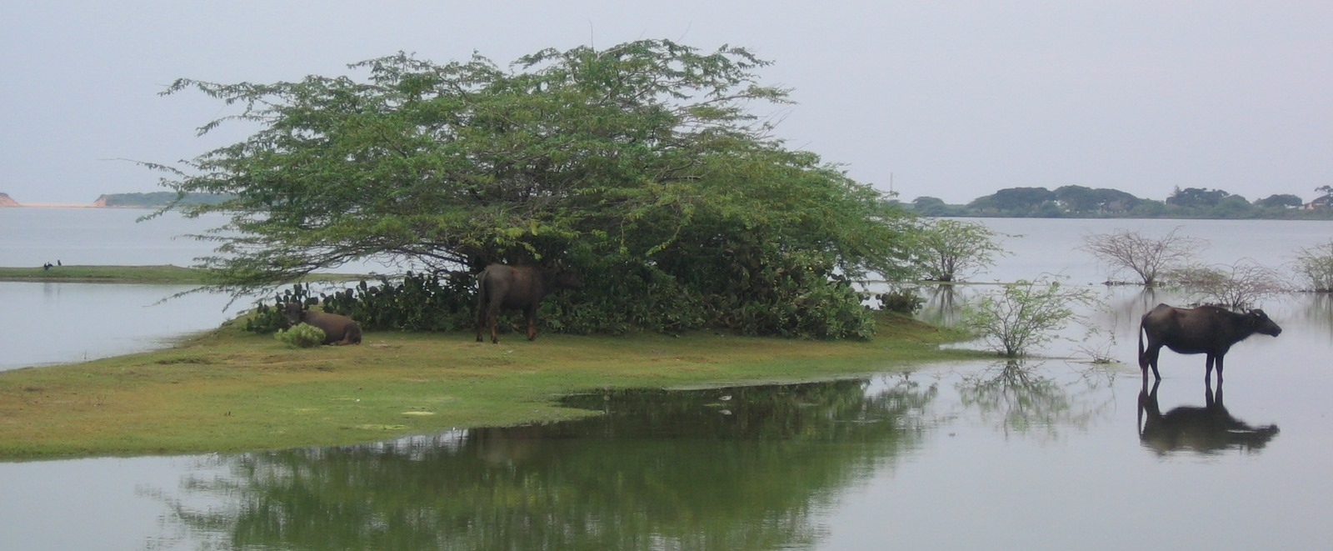
Thank you!

